Slide 1
Handwritten Mathematical Expression Recognition
SMAI Course Project
Notes:
To use this title animation slide with a new image simply 1) move the top semi-transparent shape to the side, 2) delete placeholder image, 3) click on the picture icon to add a new picture, 4) Move semi-transparent shape back to original position, 5) Update text on slide.

Slide 2
“MACHINE LEARNING WILL AUTOMATE JOBS THAT MOST PEOPLE THOUGHT COULD ONLY BE DONE BY PEOPLE.”
—DAVE WATERS

Slide 3
SUBJECT
Multi-Scale Attention with Dense Encoder for Handwritten Mathematical Expression Recognition
“Importance of Mathematical Expressions”
Mathematical expressions are indispensable for describing problems in maths, physics and many other fields.
“Need of the hour”
While natural input is convenient, it also requires the development of systems that are able to recognize handwritten mathematical expressions (HMEs)
“Challenges”
Complicated two-dimensional structures
Ambiguous handwriting input.
Variant scales of handwritten math symbols.

Slide 4
ARCHITECTURE
5
(Multi-Scale Attention)
1
(Watcher)
2
(Parser)
3
(Attender)
4
(DenseNet)
CNN encoder that maps ME images to high level features.
RNN decoder that converts the high-level features into output sequences, word by word.
The Parser is equipped with attention mechanism
Improvement over the Encoder:
Strengthen feature extraction.
Facilitate gradient propagation
Recognition of math symbols in different scales
Restore the ﬁne-grained details dropped by pooling operations.

Slide 5
HMER PROBLEMS:
Symbol Recognition
Structural Analysis

Slide 6
POSSIBLE SOLUTIONS TO HMER PROBLEMS:
Sequential solutions first segment the input expression into math symbols and then recognize them.
In contrast, the goal of Global solutions is to recognize symbols and analyse two-dimensional structures simultaneously
The analysis of two-dimensional structures is then carried out based on the best symbol segmentation and symbol recognition results.
Symbol recognition and structural analysis are optimised using the global information of the mathematical expression. The segmentation is then achieved as a by-product of the global optimization

Slide 7
Watch , Attend and Parse
(WAP)
WAP is a neural network model which is an improved version of the attention- based encoder-decoder model . This model learns to “watch” an HME image and “parse” it into a LaTeX sequence.
So WAP has two components: a watcher and a parser, the parser is equipped with the attention mechanism.

Slide 8
Watch , Attend and Parse
(WAP)
The watcher is a convolutional neural network (CNN) encoder that maps ME images to high-level features.
The parser is a recurrent neural network (RNN) decoder that converts these high-level features into output sequences, word by word

Slide 9
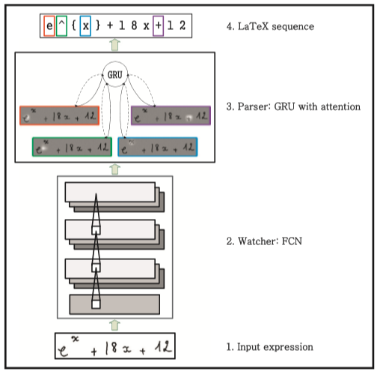
WAP
Architectures of Watch, Attend, Parse for handwritten mathematical expression recognition
The watcher is a fully convolutional network (FCN) encoder.
The parser is a Gated Recurrent Units (GRU) decoder generates the LaTeX sequence.
The attention mechanism impels the decoder to focus its attention on specific parts of the input image.
Credits: J.Zhang et al. / Pattern Recognition 71 (2017) 196–206

Slide 10
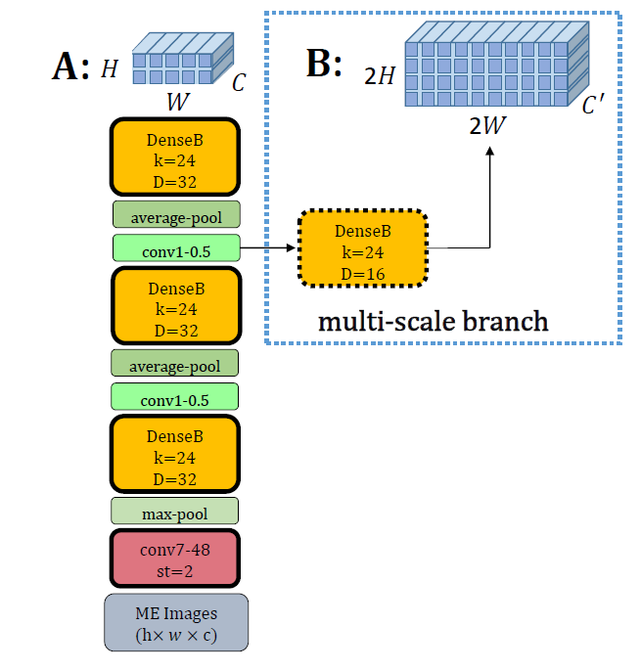


DENSE ENCODER
(WATCHER)
The watcher is a fully convolutional network (FCN) encoder.
The basic components of CNN are the convolution, pooling and activation layers.
Improvement over the CNN encoder: a novel architecture called densely connected convolutional network (DenseNet).

Slide 11
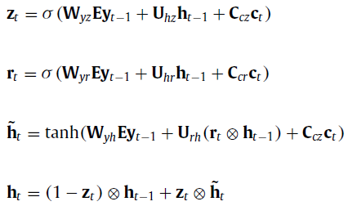

PARSER: Gated Recurrent Unit
We employ GRU as the decoder because it is an improved
version of simple RNN which can alleviate the vanishing and
exploding gradient problems.
Given input xt, the GRU output ht is computed by:

Slide 12
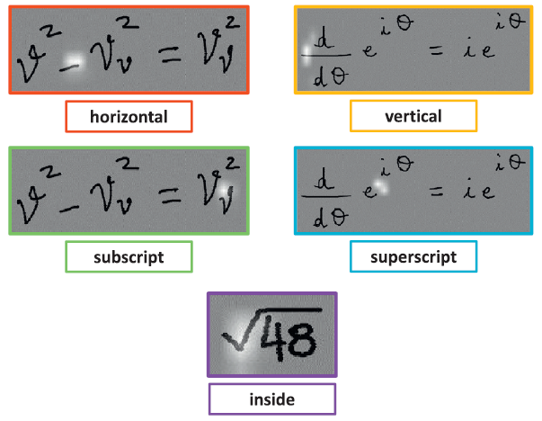
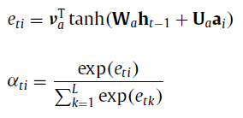

ATTENTION MODEL as MLP

Slide 13
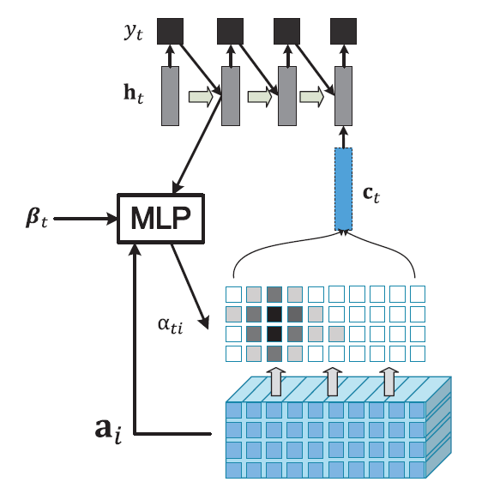
Coverage-model
Coverage means the overall alignment information that indicates whether a local region of the source HME images has been translated.
Why is lack of Coverage a serious Problem?
Schematic representation of the coverage vector based attention model. At each time step t , an MLP combines the hidden state h t−1 and all the annotation vectors a i with past alignment information βt to compute the attention weights αti .

Slide 14
Coverage-model
Coverage means the overall alignment information that indicates whether a local region of the source HME images has been translated.
The past alignment information is especially important when recognizing HME.
Mis-alignment may result in over- or under-parsing.

Slide 15
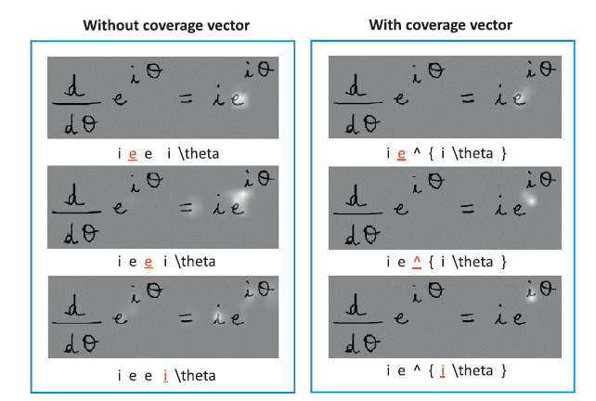
Coverage-model
Coverage means the overall alignment information that indicates whether a local region of the source HME images has been translated.
To address the problem of lacking coverage, we chose to append a coverage vector to the attention model .
Coverage vector aims keeping track of past alignment information.

Slide 16
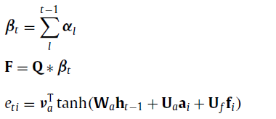
Coverage-model
The attention model based on the coverage vector can be written as:
The coverage vector is computed based on the sum of all past attention probabilities rather than on previous step attention probabilities.
The coverage vector is fed to the attention model to help adjust future attention.
Consequently, the coverage vector can guide the encoder-decoder and alleviate the problems of over- or under-parsing.

Slide 17
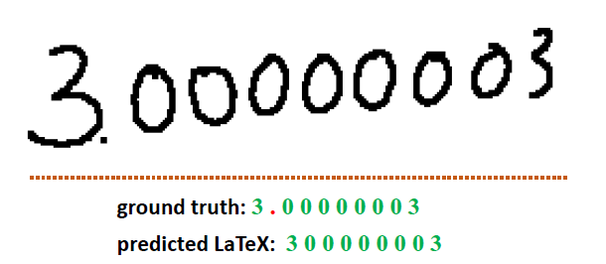
MULTI SCALE ATTENTION WITH DENSE ENCODER
This model deals with the problems caused by pooling operations.
Because the scales of handwritten math symbols vary severely, the fine-grained details of extracted feature maps are lost in low-resolution feature maps.
After many pooling layers, the visual information of the decimal point is gone, which leads to an under-parsing problem.

Slide 18
MULTI SCALE ATTENTION WITH DENSE ENCODER
To implement the multi-scale attention model, a multi-scale dense encoder is used that will provide both low-resolution features and high-resolution features.
The low-resolution features capture a larger receptive field and are more semantic while the high-resolution features restore more fine-grained visual information.
The decoder then attends to both low-resolution and high-resolution features for predicting output LaTeX strings.

Slide 19
Dataset
Train Set 8836 expressions
Train Set
!=
Test Set
CROHME 2014 dataset
Test Set
986
Expressions
101 Math Symbol classes
CROHME 2013 test set as a validation set

Slide 20
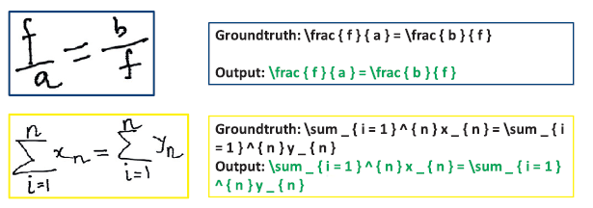
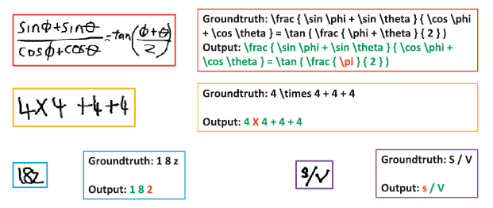
CORRECT AND INCORRECT EXAMPLES:
CORRECT
INCORRECT

Slide 21
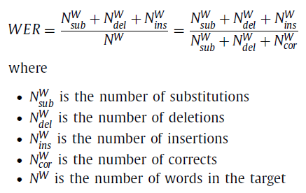
Evaluation
Expression Recognition Rates
WER
The output of our system consists of word sequences, errors such as substitutions, deletions and insertions occur.
The percentage of predicted LaTeX formula sequences matching ground truth
Our Best Result:

Slide 22
Thank You
Notes:
To use this title animation slide with a new image simply 1) move the top semi-transparent shape to the side, 2) delete placeholder image, 3) click on the picture icon to add a new picture, 4) Move semi-transparent shape back to original position, 5) Update text on slide.

