Slide 1

AICity USD to INR currency exchange rate predition

Slide 2
team: Coding Wing
Member:
Bhavik Harkhani
Kartik Laheri
Mayank Gupta
Piyush Vaghela
Nilay Jayswal

Slide 3
Introduction
USD to INR exchange rate prediction
This model will predict USD to INR rate by considering the past data set of the exchange rate.
The basic data are the daily exchange rate of USD to INR.

Slide 4
Methodology Followed
First, fetch data from API of yfinance using yfinance module and by that we get the data of exchange rate from 2018 to 2022.
Fill the null values or nan using fill nan method and spilt the data of January-2018 to june-2022 to training set and July-2022 to december-2022 to test set.
Apply Model that will give the value of the exchange rate.

Slide 5
ARIMA model
ARIMA- Autoregressive integrated moving Average
This is statical model used to forecast time series data
Combination of AR(autoregression) I(integration) and MA(moving average)
Parameters are p , q and d.

Slide 7
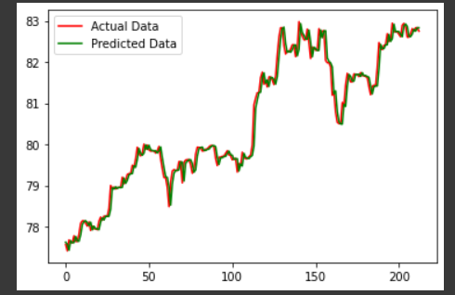
USD/INR : Actual vs predicted using arima

Slide 8
Accuracy
By, ARIMA model the accuracy: 98.101487%
Mean squared error: 0.04843

Slide 9
Issues
Lack of data :
At first we have also consider following factors as parameter for Exchange rate :
Intrest rate of RBI
GDP
International trade
Geopolitical Events
All these data are incomplete or not sufficient because some data are given at Quarterly manner ( Like GDP ) while Interest Rate and Trade are not in timely manner so it can be challenging to isolate their impact from other variables such as inflation, trade balance and geopolitical events.

Slide 10
Thank you

