Slide 1

Admission Form Development: A Guide
PG-12
Ayushi Sharma
2310990140
Bhavik Kumar
2310990142
Deepanshi Mittal
2310990151
Deewanshi Gujral
2310990152

Slide 2

Designing the Admission Form with HTML
Form Structure
Use the `
` element as the container. Define input fields using `` tags for text, email, and other data types. Include labels for clarity using `` tags. Add buttons for submission and reset using `

Slide 3
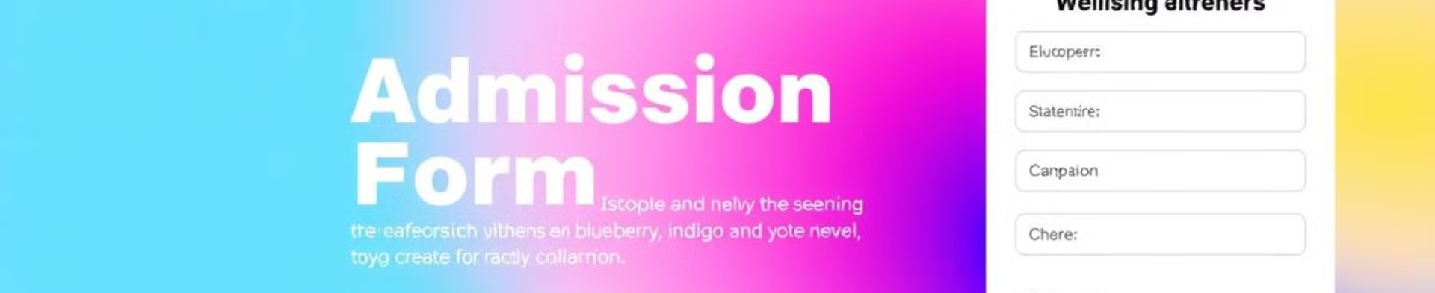
Styling the Form with CSS
Layout
Styling Elements
Responsiveness
Use CSS to define the form's layout, spacing, and alignment. Utilize flexbox or grid for responsive design.
Apply styles to input fields, labels, and buttons to enhance visual appeal. Customize colors, fonts, borders, and shadows.
Ensure the form adapts to different screen sizes using media queries. Make it user-friendly across devices.

Slide 4
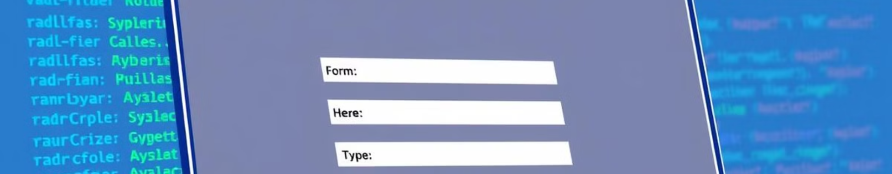



Adding Interactivity with JavaScript
Form Validation
Submission Handling
AJAX Requests
Validate user input using JavaScript to ensure data accuracy. Implement real-time error messages for invalid inputs.
Use JavaScript to prevent default form submission behavior. Capture form data and process it as needed, such as storing it in a database or a JSON file.
Leverage AJAX for asynchronous data exchange. Send form data to a server without reloading the page. This creates a smoother user experience.

Slide 5
Storing Form Data in a JSON File
JSON Structure
1
Organize the form data as an array of objects. Each object represents a submission, with properties matching the form fields.
JavaScript for Storage
2
Use JavaScript to convert the form data into a JSON string. Write this string to a local JSON file using asynchronous file system methods.
Data Integrity
3
Implement error handling to manage potential file write errors. Consider using local storage for temporary data storage if needed.

Slide 6
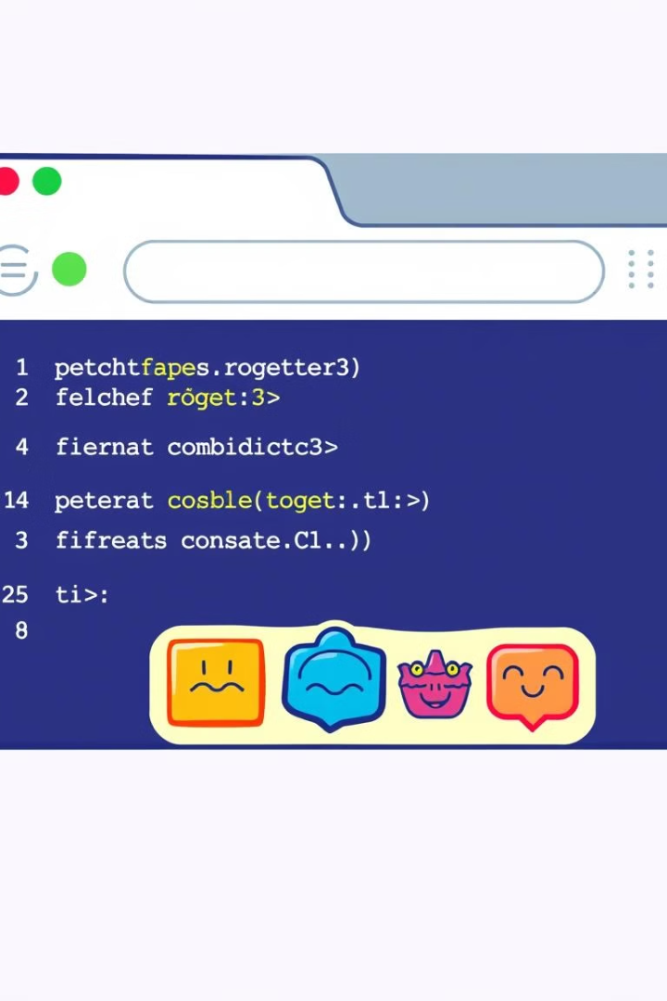
Fetching Data from the JSON File
1
2
File Access
Data Parsing
Use JavaScript's asynchronous file system methods to read the JSON file containing form data.
Parse the JSON data into a JavaScript object using `JSON.parse()`. This makes the data accessible for use within the application.
3
Error Handling
Implement error handling to manage potential file read errors. Display appropriate messages or log errors for debugging.

Slide 7
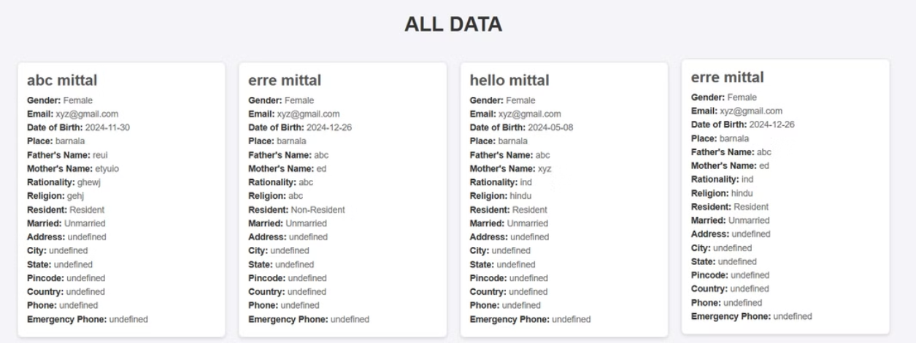
Displaying the Fetched Data on Another Page

Slide 8
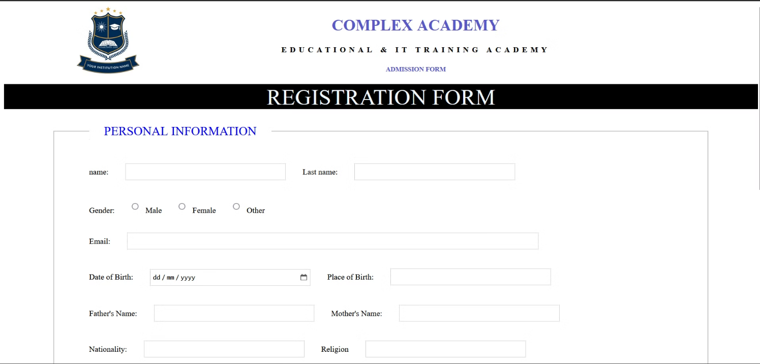
ScreenShots

Slide 9

Conclusion and Next Steps
This presentation provided a comprehensive guide to building a dynamic admission form. Next steps involve deploying the application, implementing security measures, and integrating the form with a backend database for more robust data management.

