Slide 1
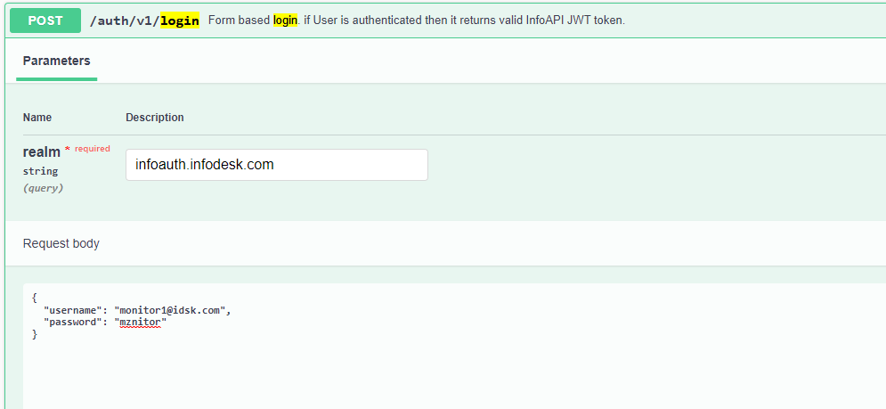
Authentication via infoAPI
Request:

Slide 2
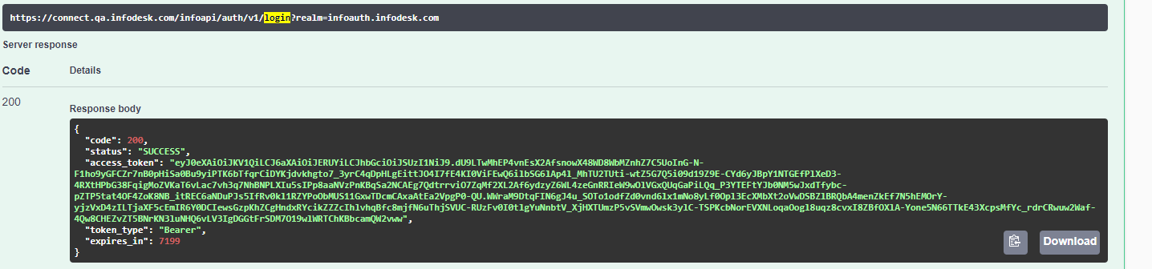
Authentication via infoAPI
Response:

Slide 3
Logs of Authentication:

Slide 4
GET Services
1)GET : https://connect.qa.infodesk.com/infoviewerapi/contacts
Logs:
2021-11-22 01:06:05.507 [4f35db304f7392cd] [4f35db304f7392cd] INFO [http-nio-8082-exec-2] com.idsk.infoviewer.service.rest.DefaultAddressBookService - Get Address Book called. Uid: monitor1@idsk.com
2) GET: https://connect.qa.infodesk.com/infoviewerapi/colleagues

