Slide 1
Business Strategy Tools
Project Charter

Slide 2
w/c |  | 5/10 |  |  |  |  | 12/10 |  |  |  |  | 19/10 |  |  |  |  | 26/10 |  |  |  |  | 2/11 |  |  |  |  | 9/11 |  |  |  |  | 16/11 |  |  |  |  | 23/11 |  |  |  |  | 30/11 |  |  |  |  | Hand in
 |  | 1 |  |  |  |  | 2 |  |  |  |  | 3 |  |  |  |  | 4 |  |  |  |  | 5 |  |  |  |  | 6 |  |  |  |  | 7 |  |  |  |  | 8 |  |  |  |  | 9 |  |  |  |  | 10
Milestone |  | Introduction |  |  |  |  | Client Briefing |  |  |  |  | Present Charter |  |  |  |  | Review Draft Analysis |  |  |  |  | Present Analysis |  |  |  |  | Ideation Phase |  |  |  |  | Solution Selection |  |  |  |  | Solution Selection |  |  |  |  | Solution Presentation |  |  |  |  | Project evaluation
Aim |  | Set The Ground Rules |  |  |  |  | Understand Assignment Brief |  |  |  |  | To present/ refine team charters |  |  |  |  | To Refine Analysis/ Analysis Outcomes |  |  |  |  | To formally present analysis process/ outcomes |  |  |  |  | To identify practical solution(s) |  |  |  |  | Initial evaluation of proposed solutions |  |  |  |  | Final evaluation of proposed solutions |  |  |  |  | Formal Presentation of Final Proposals |  |  |  |  | Giving feedback
Activities/ Roles |  | EL, +2 Support Provide Intro/ Overview |  |  |  |  | PoPs Present Brief(s) Student Q&A Students Form Teams & Start To Draft Charters |  |  |  |  | Students Present Charters EL, +2 Support Present Problem Analysis Methods |  |  |  |  | EL, +2 Support Discuss Analysis With Students |  |  |  |  | Pops/ EL Host Review Panel Students present analysis/ explore potential options with Panel |  |  |  |  | EL, +2 Support facilitate ideas generation Students generate alternative/ refined solutions |  |  |  |  | EL, +2 Support to provide evaluation methods |  |  |  |  | EL, +2 Support to provide evaluation methods |  |  |  |  | Pops/ EL Host Review Panel Students present proposals to Panel
Outcomes |  | Students Understand: UIF Their Responsibilities |  |  |  |  | Students have sufficient Information to Draft Team Charters |  |  |  |  | Agreed/ Final Charter Knowledge of Analysis Tools |  |  |  |  | Refined analysis |  |  |  |  | Documented/ Complete Analysis |  |  |  |  | Short list of justified/ practical solutions |  |  |  |  | Evaluated solutions |  |  |  |  | Evaluated solutions |  |  |  |  | Assessed Proposals |  |  |  |  | Feedback session
Support Materials |  | Outline document |  |  |  |  | Client Briefing Pack |  |  |  |  | Charter Pro-Forma Analysis Methods |  |  |  |  | Presentation Pro-Forma? |  |  |  |  |  |  |  |  |  | Ideas Creation Pack? |  |  |  |  | Evaluation Tools Pack?
Assessments |  |  |  |  |  |  |  |  |  |  |  |  |  |  |  |  |  |  |  |  |  | Charter Analysis |  |  |  |  |  |  |  |  |  |  |  |  |  |  |  |  |  |  |  | Proposal
 |  | M | T | W | T | F | M | T | W | T | F | M | T | W | T | F | M | T | W | T | F | M | T | W | T | F | M | T | W | T | F | M | T | W | T | F | M | T | W | T | F | M | T | W | T | F
G1 (GM01) | 10-12 | x |  |  |  |  | x |  |  |  |  | x |  |  |  |  | x |  |  |  |  | x |  |  |  |  | x |  |  |  |  | x |  |  |  |  | x |  |  |  |  | x
G2 (A409) | 2-4 | x |  |  |  |  | x |  |  |  |  | x |  |  |  |  | x |  |  |  |  | x |  |  |  |  | x |  |  |  |  | x |  |  |  |  | x |  |  |  |  | x
G3 (A420) | 2-4 | x |  |  |  |  | x |  |  |  |  | x |  |  |  |  | x |  |  |  |  | x |  |  |  |  | x |  |  |  |  | x |  |  |  |  | x |  |  |  |  | x
G4 (A409) | 10-12 |  |  |  | x |  |  |  |  | x |  |  |  |  | x |  |  |  |  | x |  |  |  |  | x |  |  |  |  | x |  |  |  |  | x |  |  |  |  | x |  |  |  |  | x
G5 (C419) | 4-6 |  |  |  |  | x |  |  |  |  | x |  |  |  |  | x |  |  |  |  | x |  |  |  |  | x |  |  |  |  | x |  |  |  |  | x |  |  |  |  | x |  |  |  |  | x

Slide 3
Team Charters
Purpose: What is the purpose of this work?
What are the Objectives of this work….to define the problem? to research factors that impact the problem?...to identify appropriate solutions? Etc.
For each objective, What would be the tangible Outcome? | What Task must you complete to achieve each Outcome? | Who will manage each task | Wk1 | Wk2 | Wk3 | Wk4 | Wk5 | Wk6 | Wk7 | WK8 | Wk9 | Wk10
1 | 1
 | 2
 | 3
2 | 4
 | 5
3 | 6
 | 7
4 | 8
What are the Critical Success Factors for a successful project? 1.? 2? | Who are the Team members and what are their roles? 1? 2? | What are the Risks of not completing this project? 1? 2? |  |  |  | How will each of these Risks be mitigated? 1? 2? 3?
 |  | Approved By: Approved Date:
1
2
3
4
5
6
7
8
9
10
XX
Complete in the sequence only

Slide 4
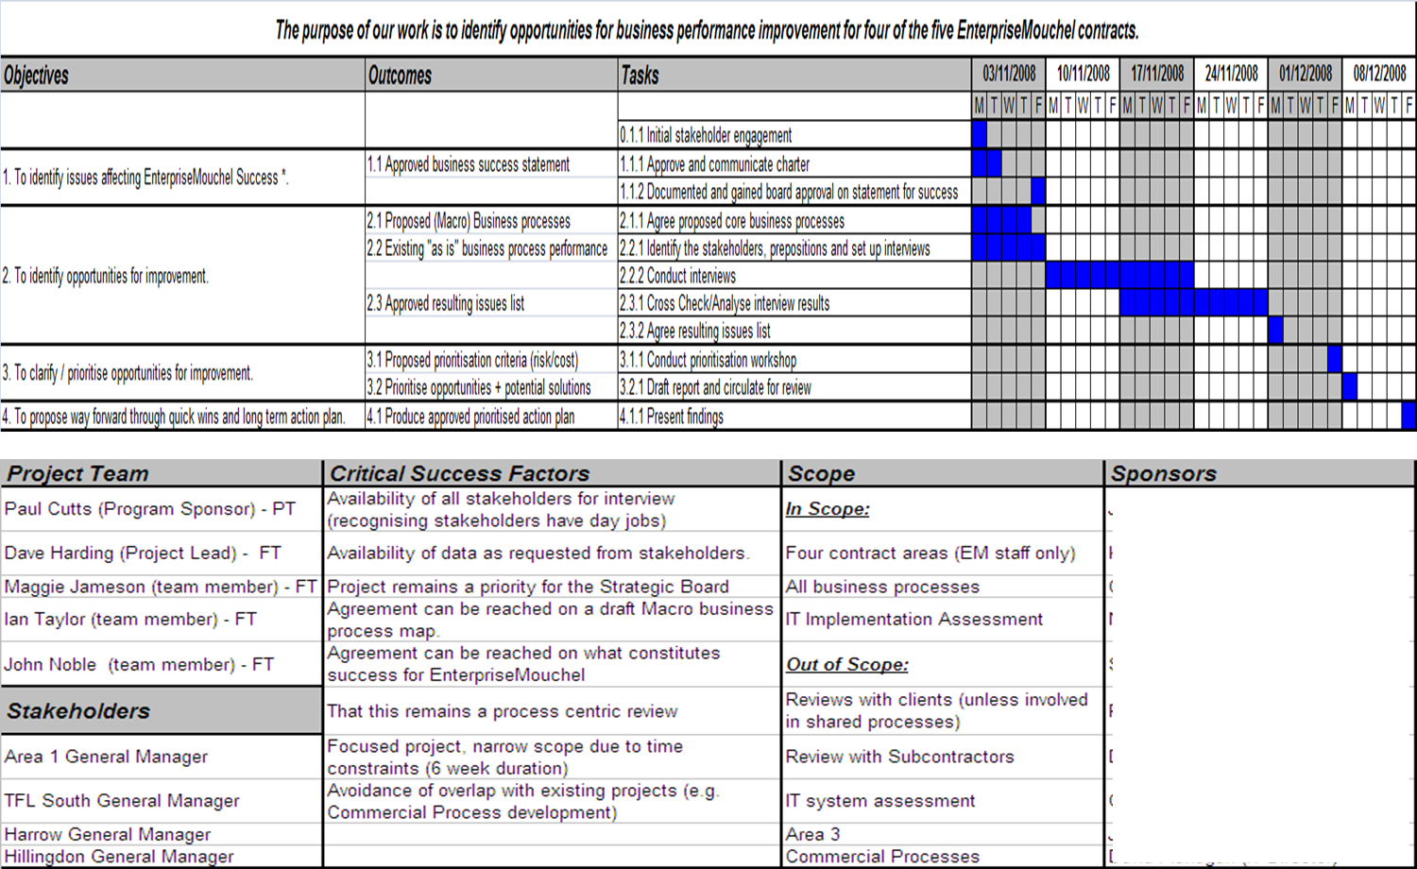
Example Team Charter

