Slide 1
PROJECT
AIML-(22CS015)
Dated: 14th March 2024
Department of Computer Science and Engineering, Chitkara University, Punjab
Submitted By: Bhavika
Rollno :2210990219
Group: 30
Sem: IVth

Slide 2

Project Details
Project Name: “Ferb-Latin Encryption/Decryption”
Programming Tool : Vs Code , Python
2

Slide 3
Project Introduction
Project name : ❝ Ferb-Latin Encryption/Decryption
❞
This project work is a part of Object Oriented Programming in “Python”, submitted to department of computer science & engineering.
The Ferb-Latin Encryption and Decryption program is a simple text manipulation tool based on the Ferb-Latin cipher. Ferb-Latin is a playful variant of Pig Latin, where for words longer than three characters, the first letter is moved to the end of the word and followed by "erb". This program allows users to encrypt plaintext into Ferb-Latin and decrypt Ferb-Latin back into plaintext.
3

Slide 4
Technologies used in Project
The Ferb-Latin Encryption and Decryption project appears to be a relatively simple script written in Python. As such, it doesn't involve a wide range of technologies. However, here are the main technologies and concepts involved:
Python Programming Language:
Python is a versatile and easy-to-learn programming language commonly used for various applications, including scripting, web development, data analysis, artificial intelligence, and more. In this project, Python is used to implement the encryption and decryption algorithms, as well as the user interface.
Text Manipulation:
The project involves manipulating strings of text, including splitting text into words, modifying individual words, and recombining them. This requires knowledge of string manipulation techniques provided by Python.
Basic Input/Output Handling:
The project utilizes basic input/output operations to interact with the user. It prompts the user for input, displays messages, and outputs the results of encryption or decryption.
4

Slide 5
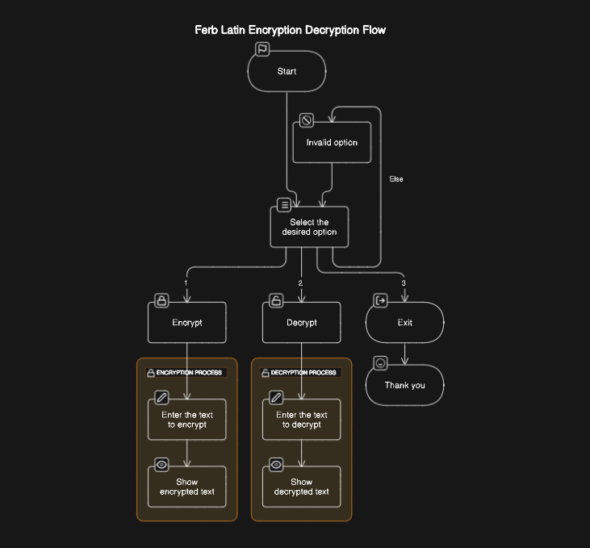
Working of Project(flow chart)

Slide 6
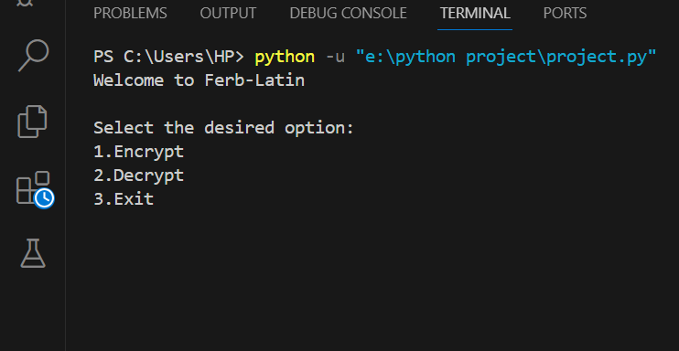
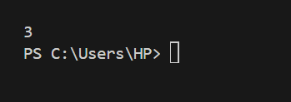

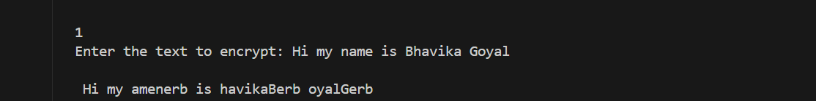
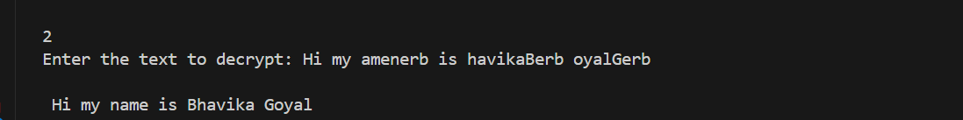
Output snapshots
1. Welcome screen :
4. User input 3 :
5. Any other input
2. User input 1 :
3. User input 2 :

Slide 7
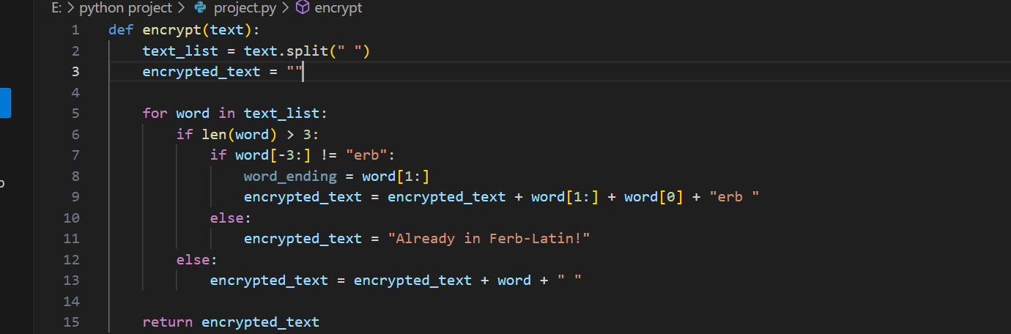
Source Code (i)

Slide 8
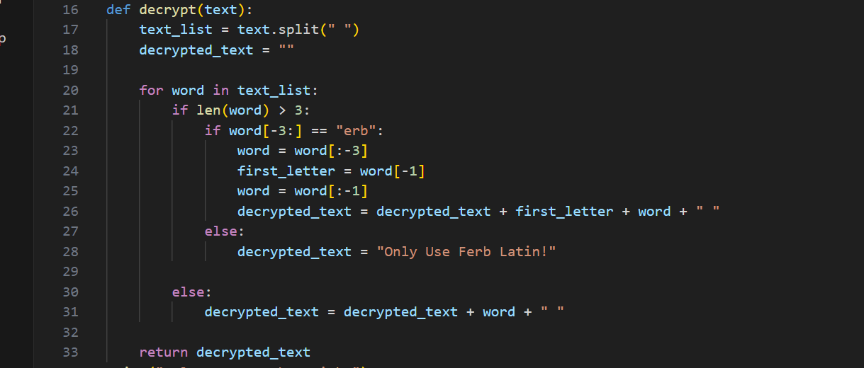
Source Code (ii)

Slide 9
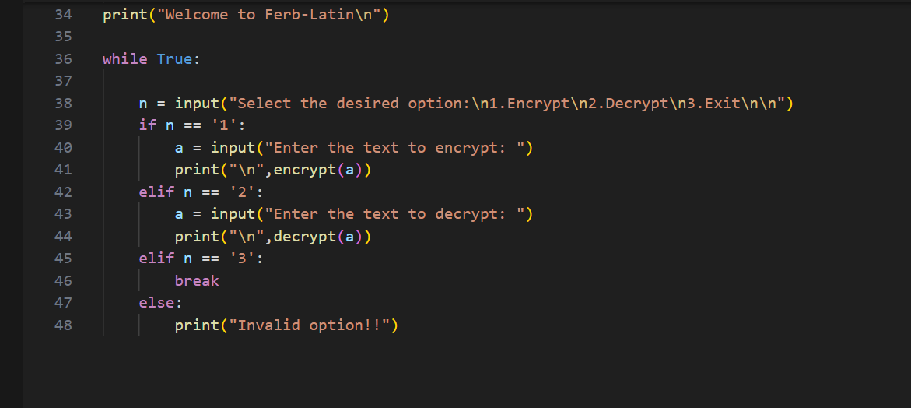
Source Code (iii)

Slide 10
Future Scope and Conclusion
While the Ferb-Latin Encryption and Decryption project currently serves as a simple text manipulation tool, there are several potential avenues for expanding its scope and functionality. Here are some ideas for future enhancements:
Graphical User Interface (GUI):
Develop a graphical user interface (GUI) using libraries like Tkinter or PyQt to provide a more user-friendly experience. This would allow users to interact with the program through buttons, text fields, and other graphical elements.
File Encryption/Decryption:
Extend the project to support encryption and decryption of text files. Users could specify input and output files, allowing them to process larger amounts of text more conveniently.
Additional Ciphers:
Implement other encryption and decryption algorithms alongside Ferb-Latin. This could include classic ciphers like Caesar cipher, Vigenère cipher, or more modern techniques like AES encryption.
10

Slide 11
THANK YOU
11

