Slide 1
Traffic Efficient Model for Data Applications using Partition and Aggregation
Alpesh Ahir
Bhavika Bhanushali
Prajwal Gowda
Vineeth Vasudevan

Slide 2
Problem Definition
Data duplication when files are uploaded on cloud
Efficiency plays the major role in data storage and retrival which has to be achieved
Hash function is not traffic efficient
Load Balance issues
No immediate data retrieval is possible

Slide 3
System Requirements
Operating system : Windows 7 or latest.
Language : Java
IDE : Eclipse
Database : SQLYog
Fornt-end : HTML, CSS
Server : Apache Tomcat 6.0

Slide 4
MODULES
The module is divided into 2 sessions:
Admin session
User session

Slide 5
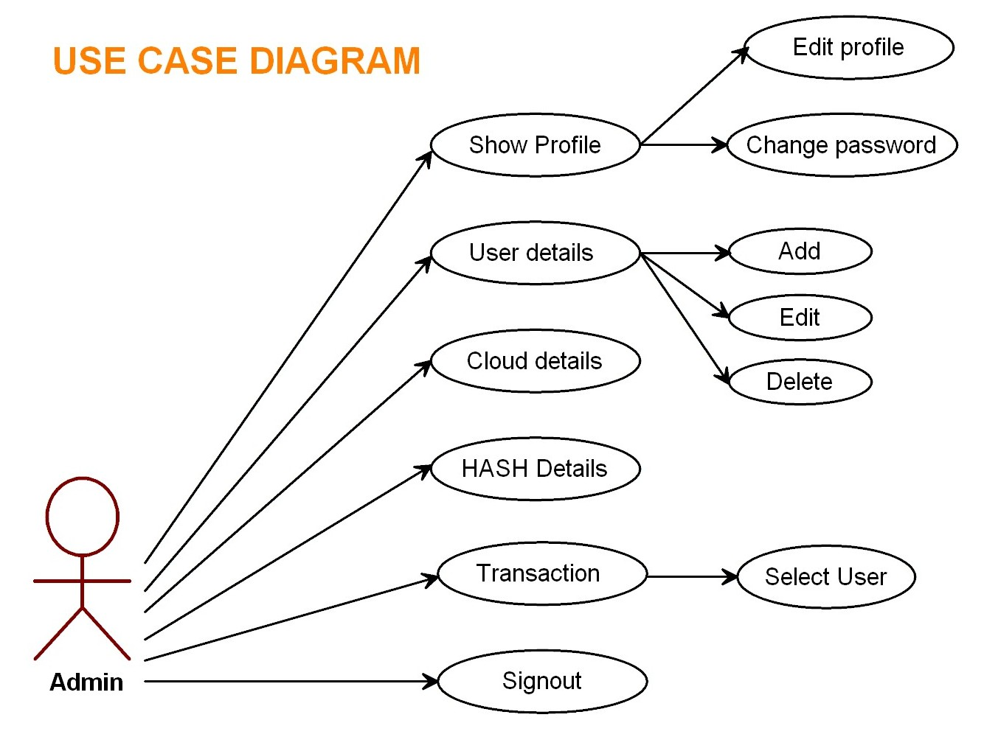
ADMIN SESSION
Admin login
Show profile
User details
Cloud details
Hash details
Transaction
Sign-out

Slide 6
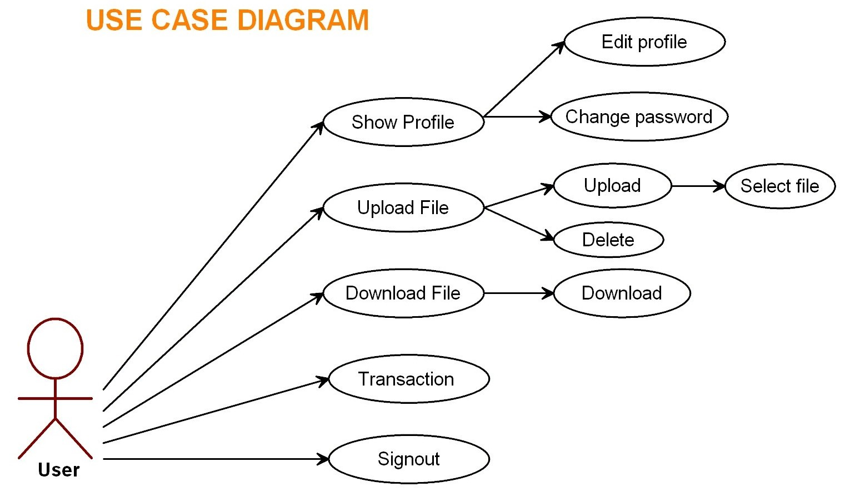
USER SESSION
User login
Show profile
Upload file
Download file
Transaction
Sign-out

Slide 7
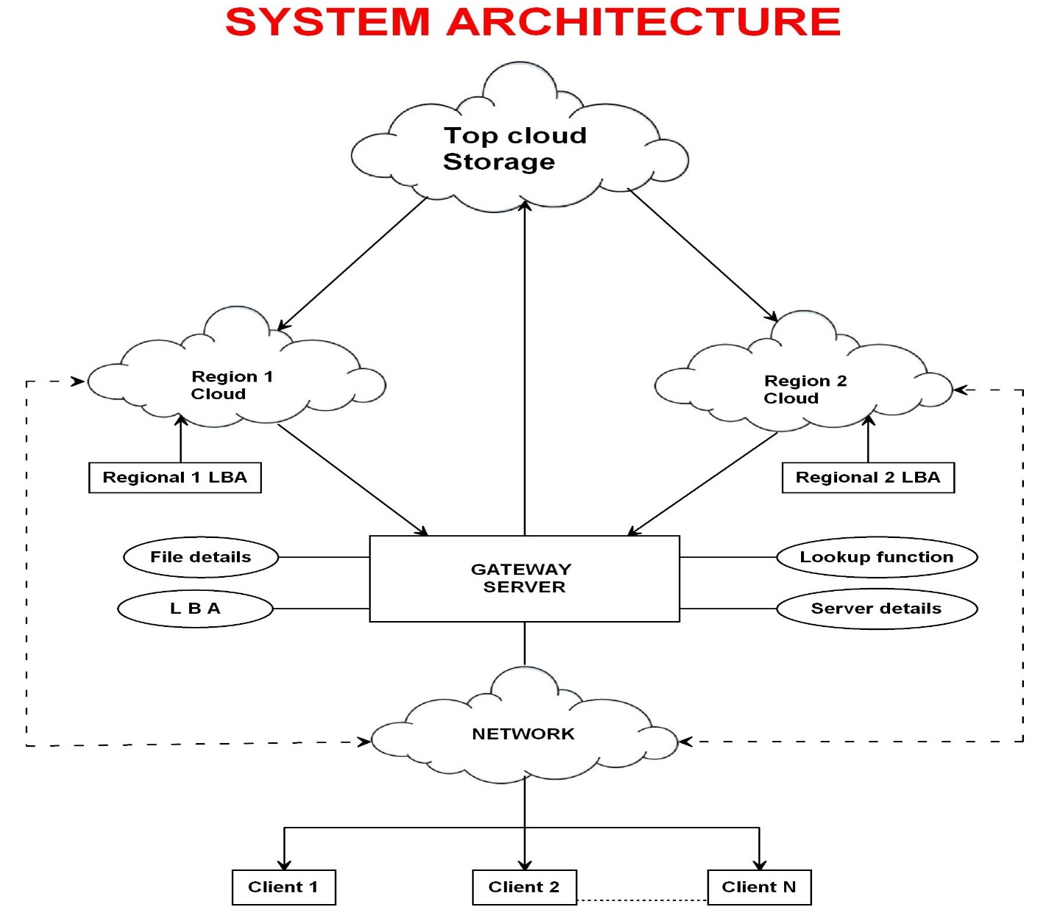

Slide 8
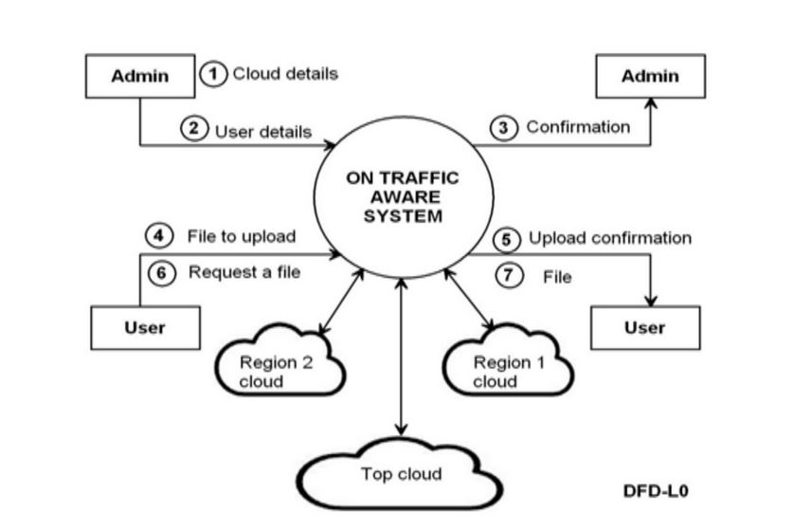
Context Analysis Diagram

Slide 9
Mapping & Reducing using MD5 hash Algorithm
Mapping
Reducing
ABCD
ABCD
ABCDE
ABCDE
EFGH
EFGH
ABCD

Slide 10
Goals
Efficient File Management
Storing Data on Cloud
Distributed File Management system
Reduce the Network Traffic

Slide 11
Thank You

