Slide 1


CYBERSHIELD360
Protecting Businesses. Empowering Growth.
AI-Powered Cybersecurity Management Platform for Startups, SMEs & Growing Organizations
INVESTOR & BUSINESS PORTFOLIO OVERVIEW | 2026

Slide 2




EXECUTIVE SUMMARY
One Platform. Complete Cyber Resilience.
CyberShield360 is an AI-powered cybersecurity management platform built for startups, SMEs, educational institutions, healthcare providers, and other growing organizations that need enterprise-grade protection without enterprise-grade cost or complexity.
10
8
Integrated Security Modules
Target Customer Segments
The platform unifies security monitoring, employee awareness, vulnerability assessment, and business reporting into a single, centralized dashboard — delivered as an affordable subscription.
3
AI
Flexible Subscription Tiers
Powered Threat Insights
“Enterprise-inspired cybersecurity management, delivered as an affordable, user-friendly SaaS platform for growing businesses.”
CYBERSHIELD360
Executive Summary
02

Slide 3

THE PROBLEM
SMEs Are Under Attack — And Underprepared
Rising exposure to phishing, ransomware, malware, and data-breach risk as digital adoption accelerates
41%
of European SMEs cite limited internal IT capacity as a barrier to advanced security
Most organizations lack dedicated cybersecurity teams or enterprise-scale security budgets
Source: ENISA
39%
of organizations in emerging markets delay security upgrades due to cost
Existing enterprise security suites are expensive, complex to deploy, and built for large IT teams
Source: APNIC
54%
of security incidents globally involve a phishing component
Source: Industry research
CYBERSHIELD360
Industry Problem
03

Slide 4



MARKET OPPORTUNITY
A Large, Fast-Growing, Underserved Market
11.9%
Global market CAGR through 2033
13–15%
CAGR for the SME security segment — the fastest-growing customer size band
$8.6B → $16.9B
India cybersecurity market growth, 2025–2030 (14.5% CAGR)
Source: Grand View Research, 2026
Sources: MarketsandMarkets, Grand View Research (2026)
The fastest-growing segment of a $300B+ market has almost no purpose-built, affordable platform — that is CyberShield360's opening.
CYBERSHIELD360
Market Opportunity
04

Slide 5
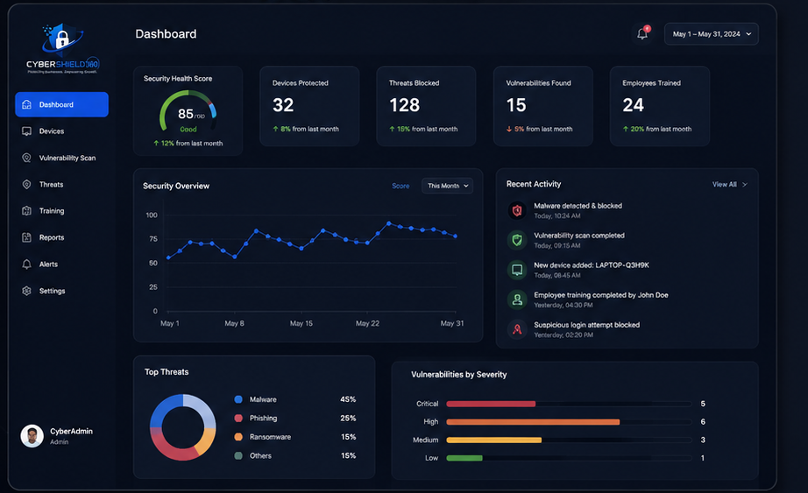



OUR SOLUTION
Centralized. Affordable. AI-Powered.
CyberShield360 provides an affordable, subscription-based SaaS platform that helps organizations monitor security, educate employees, detect vulnerabilities, and improve cyber resilience — all through a single, centralized dashboard.
Monitor
Continuous visibility into security posture across devices and systems
Educate
Build a security-first culture with structured employee awareness training
Detect
Identify vulnerabilities before attackers can exploit them
Improve
Strengthen cyber resilience with AI-driven, actionable recommendations
Live Security Dashboard — Real-Time Health Score & Threat Overview
CYBERSHIELD360
Our Solution
05

Slide 6

PRODUCT OVERVIEW
A Cloud-Based Cybersecurity Command Center
CyberShield360 is a cloud-based cybersecurity management application offering AI-powered insights, security scoring, vulnerability management, employee awareness training, and reporting — accessible anywhere, on any device.
AI-Powered Insights
Security Scoring
Vulnerability Management
Employee Training
Machine-driven analysis surfaces the risks that matter most
A single, easy-to-understand Security Health Score for the whole org
Continuous scanning and prioritized remediation guidance
Built-in awareness modules and phishing simulations
CYBERSHIELD360
Product Overview
06

Slide 7





PLATFORM FEATURES
10 Integrated Modules. One Dashboard.
AI Security Dashboard
Security Health Score
Vulnerability Scanner
Threat Monitoring
Employee Security Training
Phishing Simulation
Security Reports
Alert Center
Device Management
Admin Dashboard
CYBERSHIELD360
Platform Features
07

Slide 8
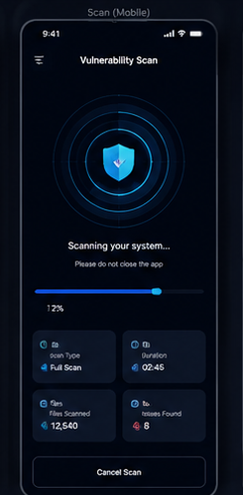
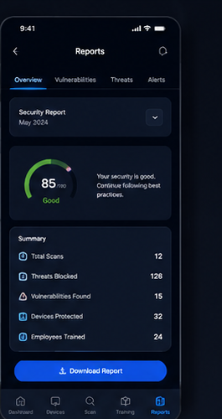
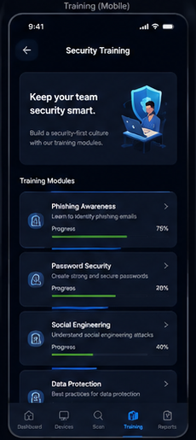
PRODUCT WALKTHROUGH
Designed for Clarity. Built for Action.
Web Dashboard — Security Health Score, Threats, and Vulnerabilities at a Glance
Vulnerability Scan
Security Reports
Security Training
CYBERSHIELD360
Product Walkthrough
08

Slide 9







TARGET CUSTOMERS
Built for Every Growing Organization
Small & Medium Businesses
Startups
Educational Institutions
Healthcare Organizations
Retail Businesses
Financial Service Providers
Professional Service Firms
Government Contractors
CYBERSHIELD360
Target Customers
09

Slide 10

BUSINESS MODEL
Diversified, Recurring SaaS Revenue
Software as a Service (SaaS) — five complementary revenue streams built around a recurring subscription core.
Monthly Subscriptions
Annual Subscriptions
Enterprise Licensing
Professional Consulting
Employee Training Packages
Predictable recurring revenue from Starter and Business Shield plans
Discounted annual commitments that improve retention and cash flow
Custom-priced licensing for large, multi-location organizations
Advisory engagements for security strategy and compliance
Standalone awareness and phishing-simulation training add-ons
CYBERSHIELD360
Business Model
10

Slide 11

PRICING STRATEGY
Simple Tiers That Scale With Our Customers
MOST POPULAR
Starter Shield
Business Shield
Enterprise Shield
₹499 /month
₹1,499 /month
Custom Pricing
Security Dashboard
Advanced Vulnerability Assessment
Dedicated Account Manager
Basic Vulnerability Scan
Employee Training
Advanced Threat Monitoring
Monthly Security Report
Phishing Simulation
Compliance Reporting
Email Support
Security Alerts
Multi-location Management
Priority Support
Custom Integrations
Premium Support
CYBERSHIELD360
Pricing Strategy
11

Slide 12

GO-TO-MARKET STRATEGY
From Awareness to Long-Term Partnership
1
2
3
4
Awareness
Acquisition
Adoption
Expansion
Content marketing, SEO, and cybersecurity education aimed at founders and IT leads at SMEs, schools, clinics, and retailers
Direct outreach, channel partnerships with IT resellers/MSSPs, and a self-serve free trial on the Starter Shield plan
Guided onboarding, employee training rollout, and phishing simulations to drive early engagement and habit
Upsell from Starter to Business and Enterprise Shield as customers grow, plus cross-sell of consulting and training
CYBERSHIELD360
Go-to-Market Strategy
12

Slide 13


COMPETITIVE ANALYSIS
A Purpose-Built Alternative for Growing Businesses
Capability
CyberShield360
Traditional
Antivirus Tools
Enterprise
Security Suites
Affordable for SMEs
AI-Powered Insights
Easy-to-Use Interface
Employee Awareness Training
Vulnerability Management
Cloud-Native & Scalable
Legend: ✓ Full capability – Partial / add-on ✕ Not offered
CYBERSHIELD360
Competitive Analysis
13

Slide 14
FINANCIAL HIGHLIGHTS
Illustrative 3-Year Growth Model
For portfolio demonstration purposes — projections are illustrative and based on target subscription mix, not audited results.
Revenue mix weighted toward Business Shield plan uptake
Assumes gradual expansion into consulting & training add-ons
Enterprise licensing modeled as upside, not baseline
CYBERSHIELD360
Financial Highlights
14

Slide 15
PRODUCT ROADMAP
A Phased Path From MVP to Global Platform
1
2
3
PHASE 1
PHASE 2
PHASE 3
Foundation
Intelligence
Scale
Launch MVP
AI Threat Detection
Compliance Management
Security Dashboard
Mobile Application
API Integrations
Vulnerability Scanner
Employee Training Portal
Global Expansion
Reporting System
CYBERSHIELD360
Product Roadmap
15

Slide 16


FUTURE EXPANSION
From India's Trusted Platform to Global Reach
Vision: To become India's most trusted cybersecurity management platform for small and medium-sized businesses.
Mission: To make enterprise-grade cybersecurity accessible, affordable, and easy to manage for every growing business.
Compliance Management
API Integrations
Global Expansion
Built-in support for regulatory frameworks as customers scale
Open integrations with existing IT, HR, and security tooling
Extending beyond India into other high-growth SME markets
CYBERSHIELD360
Future Expansion
16

Slide 17
WHY CYBERSHIELD360
Built to Win Where Growing Businesses Live
Affordable pricing designed specifically for SMEs
Comprehensive, board-ready reporting
AI-powered insights, not just raw alerts
Built-in employee awareness training
Easy-to-use interface requiring no dedicated IT team
Scalable subscription model that grows with the customer
Cloud-based accessibility from anywhere
Enterprise-grade protection. Startup-friendly pricing. Built for the businesses the industry has overlooked.
CYBERSHIELD360
Why CyberShield360
17

Slide 18
Thank You
Protecting Businesses. Empowering Growth.
CYBERSHIELD360 | AI-POWERED CYBERSECURITY MANAGEMENT PLATFORM

