Slide 1

KOREAN-INSPIRED DIY CAPSULE MASK KIT
Business & Investment Portfolio Presentation
K-BEAUTY FOR EVERY BUDGET
Prepared for: MBA / MBM Business Strategy Portfolio
OCTDEC Skincare Pvt. Ltd. | Mumbai, Maharashtra, India

Slide 2
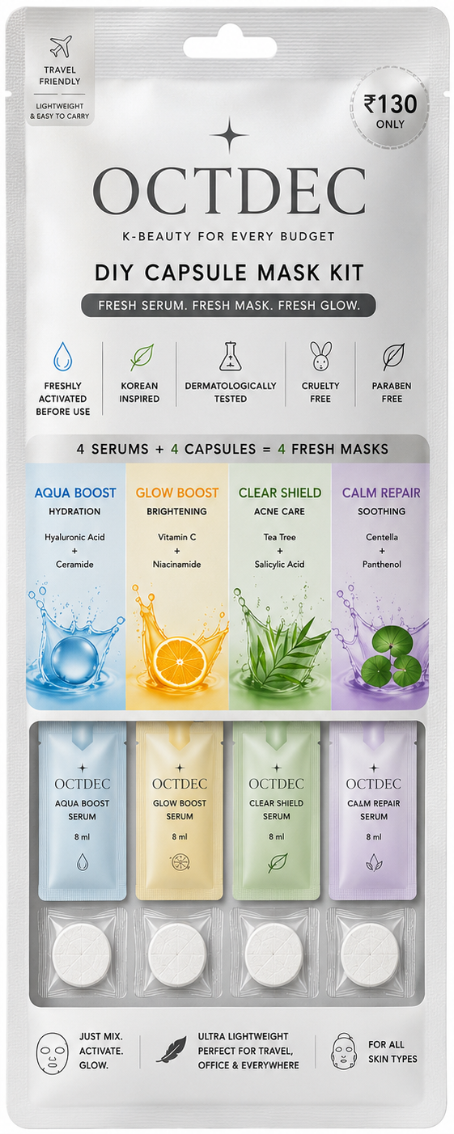
EXECUTIVE SUMMARY
A Fresh, Affordable Take on K-Beauty
OCTDEC delivers Korean-inspired skincare in a compact, freshly-activated DIY format — combining serum and compressed mask capsule at the moment of use, at a price point built for the Indian mass market.
₹130
4-in-1
16–35
8 ml
Price per kit
Skincare variants
Core target age
Freshly mixed serum
WHY IT WORKS
Freshness-first format: serum activates the mask only at the point of use — no preservative-heavy pre-soaked sheets.
Four dermat-relevant concerns (hydration, brightening, acne care, soothing) in one travel-ready pouch.
Priced at ₹130 — accessible to students and first-time K-beauty users, not just premium shoppers.
Lightweight, spill-proof, and built for travel, hostel, and office use.
OCTDEC
02 / 15

Slide 3




THE PROBLEM
Korean Skincare Is Loved — But Poorly Served in India
Import Pricing
Bulky & Wasteful
Short Shelf Freshness
One Mask, One Concern
Authentic K-beauty sheet masks and serums are priced for premium shoppers, out of reach for students and first-timers.
Traditional pre-soaked sheet masks are heavy, leak in transit, and are impractical to carry while travelling.
Pre-soaked sheets sit in preservative-laden essence for months before use, reducing perceived freshness.
Most kits offer a single variant — consumers must buy multiple separate products for different skin needs.
The gap: Indian consumers want Korean-style skincare rituals, but need it affordable, portable, hygienic, and fresh at the point of use.
OCTDEC
03 / 15

Slide 4




MARKET OPPORTUNITY
A Large, Fast-Growing Market With Room for a New Format
9.4% CAGR
TAM
India skincare market projected to grow from ~$2.98B (2026) toward $5.1B by 2032.
$31B+
36.4% CAGR
SAM
$2.98B
D2C beauty & personal care in India is growing faster than the category overall.
SOM
Social-Led Discovery
Target beachhead
The majority of skincare buyers now discover products via social media, favouring novel, shareable formats.
TAM → SAM → SOM (illustrative sizing)
K-Beauty Pull
Korean skincare rituals and ingredients continue to shape Indian consumer preference and routines.
Sources: Vyansa Intelligence, IMARC/Astute Analytica industry estimates, 2026.
OCTDEC
04 / 15

Slide 5
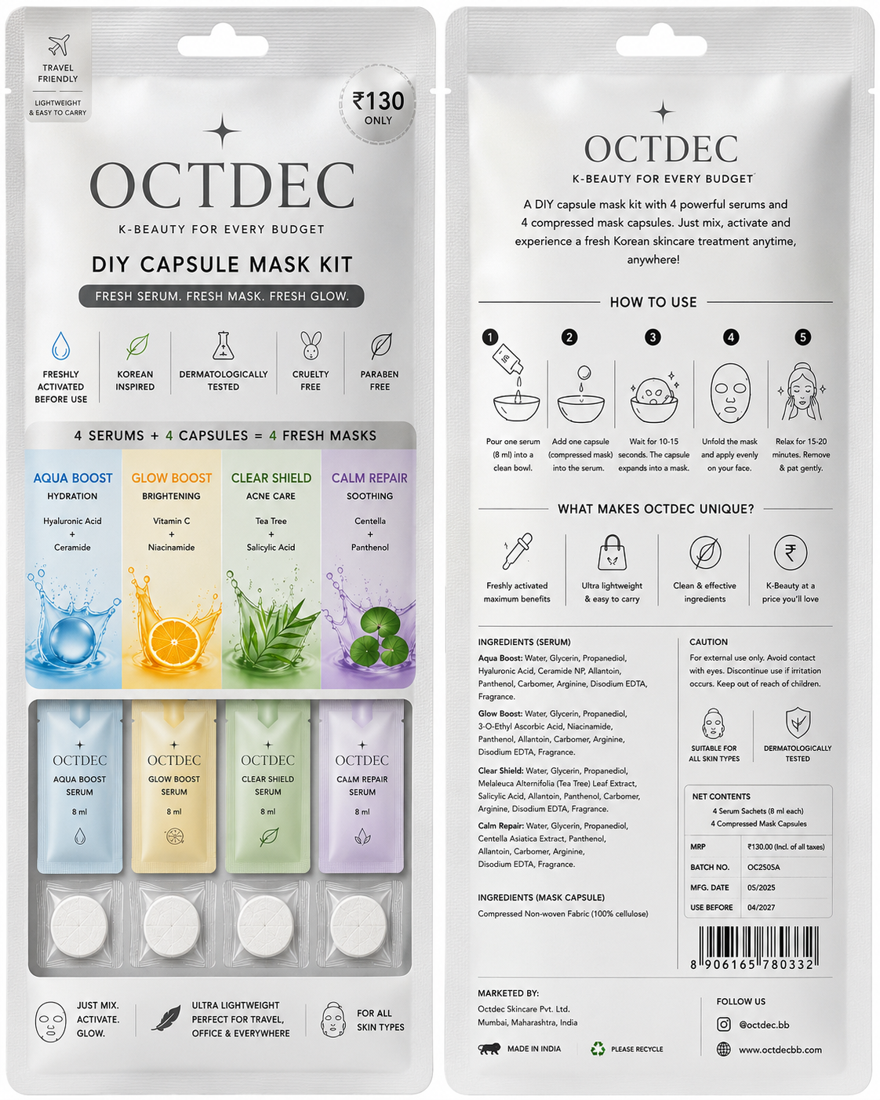










PRODUCT CONCEPT
Fresh Serum. Fresh Mask. Fresh Glow.
Not a pre-soaked sheet mask. Each pouch carries dry, compressed mask capsules and separate serum sachets — combined by the user just before application for a mask that is mixed fresh, every time.
1
2
3
4
5
Pour Serum
Add Capsule
Let It Expand
Apply
Relax & Glow
Empty one 8 ml serum sachet into a clean bowl.
Drop in one compressed mask capsule.
Wait 10–15 seconds as it blooms into a full sheet.
Unfold and apply evenly to a clean face.
Leave on 15–20 minutes, then remove and pat gently.
Travel-Friendly
Freshly Activated
Dermat. Tested
Cruelty-Free
Paraben-Free
OCTDEC
05 / 15

Slide 6





PRODUCT FEATURES & BENEFITS
Four Variants, One Format
Aqua Boost
Glow Boost
Clear Shield
Calm Repair
HYDRATION
BRIGHTENING
ACNE CARE
SOOTHING
Hyaluronic Acid + Ceramide
Vitamin C + Niacinamide
Tea Tree + Salicylic Acid
Centella + Panthenol
CORE BENEFITS AT A GLANCE
Freshly Activated
Ultra-Portable
4-in-1 Variety
Accessible Price
Serum meets capsule only at use — no long soak time.
Flat, lightweight sachets fit any bag or pocket.
One pouch, four skin concerns covered.
Premium ritual at a ₹130 mass-market price point.
OCTDEC
06 / 15

Slide 7



TARGET CUSTOMERS
Who OCTDEC Is Built For
Students (16–24)
Young Professionals (23–35)
Frequent Travellers
Gender-Inclusive
Curious, budget-conscious, discovering skincare routines for the first time via social media.
Time-poor, want convenient self-care that travels well between home, office, and gym.
Need compact, spill-proof skincare that survives hostel stays, flights, and hotel rooms.
Simple, unfussy format that appeals equally to men and women new to K-beauty.
Illustrative age-mix of target buyers
What they all have in common
Active on Instagram / short-form video, price-aware, and open to trying new skincare formats.
Prefer trial-sized or single-use formats before committing to full-size products.
OCTDEC
07 / 15

Slide 8
COMPETITOR ANALYSIS
A White Space Between Mass and Premium
 | OCTDEC | Imported K-Beauty Sheet Masks | Mass-Market Indian Brands | Traditional Sheet Masks
Price per use | ₹130 | ₹250–600 | ₹50–150 | ₹40–100
Freshness at use | Freshly mixed | Pre-soaked | Pre-soaked | Pre-soaked
Variants per pack | 4 concerns | 1 concern | 1 concern | 1 concern
Travel-friendly | Yes — flat & light | Bulky | Bulky | Bulky
K-beauty positioning | Yes | Yes | No | No
OUR POSITIONING
OCTDEC sits between imported K-beauty (aspirational but expensive) and mass-market Indian sheet masks (cheap but generic and stale) — offering K-beauty-grade variety and freshness at mass-market accessibility.
OCTDEC
08 / 15

Slide 9




MARKETING STRATEGY
Reaching Gen Z and Young Professionals Where They Are
Social-First Content
Campus & Micro-Influencers
Quick-Commerce Visibility
Sampling & Bundling
Short-form “capsule reveal” videos, unboxings, and skin-concern education on Instagram & YouTube Shorts.
College ambassador programs and nano/micro creators for authentic, affordable reach.
Featured placement on Blinkit, Zepto, and Instamart for impulse, trial-size purchase behaviour.
Single-sachet samples at cafes, gyms, and college fests to drive low-risk trial.
BRAND MESSAGE PILLARS
“Fresh, not stale”
“K-beauty, decoded”
“Fits in your pocket”
“₹130 well spent”
Mixed at the moment of use.
Korean ritual made simple.
Built for life on the move.
Premium feel, honest price.
OCTDEC
09 / 15

Slide 10




SALES STRATEGY
A Phased, Multi-Channel Go-To-Market
Phase 1: Local Launch
D2C via Instagram + WhatsApp storefront in Mumbai/Kalyan; campus pop-ups and college fests.
ILLUSTRATIVE CUSTOMER FUNNEL
Social / Quick-Commerce Impressions
100%
Phase 2: Quick Commerce
Onboard to Blinkit, Zepto, Instamart and Amazon/Flipkart for impulse-buy discovery.
Product Page / Sample Views
45%
Add to Cart / Sample Requests
Phase 3: Retail Partnerships
22%
Salons, gyms, pharmacies, and college canteens as checkout-counter impulse items.
First Purchase
12%
Phase 4: Pan-India & Export
Repeat Purchase (multi-variant)
Scale distribution nationally; explore South Asian and Gulf export corridors.
5%
OCTDEC
10 / 15

Slide 11

BUSINESS MODEL
Multiple Revenue Streams, One Lean Product Line
D2C Online
Quick Commerce
Retail & Institutional
Bundles & Subscriptions
Instagram, WhatsApp & website storefront at full retail price.
Blinkit / Zepto / Instamart listings for impulse discovery.
Salons, gyms, colleges; bulk/corporate gifting orders.
Multi-pouch bundles and monthly refill subscriptions.
UNIT ECONOMICS (ILLUSTRATIVE, PER KIT)
WHY THE MODEL IS LEAN
MRP (Retail Price) | ₹130
Est. cost of goods (serum, capsules, pouch) | ₹45
Packaging, logistics & handling | ₹15
Estimated gross margin per unit | ₹70 (~54%)
Single SKU, four pre-portioned variants — no complex manufacturing lines.
Low per-unit price supports high-frequency, low-friction repeat purchase.
Asset-light: contract manufacturing keeps fixed costs low at early scale.
Bundling and subscriptions raise average order value without new SKUs.
OCTDEC
11 / 15

Slide 12
FINANCIAL OVERVIEW
Illustrative 3-Year Growth Trajectory
Figures below are illustrative projections for planning purposes, not audited financials.
Projected Revenue (₹ Lakh)
Illustrative Cost Breakdown
~54%
₹130
10x
Asset-light
Gross margin per unit
Average selling price
Illustrative Y1→Y3 revenue growth
Contract manufacturing model
OCTDEC
12 / 15

Slide 13




SWOT ANALYSIS
Where OCTDEC Stands Today
Strengths
Weaknesses
Unique fresh-activation DIY format
Highly accessible ₹130 price point
Four variants in one travel-friendly SKU
New, unrecognised brand vs. established players
Consumer education needed on DIY mixing
Limited working capital at early stage
Opportunities
Threats
Fast-growing India skincare & D2C market
Quick-commerce enables rapid trial distribution
Room to extend into new variants & formats
Low barrier to entry for imitators
Price wars from mass-market incumbents
Shifting social media / platform economics
OCTDEC
13 / 15

Slide 14
FUTURE EXPANSION
Roadmap Beyond the Launch Kit
NEAR TERM
MID-LONG TERM
Strengthen Core Line
Subscription & Loyalty
Deepen distribution of the 4-variant kit across quick-commerce and campus channels.
Launch refill subscriptions and a loyalty program to raise repeat purchase rate.
MID TERM
LONG TERM
New Variants & Formats
Regional & Export Growth
Add night-repair and men's grooming variants; explore lip and eye capsule formats.
Expand pan-India and explore export to South Asian and Gulf markets.
North Star: become the most trusted affordable K-beauty brand for young India — one fresh capsule at a time.
OCTDEC
14 / 15

Slide 15
Thank You
OCTDEC brings the ritual of Korean skincare to every Indian pocket — fresh, portable, and priced for real life.
www.octdecbb.com
@octdec.bb
Octdec Skincare Pvt. Ltd., Mumbai, Maharashtra

