Slide 1

DETAILED PROJECT REPORT ON CAMPUS PLACEMENT PREDICTION
Created By :-
Bhavika Pathak

Slide 2
Introduction to CAMPUS PLACEMENT Prediction
PURPOSE OF THE PROJECT
The purpose of the project is to leverage machine learning techniques to develop a predictive model that can accurately forecast the likelihood of students being placed during campus recruitment, thereby enhancing the efficiency of the placement process, providing valuable insights to stakeholders, and facilitating informed decision-making for students, faculty, and recruiters.
GOALS OF THE PROJECT
The goal of the project is to create a robust machine learning model capable of accurately predicting campus placement outcomes for students. This model aims to provide valuable insights into factors influencing placement success, thereby assisting educational institutions, recruiters, and students in optimizing their resources, strategies, and decisions related to the recruitment process. Ultimately, the goal is to enhance the efficiency and effectiveness of campus placements and contribute to the career growth and development of students.

Slide 3
Architecture
Database (Kaggle)
Data Collection
Exploratory Data Analysis (EDA)
Feature Engineering
Feature Selection
Model Creation
Model Performance
Model Saving
User Interface Designing
Flask API Development
User Data Validation
Cloud Setup
Model Deployment

Slide 4
Data Collection and Preprocessing
Data Collection
Gathered data from various collage.
Collected information such as 10Th & 12Th percentage,Qualification,Graduation Percentage etc.
Data Cleaning
Removed duplicate records and irrelevant columns.
Handled missing values by imputing or deleting them based on the analysis of their impact on the model.
Checked for and handled outliers that could affect the model's performance.

Slide 5
Data Pre-Processing
Dropping the irrelevant features from the dataset
Separating the numerical and categorical features
Handling missing values in numerical features using median
Handling missing values in categorical features using mode
Numerical features transformation using ‘Log’ and ‘Square Root’ Transformation
Encoding categorical features using ‘One-Hot-Encoding’ and ‘Label Encoding’
Checking multi-collinearity and dropping highly correlated independent features

Slide 6
Model Creation and Evaluation
Different classification algorithms like SVM, Decision Tree, Random Forest, K-NN, XGBoost, etc. created and tested
Random Forest, SVM , XGBoost, Decision Tree were given good result
SVM as the best model chosen for training and testing purpose
Model performance evaluated based on Accuracy, Confusion Matrix, Recall

Slide 7
SVM
SVM is a robust algorithm for classification tasks, handling complex decision boundaries well.
Its strengths include effectiveness in high-dimensional spaces, robustness to overfitting, and interpretability.
In our project, SVM was applied to predict campus placement outcomes.
We used SVM with appropriate kernel functions, tuning parameters for optimal performance.
Future considerations involve further optimizing SVM and exploring its application in related projects.

Slide 8
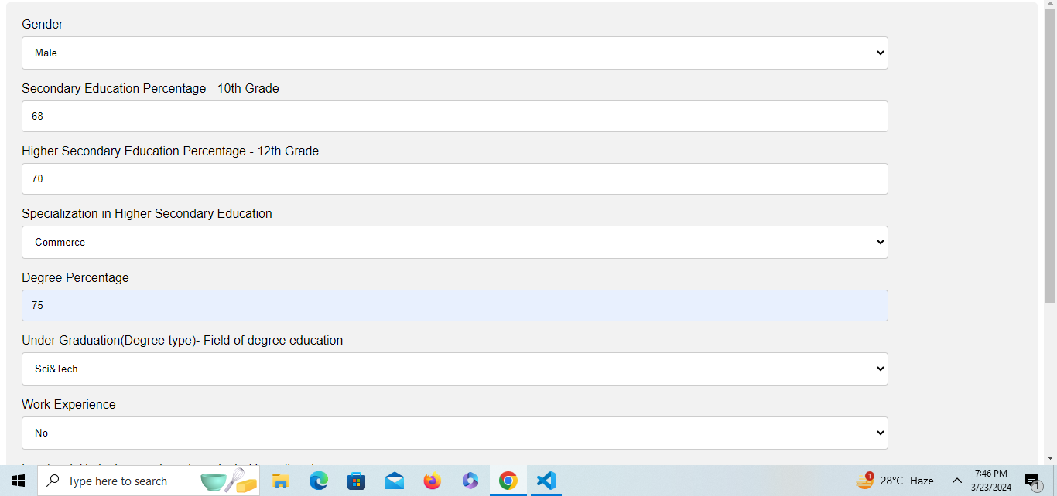
USER INTERFACE

Slide 9
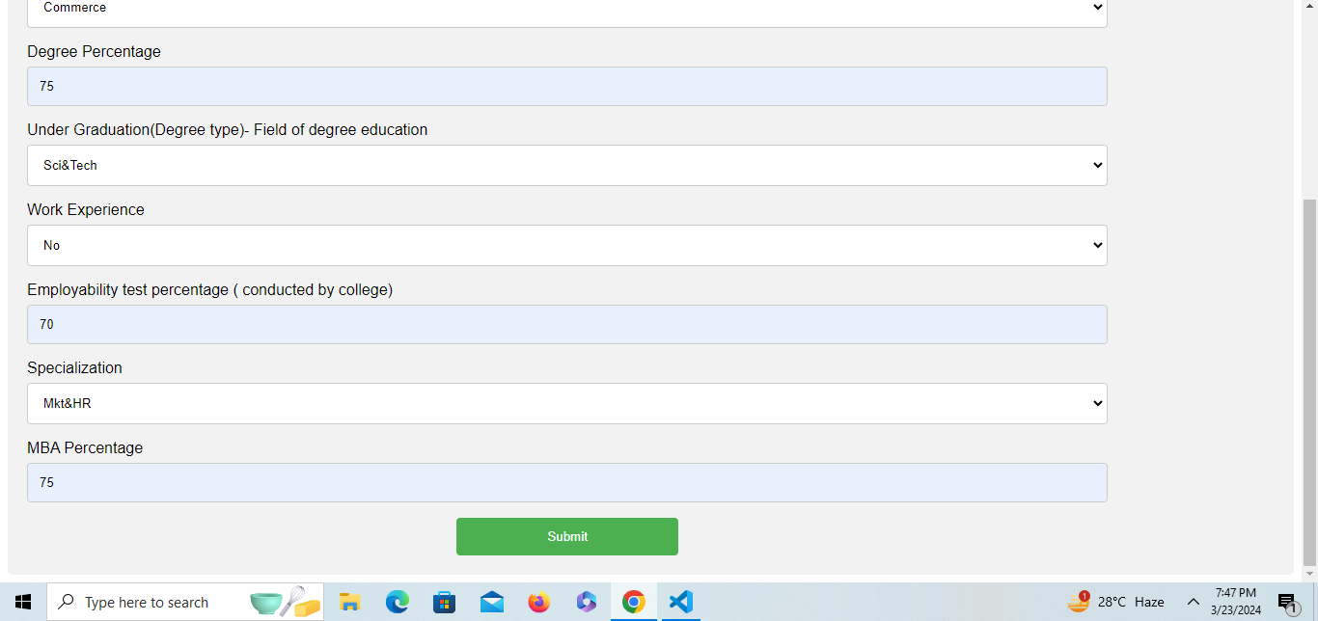

Slide 10
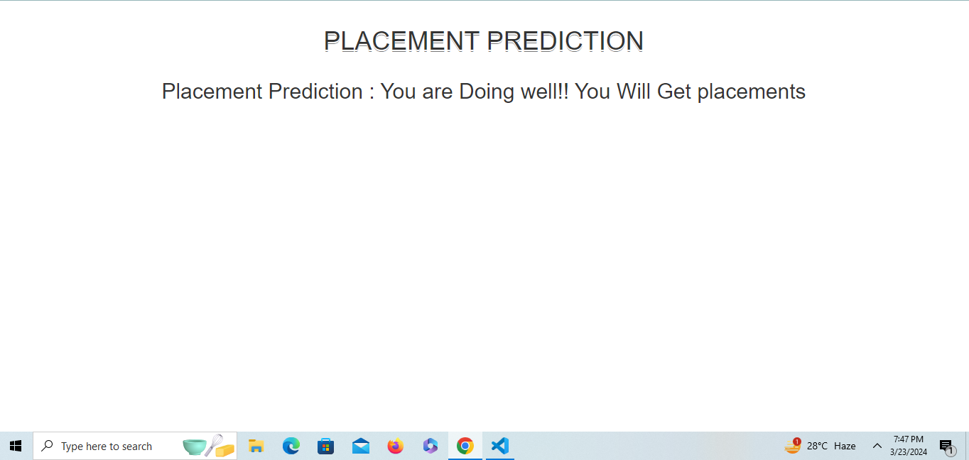

Slide 11
RESULTS AND INSIGHTS
The machine learning model achieved an accuracy of 89.74% in predicting Student Placement.

Slide 12
SOFTWARES
PyCharm is used as IDE.
Matplotlib and Seaborn are used for visualization of the plots.
Heroku is used for deployment of the model.
Front-end development is done using html, CSS, bootstrap
Flask is used for backend development and for API development.
GitHub is used as version control system.

Slide 13
DEPOLYMENT
The final model is deployed on Horeku Cloud URL:
https://campus-placements.herokuapp.com

Slide 14
CONCLUSION AND FUTURE WORK
Conclusion
The project successfully developed a predictive model for campus placement using machine learning techniques.
Results demonstrate the model's effectiveness in forecasting placement outcomes, aiding stakeholders in decision-making processes.
Overall, the project contributes to improving efficiency and accuracy in the campus placement process.
Future Work
Future efforts could focus on enhancing the model's predictive capabilities by incorporating additional data sources or refining feature engineering techniques.
Exploring advanced machine learning algorithms or ensemble methods may further improve prediction accuracy.
Additionally, integrating real-time data and feedback loops could enhance the model's adaptability and relevance over time.

Slide 15
FAQs
Q1) What is the source of data? A1) The dataset is obtained from famous machine learning repository. https://www.kaggle.com/c/ml-with-python-course-project/data
Q2) What was the type of data?
A2) The dataset was the combination of Numerical and Categorical features.
Q3) What’s the complete flow you followed in this Project?
A3) Refer slide 3rd for better understanding of the project and flow
Q4) What techniques were you using for data pre-processing?
Dropping the irrelevant features from the dataset
Separating the numerical and categorical features
Handling missing values in numerical features using median
Handling missing values in categorical features using mode
Numerical features transformation using ‘Log’ and ‘Square Root’ Transformation
Encoding categorical features using ‘One-Hot-Encoding’ and ‘Label Encoding’
Checking multi-collinearity and dropping highly correlated independent features

Slide 16
FAQs
5) How training was done or what models were used?
A5) First Data pre-processing done on final CSV file after cleaning the dataset. After that we did exploratory data analysis and feature selection and then different ML model such as Decision Tree, Random Forest and XGBoost are trained and based on performance we selected the best model.
Q6) How Prediction was done?
A6) The testing files are shared by the client. We perform the same life cycle and then loaded the best model and perform prediction. In the end we get the prediction.
Q7) What are the different stages of deployment?
A7) After model training and finalizing a model, we created required files for deployment. And finally deployed our model over Horeku.
Q8) How is the User Interface present for this project?
A8) UI is very user friendly and easy to use. URL: https://campus-placements.herokuapp.com

