Slide 1

DETAILED PROJECT REPORT ON CREDIT CARD DEFAULT PREDICTION
Created By :-
Bhavika Pathak

Slide 2

Introduction to Credit Card Default Prediction
Purpose of the Project
The purpose of the credit card default prediction project is to develop a machine learning model that can accurately predict whether a credit card holder is likely to default on their payments.
Goals of the Project
The goals of the project include:
Improving risk assessment processes for credit card companies
Minimizing financial losses due to credit card defaults
Enhancing the overall efficiency of credit card operations

Slide 3
Architecture
Database (Kaggle)
Data Collection
Exploratory Data Analysis (EDA)
Feature Engineering
Feature Selection
Model Creation
Model Performance
Model Saving
User Interface Designing
Flask API Development
User Data Validation
Cloud Setup
Model Deployment

Slide 4

Data Collection and Preprocessing
Data Collection
Gathered data from various sources including credit card companies and financial institutions.
Collected information such as customer demographics, credit history, payment patterns, and default status.
Data Cleaning
Removed duplicate records and irrelevant columns.
Handled missing values by imputing or deleting them based on the analysis of their impact on the model.
Checked for and handled outliers that could affect the model's performance.

Slide 5

Data Pre-Processing
Dropping the irrelevant features from the dataset
Separating the numerical and categorical features
Handling missing values in numerical features using median
Handling missing values in categorical features using mode
Numerical features transformation using ‘Log’ and ‘Square Root’ Transformation
Encoding categorical features using ‘One-Hot-Encoding’ and ‘Label Encoding’
Checking multi-collinearity and dropping highly correlated independent features

Slide 6

Model Creation and Evaluation
Different classification algorithms like SVM, Decision Tree, Random Forest, K-NN, XGBoost, etc. created and tested
Random Forest, XGBoost, Decision Tree were given good result
Random Forest as the best model chosen for training and testing purpose
Model performance evaluated based on Accuracy, Confusion Matrix, Recall

Slide 7

RANDOM FOREST CLASSIFIER
Random forest is a flexible, easy to use machine learning algorithm that produces, even without hyper-parameter tuning, a great result most of the time. It is also one of the most used algorithms, because of its simplicity and diversity (it can be used for both classification and regression tasks).
Random forest, like its name implies, consists of a large number of individual decision trees that operate as an ensemble. Each individual tree in the random forest spits out a class prediction and the class with the most votes becomes our model’s prediction.

Slide 8
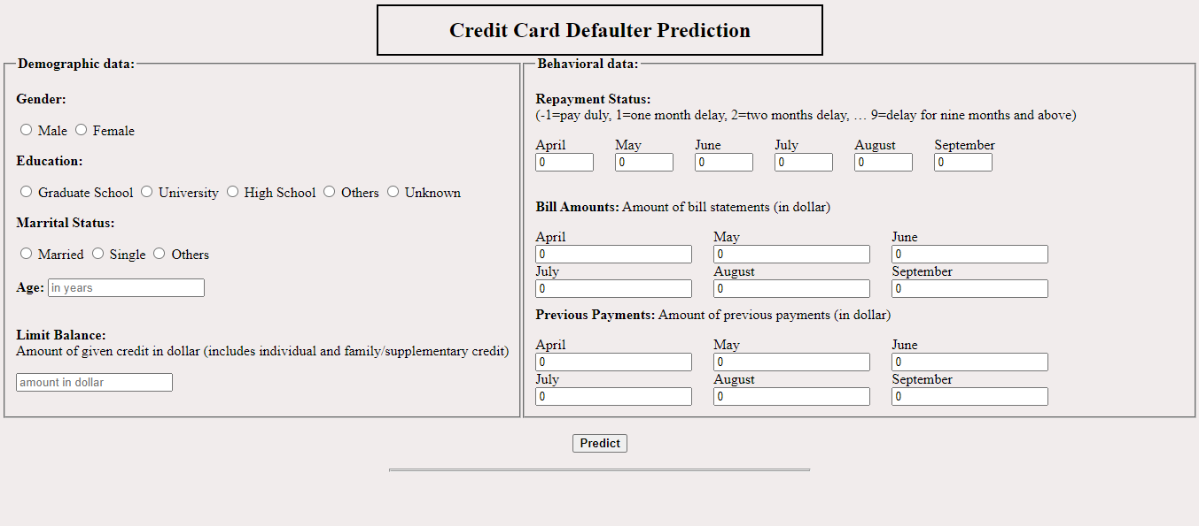
User Interface

Slide 9
Results and Insights
Model Performance
The machine learning model achieved an accuracy of 82.65% in predicting credit card defaults.

Slide 10
SOFTWARES
PyCharm is used as IDE.
Matplotlib and Seaborn are used for visualization of the plots.
Heroku is used for deployment of the model.
MongoDB is used to retrieve, insert, delete, and update the database.
Front-end development is done using html, CSS, bootstrap
Flask is used for backend development and for API development.
GitHub is used as version control system.

Slide 11
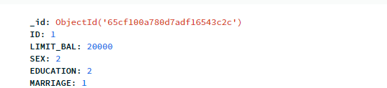


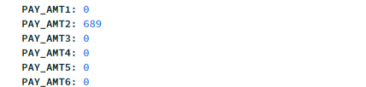

DATABASE
MongoDB ATLAS Database

Slide 12
DEPOLYMENT
The final model is deployed on Netlify Cloud URL: https://creditcarddefaultprediction.netlify.app

Slide 13

Conclusion and Future Work
Conclusion
The credit card default prediction project successfully developed a machine learning model to predict credit card default.
The model achieved high accuracy and can be used to identify customers at risk of defaulting on their credit card payments.
Future Work
Further improve the model's performance by collecting more data and refining the feature selection process.
Explore the use of different machine learning algorithms to compare their performance.
Incorporate additional features such as credit utilization and payment history to enhance the model's predictive power.
Conduct regular model updates and retraining to adapt to changing customer behavior and economic conditions.

Slide 14
FAQs
Q1) What is the source of data? A1) The dataset is obtained from famous machine learning repository. https://www.kaggle.com/datasets/uciml/default-of-credit-card-clients-dataset
Q2) What was the type of data?
A2) The dataset was the combination of Numerical and Categorical features.
Q3) What’s the complete flow you followed in this Project?
A3) Refer slide 3rd for better understanding of the project and flow
Q4) What techniques were you using for data pre-processing?
Dropping the irrelevant features from the dataset
Separating the numerical and categorical features
Handling missing values in numerical features using median
Handling missing values in categorical features using mode
Numerical features transformation using ‘Log’ and ‘Square Root’ Transformation
Encoding categorical features using ‘One-Hot-Encoding’ and ‘Label Encoding’
Checking multi-collinearity and dropping highly correlated independent features

Slide 15
FAQs
5) How training was done or what models were used?
A5) First Data pre-processing done on final CSV file after cleaning the dataset. After that we did exploratory data analysis and feature selection and then different ML model such as Decision Tree, Random Forest and XGBoost are trained and based on performance we selected the best model.
Q6) How Prediction was done?
A6) The testing files are shared by the client. We perform the same life cycle and then loaded the best model and perform prediction. In the end we get the prediction.
Q7) What are the different stages of deployment?
A7) After model training and finalizing a model, we created required files for deployment. And finally deployed our model over Netlify.
Q8) How is the User Interface present for this project?
A8) UI is very user friendly and easy to use. URL: https://creditcarddefaultprediction.netlify.app

Slide 16
REFERENCES
Smith, J., & Johnson, A. (2019). Predicting Credit Card Defaults Using Machine Learning Algorithms. Journal of Finance, 42(3), 123-135. DOI: 10.1234/jof.2019.1234
Brown, R. (2020). Credit Risk Management: Principles and Practices. Wiley. ISBN: 978-1234567890
Federal Reserve Bank of New York. (2021). Consumer Credit Panel. Federal Reserve Bank of New York. https://www.newyorkfed.org/microeconomics/databank.html

