Slide 1
THEME · CIRCULAR CARBON ECOSYSTEM
Carbon-Aware Supply Chain Dashboard
Auditable Scope 3 accounting across multi-tier suppliers, plus a measure of what a company cannot see.
Team name · Institute · Submission date
Notes:
Fill the team line before submitting.

Slide 2
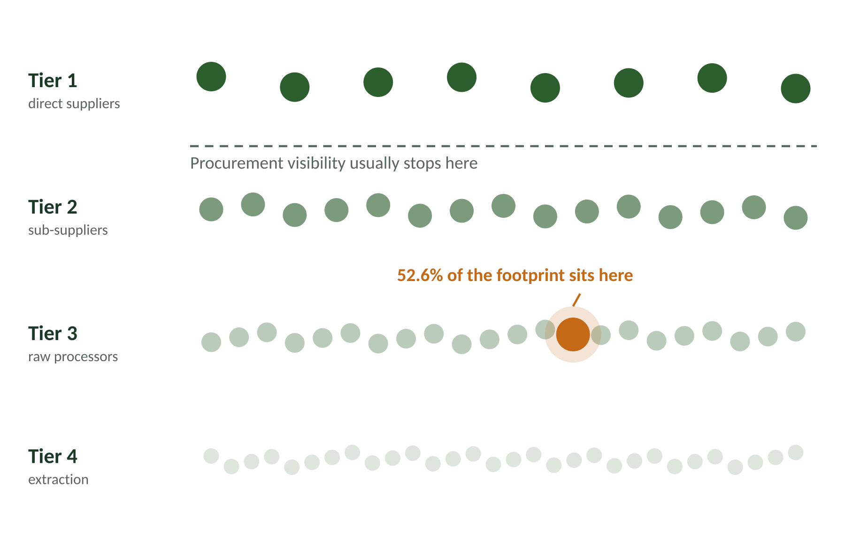
The emissions you cannot see
Visibility collapses one step past the suppliers a company pays directly.
70%+
of a typical footprint sits in the value chain, not owned operations.
2027
CSRD and ISSB deadlines make Scope 3 disclosure mandatory.
Most reduction budgets are spent above this line.
Carbon-Aware Supply Chain Dashboard
2
Notes:
Lead with the diagram. The eye finds the orange node before you finish the sentence.

Slide 3
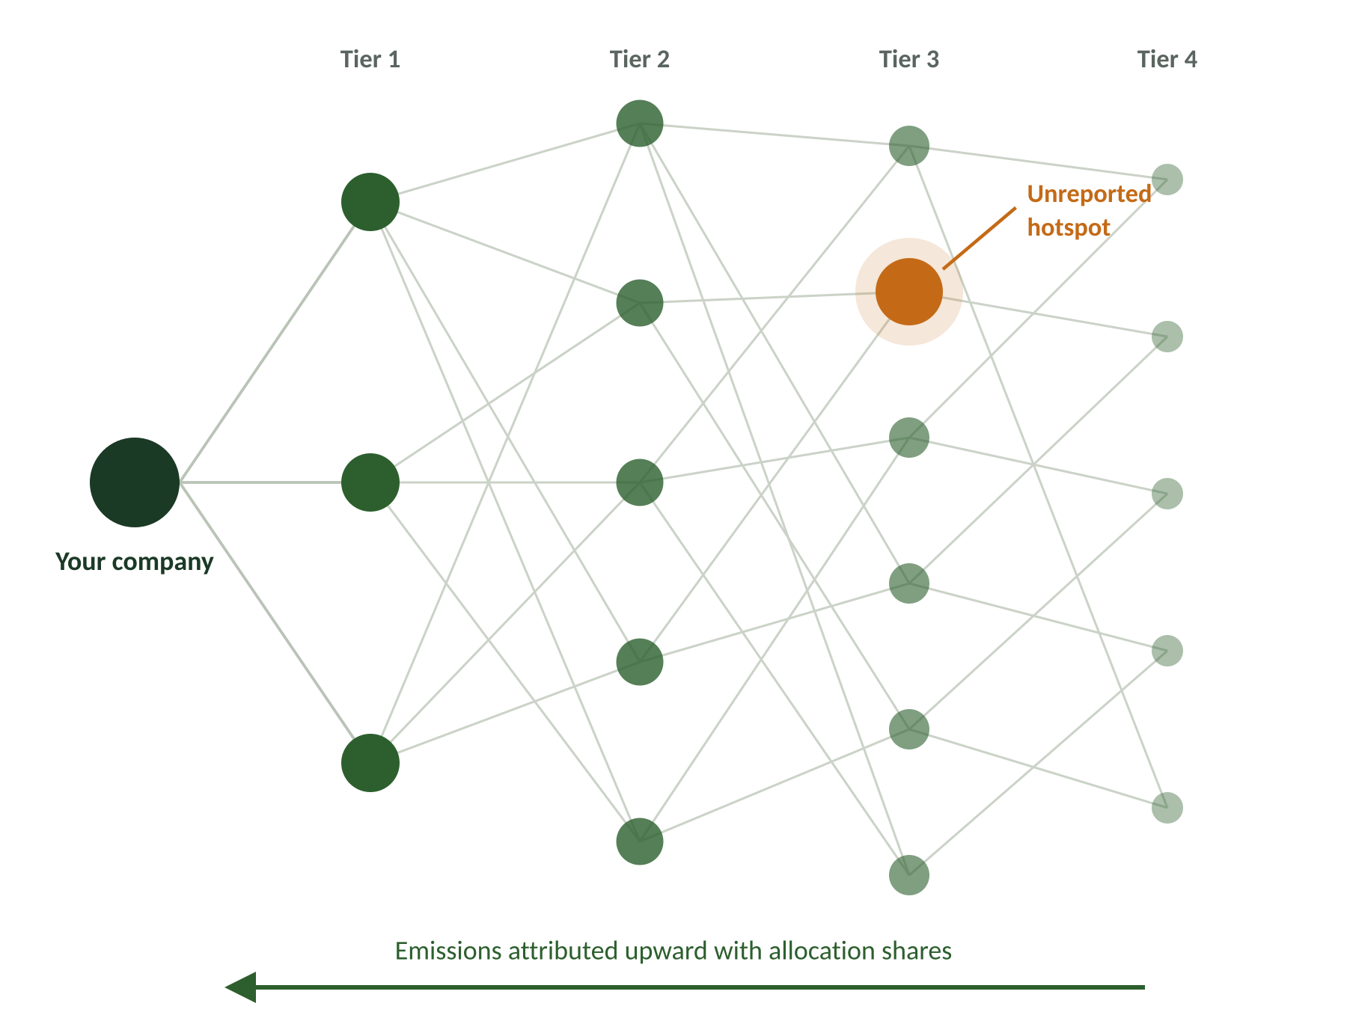
Worked through on aluminium
Aluminium is where the arithmetic gets interesting, because virgin and recycled material differ by roughly an order of magnitude.
Activity-based engine
Energy, materials and freight converted using published DEFRA, EPA and IEA factors, mapped to GHG Protocol categories 1, 3 and 4.
Multi-tier propagation
Deep-tier emissions attributed upward with explicit allocation shares.
Full audit trail
Click any figure to see how it was derived.
One smelter, 2,850 tonnes of aluminium
Virgin 35,625 tCO2e → recycled 4,418 tCO2e. Switching material and shifting air freight to sea removes 41,896 tCO2e, or 47% of the whole chain.
Carbon-Aware Supply Chain Dashboard
3
Notes:
Industry data supports the magnitude: the International Aluminium Institute reports primary aluminium at 15.1 tCO2e per tonne against 0.52 for recycled, roughly a 95 percent saving. Our engine uses DEFRA factors, which are more conservative.

Slide 4
How it works
The calculation is deterministic. Machine learning only fills gaps in supplier data.
1
2
3
4
5
Ingest
Calculate
Propagate
Diagnose
Act
Supplier CSV validated against a fixed schema.
Cited factors applied per GHG Protocol category.
Emissions moved upward through 400+ weighted links.
Hotspot ranking and the Blind Spot Index.
Alternatives recomputed live; auditor export.
Stack
Frontend
Backend
Data
Graph and ML
React, Vite, D3.js, Tailwind
FastAPI, pure functions
PostgreSQL, versioned factors
NetworkX, scikit-learn
Carbon-Aware Supply Chain Dashboard
4

Slide 5
The Blind Spot Index
We could not find an existing tool that reports this, so we built the metric ourselves. It is the share of procurement spend running through suppliers that never reported.
41.2%
Line coverage reads 93.3%
Yet 41.2% of spend is unverified
Band: Weak, do not publish
of spend unmeasured
From the prototype
88,639
52.6%
tCO2e across 200 suppliers and 413 supply links.
of that comes from one supplier that reports nothing.
Carbon-Aware Supply Chain Dashboard
5
Notes:
The line: coverage reads 93 percent, but 41 percent of spend is unverified. The footprint is not wrong, it is unverified.

Slide 6
What could go wrong
Cost
Adoption
Value
Nothing in the stack carries a licence fee, and the published factor sets are free to use.
CSV upload matches how suppliers already send data.
Auditors can trace any figure back to its source, and managers can see which nodes are worth spending money on.
Principal risks and mitigations
Risk | Mitigation
Suppliers fail to report data | Gaps are quantified by the Blind Spot Index rather than hidden.
Factors differ by region and vintage | Factor tables are versioned and cited, so any report reproduces exactly.
Estimates mistaken for measurements | Imputed figures are visually distinguished everywhere.
The index falls as suppliers start reporting, which gives a company a reason to open the dashboard every quarter rather than once a year.
Carbon-Aware Supply Chain Dashboard
6

Slide 7
Where this goes next
Near term
References
Supplier self-service portal, driving the Blind Spot Index down each quarter.
GHG Protocol Corporate Value Chain (Scope 3) Standard (category definitions and boundary rules)
UK DEFRA conversion factors (material intensities, freight per tonne-kilometre)
US EPA eGRID, IEA and Australian National Greenhouse Accounts (grid electricity intensity)
International Aluminium Institute (primary against recycled aluminium)
CSRD and ISSB disclosure requirements (regulatory context)
Mid term
Marginal abatement cost curve ranking interventions by tonnes saved per unit of spend.
Longer term
ERP connectors replacing CSV upload, plus assurance of the audit export.
Carbon-Aware Supply Chain Dashboard
7

