Slide 1


Slide 2



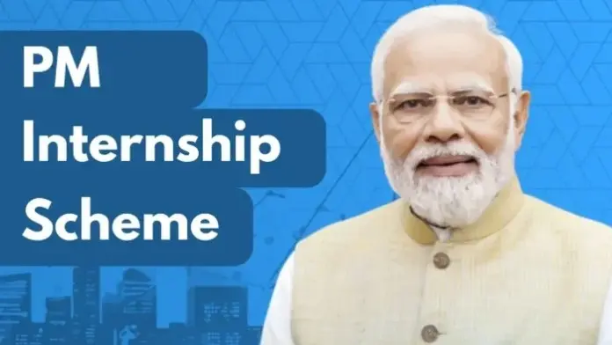
CODE VERSE HACKATHON 2025
Problem Statement Title :- Al-Based Internship Recommendation Engine . for PM Internship Scheme
Team Name :- Quantum
Team Members :- Bhavikesh, Harshal, Chaitanya, Apurva
Idea Title :- SmartMatch

Slide 3
SmartMatch
What is the problem?
Many students applying to the PM Internship Scheme—especially from rural and underserved areas—struggle to find internships that match their skills or interests. With limited digital literacy and hundreds of listings, they often apply randomly or miss out entirely.
We aim to solve this by building a simple, AI-powered tool that guides each student to the 3–5 most relevant internships based on their profile.

Slide 4
What do we propose?
We developed a lightweight, rule-based recommendation engine that :
Collects basic inputs: education, skills, interests, and preferred location.
Calculates a “match score” for each internship using weighted logic.
Suggests top internships tailored to the user’s profile.
Works on mobile, supports regional languages, and is easy to use—even for first-time users.
No login, no complexity—just smart, relevant suggestions.

Slide 5

What Prototype We Planned ?
Our working prototype includes:
A simple mobile-friendly form for students to enter their details.
A matching algorithm that ranks internships based on profile fit.
Internship “cards” showing match %, title, location, and one-click apply.
Feedback option (thumbs up/down) to improve future suggestions.
It’s fast, visual, and designed for students with minimal digital experience.

Slide 6
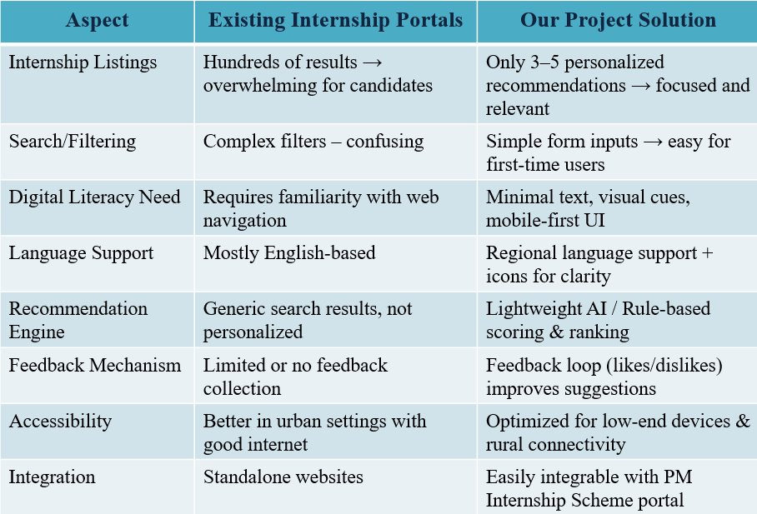
Existing Internship Portals v/s Our Solution

Slide 7
Potential Challenges & Risks
Data quality issues (incomplete skills or internship details).
Language barriers for rural/tribal candidates.
Limited digital literacy of first-time users.
Risk of bias in recommendations (favoring urban students).
Scalability challenges if millions of users access simultaneously.
Strategies to Overcome Challenges
Data validation & cleaning → ensure accurate internship/student profiles.
Multi-language support & icons → make it accessible in regional languages.
Visual, step-by-step UI → reduce digital literacy barriers.
Fairness checks → balance recommendations across rural & urban candidates.
Scalable architecture → cloud deployment with load balancing.

Slide 8
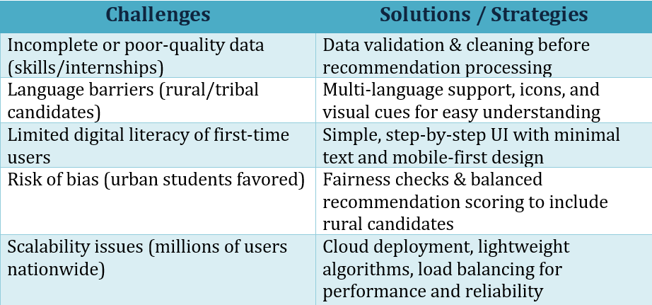
Challenges v/s Solution

Slide 9
FEATURES
1. Personalized Internship Recommendations
The system suggests only 3–5 highly relevant internships for each candidate instead of showing hundreds of options.
Matches are based on education level, skills, sector interest, and location preferences.
Helps students focus on the best-fit opportunities rather than wasting time browsing irrelevant ones.
2. Lightweight AI / Rule-based Engine
Uses a simple rule-based algorithm for filtering and ranking internships.
Optionally enhanced with ML-light models (e.g., Scikit-learn for scoring).
Optimized to run on low-end devices and areas with poor internet connectivity.
Avoids resource-heavy models → ensures low cost and easy deployment.

Slide 10
3. Simple & Intuitive User Interface
Mobile-first design since most rural/tribal youth access internet via smartphones.
Minimal text → uses icons, buttons, and step-by-step navigation.
Card-style output → each internship is displayed with key info (title, company, skills match %, location, apply button).
4. Regional Language Support
Provides multi-language options (e.g., Hindi, Marathi, Tamil, etc.).
Uses simple vocabulary and visual cues for clarity.
Ensures inclusivity for tribal, rural, and first-generation learners who may not be fluent in English.
5. Feedback Loop & Continuous Improvement
Candidates can give quick feedback (👍/👎 or star rating) on recommendations.
The system learns from preferences over time → improves personalization.
Helps refine the recommendation logic to suit real user needs.

Slide 11

6. Easy Integration with PM Internship Scheme Portal
Built as a modular component that can be embedded into the existing government portal.
Requires only basic backend API connections for fetching internships and storing user profiles.
7. Inclusivity & Accessibility Focus
Designed keeping in mind first-generation learners and youth from rural/tribal backgrounds.
Simple navigation → no complex forms or confusing filters.
Promotes equal opportunity access across urban and rural India.

Slide 12
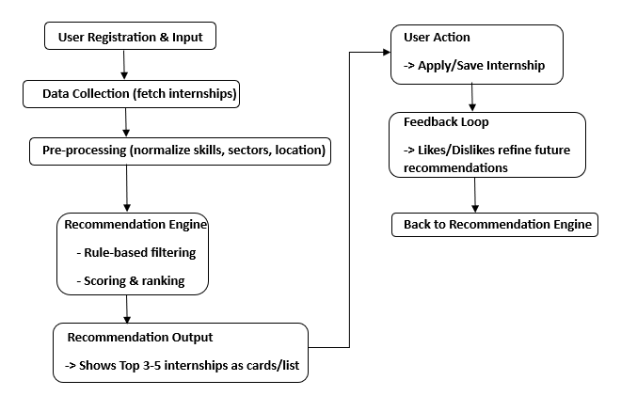
WORK FLOW

Slide 13

TECHNICAL APPROACH
Technologies to be Used:
Frontend/UI: HTML, CSS, JavaScript (mobile-first, responsive)
Backend: Python (Flask/Django lightweight APIs)
AI/Recommendation Logic:
Rule-based filtering (skills, education, location)
Optionally ML-light model (scikit-learn)
Database: SQLite / MySQL for storing internships & profiles
Languages/Localization: i18n libraries, regional language support
Deployment: Cloud hosting (AWS/Heroku) or Govt. portal integration

Slide 14
METHODOLOGY & PROCESS FOR IMPLEMENTATION
Requirement Gathering – Define candidate inputs & output format
Data Collection – Internship details + sample student profiles
Model Design – Rule-based matching → optional ML refinement
Prototype Development – Form inputs + recommendation cards UI
Testing & Feedback – Pilot with small student group, collect feedback
Refinement – Improve UI, add language/localization, fine-tune matching
Integration – Connect with PM Internship Scheme portal

Slide 15
Potential Impact
Increases access to relevant internships for youth across India.
Empowers first-generation learners with career opportunities.
Reduces misaligned applications → improves selection chances.
Promotes inclusive growth by reaching rural, tribal, and remote candidates.
Strengthens the PM Internship Scheme as a national skill-building platform.
Benefits
For Students: Saves time, reduces confusion, improves match quality.
For Government: Better utilization of internship opportunities, higher success rate of the scheme.
For Organizations: Get candidates who are more aligned with their requirements.
For Society: Promotes equal opportunities, digital empowerment, and workforce readiness.

Slide 16
Thank You!

