Slide 1

Sentiment Analysis using NLP on Hotel Reviews
Presented by : Group 2
1.Mr.Madhuresh Kumar 2.Ms.Varsha Reddy 3.Mr.Hemant Shinde 4.Mr.Karan Patil 5.Ms.Madhuri Varpe 6.Mr.Omprasad Kolhal 7.Ms.Shraddha Hukkeri

Slide 2
Business Objective:
To understand the attributes that travelers consider while selecting a hotel.
Thereby understanding the elements to be added to improve the hotel's brand value

Slide 3
Exploratory Data Analysis [EDA]
Basic Data Understanding
Text Processing
Data Visualizations

Slide 4
Basic Data Understanding
Data contains an overall of 20491 reviews with respective ratings.
Data doesn’t contain any Null Entries.

Slide 5
Text Processing
The maximum count of review by the rating is , 5 star rating with 9054 reviews.
The least count of review by the rating is , 1 star with 1421 reviews.
The higher the rating , longer the review.
After generalizing the reviews :
73.7% of reviews were positive
15.7% of reviews were negative
10.7 % were neutral.

Slide 6
Data Visualization
Common words & Stop words
Bi and Tri Grams
Word Clouds

Slide 7
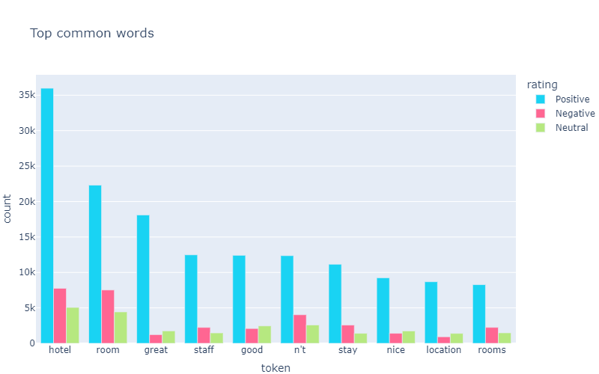
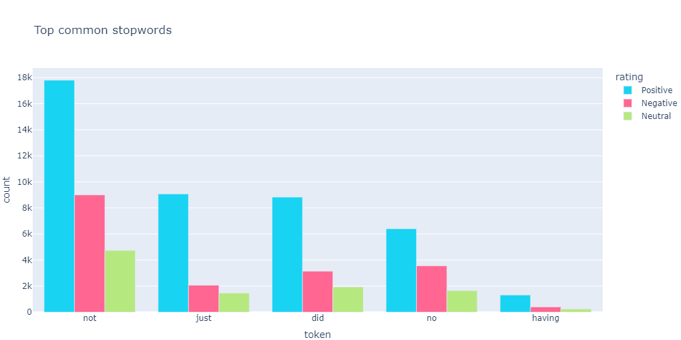
Common words & Stop words

Slide 8
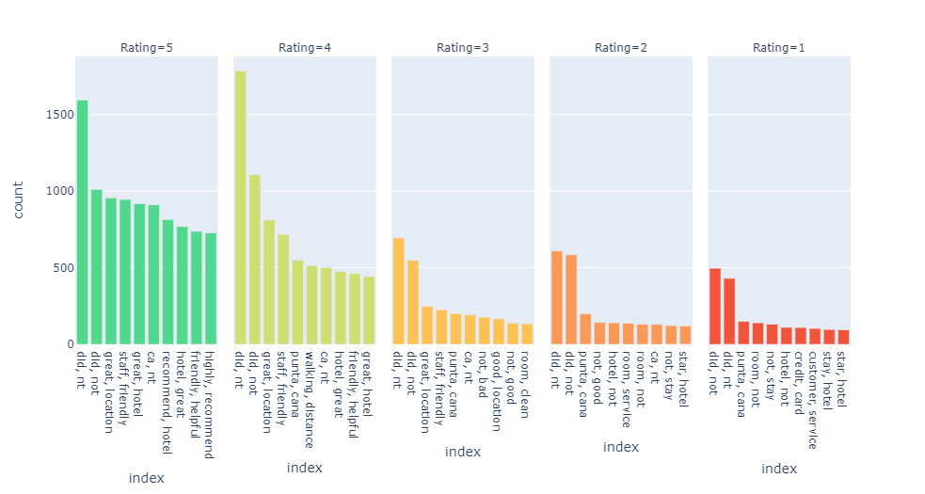
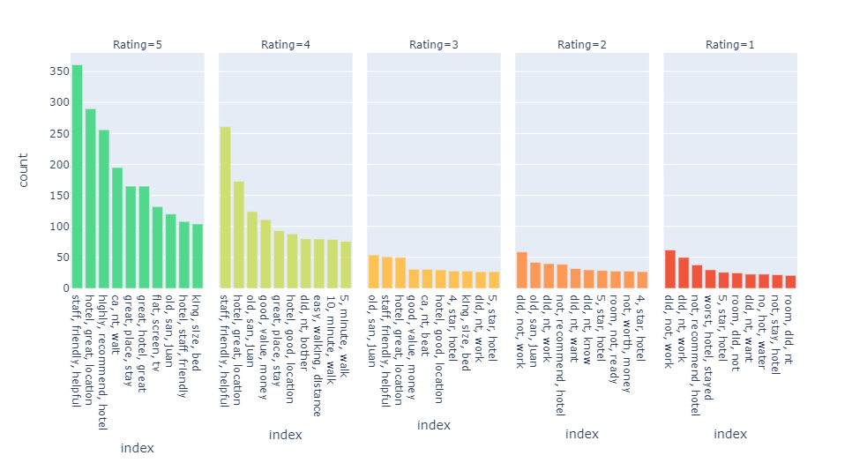
Bi and Tri Grams

Slide 9
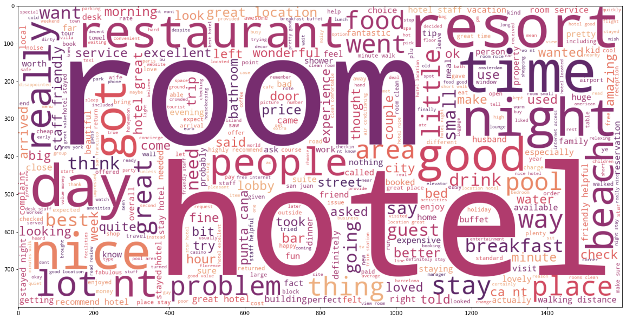
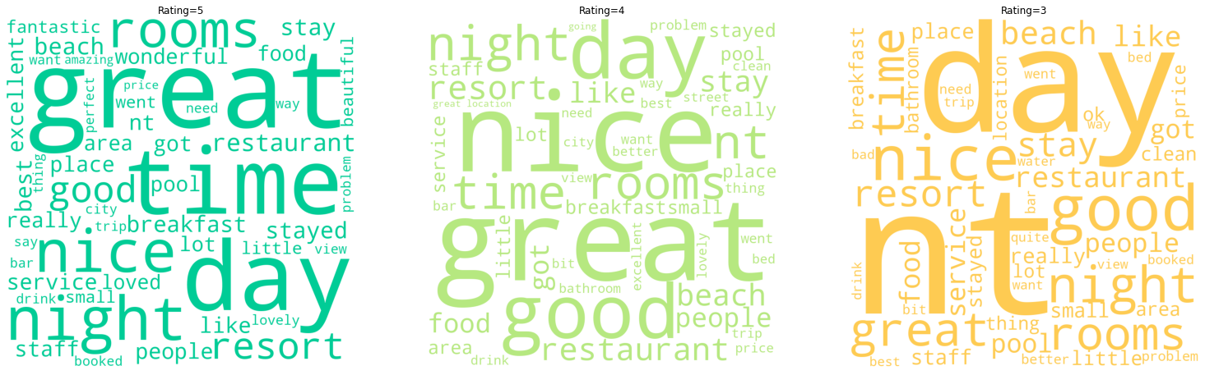
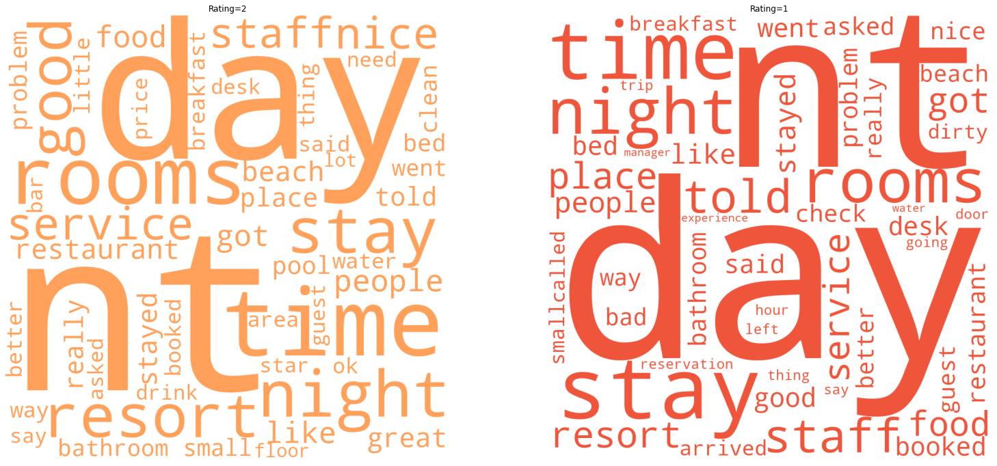
Word Clouds

Slide 10
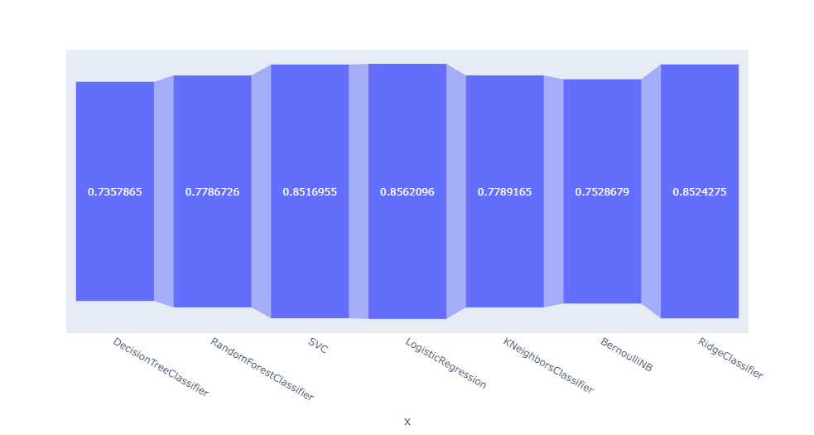
Model Building with SKLEARN
Data was split into 80 : 20 as for training and testing purposes .
Model ​ | Accuracy​ ​
Decision Tree Classifier ​ | 0.7401181​ ~ 74.01%
Random Forest Classifier​ | 0.7785512​ ~ 77.85%
SVC ​ | 0.8547473​ ~ 85.47%
Logistic Regression​ | 0.8585904​ ~ 85.85%
KNeighbors Classifier ​ | 0.7775745​ ~ 77.75%
Bernoulli N B​ | 0.7512816​ ~ 75.12%
Ridge Classifier ​ | 0.8559050​ ~ 85.59%

Slide 11
Model Finalization
Since Logistic Regression performs better than other models in this case, we will use Logistic Regression to train our model

Slide 12
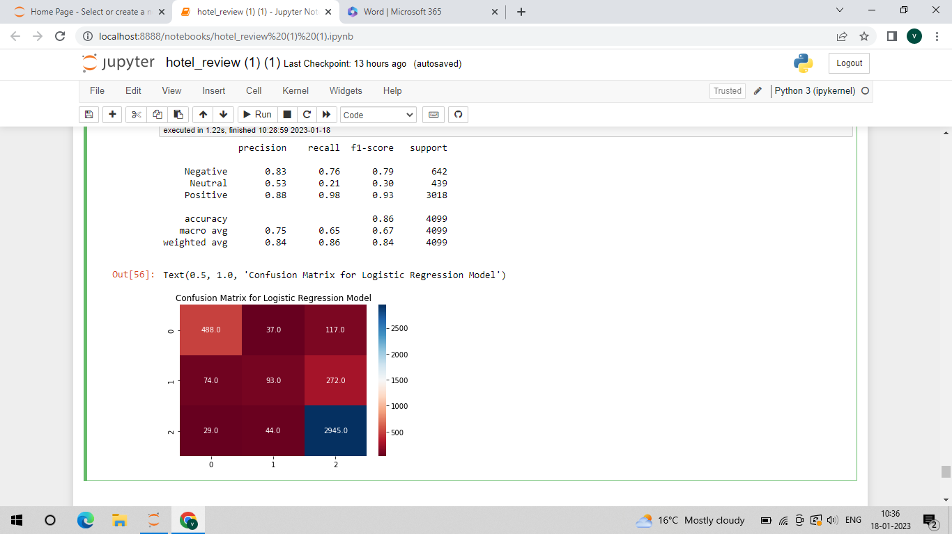
Classification report and Confusion matrix

Slide 13
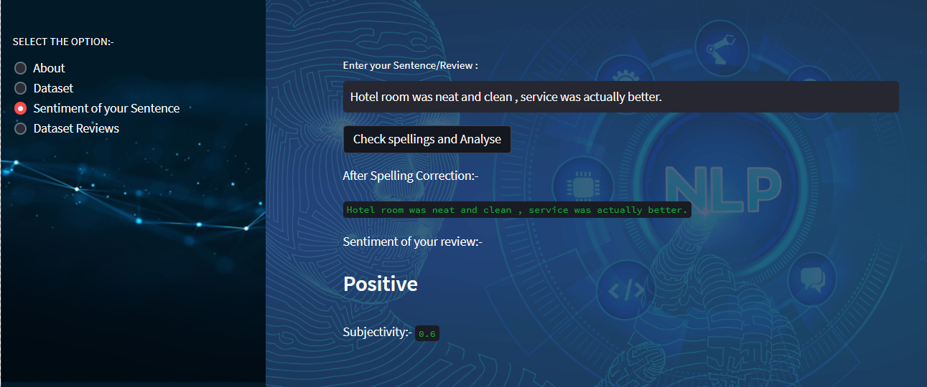
Deployment using Streamlit

Slide 14
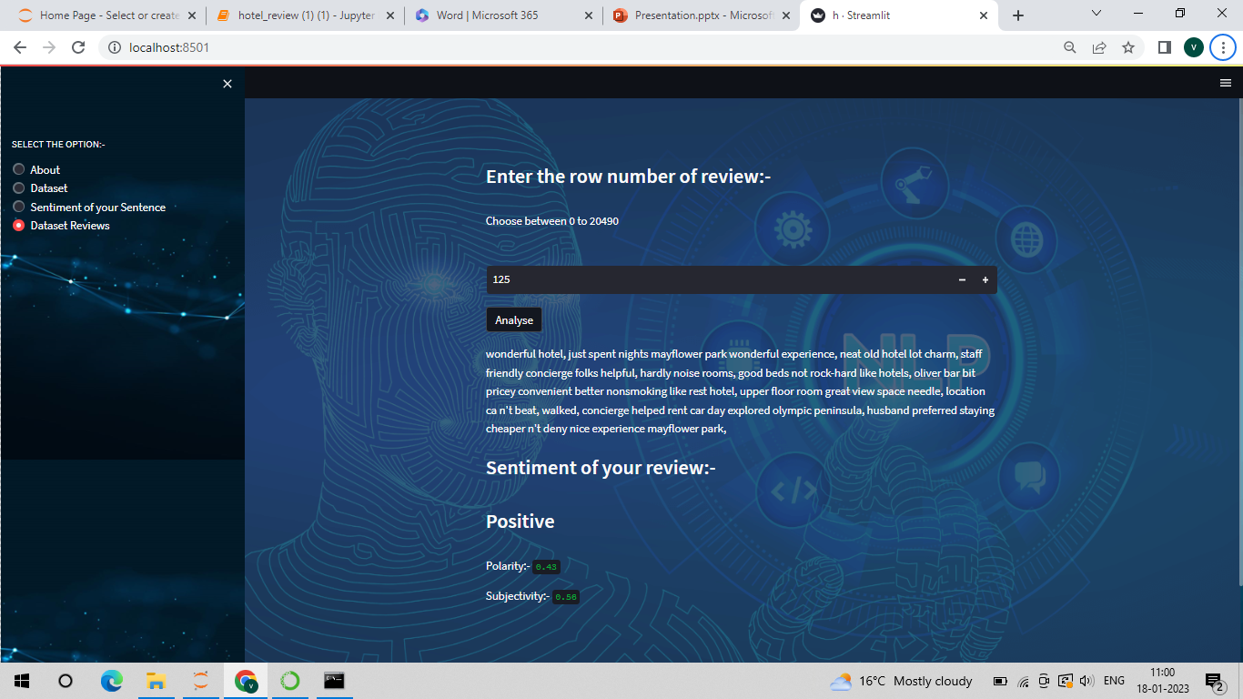

Slide 15


