Slide 1

Combat Sexual Abuse via Machine Learning
Prepared By:
Students' Name:
Vyoma Patel (AU2044005)
Bhavin Gor (AU2044008)
Preyanshu Sukhadia (AU1841140)
Prasham Mody (AU1841143)
Course: Machine Learning(ML)
Course Code: CSE523

Slide 2

Introduction
The proposed project definition quests about how Machine Learning can provide new ways to overcome this gender based violence.
This is one of the crucial problems to be dealt and necessary actions should be taken.
Artificial Intelligence has been prevalent in today's era for handling and mitigating such criminal incidents.
AI model is a collaborative technique by Omdena and Safecity project.
This model leverages open-sourced data as well as Safecity’s database to build heatmaps, and safe routes using Nearby Search, Directions API and Grid Coverage techniques.
The Safecity platform acts as a crowd sourced place where individuals can share their personal stories of sexual assaults and rapes.

Slide 3
Problem Statement
The idea here is how effectively based on details gathered can the hotspots be known across the world at a quicker pace.
Based on the segmentation of different categories to derive insights as which type of incident is more prevalent globally.

Slide 4
Existing Body of Work
As, the dataset gathered by Safecity a crowd sourcing platform, it is mostly in type of reports and description, basically a textual data.
So earlier, the researchers have used NLP and deep learning classification algorithms approached to this problem.
Also used word embeddings, LIME analysis and t-SNE.

Slide 5
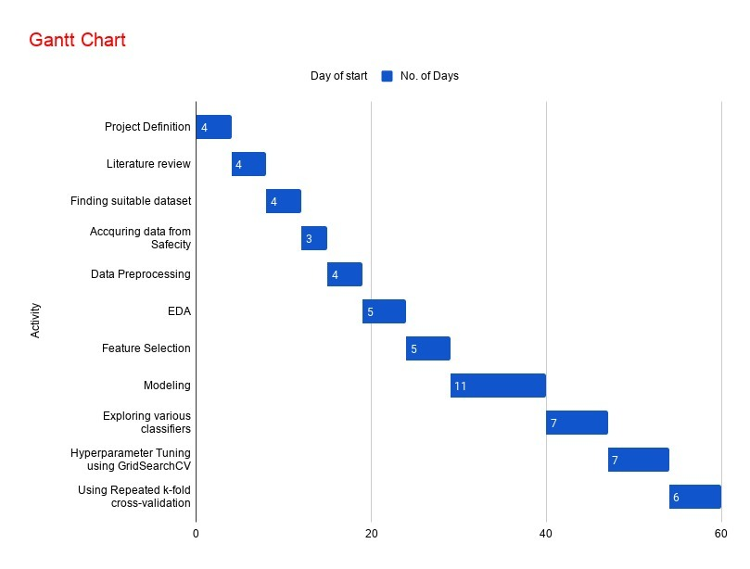
GANNT chart

Slide 6
Our Approach
We are here to use traditional ML Classification algorithms to classify whether the category and description is correctly classified.
For this we used Count Vectorizer, TFidfTransformer for training purpose.
Also visualized the data as what were the peak hours, weekday, places, where the incident occurred often.
Implemented feature extraction techniques like PCA for more accurate results.
We also performed hyperparameter tuning using GridSearchCV to find the best possible model.

Slide 7
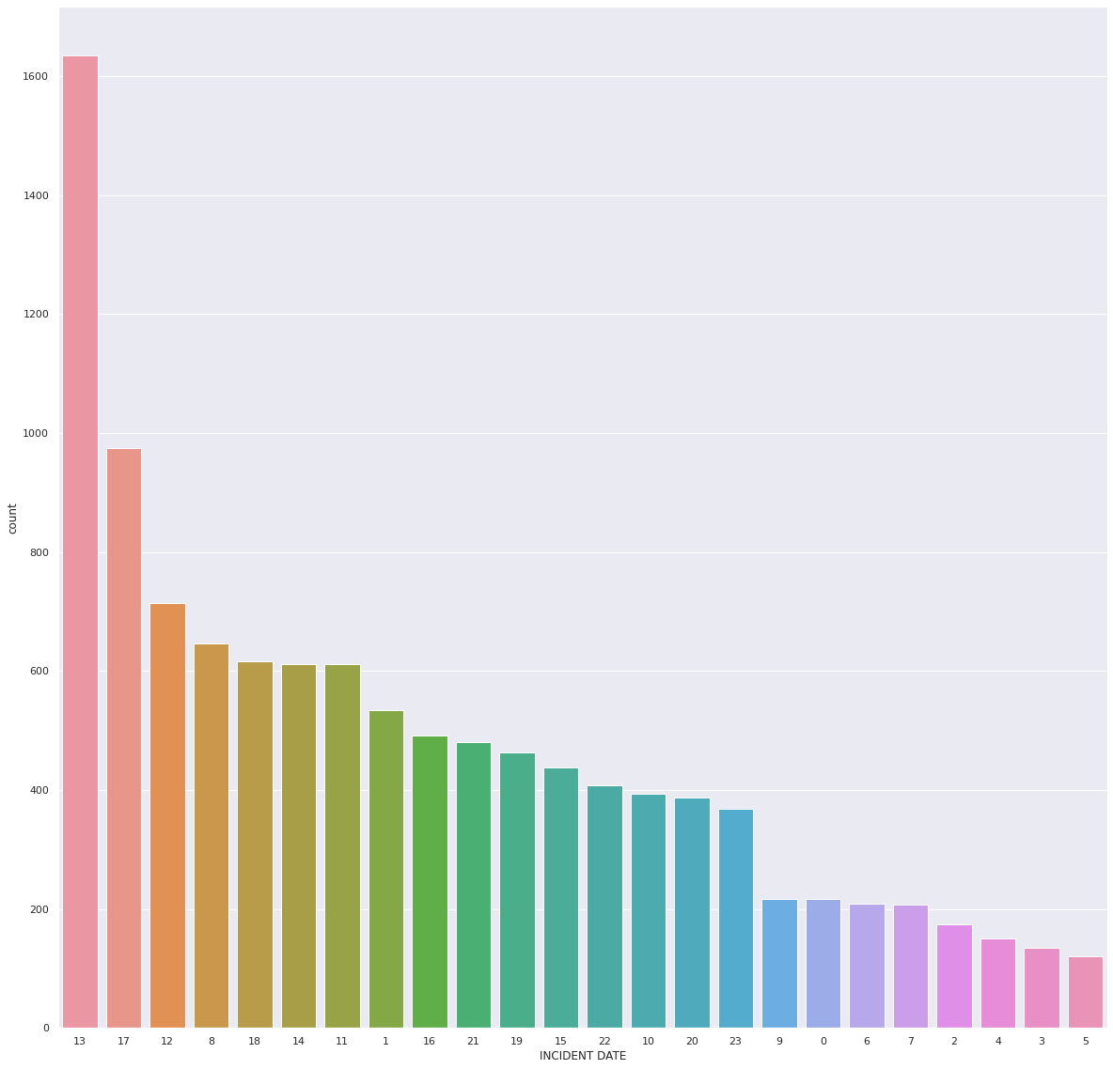
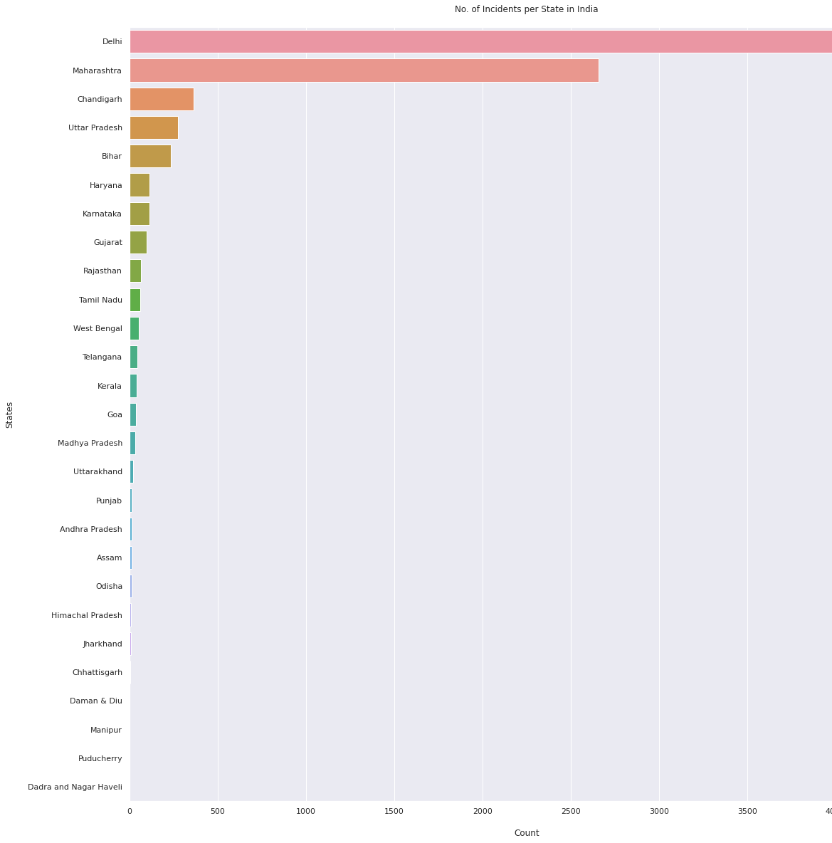
Incidental Hours Analysis
Indian Incident State Analysis

Slide 8
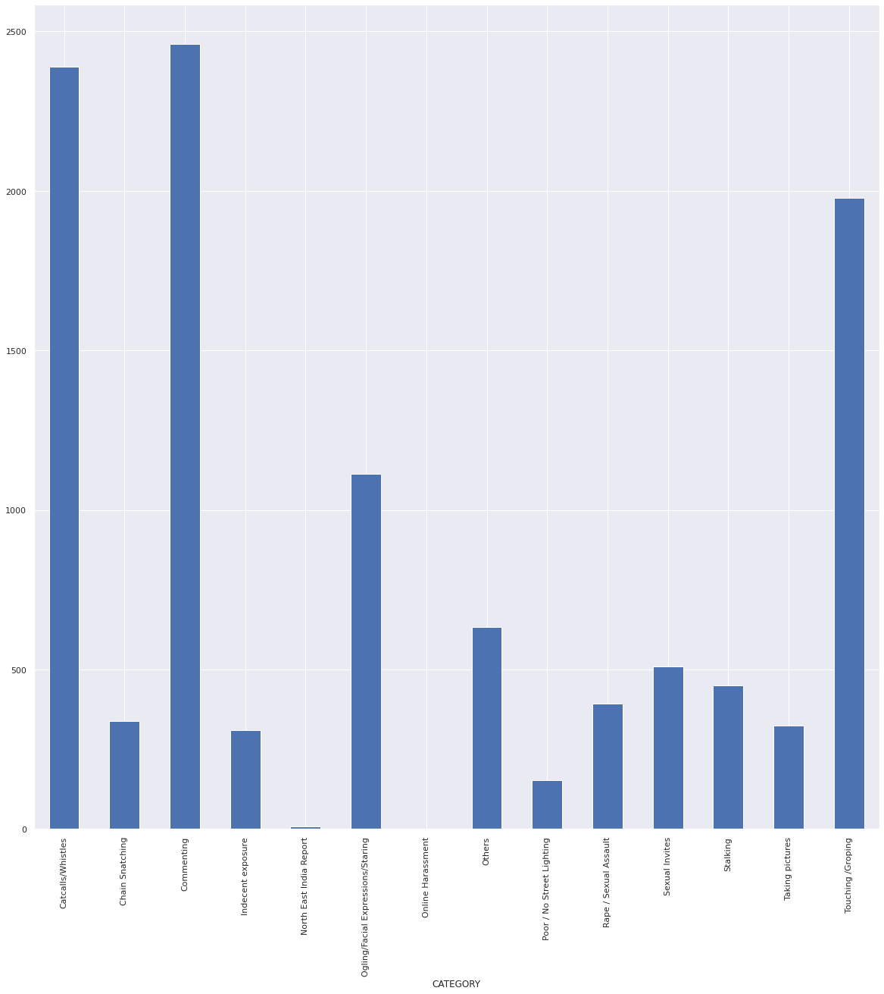
Category Wise Counts

Slide 9
Final Results
We implemented different ML classification algorithms and found their accuracies in order to find the best model.
After performing hyperparameter tuning we found a difference in the obtained accuracies of respective classification algorithms.
We represented those accuracies using different line graphs.
We also found accuracies using different SVC kernels.

Slide 10
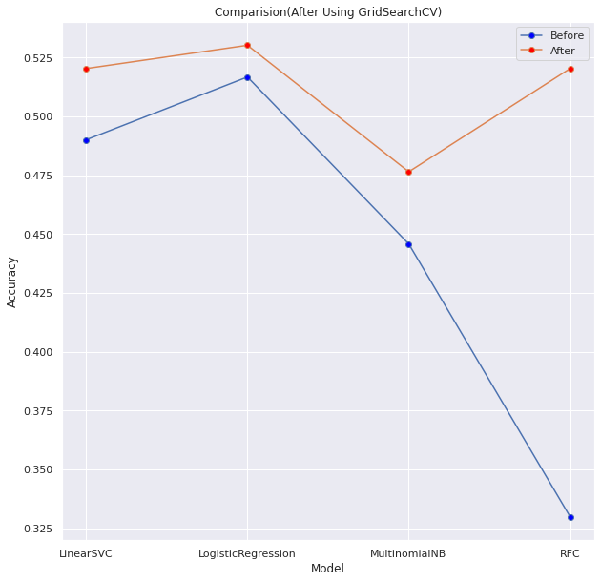
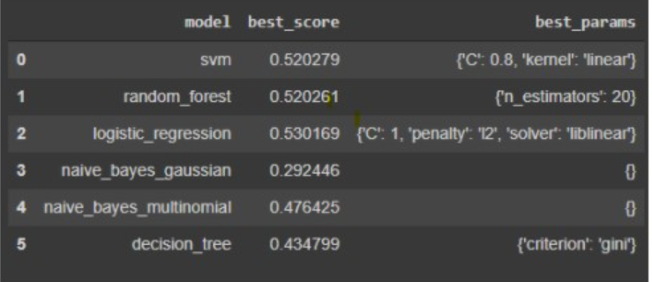
Accuracy Results

Slide 11
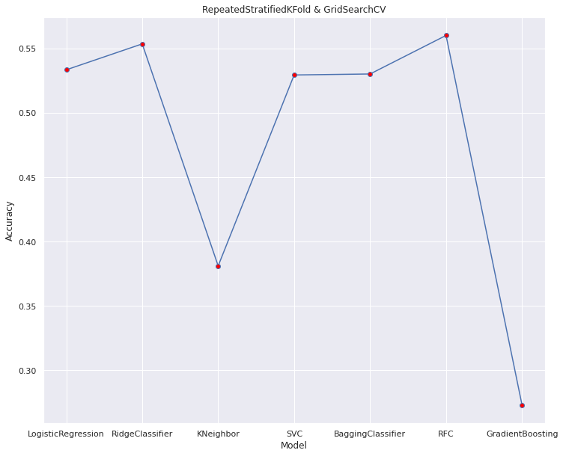
Accuracy Results

Slide 12
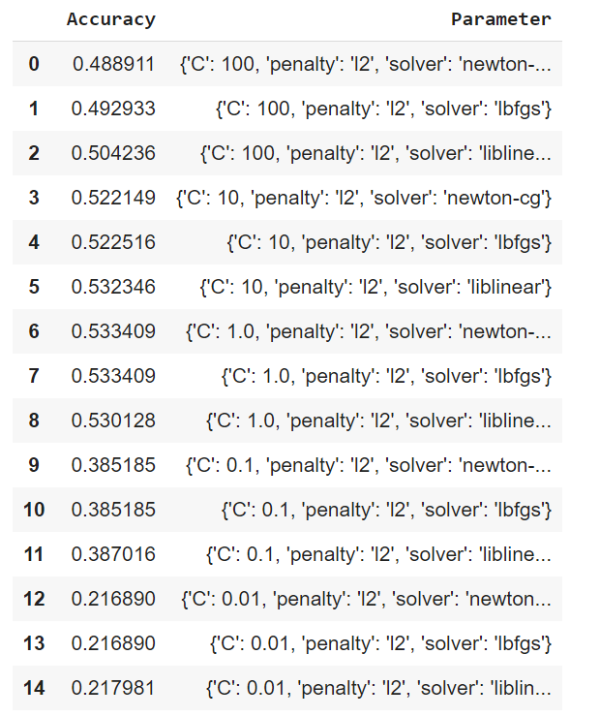
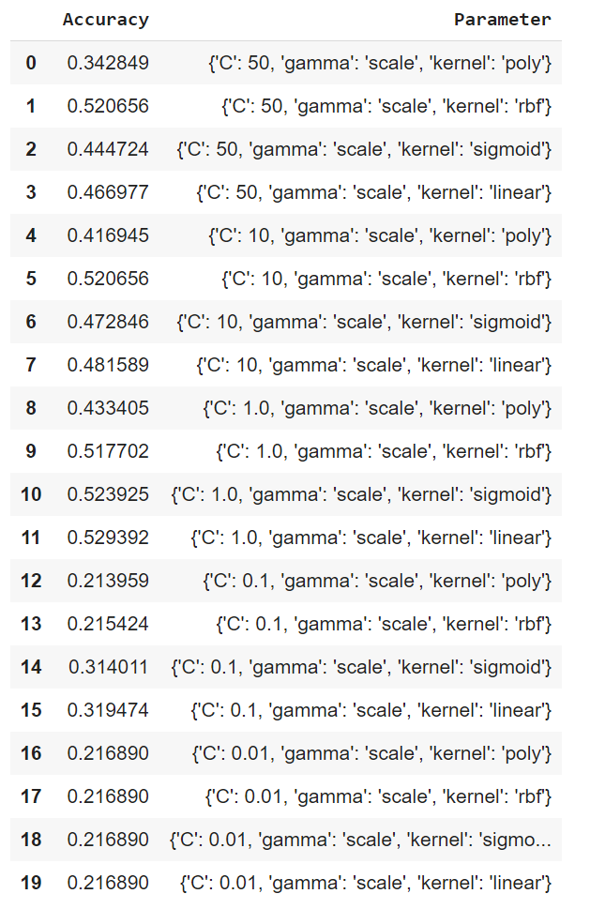
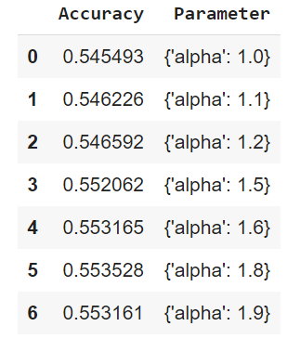
Accuracy Results (After hyperparameter tuning)
Ridge Classifier
SVC
Logistic Regression

Slide 13
Conclusion
After performing hyperparameter tuning, we improved the accuracy of the respective ML classification algorithms.
The highest accuracy which we were able to obtain was 56% accuracy using RandomForestClassifier.

Slide 14
Role of each group member in the project
Task | Vyoma | Bhavin | Preyanshu | Prasham
Data collection | ✔ |  |  | ✔
Data Cleaning | ✔ | ✔ | ✔ | ✔
Data pre-processing | ✔ | ✔ | ✔
Performing EDA |  | ✔ | ✔ | ✔
Transformation of data | ✔ | ✔
Implementation of different algorithms | ✔ | ✔
Building model | ✔ | ✔ | ✔ | ✔
Performing hyperparameter Tuning |  | ✔ | ✔ | ✔

Slide 15
References
https://medium.com/omdena/is-this-place-safe-274fc31c02c6
https://www.analyticsinsight.net/top-10-ai-technologies-mitigate-rape-sexual-assault/
https://journals.sagepub.com/doi/abs/10.1177/009102601104000104?journalCode=ppmd
https://analyticsindiamag.com/ai-to-combat-sexual-harassment-with-chatbots-apps-trained-algorithms/
https://www.globaltechoutlook.com/how-artificial-intelligence-helps-fight-sexual-harassment/
https://dalspace.library.dal.ca/bitstream/handle/10222/76331/sharifirad-sima-PhD-CSCI-Aug-2019.pdf?sequence=5&isAllowed=y
https://safecity.in/about/
https://github.com/LaverdeS/NLP_Sexual_Harassment_Testimonies/tree/master/category_classifier/datasets
https://maps.safecity.in/reports#

