Slide 1

Combat Sexual Abuse via Machine Learning
Prepared By:
Students' Name:
Vyoma Patel (AU2044005)
Bhavin Gor (AU2044008)
Preyanshu Sukhadia (AU1841140)
Prasham Mody (AU1841143)
Course: Machine Learning(ML)
Course Code: CSE523

Slide 2

Introduction
The proposed project definition quests about how Machine Learning can provide new ways to overcome this gender based violence.
This is one of the crucial problems to be dealt and necessary actions should be taken.
Artificial Intelligence has been prevalent in today's era for handling and mitigating such criminal incidents.
AI model is a collaborative technique by Omdena and Safecity project.
This model leverages open-sourced data as well as Safecity’s database to build heatmaps, and safe routes using Nearby Search, Directions API and Grid Coverage techniques.
The Safecity platform acts as a crowd sourced place where individuals can share their personal stories of sexual assaults and rapes.

Slide 3
Problem Statement
The idea here is how effectively based on details gathered can the hotspots be known across the world at a quicker pace.
Based on the segmentation of different categories to derive insights as which type of incident is more prevalent globally.

Slide 4
Existing Body of Work
As, the dataset gathered by Safecity a crowd sourcing platform, it is mostly in type of reports and description, basically a textual data.
So earlier, the researchers have used NLP and deep learning classification algorithms approached to this problem.
Also used word embeddings, LIME analysis and t-SNE.

Slide 5
Our Approach
We are here to use traditional ML Classification algorithms to classify whether the category and description is correctly classified.
For this we used Count Vectorizer, TFidfTransformer for training purpose.
Also visualized the data as what were the peak hours, weekday, places, where the incident occurred often.

Slide 6
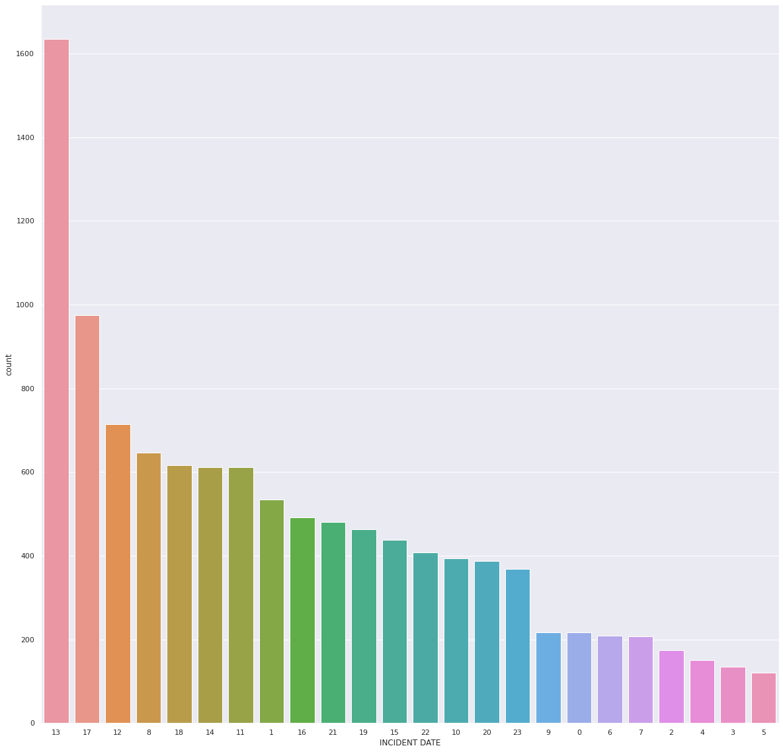
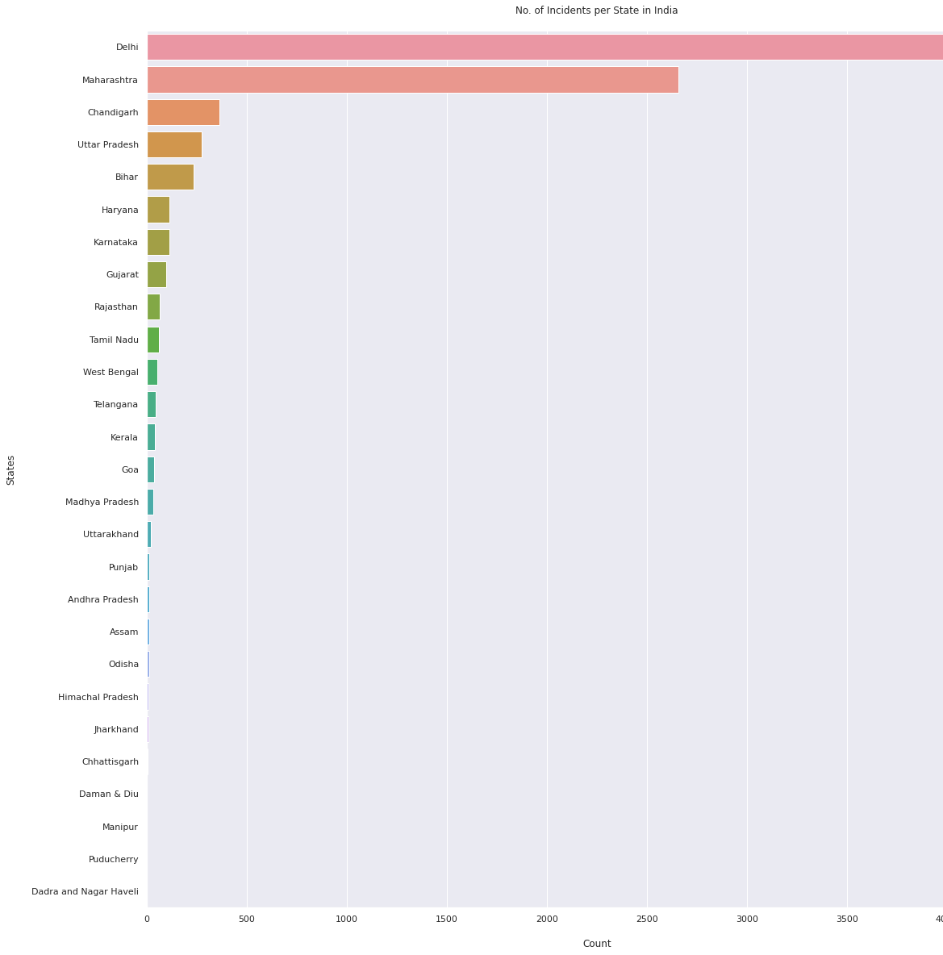
Incidental Hours Analysis
Indian Incident State Analysis

Slide 7
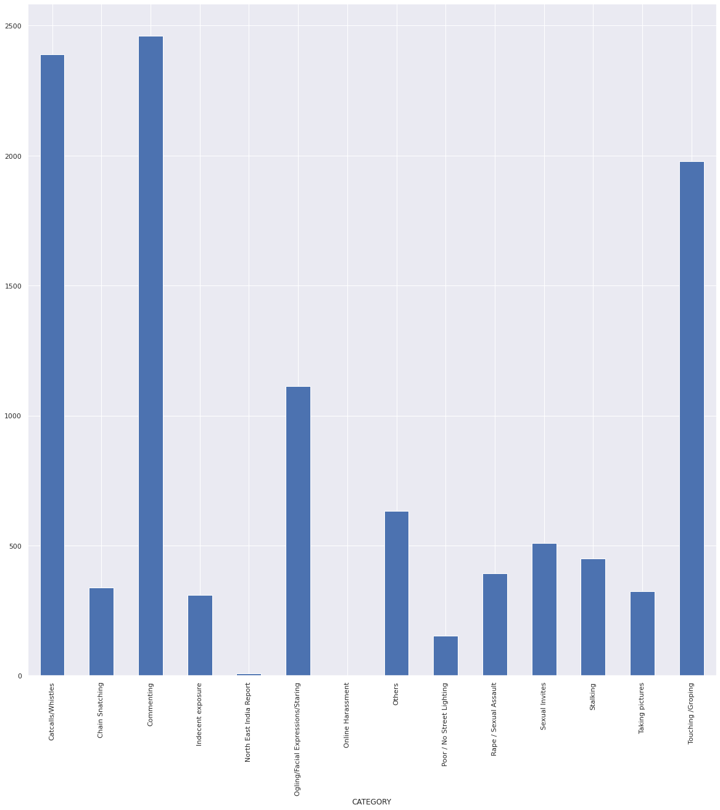
Category Wise Counts

Slide 8
Initial Results
The initial results which we got from our experiments with algorithms is that, Linear SVC, Logisitc Regression both had nearby 50% accuracy.
Also we plotted confusion matrix using heatmap for actual and predicted labels to know in which category the values are mostly misclassified.

Slide 9
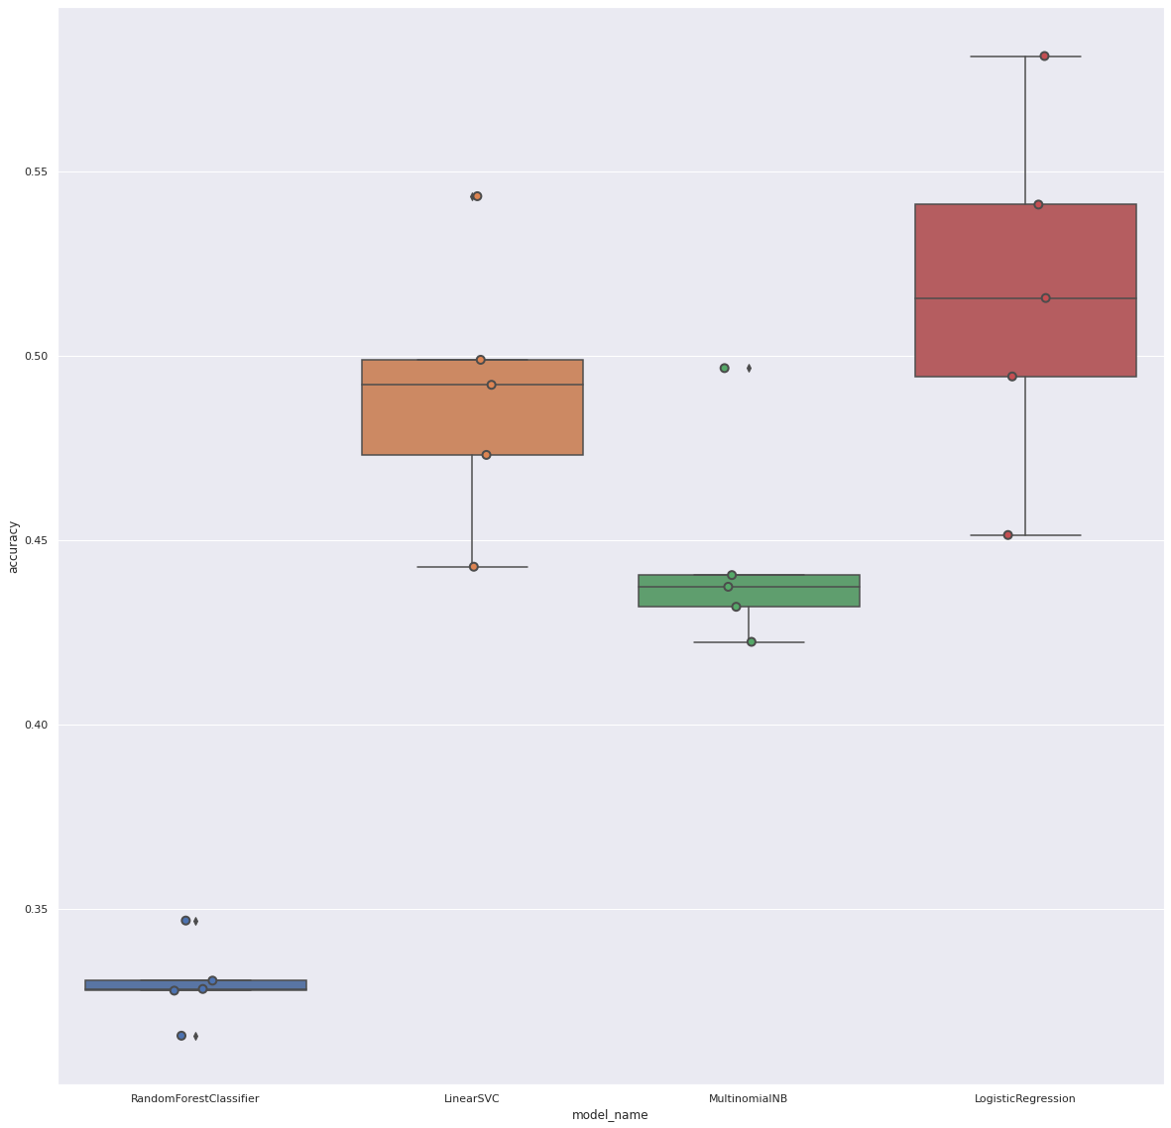
Box Plot Classification Algorithms
Model Name | Accuracy
LinearSVC | 0.490005
LogisticRegression | 0.516689
MultinomialNB | 0.445771
RFC | 0.329896

Slide 10
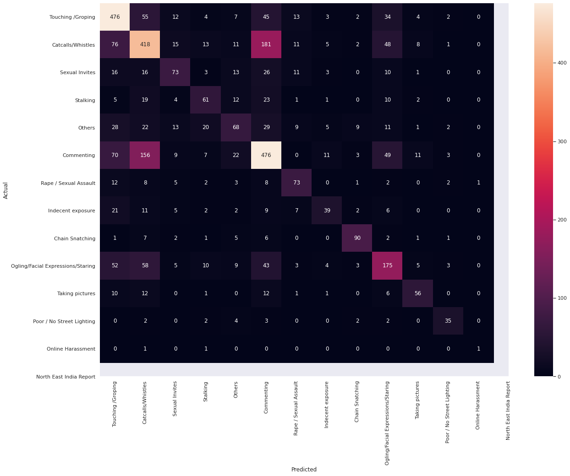
Confusion Matrix(Heat Map) of Actual and Predicted labels of different categories

Slide 11
Role of each group member in the project
Vyoma - Definition Selection, Data Collection and Preprocessing, Idea to view as classification problem. Building model
Bhavin – Exploaratory Data Analysis
Preyanshu - For some statistical tests and percentages according to dataset
Prasham – Cleaning Dataset

Slide 12
Future Works
Based on the results, we will still figure out and retrain the model for predicting more accurate results, minimizing error ratio.
Also, yet to explore about hyper parameter tuning.

Slide 13
References
https://medium.com/omdena/is-this-place-safe-274fc31c02c6
https://www.analyticsinsight.net/top-10-ai-technologies-mitigate-rape-sexual-assault/
https://journals.sagepub.com/doi/abs/10.1177/009102601104000104?journalCode=ppmd
https://analyticsindiamag.com/ai-to-combat-sexual-harassment-with-chatbots-apps-trained-algorithms/
https://www.globaltechoutlook.com/how-artificial-intelligence-helps-fight-sexual-harassment/
https://dalspace.library.dal.ca/bitstream/handle/10222/76331/sharifirad-sima-PhD-CSCI-Aug-2019.pdf?sequence=5&isAllowed=y
https://safecity.in/about/
https://github.com/LaverdeS/NLP_Sexual_Harassment_Testimonies/tree/master/category_classifier/datasets
https://maps.safecity.in/reports#

