Slide 1
Project_Name: Music Store Data Analysis
Task:
Solve given 11 business questions for Music Store so that business can make Informed Decisions about potential opportunities.
Tool Used: PostgreSQL
Analyst_Name: Bhavin Solanki
Position: Data Analyst

Slide 2
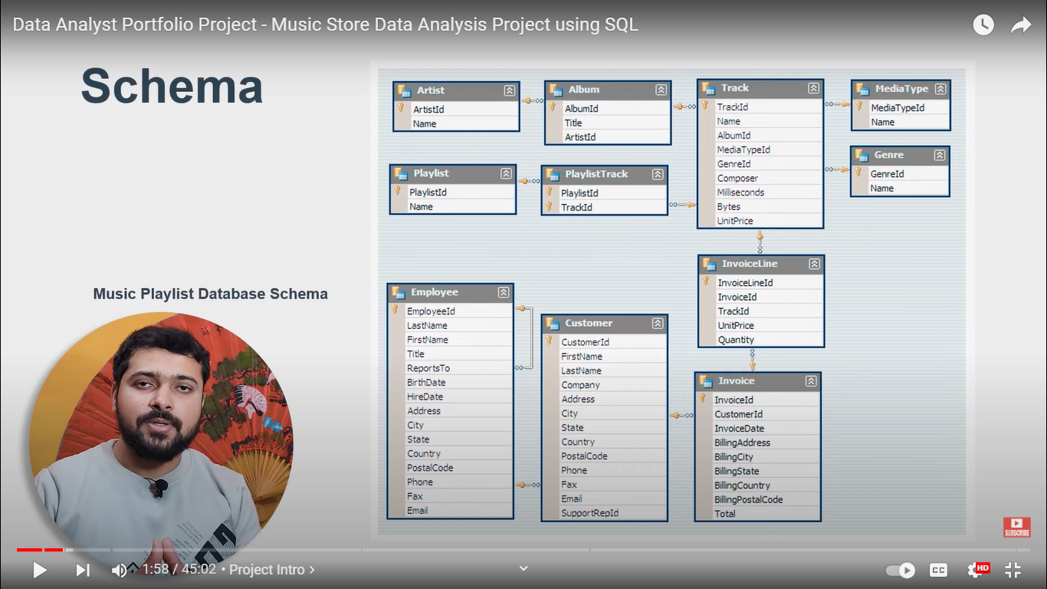
Data Model | Table Relations*
This shows 11 data Tables and how they are related to one another.
*for tech-team reference only

Slide 3
Let’s now jump to our Analysis and Findings

Slide 4
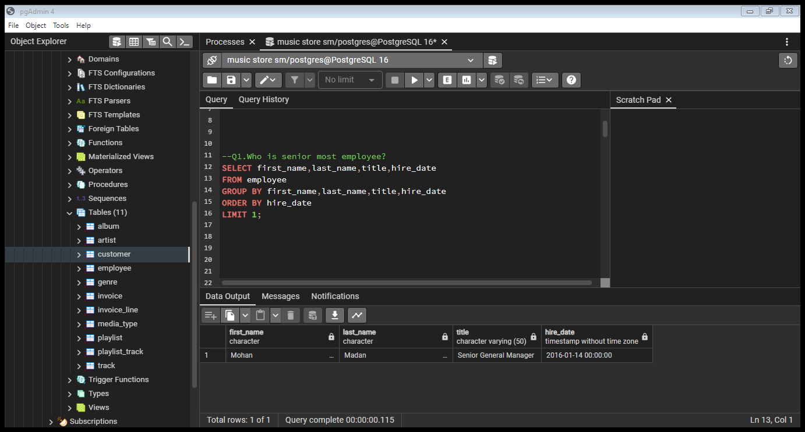
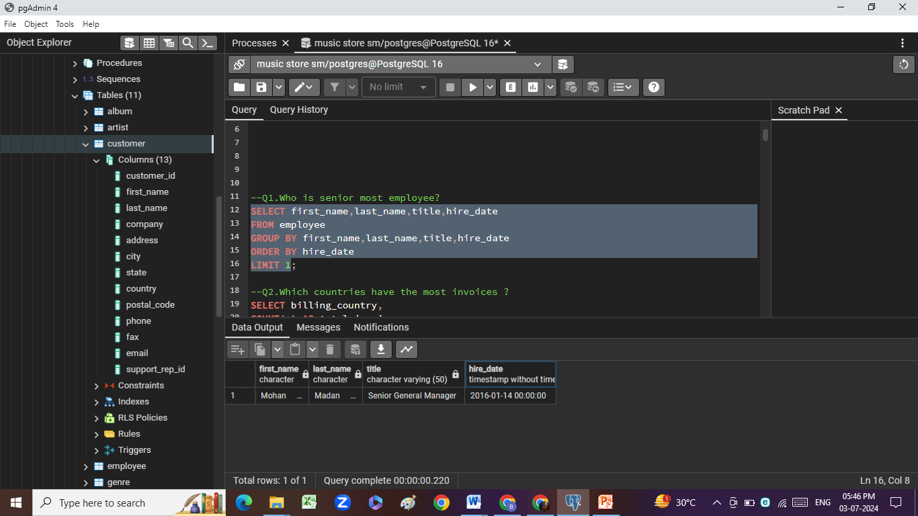
Question Set 1 - Easy
1. Who is the senior most employee based on job title?

Slide 5
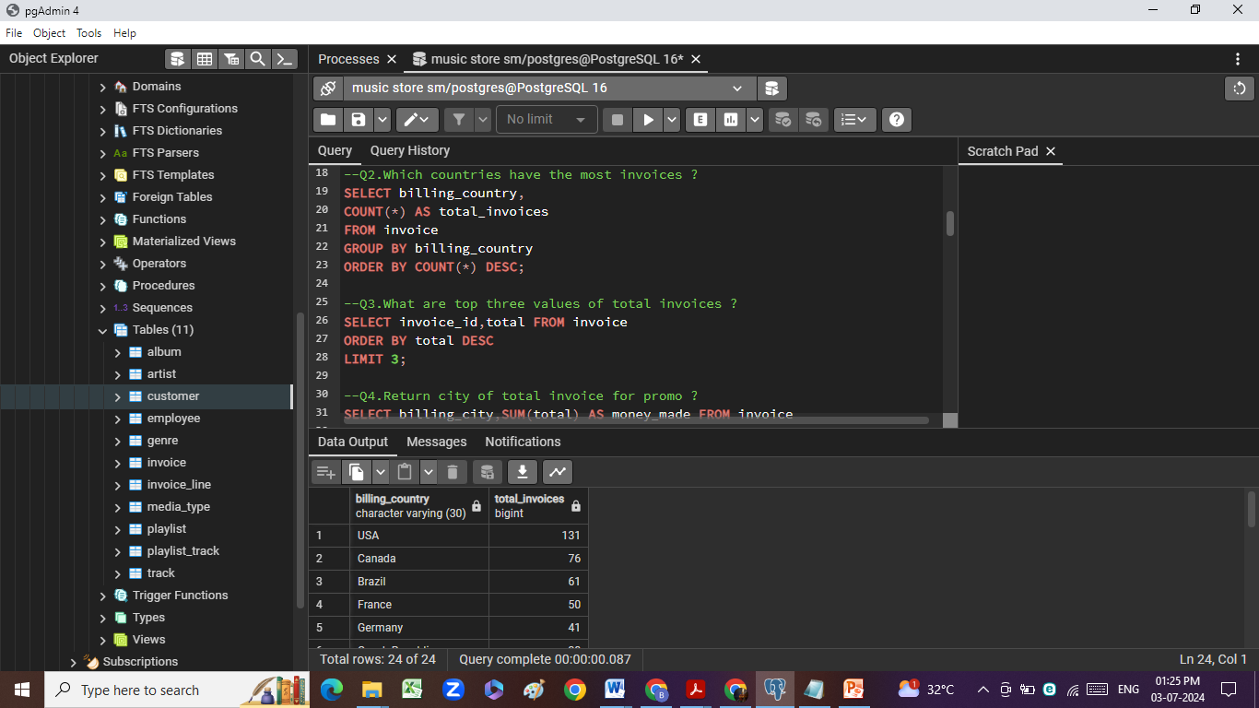
2. Which countries have the most Invoices?

Slide 6
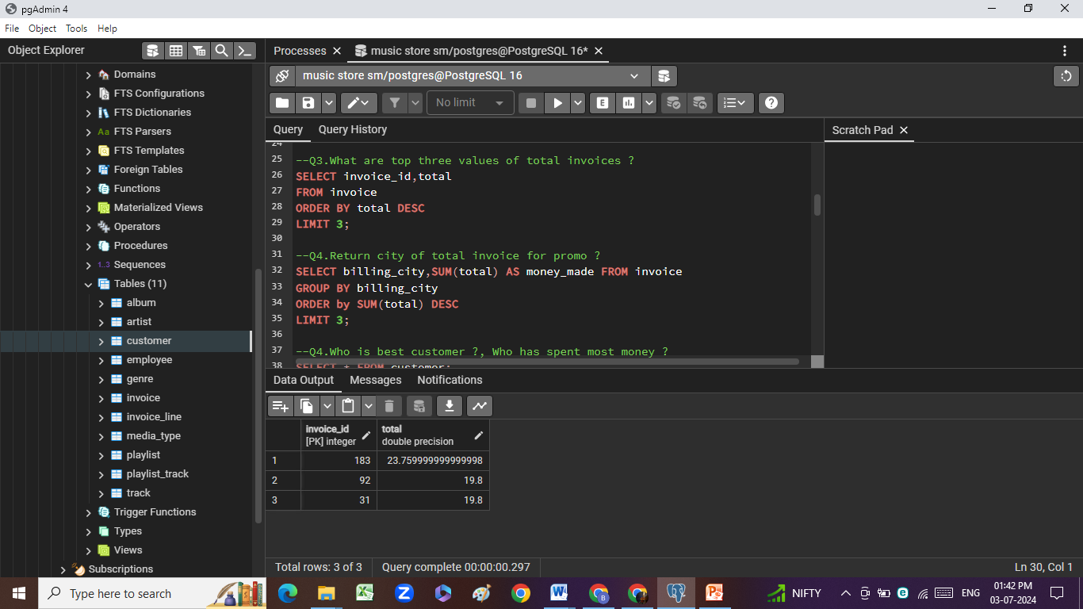
3. What are top 3 values of total invoice?

Slide 7
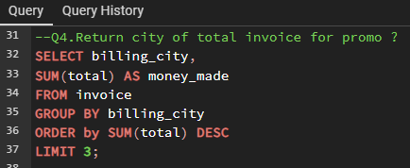
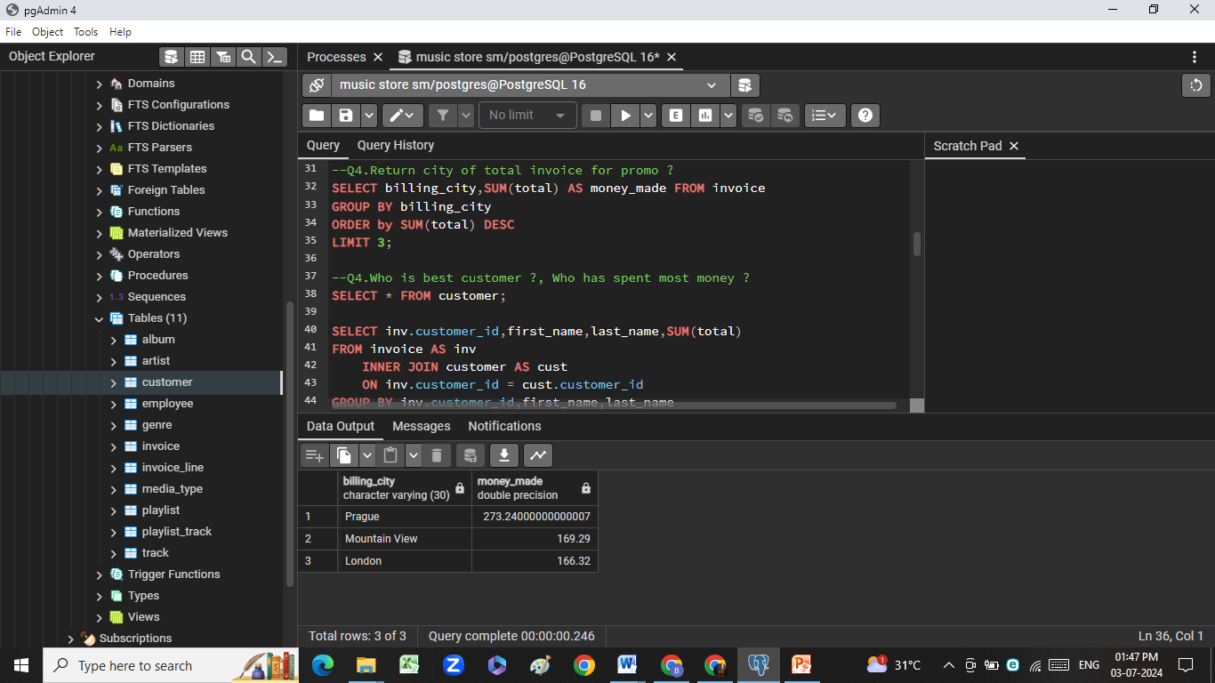
4. Which city has the best customers?
We would like to throw a promotional Music Festival in the city we made the most money. Write a query that returns THREE city that has the highest sum of invoice totals. Return both the city name & sum of all invoice totals.

Slide 8
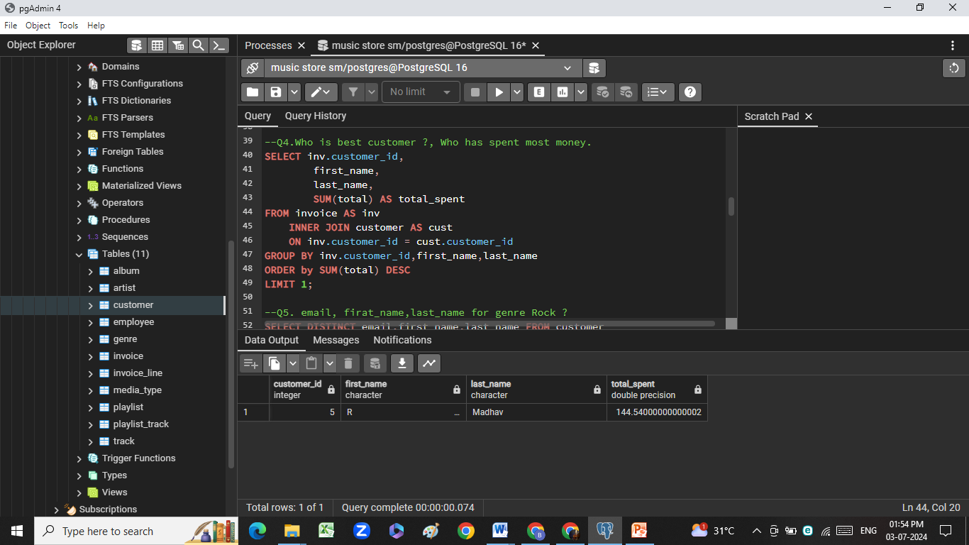
5. Who is the best customer?
The customer who has spent the most money will be declared the best customer. Write a query that returns the person who has spent the most money

Slide 9
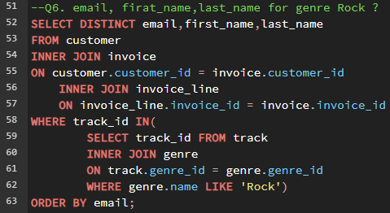
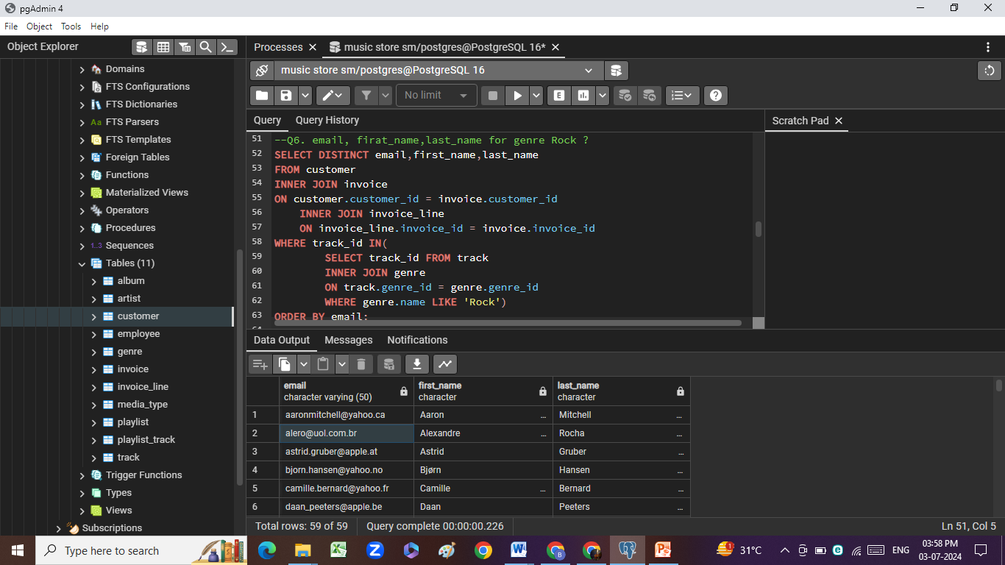
Question Set 2 – Moderate
1. Write query to return the email, first name, last name of all Rock Music listeners. Return your list ordered alphabetically by email starting with A

Slide 10
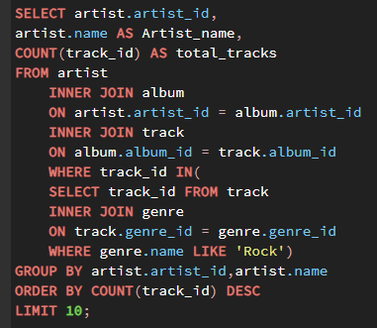
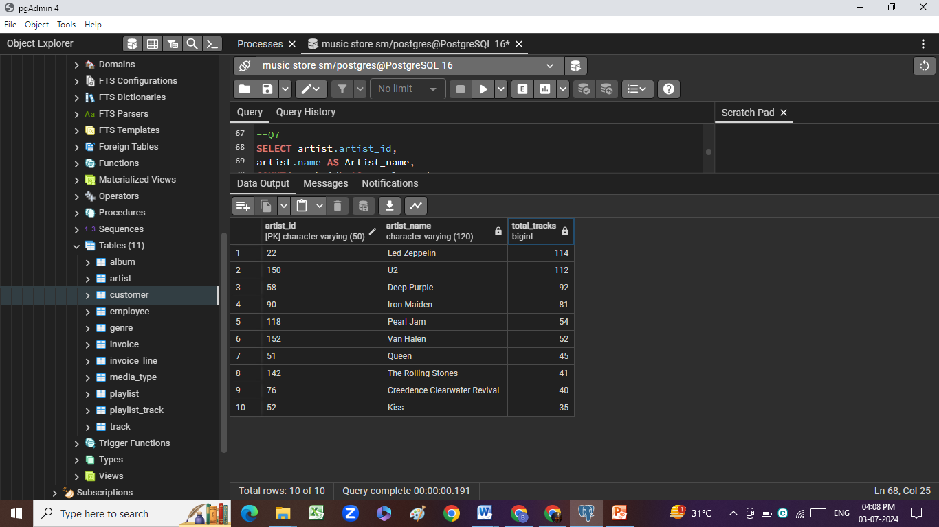
2. Let's invite the artists who have written the most rock music in our dataset. Write a query that returns the Artist name and total track count of the top 10 rock bands

Slide 11
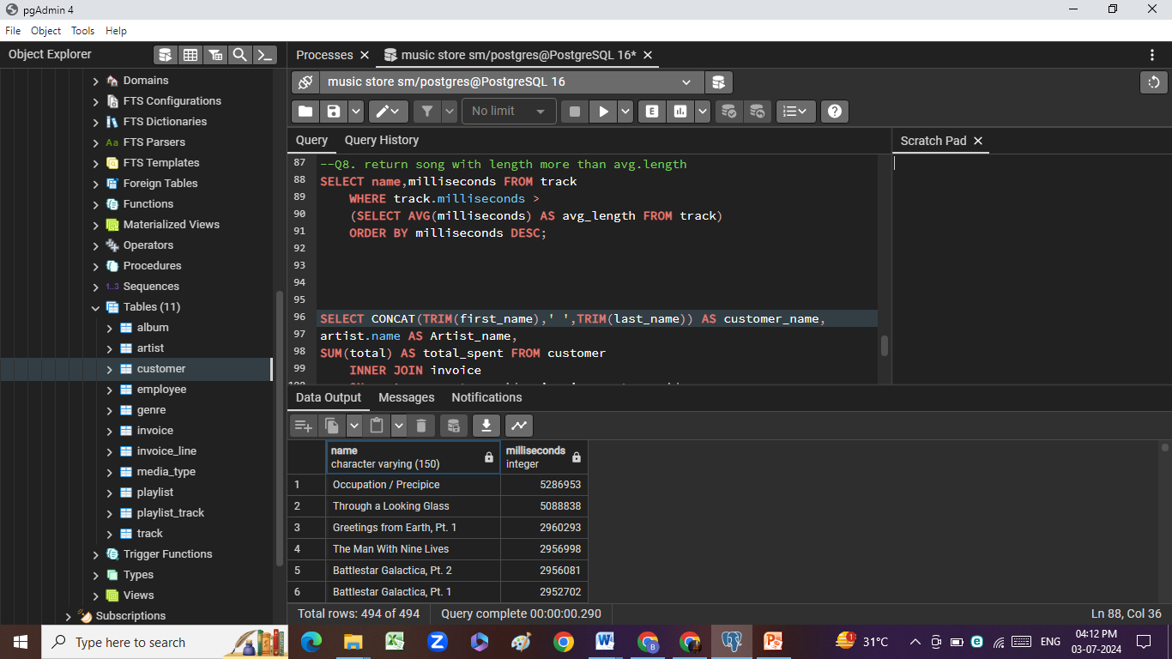
3. Return all the track names that have a song length longer than the average song length. Return the Name and Milliseconds for each track. Order by the song length with the longest songs listed first

Slide 12
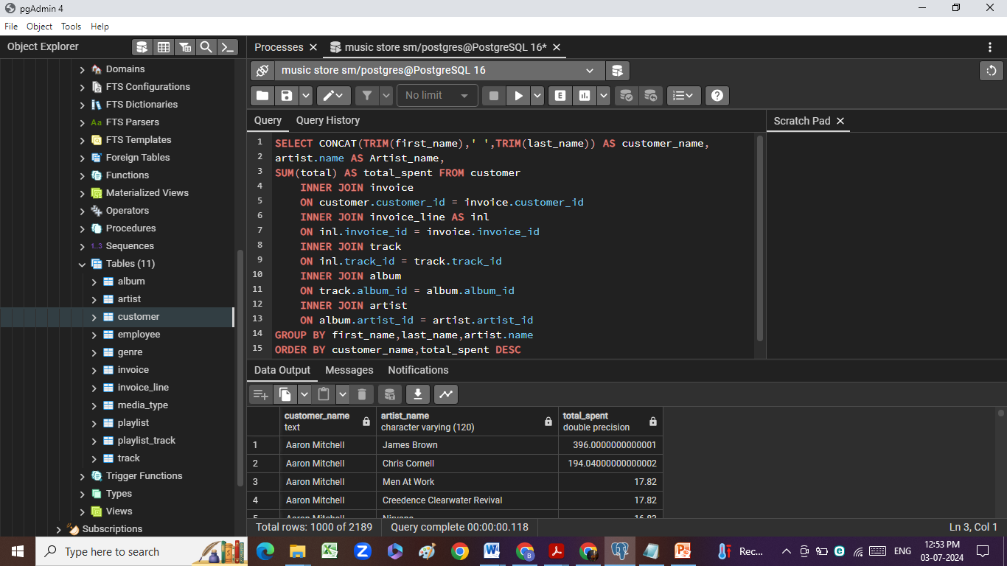
Question Set 3 – Advance
Find how much amount spent by each customer on artists?
Write a query to return customer name, artist name and total spent

Slide 13
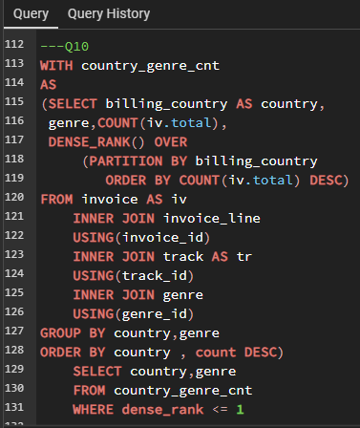
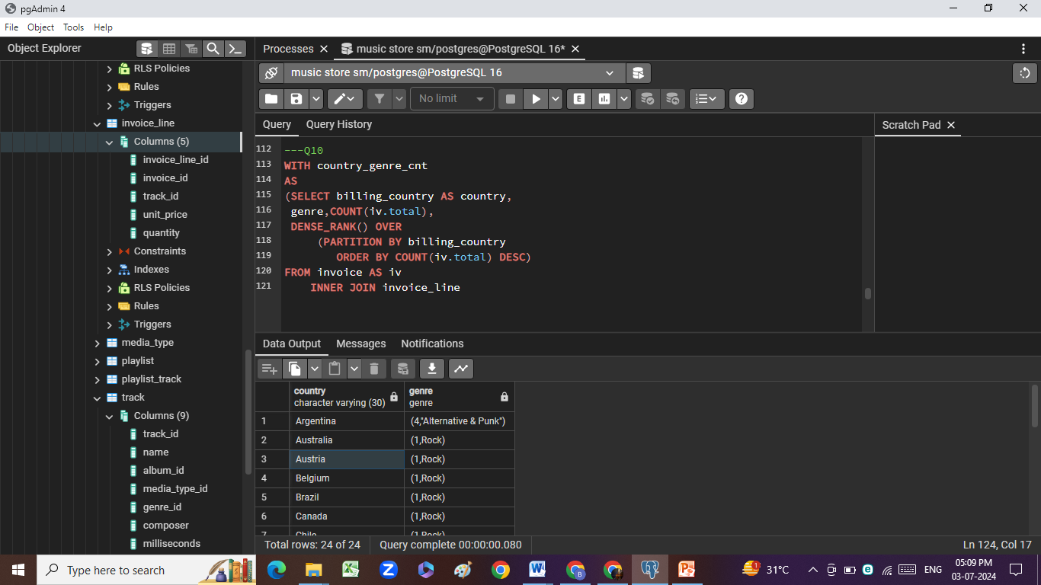
2. We want to find out the most popular music Genre for each country. We determine the most popular genre as the genre with the highest amount of purchases. Write a query that returns each country along with the top Genre. For countries where the maximum number of purchases is shared return all Genres.

Slide 14
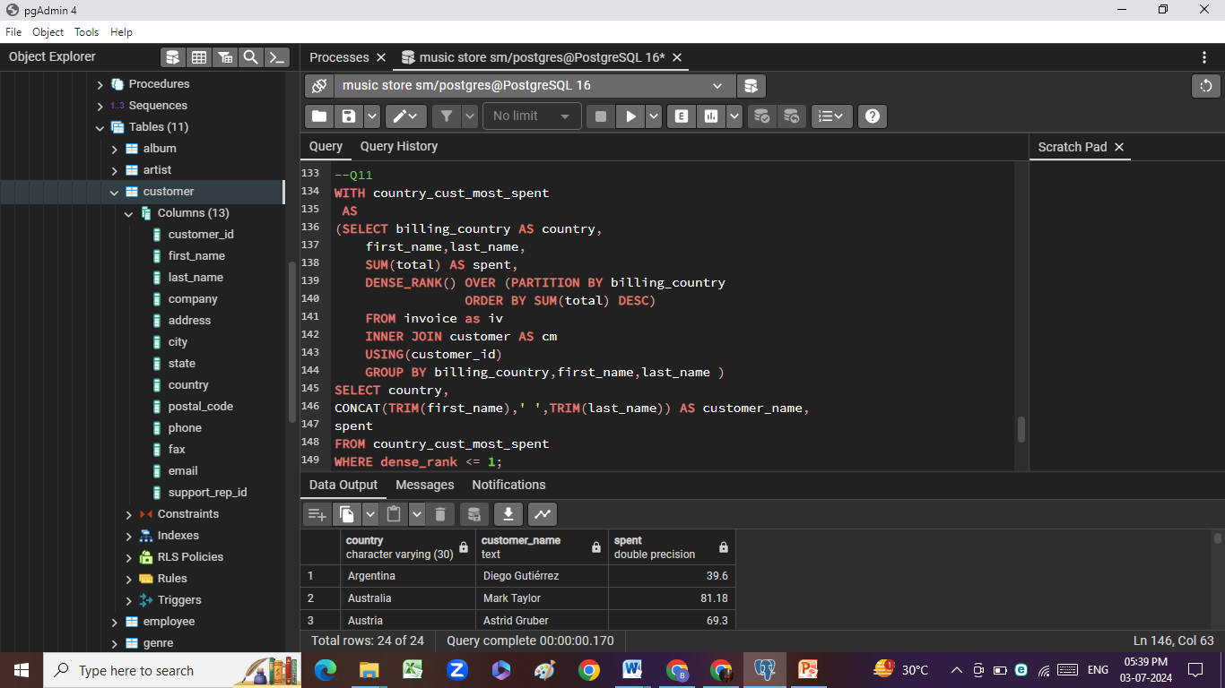
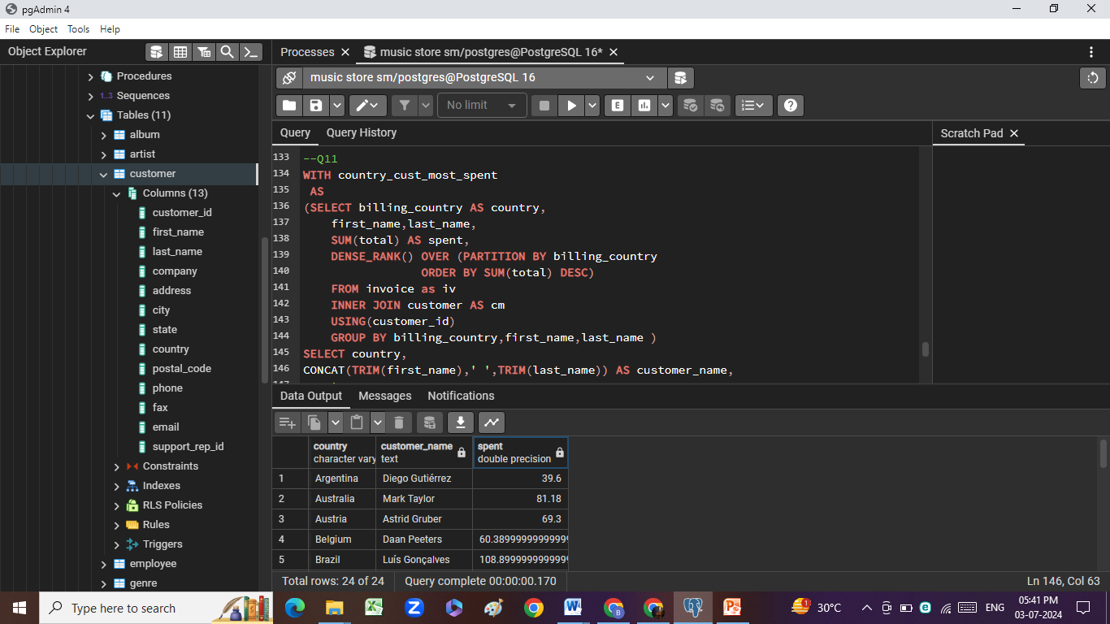
3. Write a query that determines the customer that has spent the most on music for each country. Write a query that returns the country along with the top customer and how much they spent. For countries where the top amount spent is shared, provide all customers who spent this amount

Slide 15
Key Insights:
1. USA, Canada and Brazil are Top purchasing countries with
131, 76 and 61 total purchases, respectively.
2. Most money making city is Prague
3. R Madhav is our best customer with $ 144.54 purchase.
4. With 114 tracks written by Led Zeppelin, He is a Top Rock Artist.
5. 494 tracks have length greater than Average length.
6. Rock is most popular Genre across countries*, Accept for Argentina
Where title goes to Alternative & Punk.
7. Finally we have list of top customers from each country.
To be rewarded with Gold Customer status.

Slide 16
We have solved all business questions successfully.
Coming up next is what all functions
I have utilized for this analysis…

Slide 17
PostgreSQL Functions used:
Nature of question:
Here we have dealt with 11 questions in total. Out of which 5 being easy, 3 as moderate and rest 3 as Hard.
List of functions used.
Easy Moderate Hard
Aggregates
GROUP BY
ORDER BY
JOINs
LIMIT
Multiple JOINs
Sub-Query
Window functions
CTE
Sub-Query
Multiple JOINs

Slide 18
THANK YOU
Thanks for giving me this opportunity to contribute in this project.
I hope I have added value to your business strategy, decision making with this analysis.
Special thanks to Rishabh Mishra for his apt guidance.

