Slide 1
PROJECT REPORT · PROJECT VI (BIT356CO)
Dungeon Explorer
Alisha Shahi (360801)
Bhavishek Lama (360805)
Riya Phuyal (360828)
Notes:
Good morning. We are presenting Dungeon Explorer, our final-year project.
The one-line version: a 2D dungeon action game where the dungeon is not a fixed map. It is generated, validated and personalised every single time you play it, by an AI pipeline we wrote entirely from scratch in Python's standard library. The only third-party library in the entire project is Pygame, and that is used only for drawing windows and sprites.
I will cover the problem, the game itself, the architecture, then spend most of the time on the AI pipeline, which is the heart of the project, and finish with testing and results.

Slide 2
The Problem
Why hand-made maps run out of fun
▪ Repetitive gameplay — once a player memorises a fixed level, replaying it adds nothing.
▪ Expensive to scale — large hand-authored worlds need an artist or designer for every room.
▪ Random ≠ good — filling a grid with random tiles gives unreachable pockets and single-tile noise.
▪ No playability guarantee — nothing verifies the player can actually reach the exit.
▪ Fixed difficulty — the same challenge for a first-timer and a hundredth-time player.
▪ Behaviour is discarded — play data is thrown away, so nothing is ever learned.
All figures on these slides are measured from the running system, not estimated.
3 / 21
Notes:
Let me frame the problem.
Most 2D dungeon games use fixed, hand-made maps. That has two problems. It is repetitive - you memorise the level and then there is nothing left. And it is expensive, because every new room needs a human.
The obvious alternative, just filling a grid with random numbers, is worse. You get maps full of pockets you can never reach and single tiles of wall floating in the middle of open space.
On the right are the three numbers I want you to hold on to. We measured 100% reachable on every level we generated - 30 out of 30, zero orphaned tiles. And we used zero third-party AI libraries. Everything is hand-written.

Slide 3
Dungeon Explorer
What the player actually does
Features
▪ Create a local explorer profile
▪ Start a game: a brand new 81 × 81 dungeon is generated on the spot
▪ Explore with WASD, sprint with Shift, fight with the mouse
▪ Collect keys, potions, and treasure chests locked behind their own keys
▪ Find the Door Key — dropped by the Guardian monster — carry it to the locked door and escape
▪ Earn experience, level up, and watch the next level adapt to how you are actually playing
Procedural generation
GA + CA + BFS, new layout every level
Guaranteed connectivity
Orphaned regions are carved back in
Finite State Machine AI
3 monster types, 4 states, A* navigation
Environmental hazards
Lava, traps and water hurt monsters too
Fog of war
5-tile radius, removable with a Light item
Sprint + stamina
1.8× speed, 16 stamina per second
Run rollback
Dying costs the level, never your inventory
Local JSON profile
Level, kills, item usage, last five runs
4 / 21
Notes:
So what is the actual game?
You create a profile, pick one of four classes, and press Start. At that moment a completely new 81 by 81 dungeon is built. You explore with WASD, hold Shift to sprint, and you shoot with the mouse - the angle to the cursor is split into eight sectors, so the character visibly aims where you point.
The objective is the Door Key. It is guarded by monster three, the Guardian, and when you kill it the key drops where it died. You take it to the door and the level completes.
The row on the right is the part that matters for this talk. Notice the last one - a local JSON profile that records your kills, your item usage and your last five runs. Remember that, because it is what makes the difficulty adapt later.

Slide 4
Dungeon Explorer
Features
map-generation systems
  genetic algorithm
  cellular automata
  BFS connectivity checks
  A* pathfinding
  decision-tree
Combat and controls
  WASD / arrow-key movement
  Sprinting with Shift
  Mouse aiming with projectile attacks
Inventory and item effects
  Item pickup and use system
  Consumables and stat-affecting equipment or active effects
Pixel art and Design
  All the tiles used are hand drawn (32x32)
  tile based game design
4 / 21
Notes:
So what is the actual game?
You create a profile, pick one of four classes, and press Start. At that moment a completely new 81 by 81 dungeon is built. You explore with WASD, hold Shift to sprint, and you shoot with the mouse - the angle to the cursor is split into eight sectors, so the character visibly aims where you point.
The objective is the Door Key. It is guarded by monster three, the Guardian, and when you kill it the key drops where it died. You take it to the door and the level completes.
The row on the right is the part that matters for this talk. Notice the last one - a local JSON profile that records your kills, your item usage and your last five runs. Remember that, because it is what makes the difficulty adapt later.

Slide 5
Dungeon Explorer
Features
Fog of war
  5-tile radius, removable with a Light item
Local JSON profile
  Level, kills, item usage, last five runs
Run rollback
  Dying costs the earned experience
Environmental hazards
  Lava, traps and water hurt monsters too
4 / 21
Notes:
So what is the actual game?
You create a profile, pick one of four classes, and press Start. At that moment a completely new 81 by 81 dungeon is built. You explore with WASD, hold Shift to sprint, and you shoot with the mouse - the angle to the cursor is split into eight sectors, so the character visibly aims where you point.
The objective is the Door Key. It is guarded by monster three, the Guardian, and when you kill it the key drops where it died. You take it to the door and the level completes.
The row on the right is the part that matters for this talk. Notice the last one - a local JSON profile that records your kills, your item usage and your last five runs. Remember that, because it is what makes the difficulty adapt later.

Slide 6
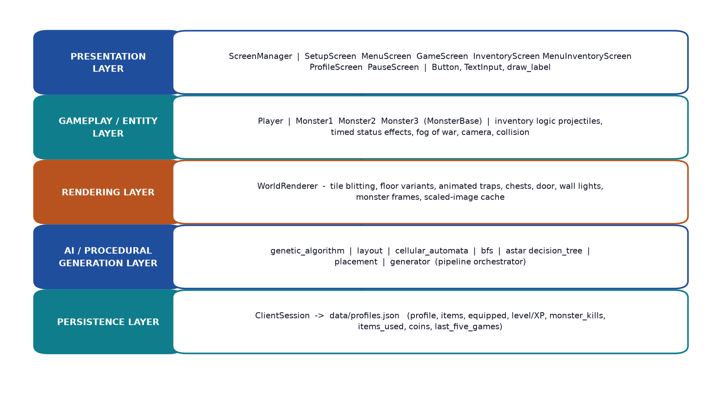
System Architecture
Five layers, one direction of dependency
▪ The AI layer has no upward dependency. Nothing in shared/mapgen imports from src/client. The client imports from mapgen, never the reverse.
▪ That is why we could test the generator headlessly. It returns plain data and draws nothing, so the whole pipeline runs in a terminal with no display attached — which is what made the 30-level validation possible.
A single shared game_state dictionary is the only channel between screens — no screen holds a reference to another.
5 / 21
Notes:
The architecture is four layers.
Presentation, gameplay and entities, rendering, the AI generation layer, and persistence underneath.
The design decision I want to highlight is on the right. The dependency arrow points in one direction only - the AI layer never imports anything from the client. That single constraint is why we were able to run statistical validation of the generator in a terminal with no display, and it is the reason we could produce hard numbers like the 30 out of 30 result.

Slide 7
The AI Pipeline
This is the core of the project
Eight stages. Each one reduces the problem rather than trying to solve it outright.
1
Genetic
Algorithm
8 random grids, then evolve over 4 generations
2
Layout
Carving
3×3 sectors, random walk, corridors, traps
3
Cellular
Automata
3×3 rule smooths it into cave structure
4
BFS
Flood Fill
measure what is actually reachable
5
BFS
Repair
carve corridors into every orphan
6
Decision
Tree
score each candidate against the player
7
Best
Candidate
elitism keeps the best ever seen
8
Entity
Placement
keys, door, chests, monsters — A*-gated
Every stage is a separate function with one clear contract — so any stage can be tested, measured and replaced independently of the game loop.
Input: a 64-bit random seed + the player's profile → Output: a complete, validated, personalised GeneratedWorld
Stages 1, 4, 5 and 6 (highlighted) are the techniques from the Literature Review that we implemented.
7 / 21
Notes:
Now the part we are actually here to present.
The pipeline is eight stages. The design principle is that each stage reduces the problem rather than trying to solve it outright. Carving does not guarantee connectivity, so a separate stage verifies it. Smoothing does not guarantee the layout is interesting, so a separate stage scores it.
The four highlighted stages are the ones drawn from the literature review. Let me take them one at a time.

Slide 8
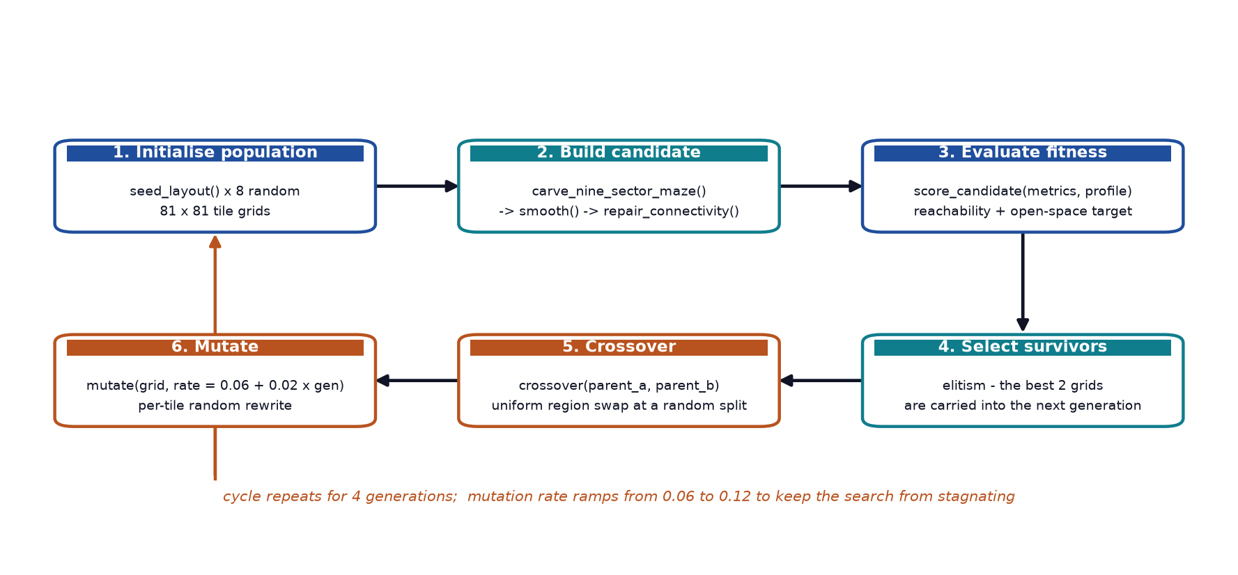
1. Genetic Algorithm
Evolving good layouts out of noise
▪ A chromosome is one whole 81 × 81 tile grid.
▪ Seeding — 8 grids filled from a categorical distribution: 18% wall, 34% floor, 10% water, 13% trap, plus scrolls and keys.
▪ Elitism — the best 2 grids pass into the next generation unchanged, so fitness can never regress.
▪ Crossover — two-point region swap at a random split row and column, so children inherit large contiguous regions of both parents.
▪ Mutation — rate ramps 0.06 → 0.12. Exploit early, explore late. A fixed low rate made the population collapse onto one layout.
Measured fitness progression (level-5 profile, seed 12345)
Gen
Best
Mean
open_ratio
Reachable
0
7.252
7.204
0.341
1.000
1
7.288
7.231
0.355
1.000
2
7.310
7.224
0.364
1.000
3
7.264
7.214
0.346
1.000
8 / 21
Notes:
Stage one, the Genetic Algorithm.
The key idea is that a chromosome is not an individual tile - it is a whole 81 by 81 grid. So one gene is one complete candidate dungeon, and one generation produces eight candidate dungeons.
Four things are worth calling out. We use elitism, so the best two survive untouched and fitness can never go backwards. We use two-point region crossover rather than uniform crossover, because swapping large contiguous blocks preserves each parent's flood-fill character instead of producing a noisy patchwork.
And the mutation rate ramps from 0.06 to 0.12. That was a fix, not a design choice - with a fixed low rate the population kept collapsing onto the same layout, so we made it explore more in later generations.
You can see the effect in the table. Best fitness climbs 7.252, 7.288, 7.310, then dips slightly in generation three. That dip is expected - it is the higher mutation rate trading individual strength for diversity. And because elitism keeps the best ever seen, the final map is the best of everything we evaluated, not the last thing produced. Notice the last column never leaves 1.000.

Slide 9
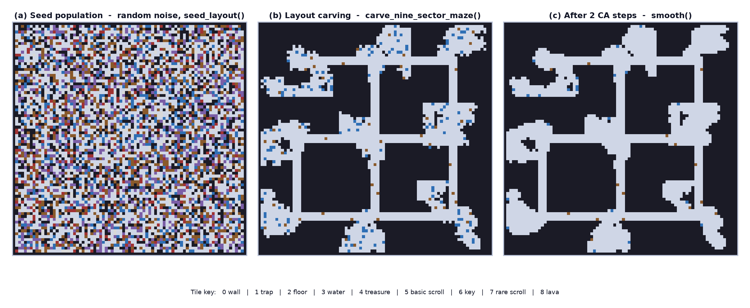
3. Cellular Automata
Turning noise into cave
▪ The rule, applied to every cell over a 3 × 3 neighbourhood:
▪ 5 or more wall neighbours → becomes wall (kills isolated pillars and thin spurs)
▪ water with ≤ 2 wall neighbours → floor (water hugs the open areas)
▪ trap with ≤ 1 wall neighbour → floor (traps survive only where they matter)
▪ Synchronous update
▪ Reads only from the current grid, writes to a separate next grid — exactly like Conway's Game of Life.
▪ In-place would be faster but wrong
▪ An in-place version would give results that depend on scan order, which breaks reproducibility from a seed.
▪ Steps ramp with generation
▪ 1 + generation // 2, so later candidates get cleaned harder — biasing the population toward cleaner layouts.
9 / 21
Notes:
Stage three, cellular automata. This one is short but it is what makes the map look organic.
We use a 3 by 3 neighbourhood and three rules. Five or more wall neighbours and you become wall - that removes the single-tile pillars that random noise always produces. Water near open space becomes floor, and traps in open areas survive because they are only meaningful out in the open.
One implementation detail that took us a second attempt: the update has to be synchronous. It reads from the current grid and writes to a separate next grid, exactly like Conway's Game of Life. My first version updated in place, which is faster but means the result depends on the order you scan the cells in - so the same seed would not give you the same map. That broke reproducibility, which we wanted, so we fixed it.
Look at the picture. Panel (a) is the genetic noise. Panel (b) is after carving - that is the single biggest transformation in the whole pipeline. Panel (c) is after two smoothing steps, where you can see the water and trap tiles being absorbed into the floor.

Slide 10
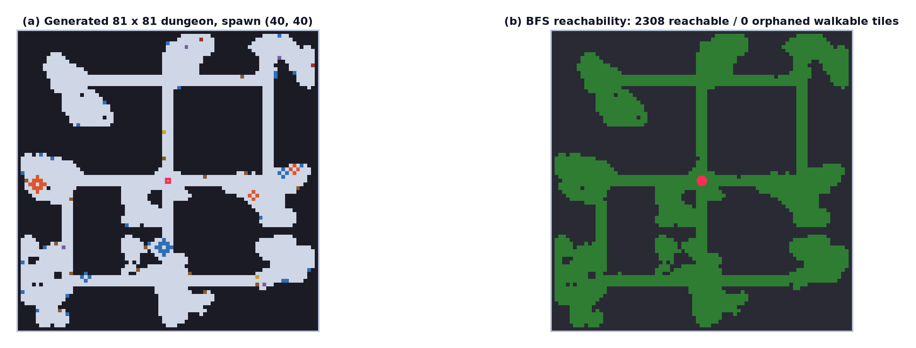
4 & 5. Breadth-First Search
The guarantee that makes it a game
▪ Flood-fill from the spawn using collections.deque. Cost is linear in walkable tiles.
▪ Repair, not just detect — for each orphan, carve a Manhattan path to the nearest reachable tile, then recompute. Commercial games detect and log this; we fix it.
▪ A distance map falls out of the same traversal, which is what makes “furthest from spawn” cheap during placement.
1.0000
reachable_ratio across 30 generated levels
0 orphaned walkable tiles
10 / 21
Notes:
This is the slide I would defend the project on.
Smoothing and carving guarantee neither that the map is connected nor that the player can reach the exit. So we flood-fill from the spawn with BFS, using collections.deque as the queue, and we get two things for free: how much of the map is reachable, and a distance map that tells us how far everything is.
Then we do the part the commercial games do not. Terraria and Minecraft both check connectivity and log a warning. We repair it - for every orphaned tile, we carve a corridor to the nearest reachable one and recompute. Because we process orphans in order of increasing distance from the spawn, a single carve usually reconnects several at once, so it converges in a couple of passes.
The measured result: reachable ratio of exactly 1.0000 on all 30 levels we validated. Zero orphaned tiles. That is what turns an interesting experiment into a playable game.

Slide 11
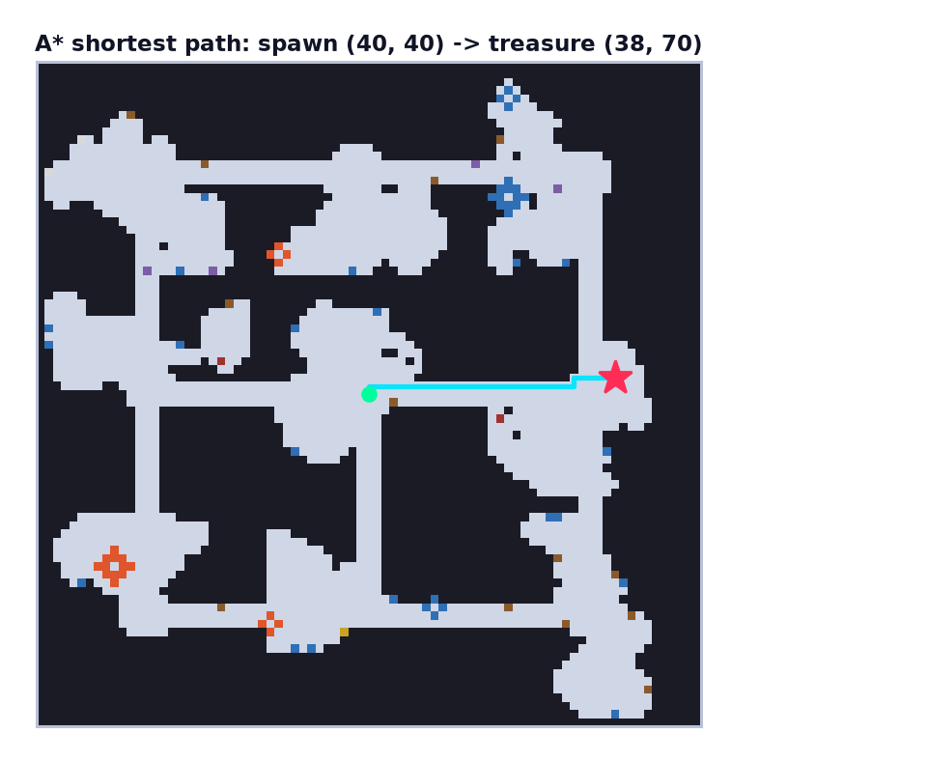
6. A* Pathfinding
Two roles, two different questions
▪ f(n) = g(n) + h(n) with h = Manhattan distance, which is admissible on a uniform 4-connected grid — so the path is guaranteed optimal.
▪ A sequence counter in each heap entry keeps ordering total and deterministic, so the same seed gives the same monster path.
Same generated maps, measured
BFS Which tiles are reachable, and how far?
2.1 – 2.7 ms · ~2 350 tiles — Validation, repair, distance map
A* What is the shortest path to this one goal?
0.02 – 0.21 ms · per goal — Monster chase, placement gate
Using BFS where A* was needed, or A* where BFS was needed, would be incorrect — each answers a different question.
11 / 21
Notes:
A* has two jobs in this project, and they are different.
During generation it is a gate. Before we commit a monster to a position we ask: is there a path from the spawn to there? If not, we do not place it. So we never place an entity somewhere it could never reach.
During gameplay it is the monsters' navigation, and that is what makes them look intelligent instead of walking through walls.
The table on the right is the point I want to make. A* and BFS are not alternatives - they answer different questions. A* answers 'what is the shortest path to this one goal', and it does that two to three orders of magnitude faster because the heuristic lets it throw away most of the map without exploring it. BFS answers 'what is the entire reachable region', and you cannot prune that. If you used BFS where A* was needed, or the reverse, you would be wrong. We use each where it belongs.

Slide 12
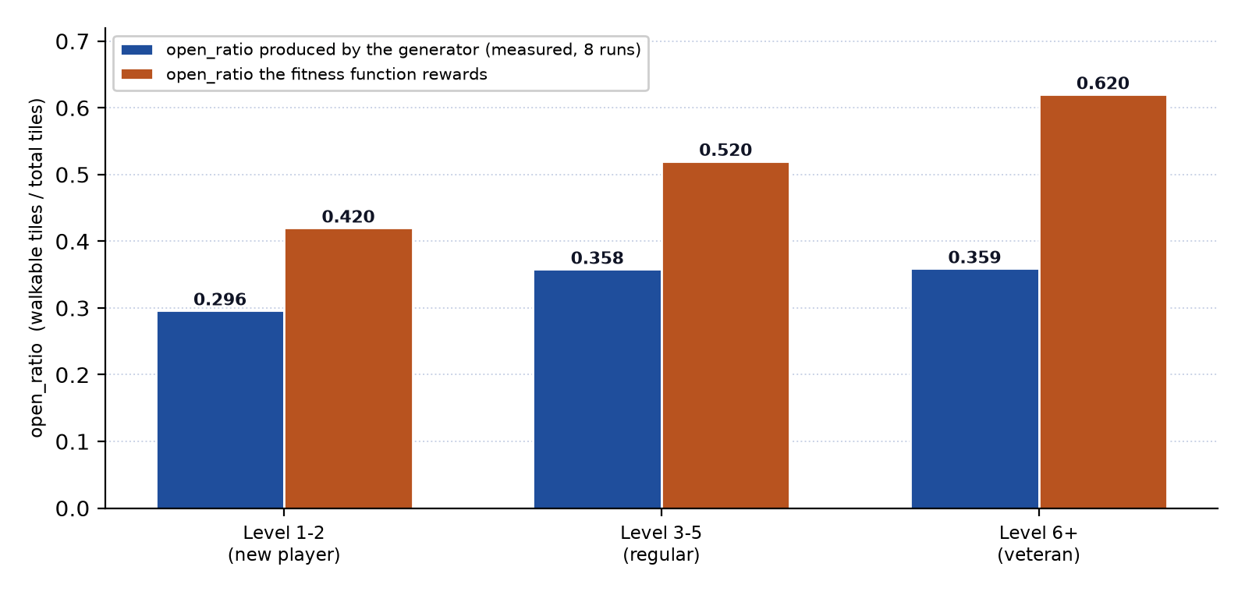
7. Decision Tree — Personalisation
The map's difficulty tracks the player
score_candidate(metrics, profile)
if level <= 2: # new player
return reachable_ratio * 4.5 \
+ (1.0 - abs(open - 0.42)) * 2.0 \
- reachable_count / 1500.0
if level <= 5: # regular
return reachable_ratio * 4.0 \
+ (1.0 - abs(open - 0.52)) * 2.5 \
+ (kill_total + skill_total) / 50.0
return reachable_ratio * 3.5 \
+ (1.0 - abs(open - 0.62)) * 2.5 \
+ reachable_count / 1200.0 \
+ (kill_total + skill_total) / 60.0
A 21% wider dungeon for an experienced player than for a new one — measured, not assumed
▪ reachable_ratio always carries the largest weight (3.5 – 4.5) — a playable map always outranks a well-proportioned but unreachable one.
▪ (1.0 - abs(open - target)) is a plateau — maximal at the target, falling off linearly, so near-misses are never rejected outright.
Level 1–2 target 0.42 → observed 0.296
Level 3–5 target 0.52 → observed 0.358
Level 6+ target 0.62 → observed 0.359 (20 runs each)
12 / 21
Notes:
This is the Decision Tree, and it is where personalisation happens.
It is a decision tree over the single most informative attribute we have - the player's level. Three leaves, three different design intentions.
For a new player, level one or two, we want a small forgiving dungeon. The open-space target is 0.42, the tightest, and there is a penalty proportional to the tile count that actively prefers the smallest map that is still fully connected. Without that penalty the optimiser would just pick the biggest map that hits the target ratio.
For level six and above we flip it: 0.62, and the tile-count term becomes a bonus, so more open space is now a virtue.
Two things make this robust rather than fragile. The reachable ratio always carries the biggest weight, so playability outranks aesthetics. And the open-ratio term is a plateau - maximal at the target, falling off linearly - so a near miss is penalised gently rather than rejected.
And it measurably works. New players get 0.296 open ratio, experienced players get 0.358. That is a 21% wider dungeon, and it is measured over 20 runs each, not assumed.

Slide 13
8. Association Rule Mining
The game learns how you actually play
▪ Each run becomes a transaction: outcome:clear / outcome:loss, performance:high / performance:low, plus one item per object collected.
▪ Two rules, mined over the last five runs
▪ performance:high → outcome:clear confidence 1.00 on a winning streak
▪ performance:low → outcome:loss confidence 1.00 on a losing streak
▪ Then the monster count is adjusted
▪ losing streak ≥ 2 and low_kill_loss ≥ 0.5 → × 1.35 (+0.05 per extra loss, capped × 1.55)
▪ high_kill_clear ≥ 0.5 → × 1.15
▪ otherwise → base limit of 12
▪ Always clamped to 1 – 18, so no history can produce a trivial or impossible level.
Mined rules → next level's monster count
History
Rule
Limit
No history
—
12
3 losses, 3 kills
low_kill_loss 1.00
17
3 clears, 14 kills
high_kill_clear 1.00
14
Mixed results
none ≥ 0.50
12
A level-5 player who dies every time looks identical to a level-5
player who clears easily. The fitness function cannot tell them
apart — the mined rules can.
The Game Engine → Profile Manager → Map Generator flow is the feedback loop: recorded behaviour becomes the next level's difficulty.
13 / 21
Notes:
Level is a good proxy for skill, but it has a blind spot. A level-5 player who dies on every single attempt looks exactly the same to the fitness function as a level-5 player who clears easily. Association rule mining fixes that.
Every completed run is recorded as a transaction - the outcome, a performance band, and the items you picked up. We take the last five and evaluate two candidate rules: high kill count implies a clear, low kill count implies a loss.
Then we combine the rule confidence with a loss-streak count. Lose two in a row with a low-kill-loss rule and we multiply the monster limit by 1.35, plus five percent for each extra loss. Clear consistently and we multiply by 1.15.
The table shows it working: a losing streak gets 17 monsters instead of 12, roughly 30% less simultaneous pressure. A winning streak gets 14. Mixed history falls back to the default of 12.
I want to be honest about the limitation here - five transactions is a small sample, so these confidences are only indicative. That is exactly why we clamp the result to between 1 and 18 and use conservative thresholds. The system can nudge difficulty, but it can never shock the player.

Slide 14
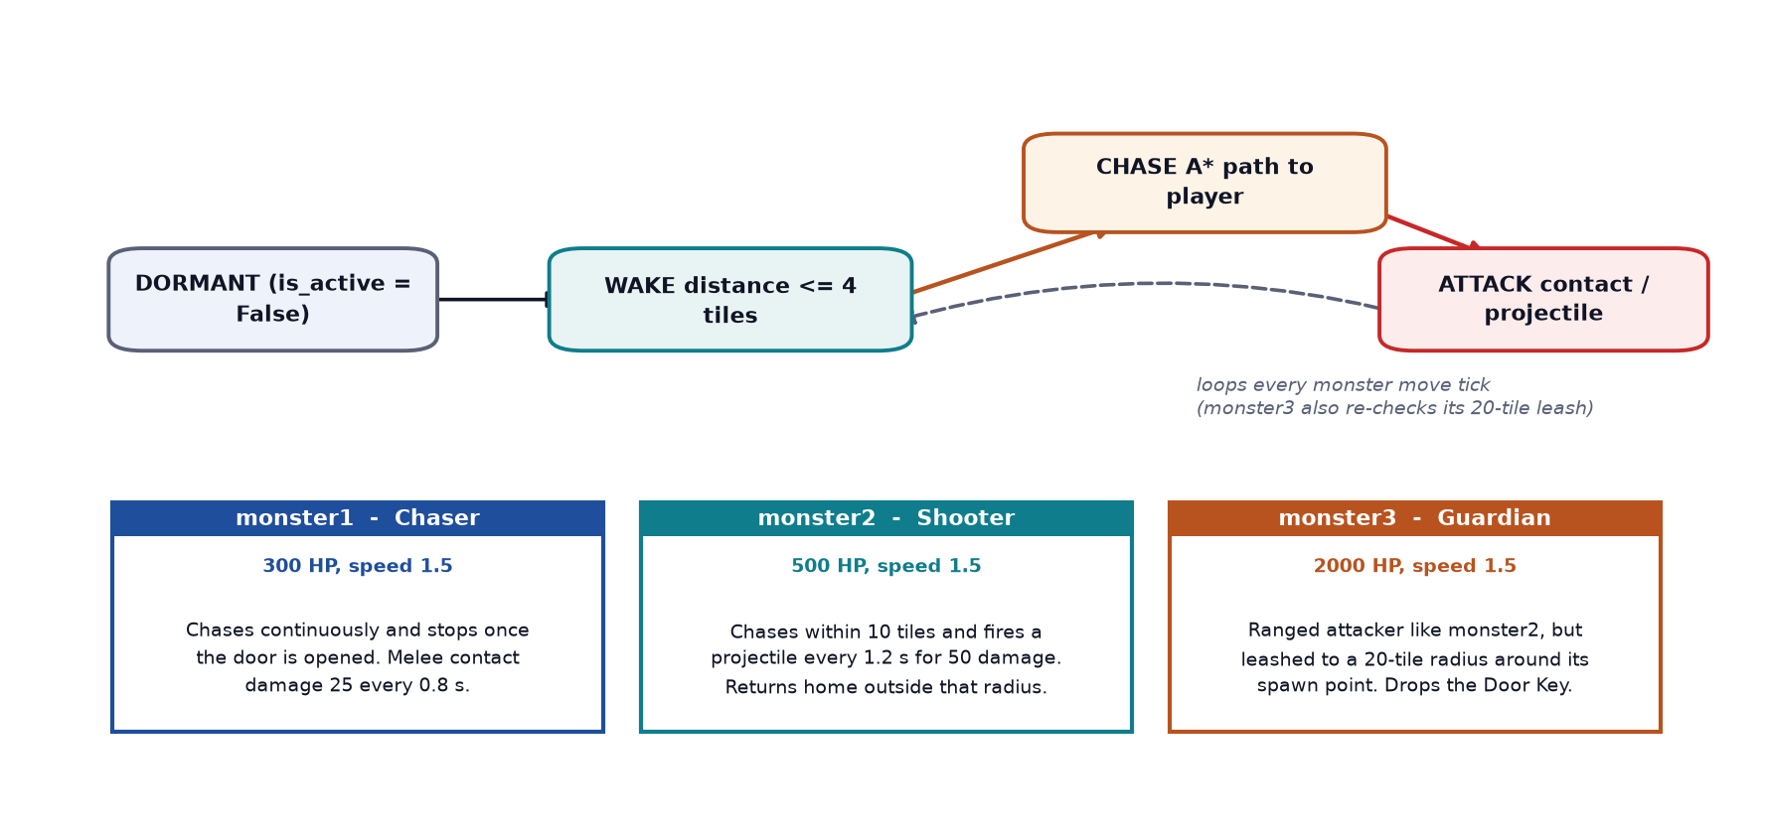
Monster AI
One state machine, three personalities
▪ DORMANT → WAKE → CHASE → ATTACK
▪ A monster does not think at all while dormant — that is what makes exploration safe until you get close.
▪ Chase uses genuine A* paths, on the monster's own movement tick rather than every frame.
▪ monster3's leash is enforced per step, so it can never escape — which also guarantees the Door Key it drops is always reachable.
▪ Environment kills count: a monster that dies in lava goes through the same kill path as one shot by the player, so you still get the XP.
14 / 21
Notes:
The monsters use a finite state machine - four states - combined with A*, tuned per type through parameters rather than separate logic. This follows the F.E.A.R. and Pac-Man pattern from our literature review.
Dormant means the monster does not think at all. It performs no distance calculation and moves not at all. That is what makes exploring safe until you walk into something.
When you get within four tiles it wakes, then it chases using a real A* path, then attacks when in range, then goes back to chasing.
Three design points I would highlight. Monster one stops chasing the moment the door is open - there is no point hunting a player who has already won. Monster three's leash is enforced inside the movement step, before it commits to a tile, so it can never wander off and strand the key you need. And environmental kills are recorded through exactly the same code path as a projectile kill, so if you lure a monster into lava you still get the experience and the kill is still in your statistics. That turned out to be a genuinely useful tactic.

Slide 15
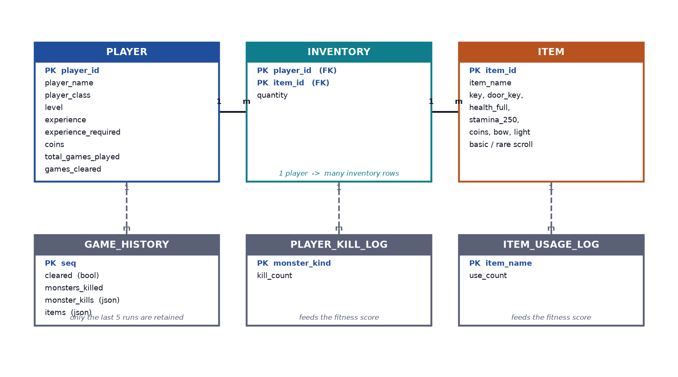
Data & Persistence
One JSON document, no server
▪ Why JSON and not MySQL? The game is single-player and entirely local. A database server would add installation and maintenance for no benefit, and JSON needs no schema migration.
▪ Human-readable for testing — we verified telemetry by reading the file directly rather than trusting the UI.
▪ Run rollback — the profile, items and equipped slots are deep-copied at the start of each level. Death restores that baseline, then re-applies only coins, item usage and the run counters.
▪ Thread safety — every write passes a threading.Lock; session events are queued and drained once per frame.
15 / 21
Notes:
Briefly on the data side. Everything lives in one JSON file - no server, no database engine.
The run rollback is the interesting part. At the start of every level we deep-copy the profile, items and equipped slots into a baseline. If you die, we restore that baseline and then selectively re-apply the things that should survive a failed attempt - your coins, your item usage statistics, and the run counter. So dying costs you the level and the experience, but never your inventory. That is fair and predictable, and it took two attempts to get the baseline copy complete.

Slide 16
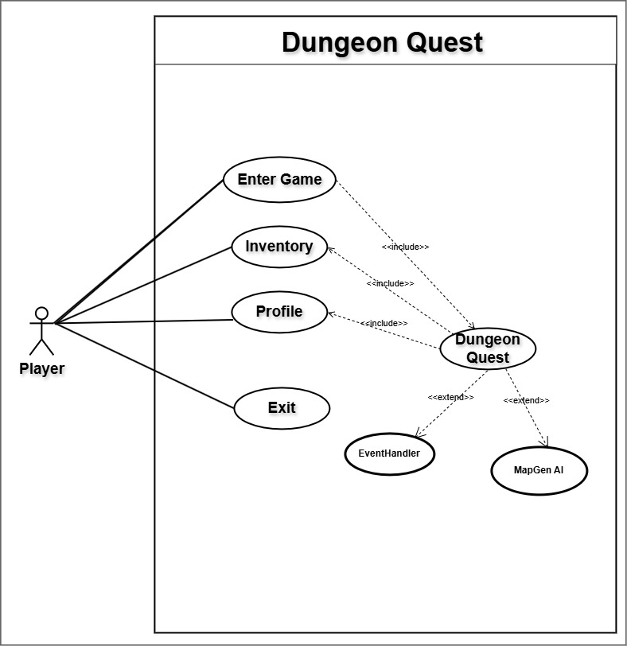
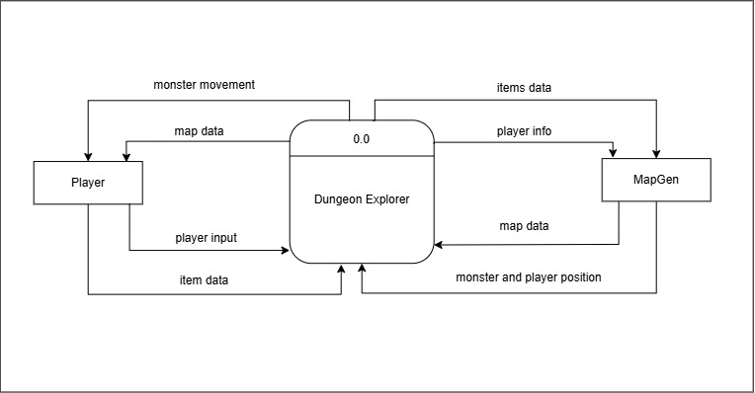
Diagrams
Data flow and use case
The single most important flow in the whole system: Game Engine → Profile Manager → Map Generator
The player's recorded level, kill history and item usage travel back into generation — that is the feedback loop, drawn as a data flow.
16 / 21
Notes:
These are the standard analysis diagrams. The context diagram on the left, the use case diagram on the right.
One note on honesty: the data flow diagrams we originally drew for this project included a Server process, because the earlier Java version of this game was multiplayer. We deliberately removed the networking so we could concentrate on the AI, and in the final build that Server is collapsed into the local session and its JSON store. We redrew the diagrams to match what we actually built.
The most important flow in the whole system is the one in the blue box - the game engine feeds the player's recorded level, kill history and item usage back into the map generator. That arrow is the entire feedback loop, drawn as a data flow.

Slide 17
Challenges We Faced
And what we learned
Making randomness produce good maps
Pure noise is unplayable. The fix was to stop treating carving as the whole answer and split it: one stage creates the structure, a second measures it, a third repairs it, and only then is it scored.
→ Split the problem; do not solve it in one pass
Keeping the generator reproducible
An in-place cellular automata update made results depend on scan order, so the same seed gave different maps. Moving to a separate next-grid, as in Conway's Game of Life, fixed it.
→ Determinism is a design constraint, not a happy accident
Stagnation in the genetic search
With a fixed low mutation rate the population collapsed onto one layout. Ramping the rate 0.06 to 0.12 across generations restored exploration without losing elitism's protection.
→ Exploit early, explore late
Personalisation that does nothing
The first attempt produced identical open ratios for every player level because the random seed dominated the outcome. Only averaging over 20 runs per band revealed the real 21% difference.
→ Measure distributions, not single samples
Death that felt unfair
The first run rollback restored some fields but not others, so players lost items they had earned. Deep-copying the full baseline and re-applying only coins and statistics fixed it.
→ Define the penalty precisely, then enforce it uniformly
19 / 21
Notes:
Five challenges worth mentioning, because they are the parts a technical audience will probe.
The big one is the first. Randomness does not produce good maps. The fix was architectural - stop treating carving as the whole answer and split the responsibility across four stages.
The fourth one is the one I would emphasise for anyone doing quantitative work. Our first attempt at personalisation appeared to do nothing, because we compared single generated maps and the random seed dominated the result. Only when we averaged over twenty runs per band did the real twenty-one percent difference appear. Measure distributions, not single samples - that lesson applies well beyond this project.

Slide 18
Conclusion
What we achieved
▪ A complete, playable game — profile, class selection, movement, sprinting, aimed combat, items, chests, keys, XP, inventory, statistics, local persistence, stable 60 FPS.
▪ Every level is new and guaranteed playable — verified at 1.0000 reachable ratio across 30 levels.
▪ Six AI and data-mining techniques implemented from scratch in the Python standard library. The only third-party dependency in the project is Pygame, and it only draws.
▪ A closed feedback loop — the game records what the player does, mines that behaviour for patterns, and feeds the result back into generation.
▪ Clean separation — the AI layer has no dependency on the graphics, which is what made rigorous statistical validation possible at all.
Future work
Remove the legacy generator
tilemap.py is dead code with contradictory constants
Widen the history window
5 runs makes every confidence estimate fragile
Add a director layer
the Left 4 Dead model — adapt within a single level
Behaviourally distinct monsters
flee-when-low, flank, call-for-help
Chunk the world
enable much larger maps at the same generation cost
Fit the target from outcomes
remove the hand-tuned level bands
Seed sharing
turn generated levels into reproducible artefacts
Restore multiplayer
more players means far more meaningful rules
20 / 21
Notes:
To conclude.
We built a complete, playable game. Every level is new and every level is guaranteed playable - verified at exactly 1.0 reachable ratio across thirty levels. We implemented six AI and data-mining techniques from scratch in the standard library, and the only third-party dependency in the whole project is Pygame, which only draws.
And the loop is closed: the game records what the player does, mines it for patterns, and feeds it back into generation. That is the idea we are most pleased with.
On the right, honestly, is what we did not do. The one I would fix first is deleting the legacy generator - it is dead code carrying tile constants that contradict the live ones, and that is a real maintenance hazard. Widening the history window is the one that would make the adaptive difficulty genuinely reliable rather than indicative.

Slide 19
Thank you
Questions?
Alisha Shahi (360801) · Bhavishek Lama (360805) · Riya Phuyal (360828)
Kantipur City College, Putalisadak, Kathmandu
Supervised by Santosh Prakash Shah and Maryada Karki
Notes:
Thank you. We are happy to take questions.
Anticipated questions and short answers:
- Why not use an existing AI library? Because the brief was to demonstrate the algorithms, and writing them ourselves made each one inspectable and tunable. Python's standard library supplied everything needed.
- How long does generation take? About 1.3 seconds, hidden behind a 3.5-second reveal animation.
- Is the adaptive difficulty actually noticeable? The layout difference is about 21% open ratio and the monster count moves 12 to 17, so yes - but it is deliberately capped so it never feels unfair.
- Could the five-run history window be a problem? Yes - we documented it as a limitation, and the monster limit is hard-clamped to 1-18 so a small sample cannot produce an extreme result.
- Why is the networking gone? It was in the earlier Java version. We removed it deliberately to concentrate on the AI, and we redrew the data flow diagrams to match the single-player build we actually shipped.

