Slide 1
TASK – 4
Data Storytelling & Statistical Validation
From descriptive analysis to business decisions
Sales Analytics Project
Final presentation • Hypothesis testing • Recommendations
TASK 4 • DATA STORYTELLING & STATISTICAL VALIDATION
1

Slide 2
Business Objective
GOAL
Turn transaction-level sales data into clear, actionable business insight.
• Analyze overall sales performance and trends.
• Identify high-performing products and categories.
• Understand customer and regional purchasing patterns.
• Validate an important business finding using statistical testing.
• Translate the evidence into practical recommendations.
TASK 4 • DATA STORYTELLING & STATISTICAL VALIDATION
2

Slide 3
Dataset Overview
Use the same cleaned dataset prepared in Tasks 1–3.
BUSINESS DATA
DIMENSIONS
METRICS
TIME
Sales transactions
Customer • City
Quantity • Price
Order Date
Order-level records
Product • Category • Gender
Total Sales
Year • Month
KEY FIELDS USED
• Order_ID and Order_Date support transaction and time analysis.
• Customer_ID, Age, Gender and Age_Group support customer segmentation.
• City, Product and Category support performance comparisons.
• Quantity, Unit_Price and Total_Sales support revenue analysis.
TASK 4 • DATA STORYTELLING & STATISTICAL VALIDATION
3

Slide 4
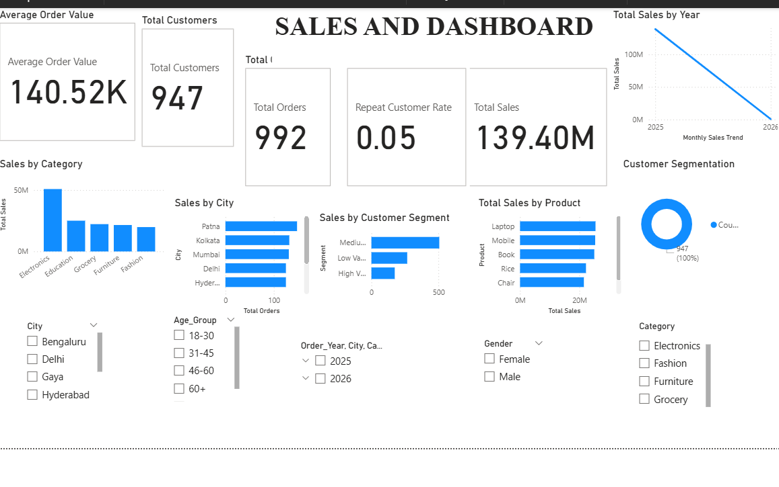
Actual Sales Dashboard — Task 3 Results

Slide 5
Actual Dashboard Findings
These figures and observations are taken from the dashboard you provided.
TOTAL SALES
TOTAL CUSTOMERS
TOTAL ORDERS
AVERAGE ORDER VALUE
₹139.40M
947
992
₹140.52K
Dashboard KPI
Dashboard KPI
Dashboard KPI
Dashboard KPI
Key observations
• Electronics is the strongest category in the displayed sales chart, at roughly ₹50M.
• Laptop and Mobile are the leading products in the displayed product ranking.
• Patna, Kolkata and Mumbai appear among the leading cities in the displayed city ranking.
• Repeat Customer Rate is 0.05, or about 5%, highlighting a customer-retention opportunity.
Note: The City visual's x-axis is labeled Total Orders, so describe those city values as orders unless the visual is corrected.

Slide 6
Key Business KPIs
Values calculated from the uploaded sales dataset.
TOTAL SALES
QUANTITY SOLD
CUSTOMERS
PRODUCTS
₹139.40M
5,435
947
6
From Total_Sales
From Quantity
Distinct Customer_ID
Distinct Product
KPI STORY
These four measures establish the scale of the business and provide the baseline for the deeper trend, customer, product and regional analysis.
Tip: copy the exact values already used in your Power BI cards.
TASK 4 • DATA STORYTELLING & STATISTICAL VALIDATION
4

Slide 7
Sales Trend Analysis
Actual monthly sales findings from the uploaded dataset.
BUSINESS STORY
• Sales peaked in March 2025 at about ₹13.06M.
• September 2025 was the lowest full month at about ₹9.18M.
• Use demand patterns to improve inventory and promotion planning.
Monthly Sales Trend — Key Values
Peak: March 2025 — ₹13.06M Lowest full month: September 2025 — ₹9.18M January 2026 is partial.
TASK 4 • DATA STORYTELLING & STATISTICAL VALIDATION
5

Slide 8
Customer Analysis
Customer-level sales and gender findings from the uploaded dataset.
WHAT TO SHOW
• Sales by Gender
• Sales by Age_Group
• Top customers by Total_Sales (if available)
Female: ₹66.93M Male: ₹72.47M
Female customers: 463 Male customers: 484
Insight to write: “The gender difference is small relative to overall sales and requires statistical validation.”
TASK 4 • DATA STORYTELLING & STATISTICAL VALIDATION
6

Slide 9
Product & Category Performance
BUSINESS STORY
• Electronics leads with about ₹50.78M.
• Laptop and Mobile are the two leading products.
• Review lower-performing categories for targeted improvement.
Category & Product Sales — Key Values
Electronics: ₹50.78M Laptop: ₹25.44M Mobile: ₹25.34M
Key finding: “__________ is the leading category/product based on Total_Sales.”
TASK 4 • DATA STORYTELLING & STATISTICAL VALIDATION
7

Slide 10
Regional / City Analysis
DECISION INSIGHT
• Patna leads with about ₹20.83M in sales.
• Kolkata and Bengaluru are the next strongest markets.
• Prioritize resources by city-level sales potential.
City Sales — Key Values
Patna: ₹20.83M Kolkata: ₹18.88M Bengaluru: ₹18.77M
Top city: ________ Sales: ₹________
TASK 4 • DATA STORYTELLING & STATISTICAL VALIDATION
8

Slide 11
Key Insights — What the Data Says
01
Sales trend
Sales performance changes over time; peak periods should guide planning.
02
Customers
A small number of segments may contribute disproportionately to revenue.
03
Products
Top products/categories are the clearest opportunities for focused growth.
04
Cities
Regional differences can reveal where marketing and inventory should be prioritized.
TASK 4 • DATA STORYTELLING & STATISTICAL VALIDATION
9

Slide 12
Business Recommendations
RECOMMENDATION 1
RECOMMENDATION 2
Double down on winners
Target valuable segments
Prioritize high-performing products and categories in promotions and inventory planning.
Build offers around the customer age/gender groups contributing the most revenue.
RECOMMENDATION 3
RECOMMENDATION 4
Focus by geography
Plan around demand
Allocate campaigns and stock based on city-level sales potential.
Use monthly patterns to prepare inventory and campaigns before peak periods.
Expected impact: stronger resource allocation • better customer targeting • improved sales planning
TASK 4 • DATA STORYTELLING & STATISTICAL VALIDATION
10

Slide 13
Hypothesis Testing
BUSINESS QUESTION
Is average customer-level Total_Sales significantly different between Female and Male customers?
NULL HYPOTHESIS (H₀)
ALTERNATIVE HYPOTHESIS (H₁)
μFemale = μMale
μ₁ ≠ μ₂
No significant difference in mean customer sales
A significant difference in mean customer sales exists
Test used: Welch’s independent two-sample t-test on 947 unique customers.
Choose the two groups from your analysis (for example, two age groups, genders, or other meaningful segments).
TASK 4 • DATA STORYTELLING & STATISTICAL VALIDATION
11

Slide 14
Statistical Results
Welch t-test on unique customers; significance level α = 0.05.
GROUP 1 MEAN
GROUP 2 MEAN
T-STATISTIC
₹144.56K
₹149.73K
-0.638
P-VALUE
95% CI
DECISION
0.523
₹-21.04K to ₹10.71K
[Reject / Fail to reject H₀]
Interpretation rule
Since p = 0.523 ≥ 0.05, the difference is not statistically significant.
TASK 4 • DATA STORYTELLING & STATISTICAL VALIDATION
12

Slide 15
Business Conclusion from the Test
STATISTICAL CONCLUSION
“At the 5% significance level, we fail to reject H₀ because p = 0.523.”
BUSINESS MEANING
“The observed difference in average customer-level sales between Female and Male customers is not statistically significant. Gender alone should not drive sales decisions.”
Important: statistical significance does not automatically mean the difference is large or commercially important. Consider effect size and business impact too.
TASK 4 • DATA STORYTELLING & STATISTICAL VALIDATION
13

Slide 16
Final Conclusion & Call to Action
FROM DATA → INSIGHT → ACTION
The analysis identifies where sales are strongest, which customers and products matter most, and where the business can focus its resources.
• Use high-performing products/categories as growth anchors.
• Target the strongest customer segments with relevant offers.
• Prioritize high-potential cities and markets.
• Use demand trends to improve planning.
• Validate major decisions with appropriate statistical evidence.
CALL TO ACTION: Convert the strongest insights into a focused sales and marketing plan, then measure the results.
TASK 4 • DATA STORYTELLING & STATISTICAL VALIDATION
14

Slide 17
Thank You
Questions & Discussion
Data Storytelling & Statistical Validation
GitHub deliverables: Final presentation + hypothesis testing summary
TASK 4 • DATA STORYTELLING & STATISTICAL VALIDATION
15

