Slide 1
Buyer Folio: Real Estate Agent Recommendation System
Module 12 Assignment - Capstone Project Presentation
Bhavishya Koluguri
Hemanth Kurra
Jayanth Malothu
Shubham Nilesh Palande
Yuva Veera Prasanna Lakshmi Kocherla
Prof. Valerie Atherley

Slide 2
Introduction
About Buyer Folio
Context
Problem statement
Buyer Folio simplifies shared property ownership with tailored agent matching and pricing optimization
Uses AI/ML to enhance transparency, fairness, and decision-making in real estate
The real estate market is increasingly adopting AI-driven solutions to address inefficiencies
Buyer Folio aims to bridge gaps in agent matching with tailored recommendations using advanced data analysis
Traditional agent matching lacks personalization and transparency
Challenges include data fragmentation, bias in decision-making, and the need for enhanced co-ownership tools

Slide 3
Objectives
01
Buyer-Agent Optimization
Implement data-driven algorithms for personalized recommendations using buyer preferences, agent expertise, and performance metrics
02
Sentiment Analysis
Leverage NLP models to extract insights on agent professionalism, responsiveness, and client satisfaction from reviews
03
Bias Mitigation
Deploy fairness-aware ML algorithms to identify and rectify systemic biases in agent recommendations and market trends
04
Interactive Dashboards
Build visual analytics tools to display agent KPIs, sentiment scores, and regional specialization for actionable insights
05
Historical Data Utilization
Analyze transaction datasets to refine pricing models, detect market trends, and optimize success rates

Slide 4
Data Analysis and Dashboard

Slide 5
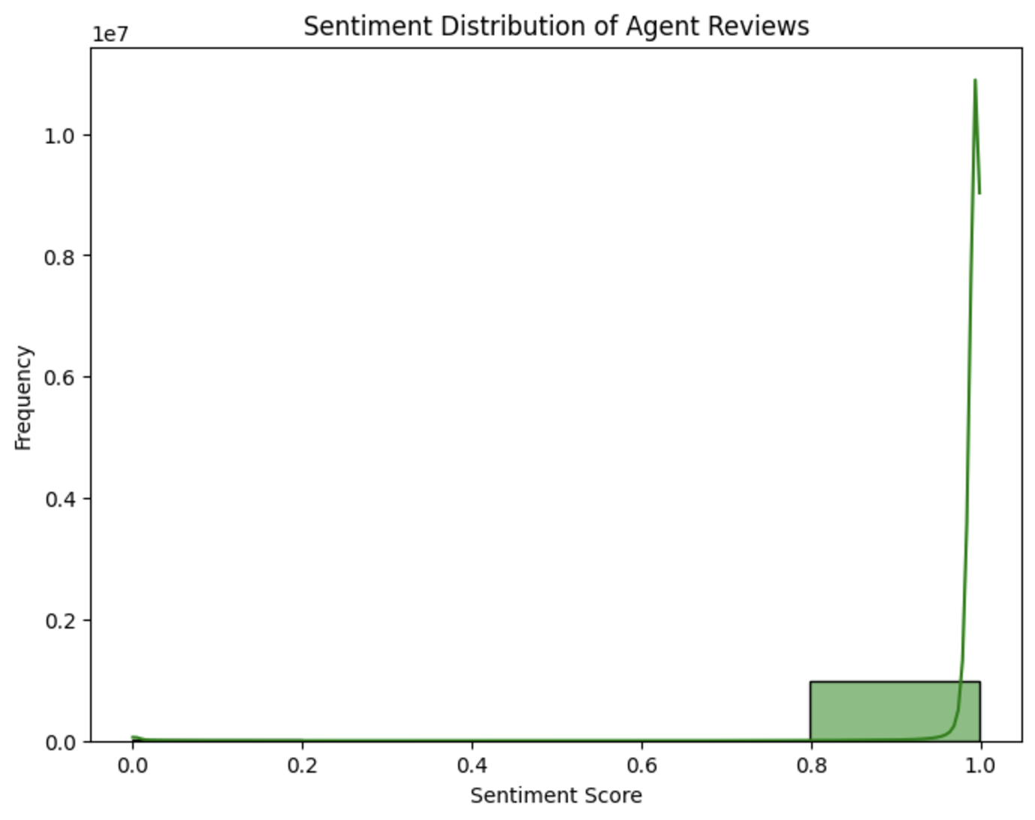
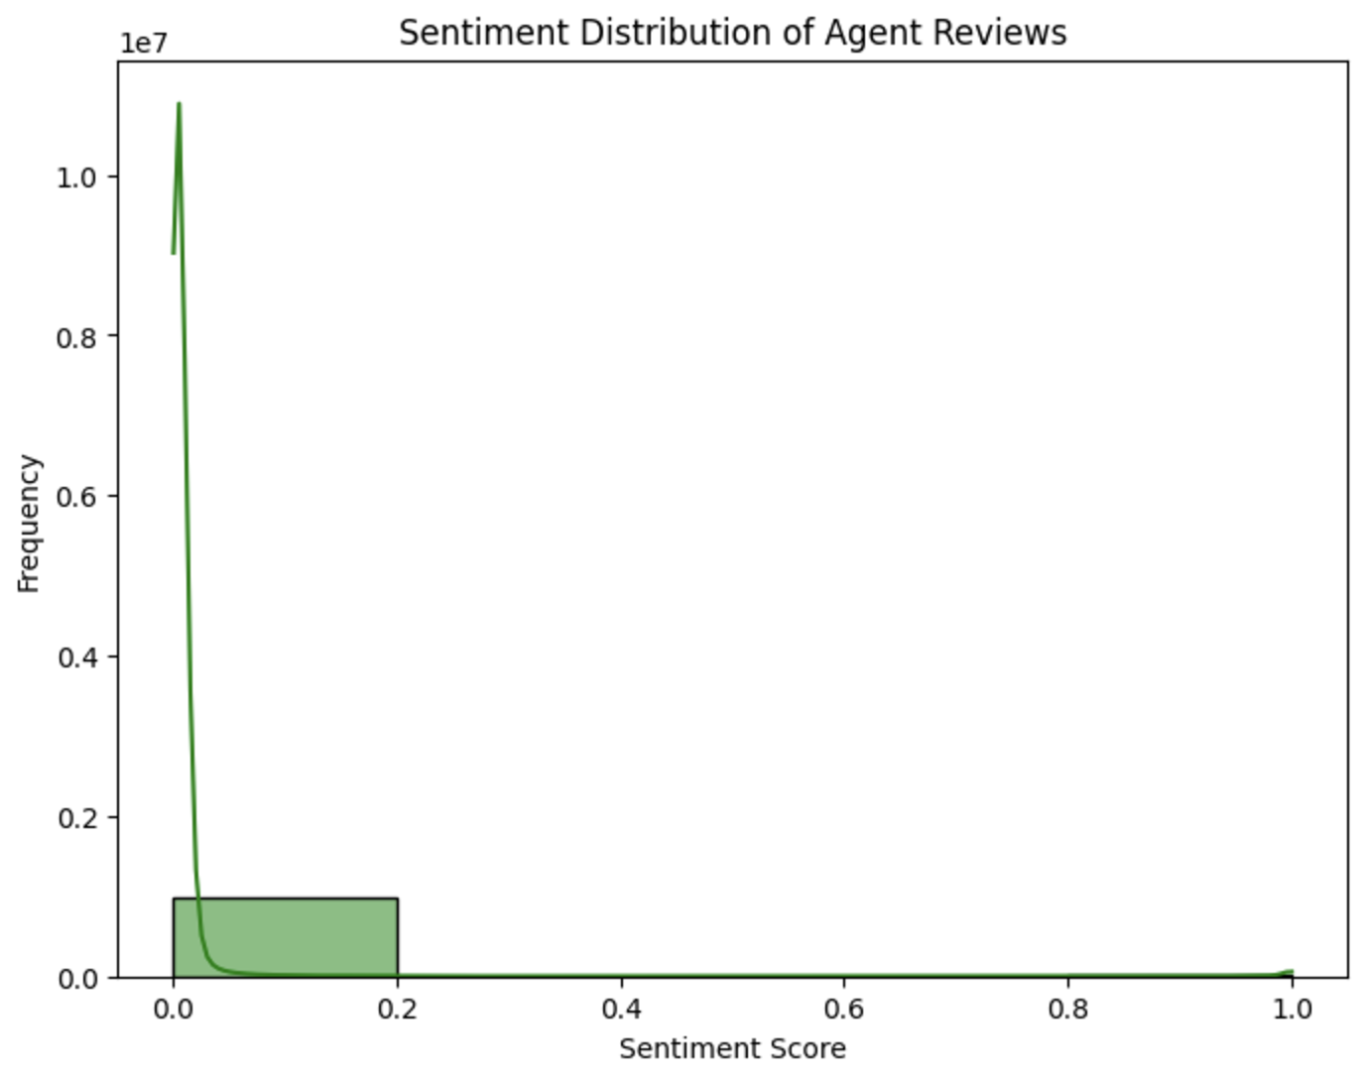
Sentiment Distribution
Positive Sentiments
Negative Sentiments

Slide 6
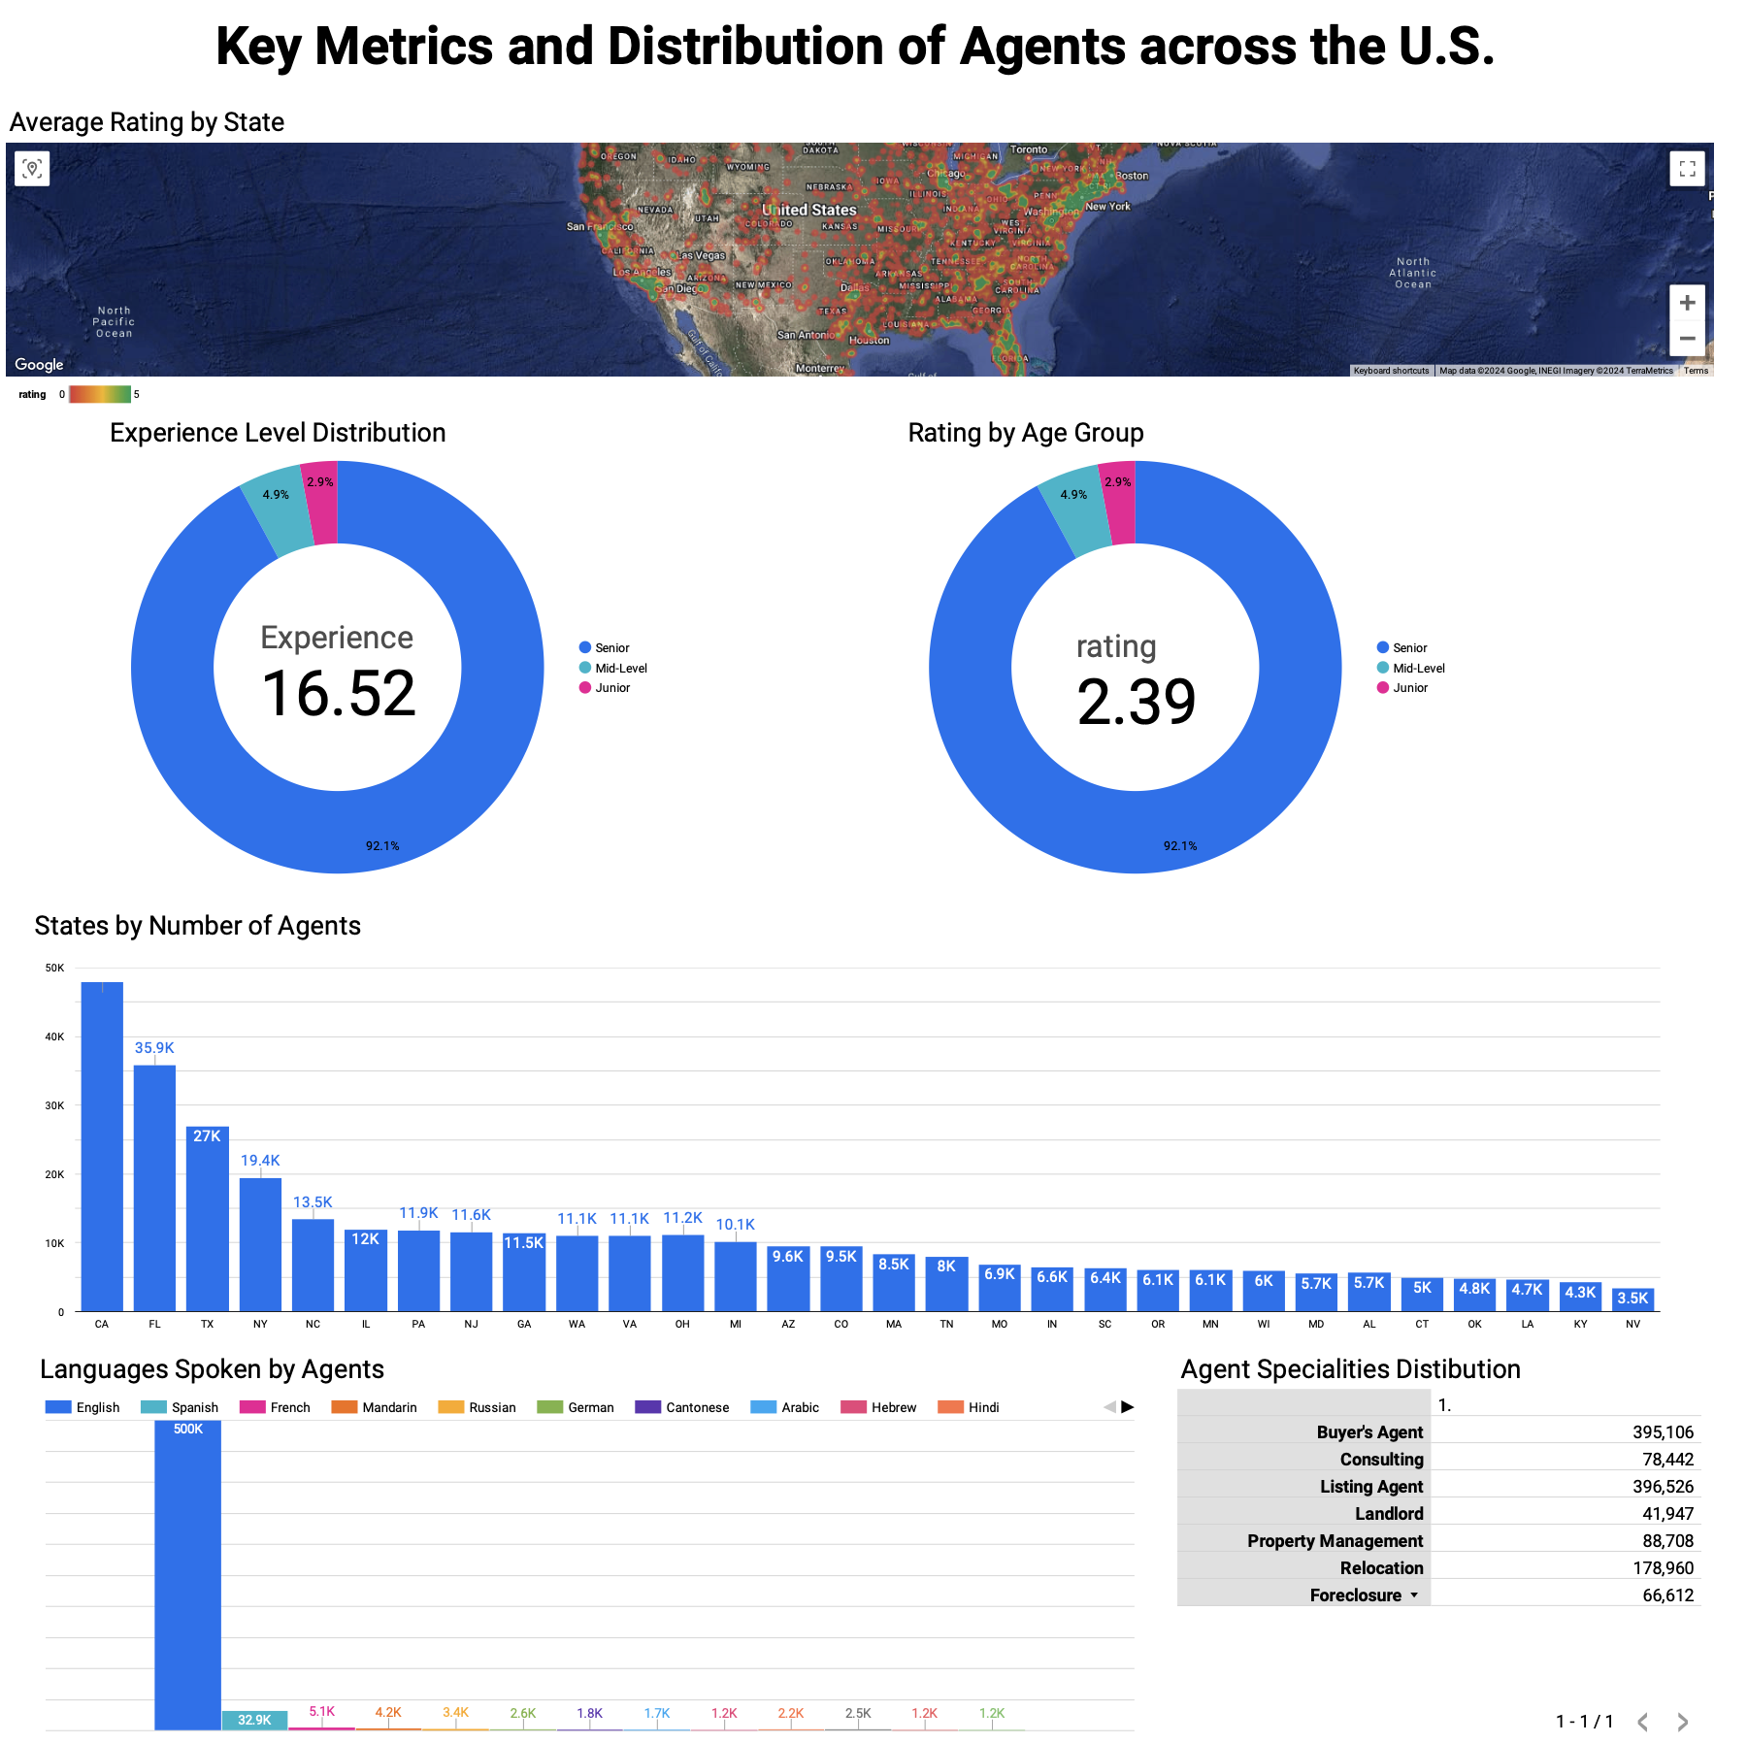

Slide 7
Experience Level Distribution
Senior agents dominate at 92.1%, with an average experience of 16.52 years, while mid-level and junior agents form a minor proportion
Rating by Age Group
Senior agents maintain an average rating of 2.39, far exceeding mid-level and junior agents' ratings
States by Number of Agents
California (35.9K) and Florida (27K) lead in the number of active agents, followed by Texas and New York, showcasing agent density variations
Languages Spoken by Agents
English is the dominant language (500K agents), with Spanish (5.1K) and French (4.2K) as notable secondary languages, reflecting multilingual capabilities
Agent Specialties Distribution
Top specialties include Buyer's Agent (395K) and Listing Agent (396K), while niches like Foreclosure (66.6K) and Relocation (178.9K) show specific expertise areas

Slide 8
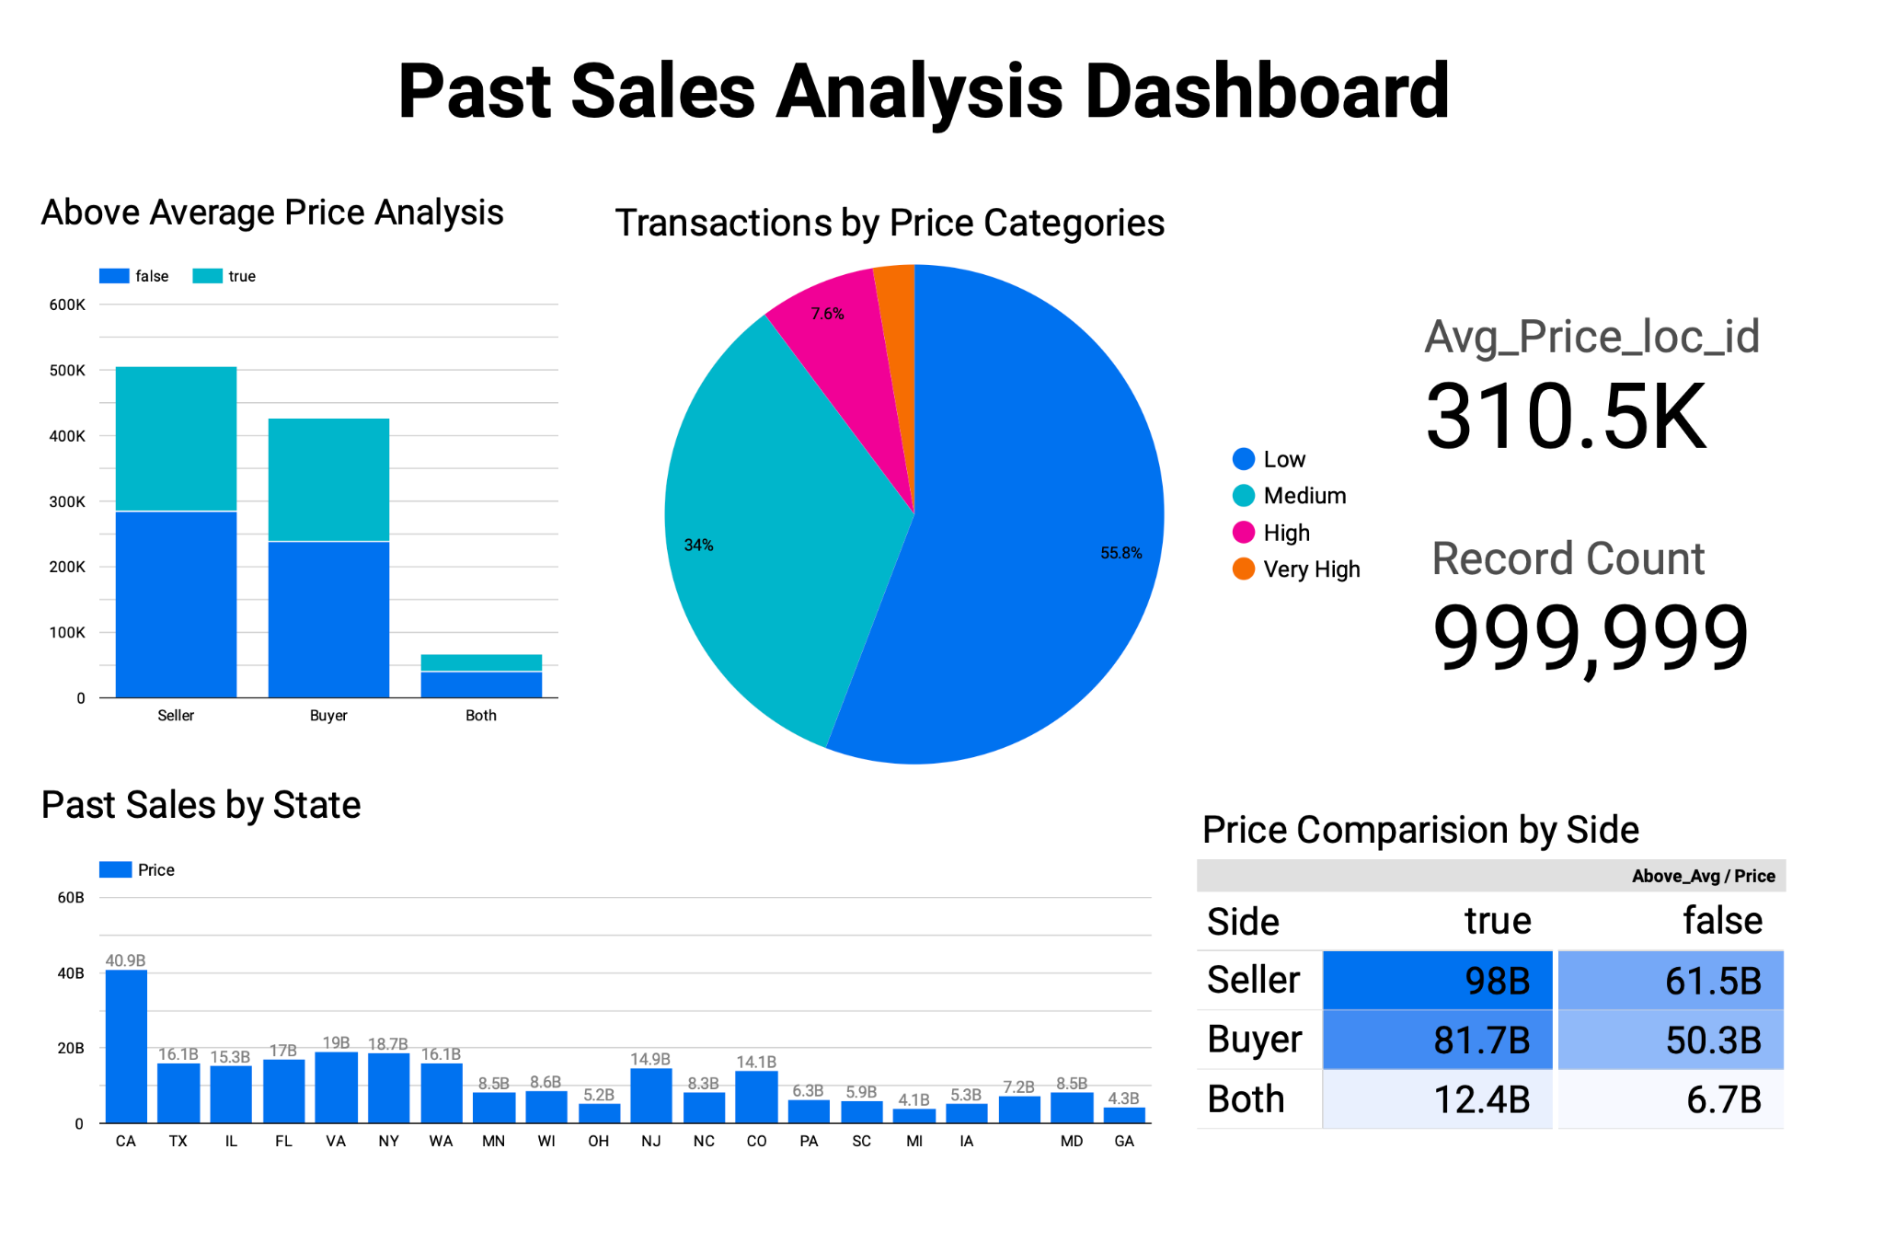

Slide 9
Above Average Price Analysis
Above Average Price Analysis: Sellers dominate transaction volumes, with balanced above and below-average sales
Price Categories
Most transactions are in the Low (55.8%) and Medium (34%) price ranges, with fewer in High and Very High categories
Sales by State
California leads with $40.9B in sales, followed by Texas and Florida, showing regional sales variations
Price Comparison by Side
Sellers account for $98B in above-average sales, surpassing buyers at $81.7B
Summary
Average price per location is $310.5K across 999,999 records, providing a comprehensive view of transaction trends

Slide 10
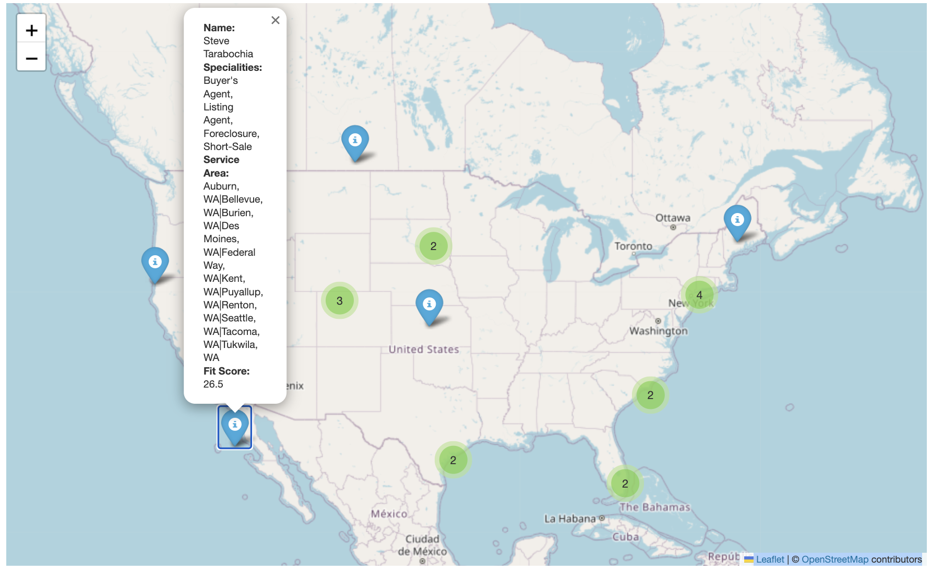

Slide 11
Recommendation System
Purpose: The recommendation system identifies the top real estate agents based on user input (location) and agent performance metrics
Fit Score Calculation: Combines Experience and Rating (weighted equally at 0.5 each) to rank agents
Location Filtering: Filters agents based on the user's input (e.g., city, zipcode) by matching it to agents' service areas
Filtering and Ranking: Identified agents serving the desired location and ranked them by fit_score
Visualization: Mapped top 20 agents on an interactive map using Folium and MarkerCluster for user-friendly exploration

Slide 12
Data Information (Agent Information Data)
Dataset Size
Contains 500,002 records with 25 features per agent profile
Key Columns
Agent Details: Id, f_name, l_name, jobtitle, rating
Professional Info: specialities, languages, experience, lic_num
Geospatial Data: latitude, longitude, City, State
Contact Info: email, phone, website
Missing Data
Major columns like languages and jobtitle had over 80% missing values, handled via imputation and placeholder values
Unique Features
Extracted specialties, multilingual capabilities, and geospatial attributes for better agent profiling

Slide 13
Data Preprocessing (Agent Information Data)
Data Cleaning and Imputation
Feature Engineering
Encoding and Integration
Addressed missing data using techniques like median imputation for numeric fields and placeholders for categorical fields (jobtitle, brokername, languages)
Ensured consistent formatting by normalizing text data and filling incomplete entries
Extracted attributes like Job Title, Experience, and Specialities from unstructured fields using regex and vectorized functions
Parsed city and state information from service_area and geospatially mapped agents using latitude and longitude
Encoded categorical variables for languages and specialities using frequency-based binary encoding for the top 20 categories
Merged datasets to eliminate duplicates and enrich agent profiles with geospatial and transactional data

Slide 14
Data Information (Agent Review Data)
Dataset Size
Contains 1,000,000 records with 10 features for each agent review
Key Columns
Review Details: Id, loc_id, review_id, reviewtext, reviewdate
Rating Metrics: overallrating, Local_knowledge, Process_expertise, Responsiveness, Negotiation_skills
Missing Data
Approximately 1.3% of rating-related columns (Local_knowledge, Process_expertise) had missing values, addressed through imputation and sentiment mapping
Unique Features
Captures both quantitative ratings and qualitative feedback for holistic agent performance analysis

Slide 15
Data Preprocessing (Agent Reviews)
Text Cleaning and Tokenization
Visualization
Sentiment Analysis
Removed stop words, performed lemmatization, and tokenized reviewtext using NLP libraries (TextBlob, NLTK)
Generated sentiment distribution histograms and word clouds for review insights
TextBlob: Polarity scores mapped to a rating scale (1 to 5) for missing values in rating columns
RoBERTa Model: Applied for advanced sentiment scoring with positive and negative sentiment probabilities
Feature Engineering
Handling Missing Data
Extracted sentiment scores and mapped them to existing agent rating metrics (Local_knowledge, etc.)
Imputed missing values in rating metrics (Process_expertise, Responsiveness) using derived sentiment scores for consistency

Slide 16
Data Information (Past Sales Data)
Dataset Size
Contains 1,000,000 records with 6 features for each past property sale
Key Columns
Property Details: Id, loc_id, Property_Details_address
Transaction Details: Side (Buyer/Seller), Price, Sold_Date
Missing Data
Property_Details_address has ~2.5% missing values, handled by filling placeholders or dropping rows.
Unique Features
Includes derived metrics like Avg_Price_loc_id and Above_Avg (flag for above/below location average price)
Time-based features (Month, Year) extracted for trend analysis

Slide 17
Data Preprocessing (Past Sales Data)
Data Cleaning
Feature Engineering
Visualization
Converted Price column to numeric by removing “$” symbols and filling missing prices with the mean value
Parsed Property_Details_address to extract City, State, and Zipcode
Added Avg_Price_loc_id for average price per location and Above_Avg as a flag for above/below average sales
Created Price_Category to group properties into Low, Medium, High, and Very High price ranges
Plotted sales volume trends by Month and price distributions across Side (Buyer/Seller)
Created visual insights for average price by price category and transaction side

Slide 18
Data Governance and Ethical Issues
Data Privacy and Security
Ensuring sensitive data is protected against unauthorized access, with strong encryption, secure storage, and adherence to privacy regulations (e.g., GDPR, CCPA)
05
Data Bias and Fairness
Identifying and mitigating biases in data, models, or algorithms to ensure fairness and equity in outcomes, avoiding discrimination against specific groups or individuals
01
04
Informed Consent
Ensuring that individuals are fully aware of how their data is being used, with explicit consent obtained prior to data collection, in line with ethical standards
Transparency and Accountability
Providing clear visibility into data collection, usage, and processing practices, while being accountable for data handling and decision-making processes
02
03
Data Ownership and Access
Defining clear ownership rights over data, ensuring equitable access for stakeholders while safeguarding intellectual property and preventing misuse

Slide 19
Challenges
Data Quality: Missing and inconsistent data across agent profiles, reviews, and sales datasets required extensive cleaning and imputation.
Bias in Recommendations: Addressing systemic biases in agent selection and performance metrics while ensuring fairness and transparency.
Scalability: Handling large datasets with over a million records for real-time processing and analysis.
Integration: Aligning diverse datasets (agents, reviews, sales) to create a unified recommendation system

Slide 20
Future Scope
Enhanced NLP Models: Incorporate domain-specific language models for better sentiment analysis and review comprehension.
Dynamic Fit Scoring: Develop adaptive scoring algorithms that consider dynamic factors like market trends and agent availability.
Improved Visualization: Build real-time dashboards with geospatial analytics for enhanced user experience.
Global Expansion: Extend the recommendation system to international markets by integrating multilingual and multicultural datasets.

Slide 21
Conclusion
Achievement: Successfully developed an AI-powered recommendation system for personalized real estate agent matching, leveraging advanced analytics and machine learning.
Key Outcomes: Integrated diverse datasets (agents, reviews, sales) to enhance transparency, fairness, and decision-making in the real estate domain.
Challenges Overcome: Addressed data quality issues, systemic biases, and scalability concerns to deliver actionable insights and user-friendly tools.
Future Vision: Expand globally with multilingual capabilities, adaptive scoring systems, and real-time geospatial dashboards to revolutionize property transactions.

Slide 22
References
Real Python. (2018, March 26). Pythonic Data Cleaning With Pandas and NumPy. Realpython.com; Real Python. https://realpython.com/python-data-cleaning-numpy-pandas/
Subedi, S. (2019, May 12). NLP with Python: Text Clustering. Sanjaya’s Blog. https://sanjayasubedi.com.np/nlp/nlp-with-python-document-clustering/
Mastering Data Governance in Analytics for Better Business Outcomes. (2024). MicroStrategy; MicroStrategy Website. https://www.microstrategy.com/blog/mastering-data-governance-in-analytics-for-better-business-outcomes
Mehwish Majeed. (2012, April 14). Ethical Issues Related to Project Management. Project-Management.com. https://project-management.com/ethical-issues-related-to-project-management/
Arora, S. (2022, July 7). Sentiment Analysis Using Python. Analytics Vidhya. https://www.analyticsvidhya.com/blog/2022/07/sentiment-analysis-using-python/
Christensen, P., Sarmiento-Barbieri, I., & Timmins, C. (2021, November 1). Racial Discrimination and Housing Outcomes in the United States Rental Market. https://doi.org/10.3386/w29516
Fuster, A., Plosser, M., Schnabl, P., & Vickery, J. (2019). The Role of Technology in Mortgage Lending. Review of Financial Studies, 32(5), 1854–1899. https://doi.org/10.1093/rfs/hhz018
Rosen, E., Garboden, P. M. E., & Cossyleon, J. E. (2021). Racial Discrimination in Housing: How Landlords Use Algorithms and Home Visits to Screen Tenants. American Sociological Review, 86(5), 787–822. https://doi.org/10.1177/00031224211029618

Slide 23
Thank You!

