Slide 1

"Drone Delivery Simulator Using Segment Trees"
A Deep Dive into Algorithmic System Design for Real-Time
DSA Case Study Evaluation: Balancing Performance,Scalability, and Precision
Presented by: Group 8

Slide 2
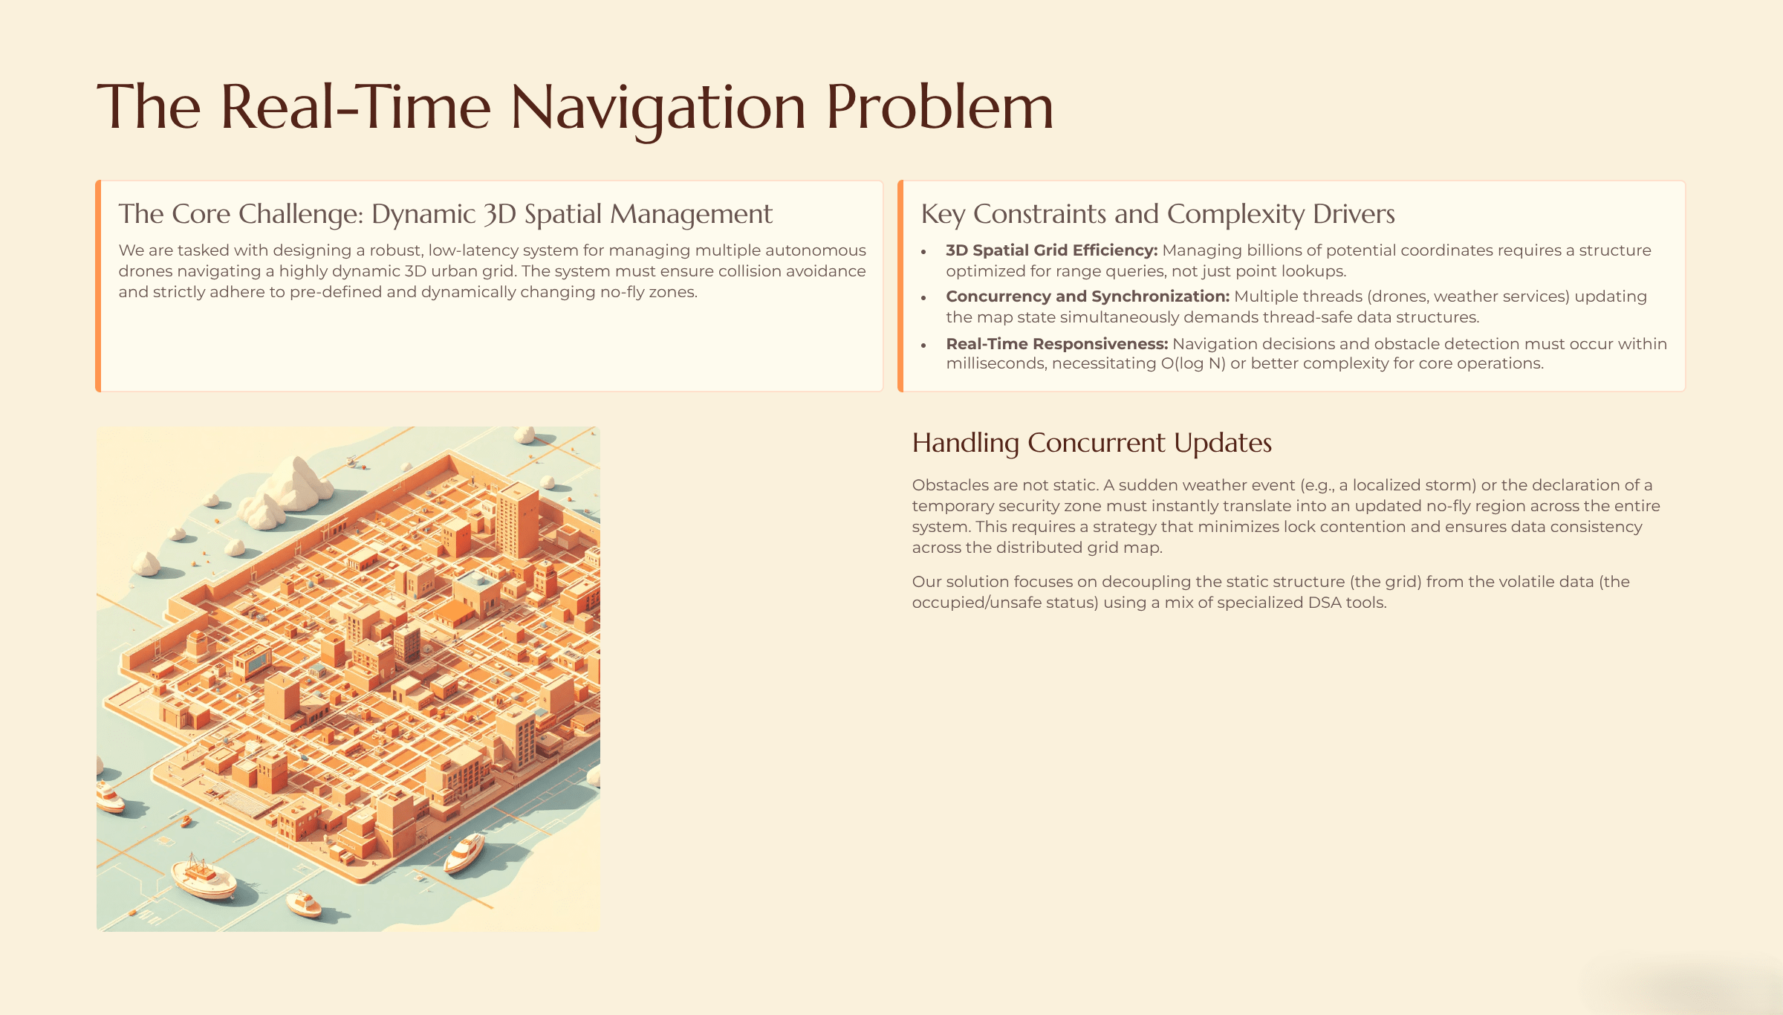

Slide 3
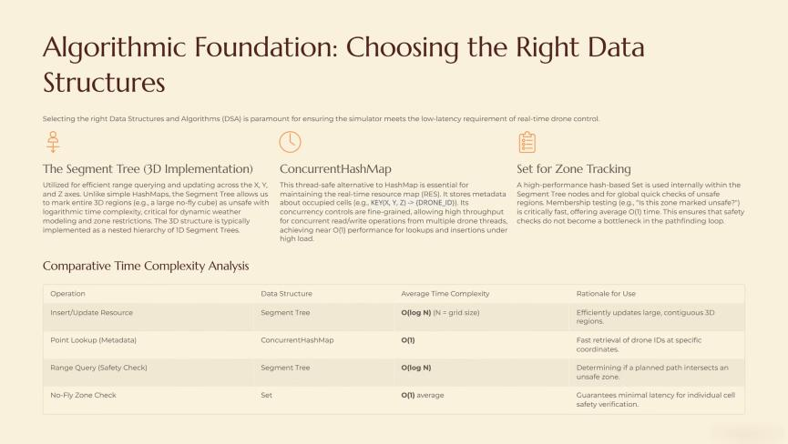

Slide 4
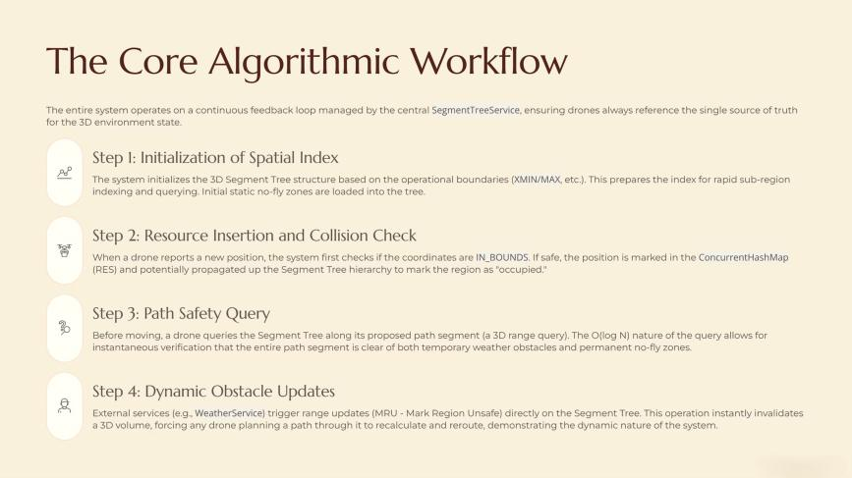

Slide 5
Algorithm:Phase
1: ChargingStation.java
System InitializationStep 1: Initialize Charging Station
1.1 Retrieve ID, name, and list of chargers.
1.2 Store data in ChargingStation class.
1.3 The ChargingStation object holds all attributes, and ID serves as a key for access.Step
2: Display Charging Station Information
2.1 Call the toString method to generate a string.
2.2 Concatenate ID, name, and chargers for display.
2. Time Complexity:
Initialization (Step 1):
Time Complexity: O(1)
Explanation: The ChargingStation constructor initializes the object attributes, a constant-time operation.
Display (Step 2):
Time Complexity: O(n)
Explanation: The toString method iterates through the list of chargers (if any), so its complexity depends on the number of chargers.

Slide 6
DeliveryPoint.java
Phase 1: System Initialization
Step 1: Initialize Delivery Point
1.1 Retrieve ID and address.
1.2 Store data in the DeliveryPoint class.
1.3 ID serves as a key for quick access.
Step 2: Display Delivery Point Information
2.1 Call toString method for string representation.
2.2 Concatenate ID and address for output.
2. Time Complexity:
Initialization (Step 1):
Time Complexity: O(1)
Explanation: Like ChargingStation, this is a constant-time operation as we are initializing simple attributes.
Display (Step 2):
Time Complexity: O(1)
Explanation: The toString method only involves concatenating a few fields (ID and address), making it a constant-time operation.

Slide 7
Drone.java
1. Algorithm:
Phase 1: System Initialization
Step 1: Initialize Drone
1.1 Retrieve ID, status, location, and other parameters.
1.2 Store drone data in the Drone class.
1.3 ID is used for fast access.
Step 2: Display Drone Information
2.1 Call toString method for string representation.
2.2 Concatenate ID, status, and location.
2. Time Complexity:
Initialization (Step 1):
Time Complexity: O(1)
Explanation: The initialization involves setting simple variables, so it's a constant-time operation.
Display (Step 2):
Time Complexity: O(1)
Explanation: Similar to ChargingStation and DeliveryPoint, displaying a Drone only involves concatenating a few fields.

Slide 8
NoFlyZone.java
1. Algorithm:
Phase 1: System Initialization
Step 1: Initialize No-Fly Zone
1.1 Retrieve ID, description, and permission status.
1.2 Store data in NoFlyZone.
1.3 ID serves as the key for access.
Step 2: Display No-Fly Zone Information
2.1 Call toString method for string representation.
2.2 Concatenate ID, description, and permission status.
2. Time Complexity:
Initialization (Step 1):
Time Complexity: O(1)
Explanation: The NoFlyZone initialization is similar to the others, a constant-time process as we're assigning values to attributes.
Display (Step 2):
Time Complexity: O(1)
Explanation: The toString method is a simple concatenation of strings, which takes constant time.

Slide 9
Warehouse.java
1. Algorithm:
Phase 1: System Initialization
Step 1: Initialize Warehouse
1.1 Retrieve ID, name, and capacity.
1.2 Store data in Warehouse class.
1.3 ID serves as the unique identifier for fast access.
Step 2: Display Warehouse Information
2.1 Call toString method for string representation.
2.2 Concatenate ID, name, and capacity.
2. Time Complexity:
Initialization (Step 1):
Time Complexity: O(1)
Explanation: The constructor only involves setting attributes, which is a constant-time operation.
Display (Step 2):
Time Complexity: O(1)
Explanation: String concatenation in the toString method makes this a constant-time operation.

Slide 10
WeatherCondition.java
1. Algorithm:
Phase 1: System Initialization
Step 1: Initialize Weather Condition
1.1 Retrieve ID, type, and severity.
1.2 Store data in WeatherCondition class.
1.3 ID allows for fast access.
Step 2: Display Weather Condition Information
2.1 Call toString for string representation.
2.2 Concatenate ID, type, and severity.
2. Time Complexity:
Initialization (Step 1):
Time Complexity: O(1)
Explanation: Similar to the other classes, this involves simple assignment to instance variables, which is constant time.
Display (Step 2):
Time Complexity: O(1)
Explanation: Concatenating a few attributes into a string takes constant time.

Slide 11
DatabaseService.java
1. Algorithm:
Phase 1: Database Operations
Step 1: Load Database
1.1 Establish connection using credentials.
1.2 Retrieve job positions, charging stations, warehouses, delivery points, etc.
1.3 Store the data into tables for fast access.
Step 2: Insert Data
2.1 Insert records into the database using SQL INSERT statements.
Step 3: Retrieve Data
3.1 Retrieve records using SQL SELECT queries.
3.2 Store the retrieved data in appropriate classes for processing.
2. Time Complexity:
Load Database (Step 1):
Time Complexity: O(n)
Explanation: The time depends on the number of records retrieved from the database, as each record is accessed individually.

Slide 12
Insert Data (Step 2):
Time Complexity: O(1)
Explanation: Inserting one record is a constant-time operation.
Retrieve Data (Step 3):
Time Complexity: O(n)
Explanation: The time complexity depends on the number of records being fetched (n), assuming a simple query with no indexes.

Slide 13
DroneService.java
1. Algorithm:
Phase 1: Drone Management
Step 1: Initialize Drone Service
1.1 Set up services like database, segment tree, etc.
1.2 Instantiate DroneService class for managing drone operations.
Step 2: Add Drone
2.1 Link the drone to a warehouse using the DroneService.
2.2 Update drone status in the database.
Step 3: Retrieve Drone Data
3.1 Fetch drone data from the database.
3.2 Update drone attributes accordingly.
2. Time Complexity:
Initialization (Step 1):
Time Complexity: O(1)
Explanation: Setting up services like databases and segment trees is a constant-time initialization step.

Slide 14
Add Drone (Step 2):
Time Complexity: O(1)
Explanation: Adding a drone is a simple database update or insertion, which is constant time.
Retrieve Drone Data (Step 3):
Time Complexity: O(1)
Explanation: Fetching one drone's data from the database is a constant-time operation.

Slide 15
RouteService.java
1. Algorithm:
Phase 1: Path Management
Step 1: Set Path
1.1 Define path based on available routes or segments.
1.2 Set path for a drone or vehicle considering constraints like time and safety.
Step 2: Validate Path
2.1 Ensure that each path segment is valid by checking for obstacles and no-fly zones.
2.2 If invalid, recalculate or return an error.
2. Time Complexity:
Set Path (Step 1):
Time Complexity: O(n)
Explanation: Depending on the length of the path (n), setting it involves iterating over the segments.
Validate Path (Step 2):
Time Complexity: O(n)
Explanation: Validating each path segment is a linear operation (one check per segment).

Slide 16
SegmentTreeService.java
1. Algorithm:
Phase 1: Segment Tree Operations
Step 1: Build Segment Tree
1.1 Initialize the segment tree with relevant data.
1.2 Populate the tree using algorithms like range queries.
Step 2: Insert and Remove Data
2.1 Insert data into segments.
2.2 Remove data from segments when necessary.
Step 3: Query the Segment Tree
3.1 Perform range queries to check availability or status of regions.
3.2 Use segment tree for efficient querying.
2. Time Complexity:
Build Segment Tree (Step 1):
Time Complexity: O(n)
Explanation: Building the segment tree requires processing all elements in the data set.

Slide 17
Insert and Remove Data (Step 2):
Time Complexity: O(log n)
Explanation: Segment trees offer efficient insert and remove operations, both in logarithmic time.
Query Segment Tree (Step 3):
Time Complexity: O(log n)
Explanation: Range queries are efficient and can be answered in logarithmic time due to the segment tree structure.

Slide 18
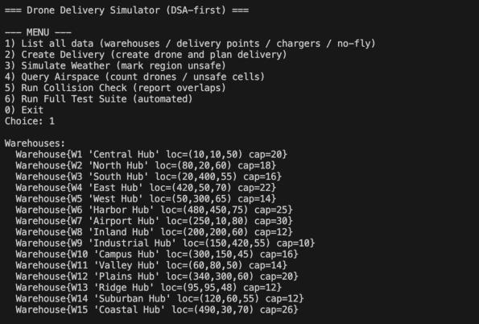
Test Case - 1

Slide 19
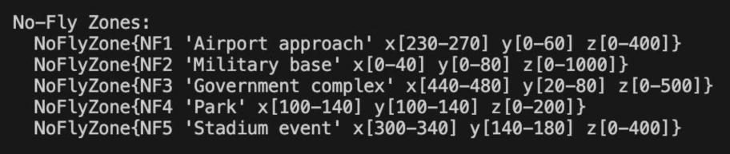

Slide 20
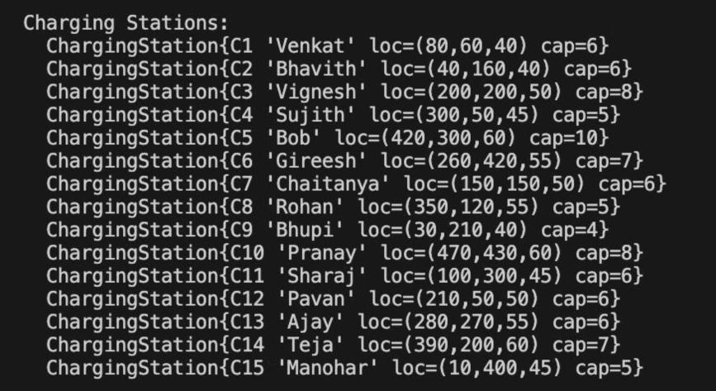

Slide 21
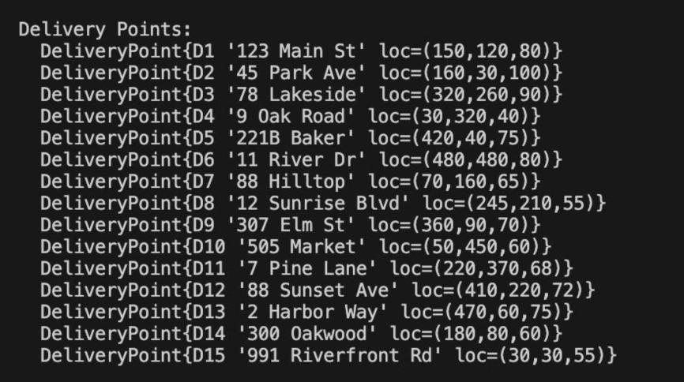

Slide 22
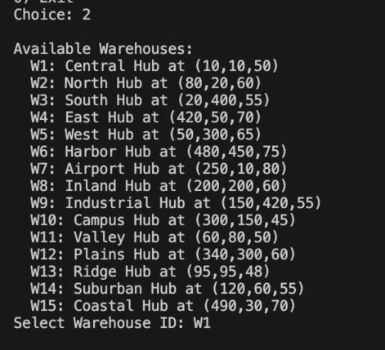
Test Case - 2

Slide 23
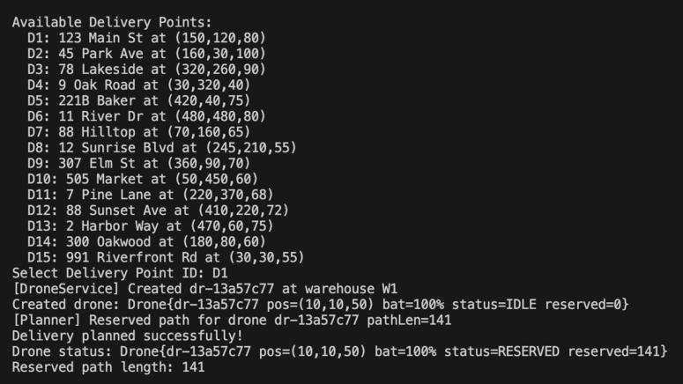

Slide 24
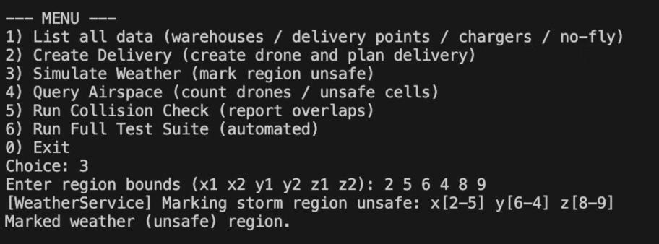
Test Case - 3

Slide 25
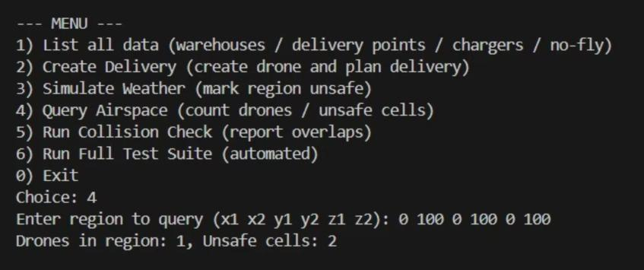
Test Case - 4

Slide 26
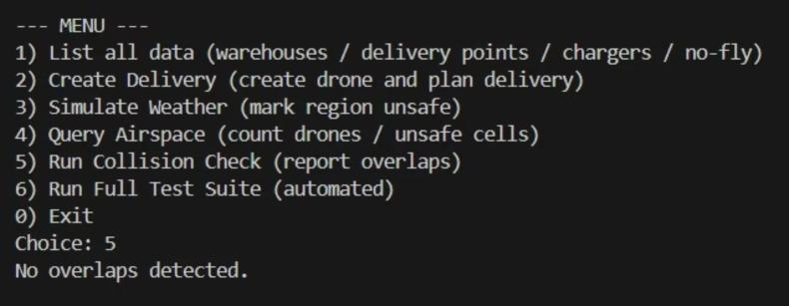
Test Case - 5

Slide 27
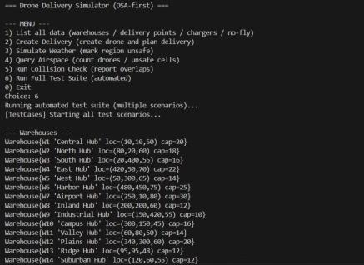
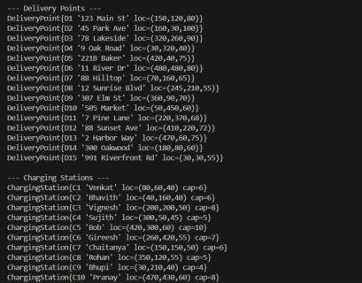
Test Case - 6

Slide 28
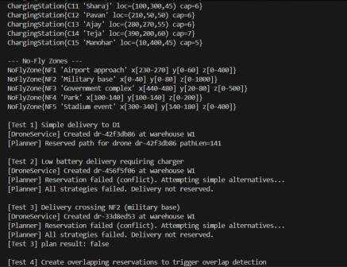
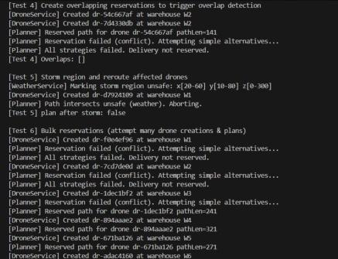

Slide 29
