Slide 1


Amazon Laptop Sales Dashboard and Data Analysis using Power BI
Presented By
Student Name: choppari bhavitha
College Name: institute of aeronautical engineering
Department: computer science and engineering
Email ID: bhavitha.choppari4@gmail.com

Slide 2
OUTLINE:
Problem Statement
Proposed System/Solution
System Development Approach
Algorithm & Deployment
Result (Output Image)
Conclusion
Future Scope
References

Slide 3
Problem Statement:
The rapid growth of online shopping platforms like Amazon has resulted in a large amount of product data being generated daily. However, analyzing this data manually to understand laptop sales trends, pricing patterns, product ratings, and brand performance is difficult and time-consuming.
Without proper visualization and analytical tools, it becomes challenging for analysts or businesses to extract meaningful insights from the data.
Therefore, there is a need for a system that can analyze and visualize Amazon laptop sales data efficiently, enabling users to easily understand sales patterns, product popularity, and pricing trends.

Slide 4
Proposed Solution:
The proposed system is an interactive Amazon Laptop Sales Dashboard developed using Power BI.
This system collects laptop product data from Amazon and transforms it into interactive visual dashboards that display key insights such as:
Total laptop sales
Brand-wise product comparison
Laptop price distribution
Product ratings analysis
Stock availability
Sales performance of different models
The dashboard allows users to quickly explore the data and make informed decisions based on visual insights.

Slide 5
System Approach:
The system is developed using the following technologies:
Power BI
Used for data visualization and dashboard creation
Provides interactive charts and analytics
CSV Dataset
Contains laptop sales and product information
Used as the primary data source
Power Query (Power BI)
Used for data cleaning and transformation
Data Analysis Techniques
Data filtering
Aggregation
Comparative analysis
These technologies help convert raw data into meaningful visual insights.

Slide 6
Algorithm & Deployment:
Algorithm Steps
Collect laptop dataset from Amazon.
Load dataset into Power BI.
Clean and preprocess the data using Power Query.
Transform data into structured format.
Create relationships and calculated measures.
Design visual dashboards using charts and graphs.
Analyze sales trends, ratings, and stock availability.
Deployment
The dashboard is deployed using Power BI Desktop.
It can also be published to Power BI Service for online access and sharing.

Slide 7
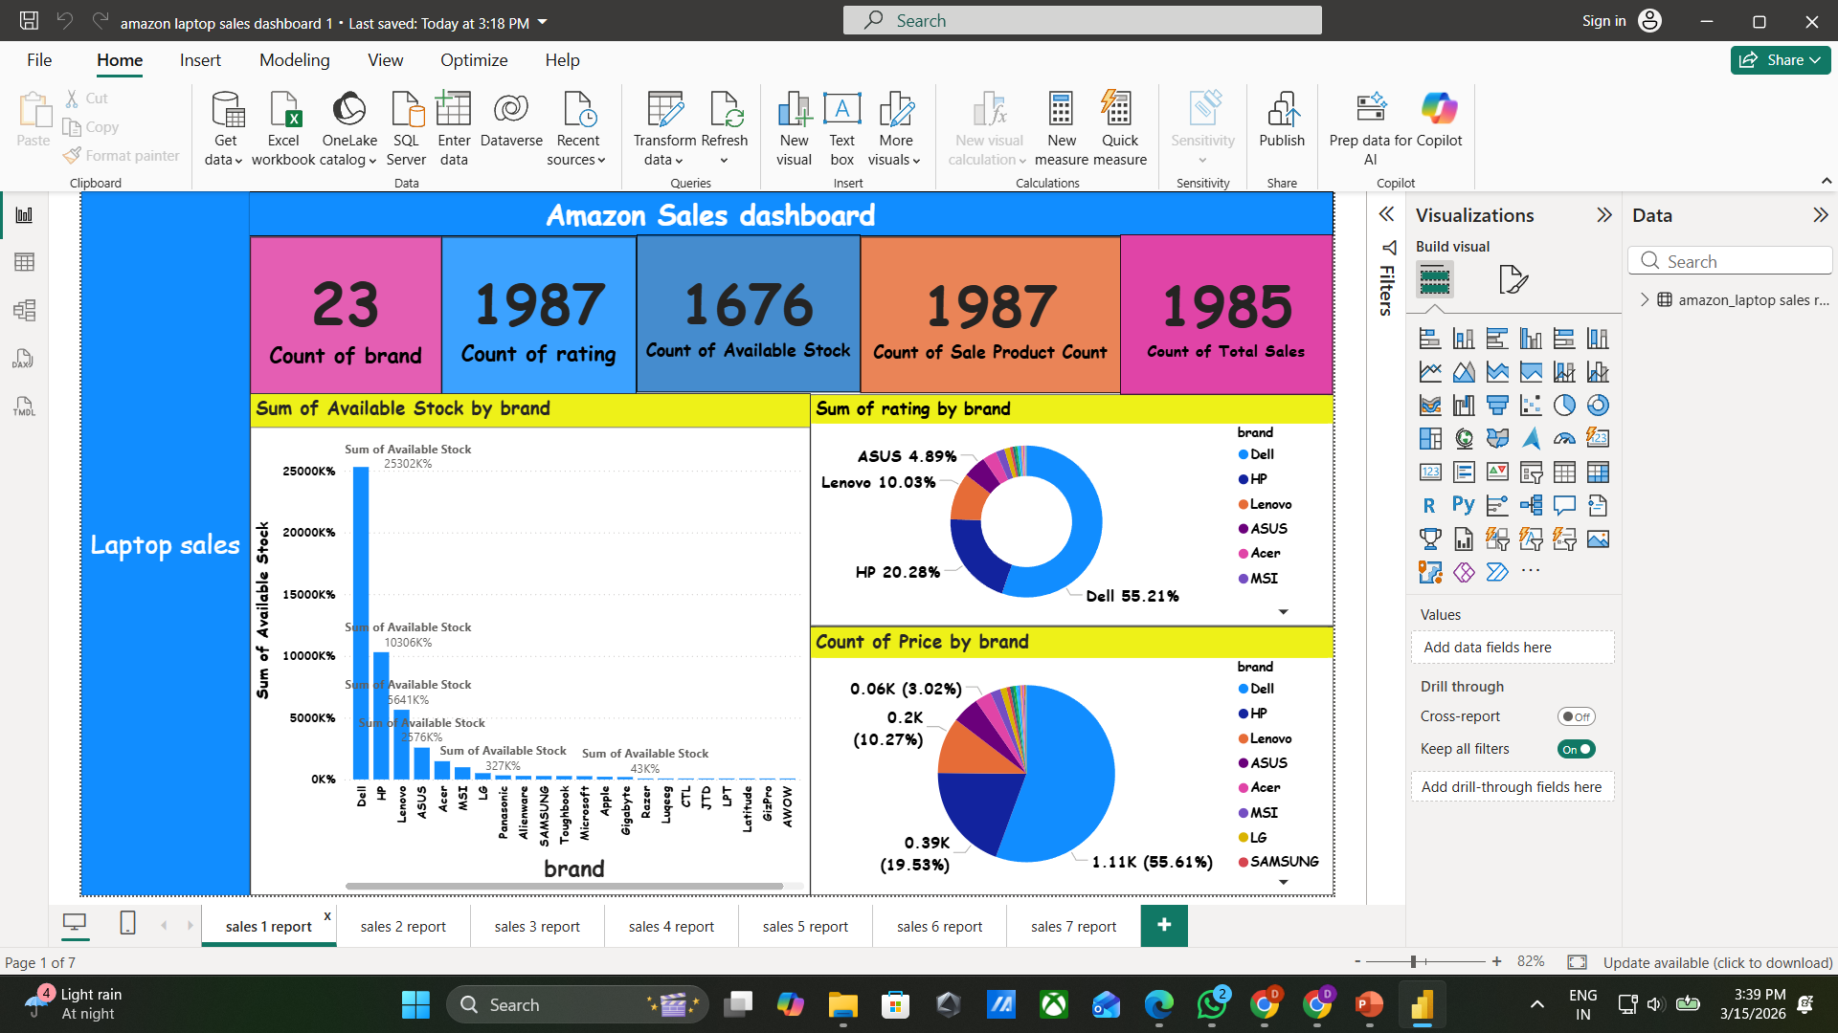
Result:
The developed Amazon Laptop Sales Dashboard successfully visualizes laptop sales data from Amazon using Power BI. The dashboard provides a clear and interactive representation of important sales metrics and product information.
Key insights obtained from the dashboard include:
23 laptop brands available in the dataset
1987 product ratings recorded
1676 available stock units
1987 sale product counts
1985 total sales recorded
The dashboard also provides visual analysis such as:
Brand-wise available stock comparison
Rating distribution across different laptop brands
Price distribution by brand
Sales performance of different brands
These visualizations help users easily understand product trends, popular brands, and stock availability.

Slide 8
Conclusion:
The Amazon Laptop Sales Dashboard provides an effective way to analyze laptop sales data using interactive visualizations.
It simplifies complex datasets and allows users to quickly identify trends in pricing, product popularity, brand performance, and customer ratings.
This system demonstrates how data visualization tools like Power BI can transform raw data into meaningful insights for better decision-making.

Slide 9
Future scope:
The system can be further improved by adding:
Real-time Amazon data integration
Predictive sales analysis using machine learning
Customer sentiment analysis from reviews
More advanced filtering options
Integration with other e-commerce platforms
These improvements can enhance the analytical capabilities of the system.

Slide 10
References:
Microsoft Power BI Documentation https://learn.microsoft.com/power-bi/
Amazon Product Dataset Sources
Data Visualization Concepts
Online resources and tutorials related to Power BI and data analytics
GitHub Link: https://github.com/Bhavitha-1007/Amazon-Laptop-Sales-Dashboard-and-Data-Analysis-using-Power-BI

Slide 11
Thank You

