Slide 1
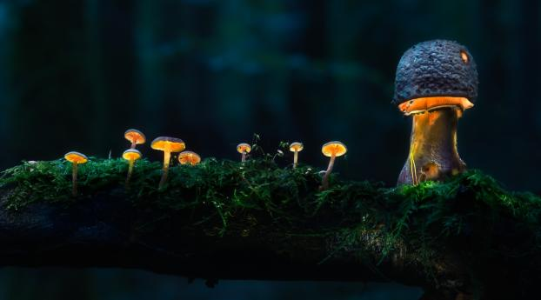
mushroom classification
Project :- P146 Mentor :- Neha Ramchandani
Created By :-
Rahul Patel, Charan Nandi, Adarsh Joshi, Hrithik, Rakesh N, Bhavitha Mitte

Slide 2
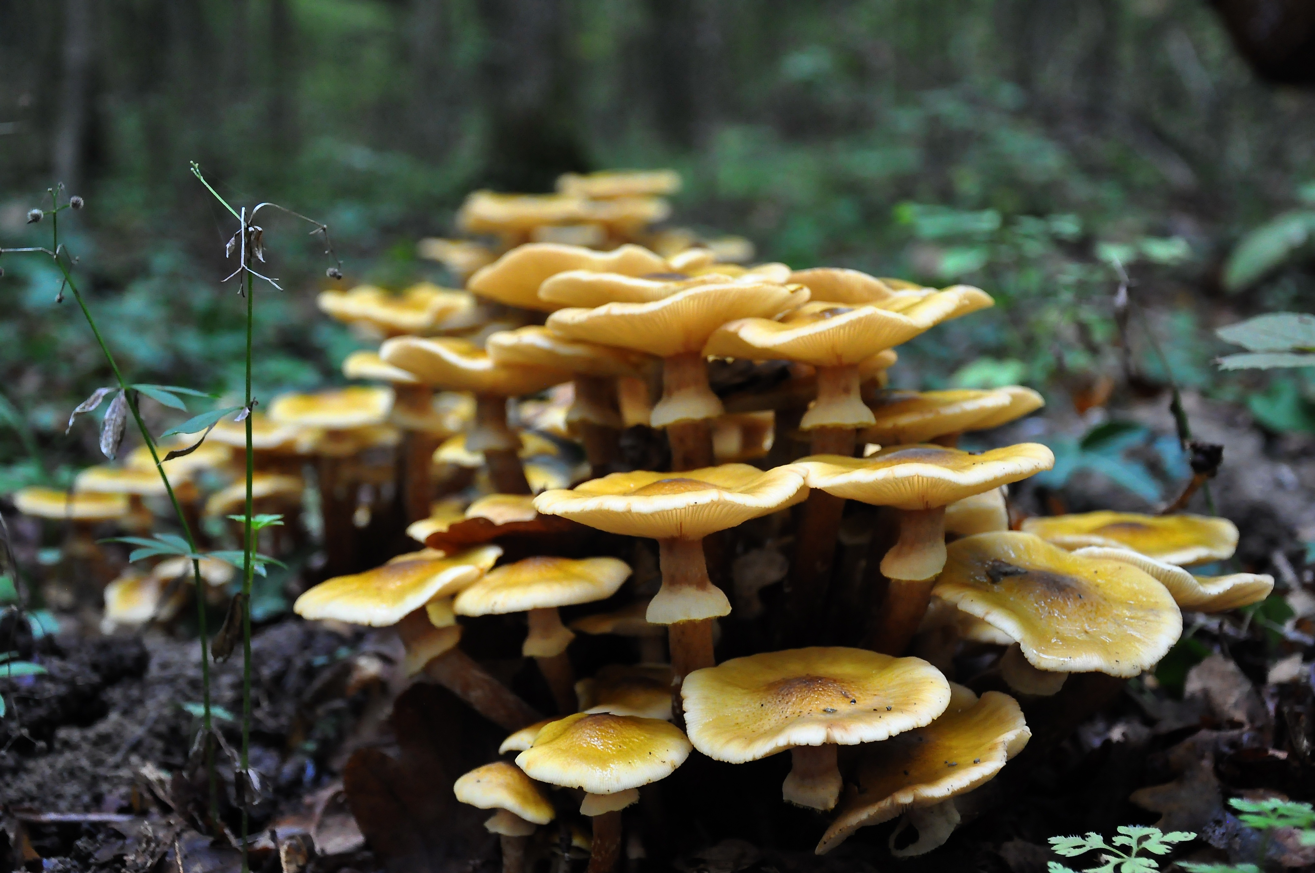
Objective :-
The Objective of this project is to create an algorithm that classifies the mushrooms between edible and poisonous.
Today, we have used sample of 8124 mushrooms and trained them on different aspects to find the difference and make the prediction in the future.
STEPS :-
Collect the data
Explore and Visualize the data
Pre-process the data
Model Building and Evaluation
Finalising the Model
Deployment

Slide 3
Packages used :-
Pandas
Seaborn
Matplotlib
Sklearn
NumPy
Streamlit

Slide 4
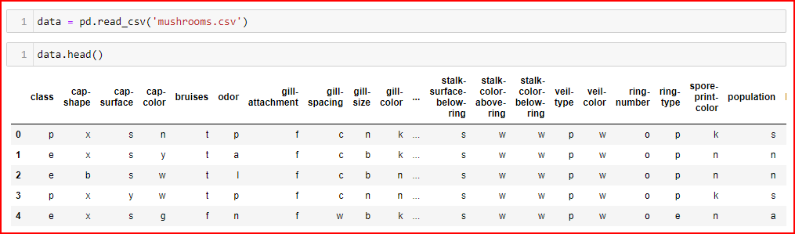
Data extraction
Data Extraction of sample of 8124 Mushrooms.
Source of Data :- Csv File

Slide 5
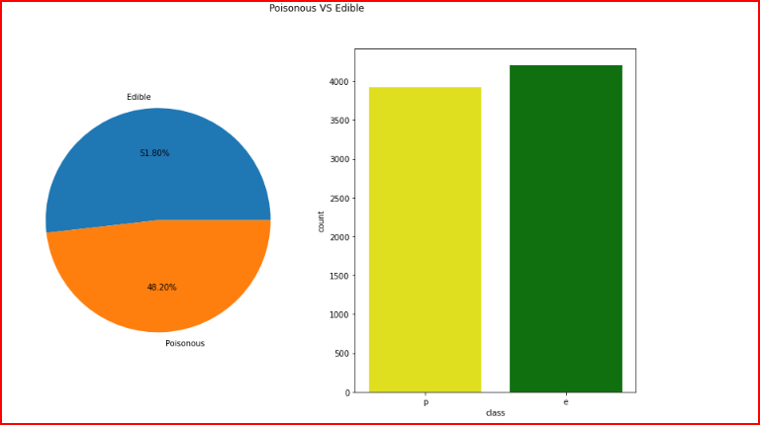
Explore and Visualizing the data

Slide 6
Pre-process the data
Label Encoding to convert categorical variables to numerical variables
Libraries :- Sklearn.preprocessing
Dimensionality reduction
Applying PCA to reduce the dimensions.
Libraries :- Sklearn.decomposition
Train – Test Split
90% of the data is used for training purposes.

Slide 7
Decision Tree
Model building and evaluation
Accuracy = 100 %
Logistic Regression
Accuracy = 94.96%
K-Nearest Neighbor
Accuracy = 100%
Support vector machines
Accuracy = 100%

Slide 8
Naïve bayes classification
Accuracy = 92.62%
Random forest classification
Accuracy = 100%
Finalizing model
Post evaluating accuracy of different models, finalizing Random Forest model to proceed.

Slide 9
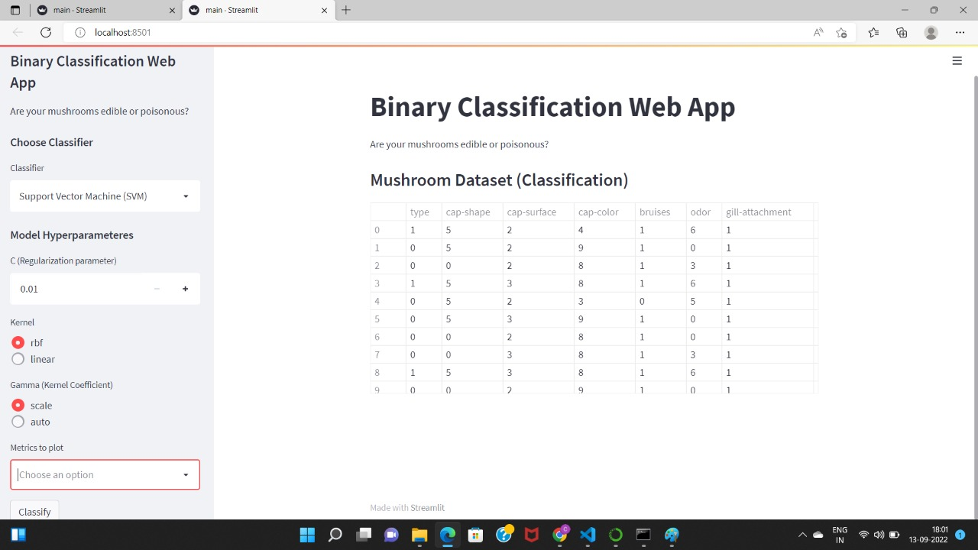
Deployment
Libraries :- Streamlit
Web App is created to classify the mushrooms with an option to do select different kernel,
Regularization Parameter etc.
Web App URL :- http://192.168.1.10:8501

Slide 10
Team member GitHub links:-
Rahul Patel - https://github.com/rahulpatel0890/mushroom_classification
Charan Nandi- https://github.com/charannandi2508/Mushroom-classification
Rakesh N - https://github.com/Rakeshprojec/Rakesh-project/tree/main
Bhavitha Mitte - https://github.com/Bhavitha-Mitte/Mushroom-Classification
Adarsh Joshi - https://github.com/adarshjoshi99/Mushroom-Classification-Project
Hrithik Shirke - https://github.com/hrithikSHIRKE/excelr-project

Slide 11
Thank you …………………………..!

