Slide 1
Welcome

Slide 2

ANNAMACHARYA PG COLLEGE OF COMPUTER STUDIES NEW BOYANAPALLI RAJAMPET -516126
Classification & separation of WhatsApp Images
using machine learning
Guid Name: presented By
C . Siva Krishnaiah T. Bhavitha
Assistant Professor Roll.No:-215N1F0021
Department of MCA MCA 4th Semister
APGCCS, Rajampet. APGCCS, Rajampet.

Slide 3
Contents:-
Abstract
Introduction
Software Requirements Analysis And Specification
System Design
Testing
Implementation
Conclusion

Slide 4
Abstract:-
In this digital era, Internet has become an integral part of human lives. Internet and social networks have become very popular, allowing anyone to easily share pictures, text, audio and video files. Among all the applications, WhatsApp has become quite famous due to its ease of use and it has replaced almost all the other messaging apps. Apart from sending messages, images and videos over it, one more reason for the heavy usage of WhatsApp is the exchange of study notes and materials by the students during the time of the examination and end up with a lot of images to be deleted at the end of each semester. And also the notices and brochures in every semester gets mixed up with other images and these needs to be separated for easy reference. As the WhatsApp folder may have many other images, selecting the study material images, brochures, etc., one by one from the other images and then deleting them is a tedious process. Henceforth, this research work has utilized machine learning to build a model for detecting and extracting the images from the WhatsApp images folder. Further, the proposed model classifies the study notes images into printed and handwritten notes. Notices and brochures received on WhatsApp are separated into a new folder. And also, screenshots and photos are grouped into separate folders. The proposed model has been built by using a deep learning concept called the Convolutional Neural Network [CNN] and by using Python’s Keras library. It takes an image and decides its category and then the action is taken accordingly.

Slide 5
INTRODUCTION

Slide 6
Introduction:
Classifications are systematically divided into groups and categories based on their characteristics. Image classification has emerged to narrow the gap between computer vision and human vision by training computers with data.
Image classification is achieved by classifying images into predetermined categories based on the content of the vision
Machine learning consists of a feature extraction engine that extracts important features such as edges and textures, and a classification engine that classifies based on the extracted features
The main limitation of machine learning is that it can be separated, but it can only extract specific features on the image, not characteristic features from the training dataset.

Slide 7
PURPOSE
The purpose of classification and separation of WhatsApp images using machine learning is to simplify and automate the organization and retrieval of images shared on the WhatsApp platform.
By leveraging machine learning techniques and visual feature extraction, the project aims to create a user-friendly solution that can efficiently classify images into customizable categories, saving time and effort for users in managing their WhatsApp image collections.

Slide 8
SCOPE
Now a days so many peoples are facing the whatsapp images to find the mixed up with other images and these need to be separated for easy reference this research work.
To utilized machine learning to build a model for detecting and extracting the images from the WhatsApp images folder. By using a deep learning concept called the Convolutional Neural Network [CNN] .

Slide 9
Existing System:-
Our system will operate according to the system architecture depicted in the diagram below, capturing images either through a digital camera or through a database.
For the next step, each image will be normalised to a predetermined size.
We employ feature extraction approaches as Histogram Equlization, and others to reduncate dimentianality.
Feature vectors are formed by extracting features from a picture using various approaches such as Histogram Equlization, and so on.
The NN(Neural Network) will be given this processed image to use in the classification process.

Slide 10
Disadvantages:-
Time taken:
The time taken for image classification and separation in the existing system might be longer due to limited image recognition accuracy and dependency on metadata for sorting.
Low accuracy:
The existing system may struggle to accurately categorize images, leading to sorting errors and misclassifications.

Slide 11
Proposed System:-
In this project we are using CNN (convolution neural networks) algorithm to classify Whatsapp images to different categories such as Question Paper, Mark sheets, Printed papers, hand written papers and circular.
CNN algorithm will get trained on above mention categories to build a classification model. This model can be applied on test images to predict image type.
To train CNN we have used same dataset given by and below showing that dataset images

Slide 12
Advantages:-
Time-saving:
An efficient image classification and separation system helps users save time by automatically organizing and categorizing images, eliminating the need for manual sorting.
High efficiency :
The system quickly and accurately organizes images, making the process smooth and effective.

Slide 13
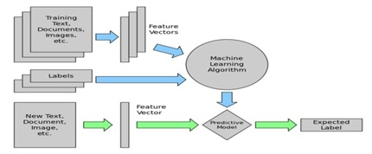
Proposed System Architecture:-

Slide 14
PRODUCT FUNCTIONS
Upload WhatsApp Images Dataset
Preprocess Dataset
Train CNN Algorithm
CNN Training Graph
Whatsapp Images Classification
Exit

Slide 15
Upload WhatsApp Images Dataset:-
using this module we will upload dataset to application and then read all images and categories from dataset
Preprocess Dataset:-
using this module we will resize all images to equal size and then normalize image pixel values and then shuffle the dataset. After processing all images will be split into train and test where application using 80% dataset for training and 20% for testing

Slide 16
Train CNN Algorithm:-
using this module we will input 80% dataset to CNN to trained a model and then 20% test images will be applied on trained model to calculate prediction accuracy
CNN Training Graph:-
using this module we will plot CNN training and loss graph
Whatsapp Images Classification:-
using this module we will upload test image and then CNN will predict

Slide 17
Specifications
HARDWARE REQUIREMENTS
•System : i3 or above.
•Ram : 4 GB.
•Hard Disk : 40 GB
SOFTWARE REQUIREMENTS
•Operating system : Windows8 or Above.
•Coding Language : python 3.7
•Framework : Tkinter
•Back End : Python

Slide 18
CNN Algorithm
The Convolutional Neural Network (CNN) is a deep learning algorithm used for image recognition and processing. It works by using filters to scan and detect patterns in the input image, then combining this information to identify and classify objects in the image accurately.
CNNs are special types of computer algorithms designed to help computers recognize and understand images. They use filters to find important patterns in pictures and combine them to figure out what objects are present in the images.
By using multiple layers of these filters, CNNs can learn more and more complex features, making them very powerful for tasks like identifying objects in photos or videos.

Slide 19
Non-Functional Requirements
Reliability : To provide Reliable Software Development
Security : Provides Enchanced Security for project Deployment
Maintainability : Provides Backup and Restore Maintainability
Usability : Provides Graphical User Interface
Performance : In performance the project occupies very limited resources.
Testability : Project is tested using validation testing

Slide 20
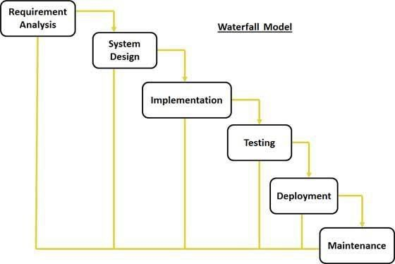
SDLC

Slide 21
SYSTEM DESIGN

Slide 22
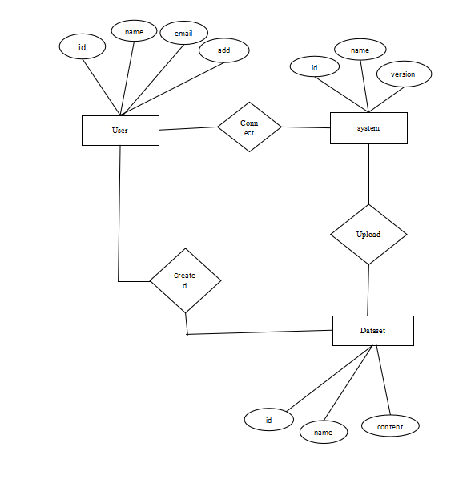
ER - Diagram

Slide 23
Table Name: User
Column | Datatype | Constraints
User Id | Number | Primary Key
Name | Varchar2() | Not Null
Email | Varchar2() | Not Null
Password | Varchar2() | Not Null

Slide 24
Table Name : System
Column | Datatype | Constraints
Id | Number | Primary Key
Name | Varchar2() | Not Null
Version | Number | Primary Key

Slide 25
Table Name: Dataset
Column | Datatype | Constraints
Id | Number | Primary Key
Name | Varchar2() | Not Null
Content | Varchar2() | Not Null

Slide 26
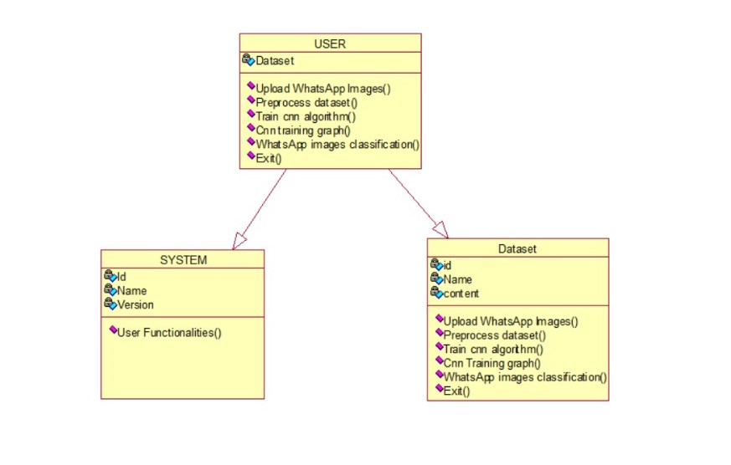
Class Diagram for over all project

Slide 27
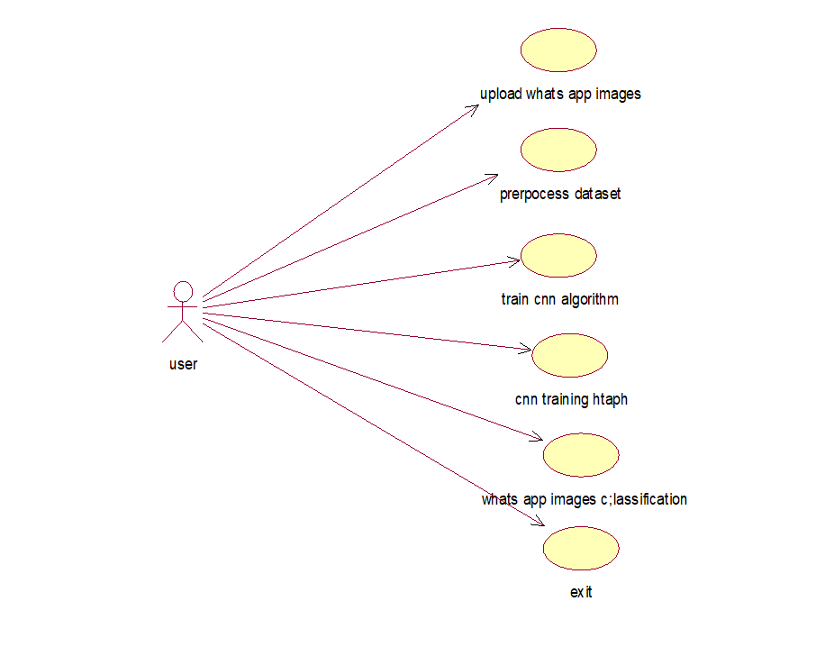
Use Case Diagram for over all project

Slide 28
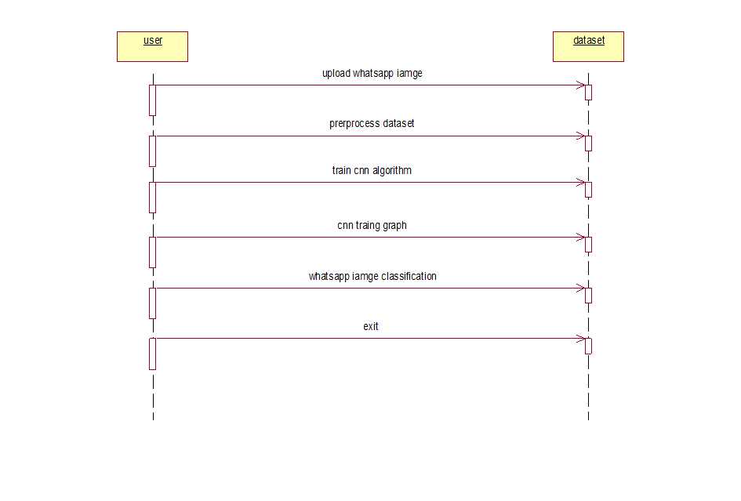
Sequence Diagram for over all system

Slide 29
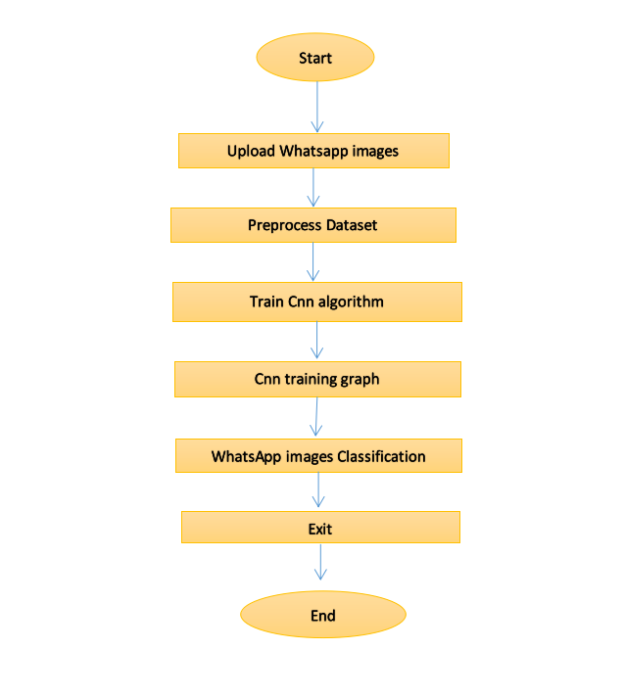
Activity Diagram for over all system

Slide 30
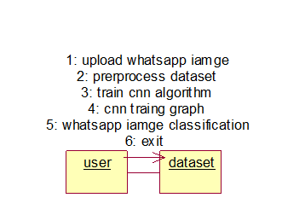
Collaboration Diagram

Slide 31
TESTING

Slide 32
Testing
Testing is a process, which reveals errors in the program. It is the major quality measure during software development. During Software development, during testing, the program is executed with a set of test cases and the output of the program for the test cases is evaluated to determine if the program is performing as it expected to perform.

Slide 33
Testing Methodologies
Types :
White box testing
Black box testing
Levels of testing:
Unit Testing
Function Testing
Integration Testing
System Testing
Acceptance Testing

Slide 34
Test Cases
S.No | Test Cases | Input | Expected Result | Actual Result | Status
1 | Upload WhatsApp Images | Upload WhatsApp Images to the system | User upload the images | Images is Successfully upload | Pass
2 | Upload Unsupported file format | Attempt to upload an image with an unsupported file format | User not upload the images | System displays an error message | Fail
3 | Preprocess dataset | Preprocess a uploaded whatsapp images | User uploaded images preprocess | Image is preprocessed as per the defined preprocessing step | Pass
4 | Train CNN Algorithm | Train the CNN Algorithm using the prepared dataset | User trained cnn algorithm | CNN Algorithm is trained successfully | Pass

Slide 35
S.No | Test Cases | Input | Expected Result | Actual Result | Status
5 | CNN training graph | Visualize the CNN training graph | User train the cnn graph | CNN training graph shows the loss & Accurecy | Pass
6 | WhatsApp images classification | Upload WhatsApp images for classification | User classified the images | WhatsApp Images are classified correctly | Pass
7 | Exit | Click the exit button in the user interface | User exit the button | Application Exit Successfully | Pass

Slide 36
IMPLEMENTATION

Slide 37
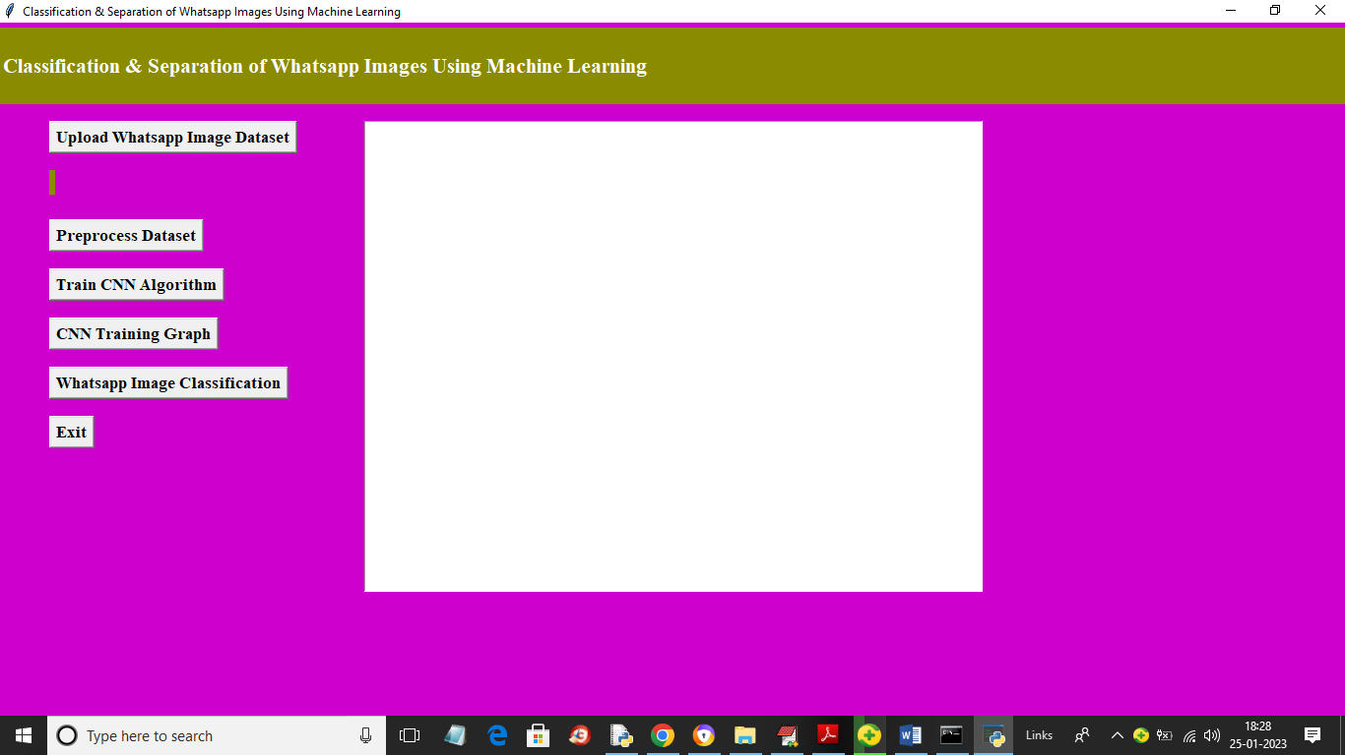
Sample Screens
Screen 1: To run project double click on ‘run.bat’ file to get below screen
Fig: Home Screen
In above screen click on ‘Upload Whatsapp Image Dataset’ button to upload dataset and get below page

Slide 38
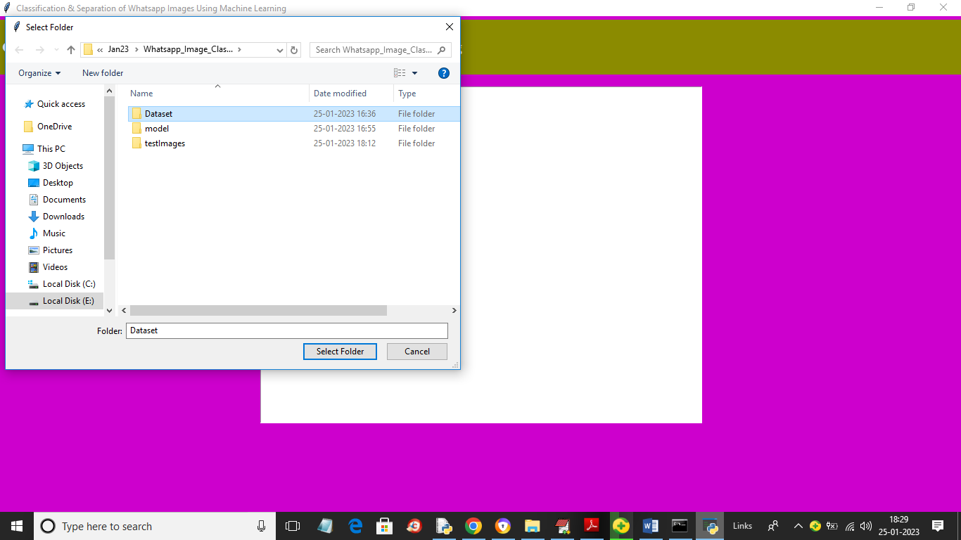
Screen 2: In above screen selecting and uploading ‘Dataset’ entire folder and then click on ‘Select Folder’ button to load dataset and get below page
Fig: Upload WhatsApp Image Dataset folder

Slide 39
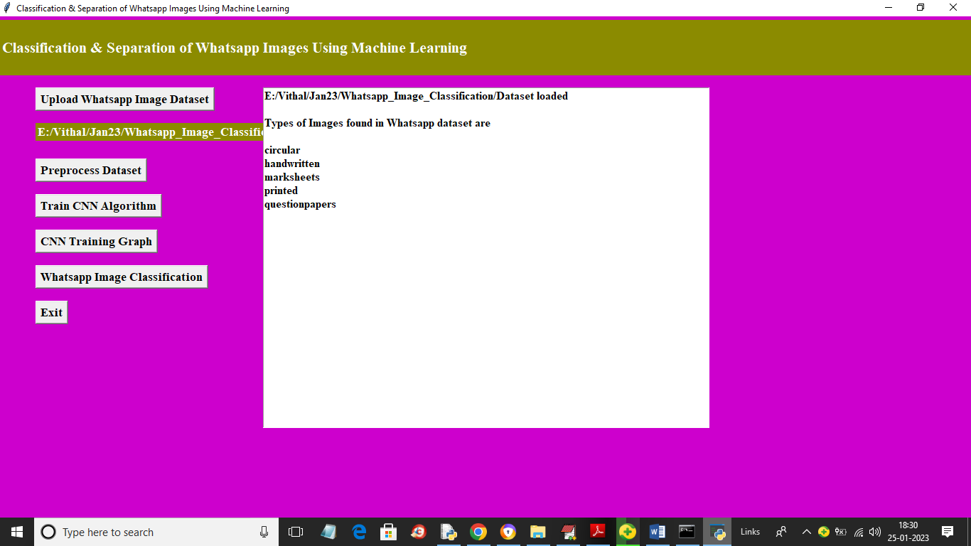
Screen 3: In above screen we can see dataset loaded and then we can see types of categories loaded and now click on ‘Preprocess Dataset’ button to resize, normalize, shuffle and split dataset into train and test
Fig: Dataset Loaded

Slide 40
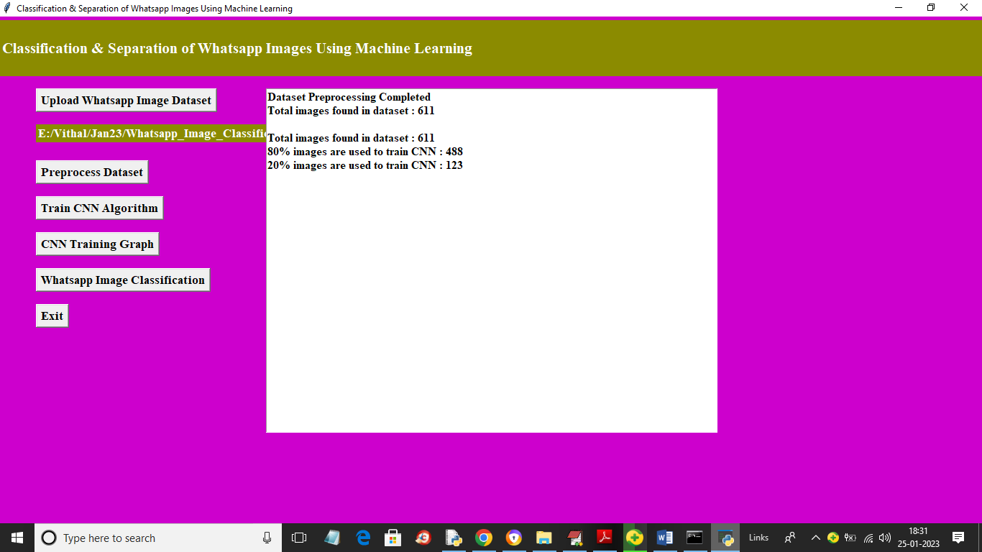
Screen 4: In above screen we can see application found total 611 images in the dataset and then process and then took 488 images for training and 123 images for testing a 80 and 20%. Now click on ‘Train CNN Algorithm’ button to train CNN and get below output
Fig: preprocess Dataset

Slide 41
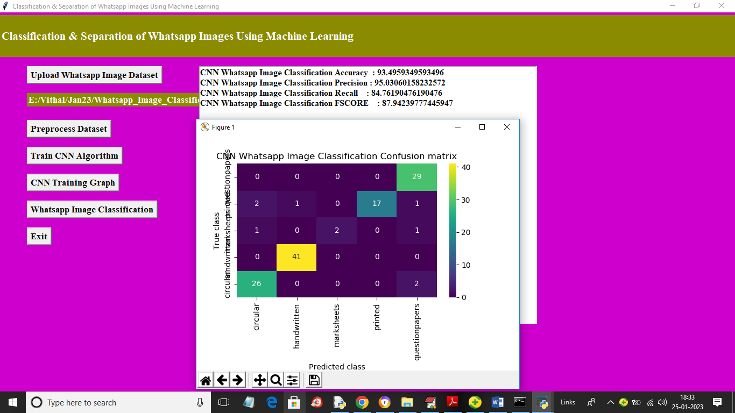
Screen 5: In above screen with CNN we got 93% accuracy and we can see precision, recall and FSCORE metric. In confusion matrix graph x-axis represents Predicted Labels and y-axis represents True Labels and all blue colour boxes contains INCORRECT prediction count which are very few and different colour boxes contains CORRECT prediction count which are high in numbers so we got 93% accuracy. Now click on ‘CNN Training Graph’ button to get below page
Fig: Train CNN Algorithm

Slide 42
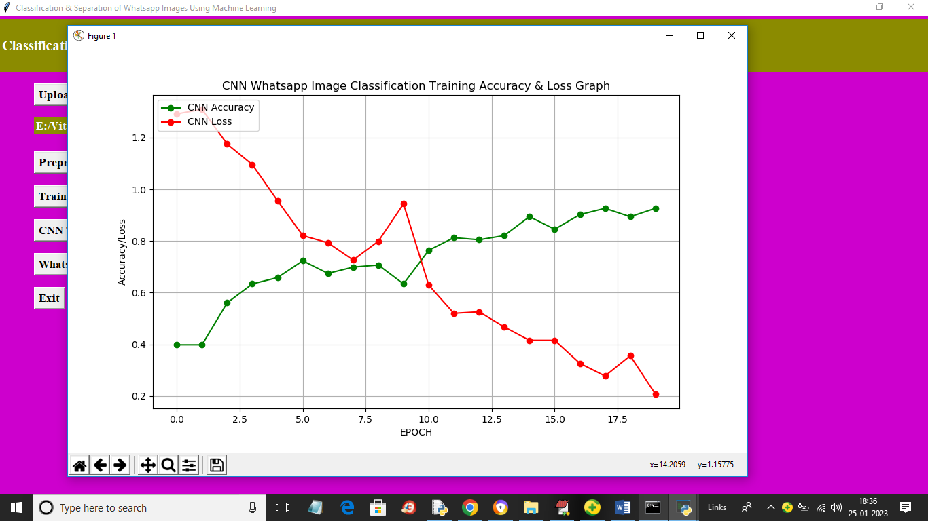
Screen 6: In above CNN training graph x-axis represents training epoch and y-axis represents accuracy and loss values. Green colour line represents Training Accuracy and red colour line represents Training LOSS and in above graph we can see with each increasing epoch accuracy got increase and reached closer to 1 and loss got decreased and reached closer to 0 1. Now close above graph and then click on ‘Whatsapp Image Classification’ button to upload test image and get classification output
Fig: CNN Training Graph

Slide 43
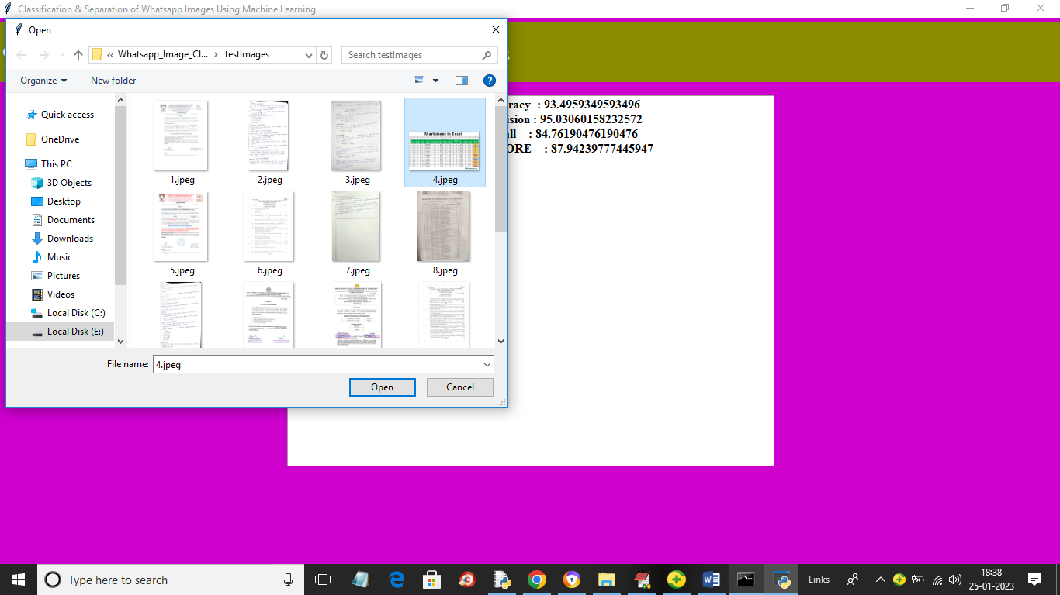
Screen 7: In above screen selecting and uploading 4.jpeg file and then click on ‘Open’ button to get below output
Fig: Select and uploading the image

Slide 44
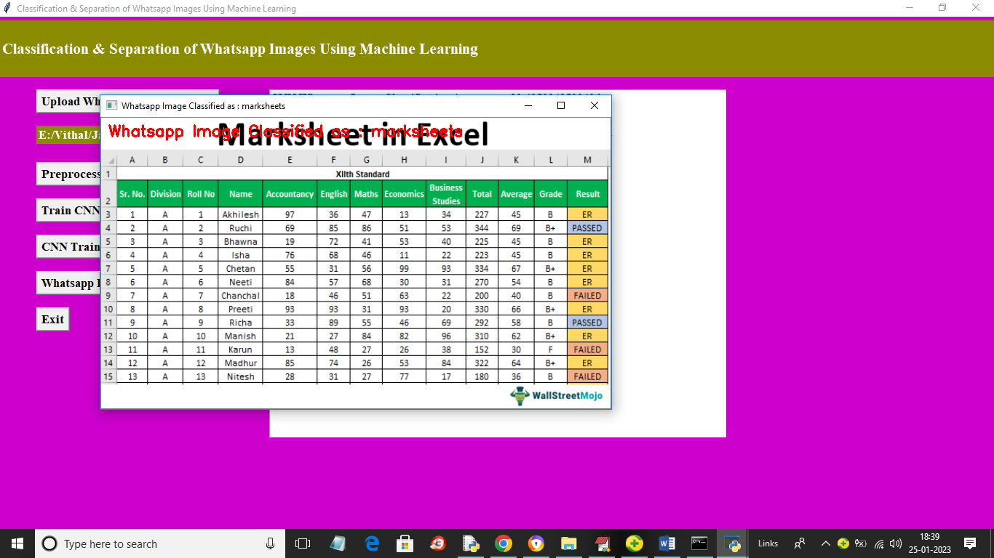
Screen 8: In above output image in red colour text or in image title you can see image classified as mark sheet. Similarly you can upload and test other images
Fig: WhatsApp Image Classified

Slide 45
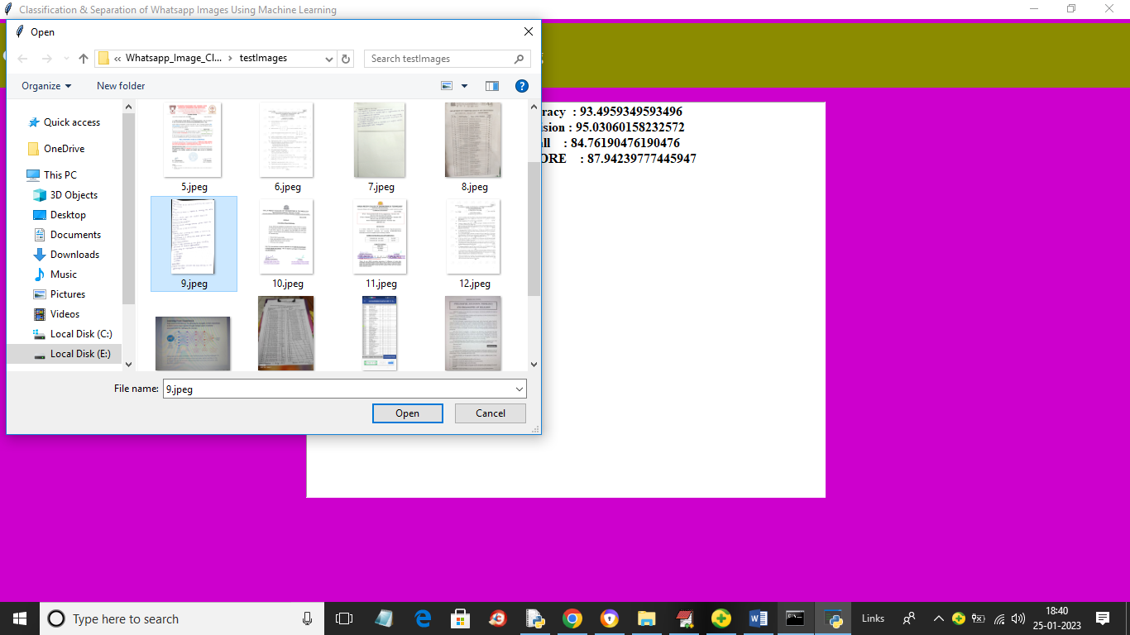
Screen 9: In above screen uploading another image and below is the output
Fig: Select and uploading the image

Slide 46
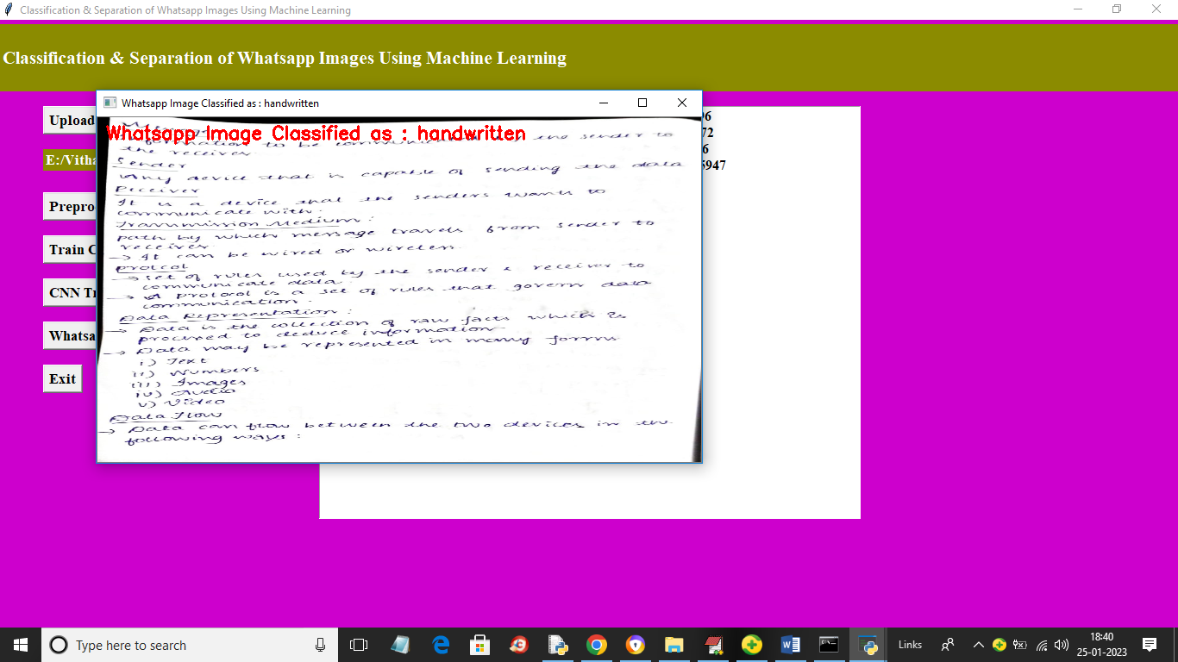
Screen 10: In above screen image classified as ‘hand written’
Fig: WhatsApp Image Classified

Slide 47
CONCLUSION

Slide 48
CONCLUSION
As a result, the proposed single sharing CNN method is very appropriate for categorizing images for simple search, and it has been successfully implemented. Using WhatsApp to disseminate false information is a significant societal issue. The accuracy of Fusion Net was superior to other conventional picture categorization techniques, as shown in the results and discussion section. In the future, this study intends to focus on combining message information (such as sender, timestamp, and group) with textual characteristics to better classify messages. A Deep Leaning method would be used to extract features from both text and media data in order to study multi-modal misinformation detection. Subsequently, the research urges to look at semi automatic techniques for creating constantly tagged WhatsApp datasets because misinformation changes over time.

Slide 49
ANY QUERIES

Slide 50
Thank You

