Slide 1

Automation Of Invigilation Duties
by
Y.BHAVITHA
Roll No. 224G1A0511
A.RAMYA SREE
Roll No. 224G1A0582
J.SUMANTH
Roll No. 224G1A05A9
Under the guidance of
Dr. S. Rajesh Babu, M.Tech., ph.D.
Assistant Professor
Department of Computer Science and Engineering
Srinivasa Ramanujan Institute of Technology
Autonomous
Rotarypuram Village, B K Samudram Mandal, Ananthapuramu – 515701.
2025-2026
A18
DEPT. OF COMPUTER SCIENCE AND ENGINEERING
02
SRINIVASA RAMANUJAN INSTITUTE OF TECHNOLOGY

Slide 2
Automation Of Invigilation Duties
Contents
Title Justification
Abstract
Problem statement
Objectives of Project
Literature survey
Proposed Work
References
GitHub Link
Queries
A18
DEPT. OF COMPUTER SCIENCE AND ENGINEERING
02
SRINIVASA RAMANUJAN INSTITUTE OF TECHNOLOGY

Slide 3
Automation Of Invigilation Duties
Title Justification
The title “Automation of Invigilation Duties” is chosen because the existing manual method of assigning invigilation responsibilities in educational institutions is time-consuming, prone to human errors, and often results in unfair workload distribution among faculty. As examinations grow in scale, administrators face increasing difficulty in handling faculty availability, timetable clashes, and subject-related constraints using traditional paper-based or spreadsheet-based processes.
Automating the invigilation scheduling process ensures accuracy, fairness, transparency, and operational efficiency.
A18
DEPT. OF COMPUTER SCIENCE AND ENGINEERING
03
SRINIVASA RAMANUJAN INSTITUTE OF TECHNOLOGY

Slide 4
Automation Of Invigilation Duties
Abstract
The project “Automation of Invigilation Duties” focuses on developing a system that automates the scheduling and management of exam invigilators in educational institutions. Manual allocation often results in errors, conflicts, and uneven workload distribution. The proposed system streamlines this process by automatically assigning duties based on faculty availability, workload balance, and timetable constraints. It prevents overlapping schedules, ensures fairness, sends notifications, and generates clear, structured reports. By reducing administrative effort and improving accuracy, the system supports smooth, efficient, and transparent examination operations.
A18
DEPT. OF COMPUTER SCIENCE AND ENGINEERING
04
SRINIVASA RAMANUJAN INSTITUTE OF TECHNOLOGY

Slide 5
Automation Of Invigilation Duties
Problem Statement
Educational institutions face difficulties in manually scheduling invigilation duties. Errors such as overlapping assignments, allocation of teachers to their own subject exams, and unfair workload distribution frequently occur. Adjusting schedules during last-minute timetable changes becomes time-consuming and stressful for administrators. Additionally, there is no centralized system to track faculty availability or store past duty records. Hence, there is a need for an automated solution that handles scheduling intelligently, prevents conflicts, and improves the efficiency and accuracy of exam duty management.
A18
DEPT. OF COMPUTER SCIENCE AND ENGINEERING
05
SRINIVASA RAMANUJAN INSTITUTE OF TECHNOLOGY

Slide 6
Automation Of Invigilation Duties
Objectives of Project
To automate the allocation of invigilation duties using a web-based scheduling system.
To ensure fair and conflict-free distribution of duties among faculty members.
To provide instant notifications and clear automated reports, bridging the gap of poor communication in traditional methods.
To generate structured reports for hall-wise, date-wise, and faculty-wise duty assignments.
To provide an integrated chatbot for answering exam and duty-related queries.
A18
DEPT. OF COMPUTER SCIENCE AND ENGINEERING
06
SRINIVASA RAMANUJAN INSTITUTE OF TECHNOLOGY

Slide 7
Automation Of Invigilation Duties
Literature Survey
No | Title | Author | Journal Name & Year | Methodology Adapted | Key Findings | Gaps Identified
1 | Online Hall Allocation System (OHAS) for Improved Examination Centre Scheduling | A. Sharma | Intl. Conf. Proc., 2024 | Designed a web-based hall allocation system that selects hall combinations and generates seating plans through a browser interface. (ResearchGate) | Reduced manual work and errors in hall selection; improved utilization of room capacity. | Focuses only on halls and seats; no invigilator duty allocation or staff-wise workload balancing. (ResearchGate)
2 | Development of Web Based Examination Timetable Management and Reporting System | O. Akinola | Web Based Exam Timetable Mgmt., 2024 | Implemented a web application that generates exam timetables, assigns invigilators and produces reports for admins. (ResearchGate) | Automated timetable and basic invigilation assignment; centralized exam data and reporting. | Limited constraint handling (no distance / nearest-faculty logic); no real-time re-assignment or chatbot help for staff queries. (ResearchGate)
3 | Exam Seating Arrangement System (Web-Based) | P. Pathari | IRJET, 2024 | Built a browser-based seating system that generates hall-wise seat lists with date, time and subject details for students and staff. (IRJET) | Simplified generation of seating charts and reduced last-minute confusion for students. | Does not allocate invigilation duties; no fairness rules or faculty-wise duty summary; no chatbot interface. (IRJET)
4 | Dynamic Exam Seating & Invigilation Management (Web App) | S. Singh & M. Sharma | IJCRT, 2025 | Proposed a web-based exam seating & invigilation module using MySQL and role-based logins for admin and staff. (IJCRT) | Reduced manual scheduling effort; provided online access to hall and duty information. | Invigilation logic is still basic (no consideration of faculty location / nearest block); lacks analytics dashboards and automated conflict checking. (IJCRT)
5 | Chatbot Student Support System in Open and Distance Learning | J. N. Ndunagu | Computers, 2025 | Deployed a web-accessible AI chatbot integrated with academic systems to answer administrative and academic queries of students. (MDPI) | Majority of users reported the chatbot as highly helpful; improved response time and reduced staff burden. | Designed for general academic support only; not connected to invigilation or exam duty workflows, and no faculty-side features. (MDPI)
A18
DEPT. OF COMPUTER SCIENCE AND ENGINEERING
07
SRINIVASA RAMANUJAN INSTITUTE OF TECHNOLOGY

Slide 8
Automation Of Invigilation Duties
Proposed System
The proposed system will operate using the following workflow:
Collect faculty details such as availability, subjects, and workload.
Upload the exam timetable including dates, rooms, and exam sessions.
Automatically allocate invigilation duties using rule-based scheduling.
Detect and prevent conflicts such as overlapping duties or subject-based restrictions.
Send automated duty notifications to faculty members.
Generate hall-wise, date-wise, and faculty-wise reports.
Store all duty logs for future reference and audit purposes.
A18
DEPT. OF COMPUTER SCIENCE AND ENGINEERING
08
SRINIVASA RAMANUJAN INSTITUTE OF TECHNOLOGY

Slide 9
Automation Of Invigilation Duties
References
Sharma A., Singh R., & Verma P. (2025). Online Hall Allocation System (OHAS) for Improved Examination Centre Scheduling. International Conference Proceedings on Computing and Automation, 2025.
Akinola O., Adewale T., & Sodiq M. (2024). Development of Web-Based Examination Timetable Management and Reporting System. Web-Based Exam Timetable Management Journal, 2024.
Pathari P., Jadhav S., & Deshmukh R. (2024). Web-Based Exam Seating Arrangement System. International Research Journal of Engineering and Technology (IRJET), 2024.
Singh S. & Sharma M. (2025). Dynamic Exam Seating and Invigilation Management Using Web Technologies. International Journal of Creative Research Thoughts (IJCRT), 2025.
Ndunagu J. N., Okoye F., & Ibrahim M. (2025). Chatbot Student Support System in Open and Distance Learning. Computers, 2025.
A18
DEPT. OF COMPUTER SCIENCE AND ENGINEERING
09
SRINIVASA RAMANUJAN INSTITUTE OF TECHNOLOGY

Slide 10
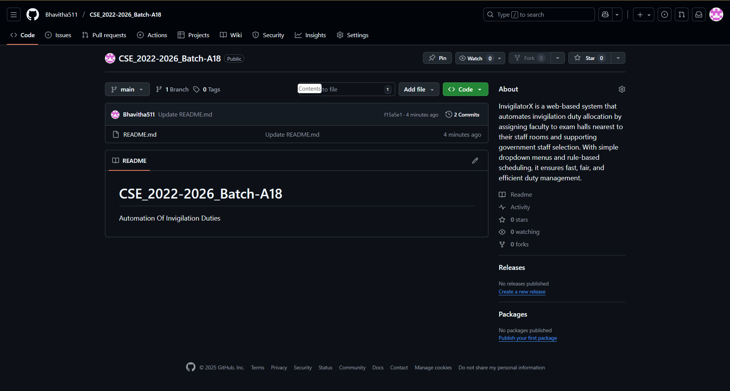
Automation Of Invigilation Duties
GitHub Dashboard
GitHub Link : https://github.com/Bhavitha511/CSE_2022-2026_Batch-A18
DEPT. OF COMPUTER SCIENCE AND ENGINEERING
10
A18
SRINIVASA RAMANUJAN INSTITUTE OF TECHNOLOGY

Slide 11
Automation Of Invigilation Duties
Any Queries?
A18
DEPT. OF COMPUTER SCIENCE AND ENGINEERING
11
SRINIVASA RAMANUJAN INSTITUTE OF TECHNOLOGY

