Slide 1

Auction Based E- Commerce Web APPLICATION
By –
BHAVIYA GANDANI
PRAFUL SURVE
JUSTIN SHELLEY
ROYA ASKARI

Slide 2
PROBLEM STATEMENT
As technology advances rapidly, on-line shopping is a new trend on Internet AND Buying and selling products on Internet is growing rapidly
As there are many e-commerce websites available, there is a need for auction based website which can allow the buyer to bid high if the product is worth its quality
An auction based web application becomes an effective tool where a seller can post the item for bidding and multiple buyers across the globe can view the product and bid high for the product
This allows the flexibility for the seller as well the buyer

Slide 3
INTRODUCTION
auction based E-COMMERCE web application is designed to make it easy for the local buying and selling of products
The auction IS for THE fun and engaging sale that maximizes the profits for the seller and convenience for the bidder
AUCTION BASED E-COMMERCE WEB APPLICATION ALSO IMPLEMENTS THE BUYING AND SELLING OF PRODUCTS WITHOUT ANY AUCTION TIMER
Web APPLICATION with a clean, intuitive user interface to facilitate posting and buying items
Web application which Provides accounts for users to register and login

Slide 4

SALES PITCH
DYNAMIC AUCTION TIMER
BOON FOR SELLer and buyer
PRODUCT, ONCE POSTED, Remains in the website forever until it is sold
Responsive website
Faster efficiency
Confidential details
Effective gui
Handles multiple users at a time

Slide 5
Advantages over traditional auction based websites
Sellers can quickly earn money for unwanted items
Sellers don't have to be in contact with multiple buyers trying to negotiate a price
Product can be purchased by any buyer after the auction timer for the product expires
Single account can be both – a seller account and a buyer account
Confidential information
Buyer details are shared to seller only when the product is purchased by the buyer
Easy to edit the profile and password
Responsive and effective gui

Slide 6

Tools
Microsoft visual studio 2015 community
Microsoft sql server 2016
C#
Asp.net
Google docs
Dropbox
github

Slide 7
Use case – UC4 posting a product for sale
Use Case ID: UC #4
Scope: Auction based e-commerce web application
Primary Actor: Seller
Preconditions: user is logged into the account

Slide 8
Use case – UC4 posting a product for sale
Main success scenario:
User clicks on “Sell a product” from the home page
System sets user type flag as ‘Seller’
System displays the “Post a product” page
User inputs product name
User inputs product category
User inputs brief description
User inputs images of product
User inputs base price
User clicks on “Post product” button
System posts the product for sale
System displays ‘Products for auction’ page
System displays message “Successfully posted product for sale”
System places the product at the beginning of the available products for auction

Slide 9
Use case – UC4 posting a product for sale
Alternative tasks:
4a. User keeps product name as blank
4a1. System displays an error message saying “This field is required”
4a2. System navigates to step 4
5a. User keeps product category unselected.
5a1. System displays error message saying “Choose one category”
5a2. System navigates to step 5
6a. User keeps product brief description as blank.
6a1. System displays error message saying “This field is required”
6a2. System navigates to step 6

Slide 10
Use case – UC4 posting a product for sale
Alternative tasks:
7a. User does not upload product images.
7a1. System displays an error message saying “At least one image required”
7a2. System navigates to step 7.
8a. User keeps base price as blank.
8a1. System displays an error message saying “This field is required”
8a2. System navigates to step 8.
8b. User inputs base price other than numbers.
8b1. System displays an error message saying “Only numbers allowed”
8b2. System navigates to step 8.

Slide 11
Use case – UC4 posting a product for sale
Post condition: System successfully posted a product for the user

Slide 12
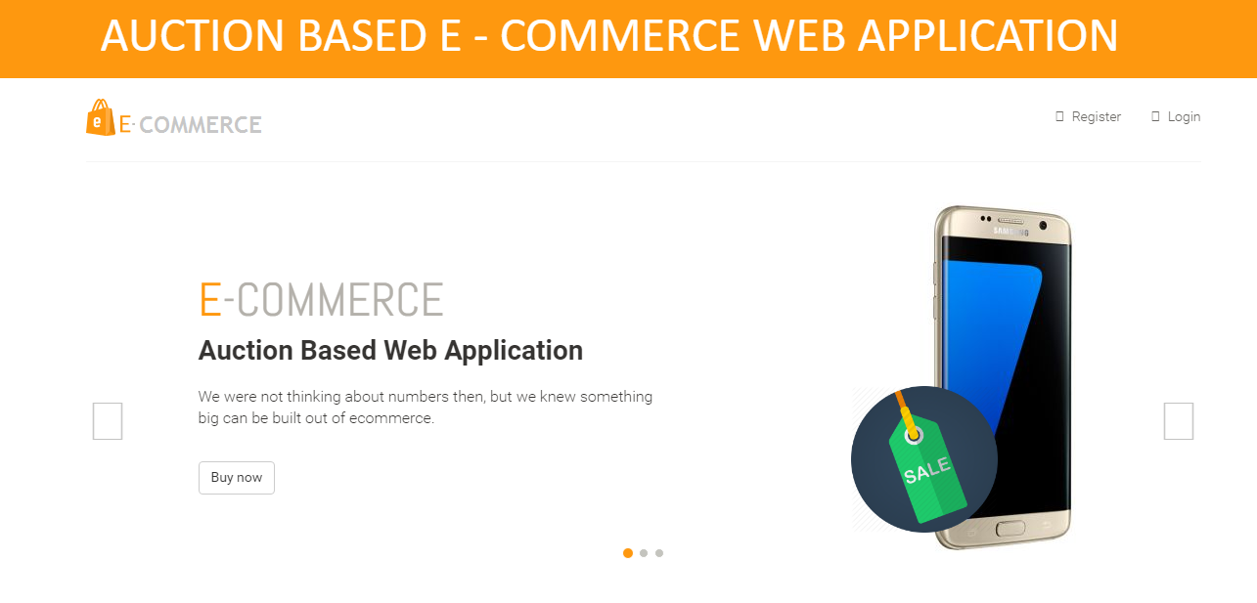
How does it work ?
Live Demo: http://www.auction.com/Eshopper/

Slide 13

Technical issues and concerns
The highest bidder will just receive a message but not the message notifications
Seller is not notified whether his/her product is sold unless they visit messages tab
Total products sold page is not implemented

Slide 14
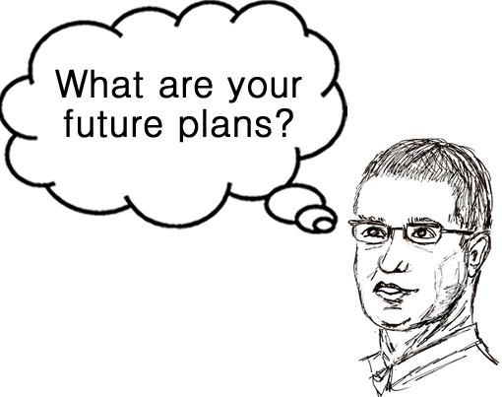
Future features to be implemented
Fixing the technical issues and concerns
Product rental
Rate and review of buyer and seller
Online payment processing

Slide 15

Challenges faced
Coming up with the name
Finding the Requirements
Figuring out scope
Staying in scope
Getting documentation right
Accidentally corrupted entire database

Slide 16
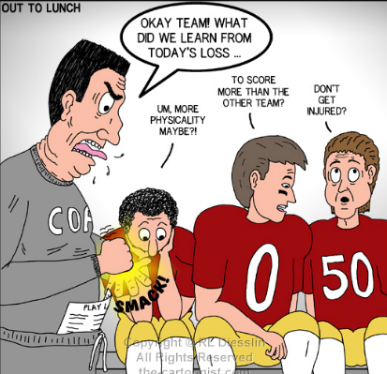
Lessons learned
programming languages and databases
how to integrate the independent tasks
how E-commerce website works
about the Group work
how to recover the issues and concerns
how to implement and host the project
How to sell the product

Slide 17
We hope you loved our product and would love to purchase it
We hope you loved our presentation and will give good ratings in the evaluation sheet

