Slide 1
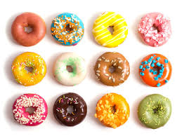
ARRAYS
Set of data elements stored under same name.
Created to hold any type of data, and each element can be individually assigned and read.

Slide 2
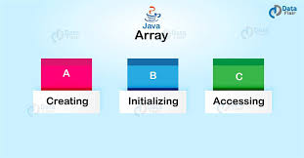

Slide 3
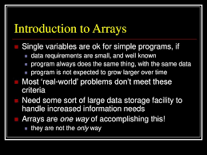

Slide 4
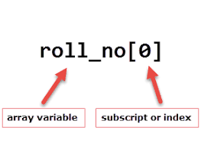

Slide 5


Slide 6


Slide 7
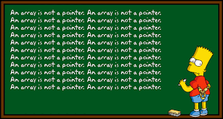

Slide 8
