Slide 1
Amex AI/ML Hackathon
Geek Goddess 2019
[Credit Card Approval Prediction]
By Madhuri Konnur

Slide 2

Here the credit card approval, predictions are made on filtering out unnecessary features/attributes, by comparing ML models and coming up with simple model with its threshold tuned.
Repo: https://github.com/MadhuriKonnur/GeekGoddess/blob/master/MK_CC_Approval_GG_hack.ipynb

Slide 3
As the demand for credit cards raising, banking sector is facing challenges in approving the cards.
Data :
Given 16 feature attributes to predict target ‘Approved’. Both test and train dataset are provided with total 690 fields values.

Slide 4
Technical architecture
Data
Pre-Processing
Feature Selection
Handling Missing Data
Standardizing Data
This holds good for both Train and Test Data, before applying model.

Slide 5
Compared different ML algorithms, Naïve Bayes classifier (autotuned) output metrics are good . For better practical oriented result metrics fined tuned threshold of Logistic Regression, on the bases of NB result.
Used Google Colab and Python 3.0

Slide 6
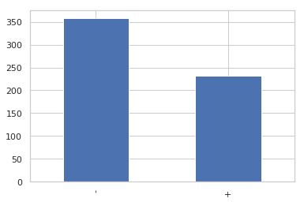
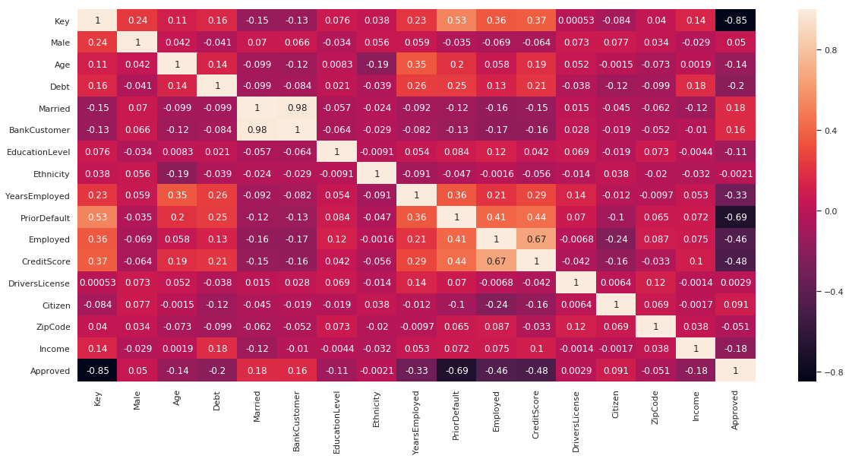
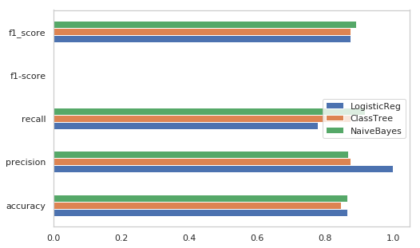
Prototype Demo:
Data Distribution.
Feature Co-relation
Before tuning metrics

Slide 7
Impact of usage:
Model provides promising precision rate. This sample model can be used for hassle free credit card approval process even for larger number of data.

Slide 8
Possible Improvement :
More metrics needs to be compared on different sets of feature selection
Neural Networks and other algorithms can be applied

Slide 9
Challenges faced:
1.Domain knowledge
2. Model fine tuning (continuous scope)
3. Treating missing values

Slide 10


