Slide 1



U & P. U. Patel Department of Computer Engineering
Skin Cancer Detection
Prepared by: Shaili Shah(18CE115)
Ayush Singla(18CE122)
Janvi Solanki(18CE123)
Bhavna Tahelyani(18CE127)
References
Features
Flowchart
About
Motivation
Requirements
Guided by : Prof. Sagar Patel
CE355 - SOFTWARE GROUP PROJECT - V

Slide 2
DEFINITION
A project for Skin Cancer Detection using Machine Learning and Flask.
References
About
Flowchart
Features
Motivation
Requirements
DESCRIPTION
A project by which the user will be able to get information about skin cancer and will be able to detect skin cancer by capturing/ uploading images of affected area.

Slide 3
1
2
References
Every year there are more number of new cases of skin cancer than the combined incidence of cancers of the breast, prostate, lung and colon.
Melonama of Skin cancer cases 2020:
No. of new cases(% of all sites): 324,635
No. of new deaths(% of all sites): 57, 043
Early detection saves lives. Learning what to look for on your own skin gives you the power to detect cancer early when it’s easiest to cure, before it can become dangerous, disfiguring or deadly.
Requirements
About
Features
Flowchart
Motivation

Slide 4


References
About
Features
Flowchart
Motivation
Requirements
Software/
Hardware
Tools and Technology
Internet
Web Browser
PC
HTML
CSS
JAVASCRIPT
OpenCV
Flask
Fastai

Slide 5
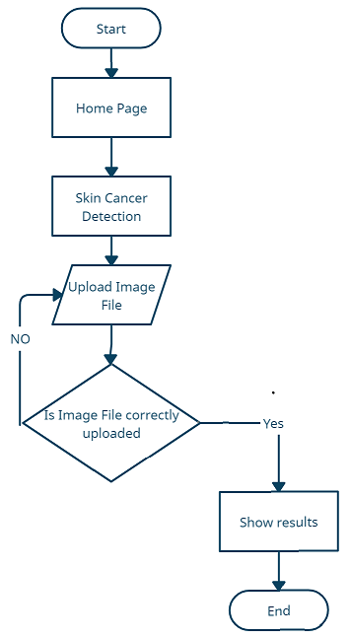
References
Flowchart
About
Features
Motivation
Requirements

Slide 6
Upload Image
Capture Image
References
Flowchart
Features
About
Requirements
Motivation
Get Prediction(%)
Get information about Skin Cancer

Slide 7
https://www.youtube.com/playlist?list=PLzMcBGfZo4-n4vJJybUVV3Un_NFS5EOgX
https://docs.fast.ai/
https://flask.palletsprojects.com/en/1.1.x/
https://pytorch.org/hub/pytorch_vision_densenet/
https://acsjournals.onlinelibrary.wiley.com/doi/full/10.3322/caac.21660
https://www.kaggle.com/kmader/skin-cancer-mnist-ham10000
Flowchart
References
Features
About
Motivation
Requirements

