Slide 1
INVESTMENT ASSIGNMENT SUBMISSION
Name: Mayreddy Bhavana

Slide 2
<Abstract>
Evaluating and analysing the investments spread across the globe, most preferable to English speaking countries for investing to get return.
Objective is to :
- Measure the linearity of the investments across the period of time and among different sectors.
- Choose among Venture, Seed, Angel, Private equity funding types
- Investment in the range of 5M – 15 M
- Preferably English speaking countries

Slide 3
<Problem solving methodology>
Manthan Systems
If the end result is not the most probable one, then recheck for data cleaning /any errors from very beginning
Use flow chart
Load the data files to the dataframes
Categorise the number of companies, Total amount of investment for every main_sector for the 3 top English speaking country correspondingly
Categorise top 3 best performing sectors per country
Prepare the data 1. convert all the data to same case 2. Look for the duplicate rows across dfs 3. Correct the datatypes
Limit the companies which procured funding in the range of 5M – 15M, as the investment limit decided
Dig deeper to understand the best performing companies in each sector
1. Get unique companies list from both sets 2. Check for any mismatch in company lists 3.merge the data on primary column to link company with country.
Merge the main_sector to the primary sectors of the companies dataset of chosen funding type
Now, put the suggestions with some visual evidence of choosing the pattern
To choose the funding type of the Investment- target variable is ‘Funds raised in USD’. - Check for nulls in target variable 2. Correct the datatypes le
Check for any data errors – spelling or spaces to avoid any bias analysis
If there is any data cleaning needed
Calculate the percentage of na values. <10% - replace/remove null value rows, else impute
In the companies data set pull the primary sector against the merged category list and map them to main_sectors in mappings.csv
To choose the type of funding-calculate the aggregate mean/median by funding type , and filter the investment range for the client is 5M-15M.
Choose top 3 English speaking countries for specific chosen Funding type, which received highest investment in the analysed set of data

Slide 4
<Analysis>
For Choosing the Funding Type:
Assumptions are:
Companies with ‘raised_amount_usd’ with null values are assumed to not raise any funds.
The number of rows with null values are ~<10%, so ignored the rows with null values.
As the data provided is the realistic data, that needs to consider every outlier. No outliers are ignored
Now compared mean and median for corresponding funding types – plot
Seed/Angel – Mean is in the limits but Median fall below the investment range
Private Equity – mean is within but median is out of the investment range
Venture – Mean/Median both are in limits
The Chosen Funding type is – ‘Venture’

Slide 5
<Analysis>
For choosing top 3 English speaking countries:
Pull the data for the chosen funding type- ‘Venture’
Now the target variable is country_code , to see if any null values
Check if the country_code can be derived from any corresponding columns
As the priority is to choose top English speaking countries, data cannot be imputed
The missing values is ~<1% , so ignored the missing rows
Based on the total sum of investments across the countries- take the top 9 countries
Out of which top 3 English speaking countries are chosen(Note- English speaking countries are chosen based on officially accepted languages by country as per latest data on Wikipedia) – plot 2
Top # English Speaking Countries suitable for investments:
USA
GBR
IND
* CHN – China is not English speaking language officailly

Slide 6
<Analysis>
Investments across main-sectors:
Assumptions are:
Choosing the companies only with investments with in 5M -15M
Mapping to the category list provided in the mapping.csv
Data Preparation:
Data is cleaning for nay null values and correct the spellings/any trailing/leading spaces
Analysis:
Top3 Sectors for every country is chosen based on the number of investments to total investment - plot
Top main sector across countries – Others(category lists in Others Main sector)
'Advice|Algorithms|All Markets|All Students|Alumni|Angels|Collectibles|College Campuses|Distribution|Distributors|DIY|Document Management|E-Commerce|E-Commerce Platforms|EDA Tools|Ediscovery|EdTech|Education|Emerging Markets|Employment|Engineering Firms|Enterprise 2.na|Enterprise Application|Enterprise Resource Planning|Enterprise Security|Enterprise Software|Enterprises|Entrepreneur|Families|Field Support Services|File Sharing|Flash Sales|Flash Storage|Fleet Management|Flowers|Freelancers|Fruit|Gay & Lesbian|General Public Worldwide|Geospatial|Gift Card|Gift Exchange|Gift Registries|Governance|Government Innovation|Governments|Guides|High School Students|High Schools|High Tech|Home Owners|Home Renovation|Homeland Security|Homeless Shelter|Hospitality|Human Computer Interaction|Human Resource Automation|Human Resources|Humanitarian|IaaS|ICT|Identity|Indians|Indoor Positioning|Intellectual Asset Management|Intellectual Property|Intelligent Systems|Interest Graph|iOS|iPad|iPhone|IT and Cybersecurity|IT Management|K-12 Education|Kids|Knowledge Management|Landscaping|Language Learning|Law Enforcement|Lead Generation|Lead Management|Legal|Licensing|Life Sciences|Linux|Local|Local Based Services|Local Businesses|Local Commerce|Location Based Services|Logistics|Logistics Company|Low Bid Auctions|Loyalty Programs|M2M|Marketplaces|Mass Customization|Match-Making|Micro-Enterprises|Mobile Security|Mobility|Network Security|Networking|Non-Tech|Non Profit|Nonprofits|Office Space|Oil|Oil & Gas|Oil and Gas|Online Education|Online Identity|Open Source|Opinions|Optimization|Outsourcing|Parenting|Parking|Personal Data|Personalization|Pervasive Computing|Physical Security|Plumbers|Point of Sale|Politics|Polling|Portals|Postal and Courier Services|Presentations|Printing|Privacy|Private School|Procurement|Product Design|Product Development Services|Productivity|Productivity Software|Professional Services|Project Management|QR Codes|Real Estate|Real Time|Realtors|Recreation|Religion|Rental Housing|Reputation|RFID|Robotics|SaaS|Sales Automation|Security|Sensors|Service Industries|Service Providers|Services|Shared Services|Shipping|Simulation|Skill Assessment|Small and Medium Businesses|Smart Grid|SNS|Software|Staffing Firms|Startups|Subscription Service|Supply Chain Management|Surveys|Synchronization|Systems|Task Management|Taxis|Tea|Technology|Telecommunications|Textiles|Tracking|Trading|Training|Translation|Universities|University Students|Usability|User Experience Design|User Interface|Utilities|Vending and Concessions|Watch|Web Development|Web Hosting|Web Tools|Wholesale|Women|Young Adults'

Slide 7
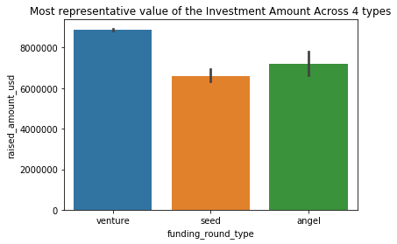
<Results>
Most representative funding Type – Investment 5M to 15M

Slide 8
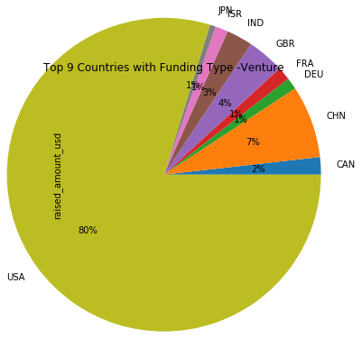
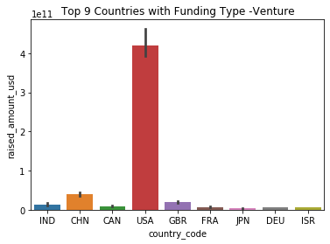
<Results>
Top 9 Countries with chosen Funding Type –Venture

Slide 9
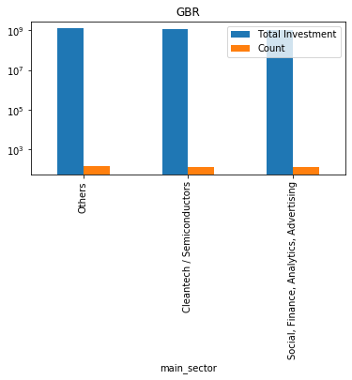
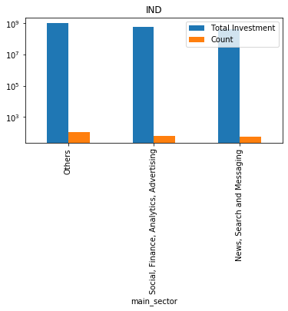
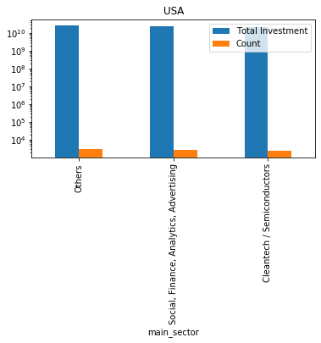
<Results>
Plot 3 - 'Investment Across top 3 sectors in top 3 English speaking countries'

Slide 10
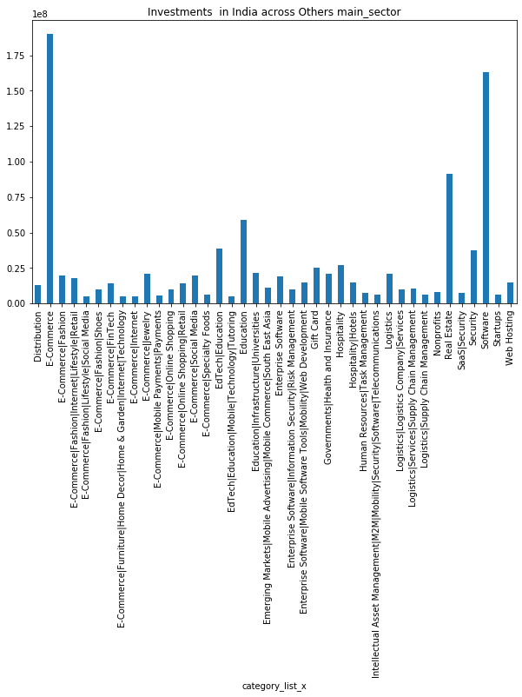
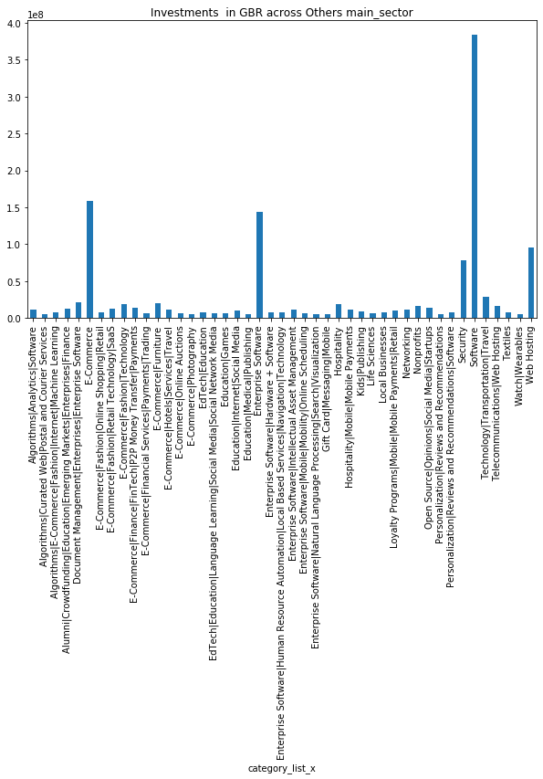
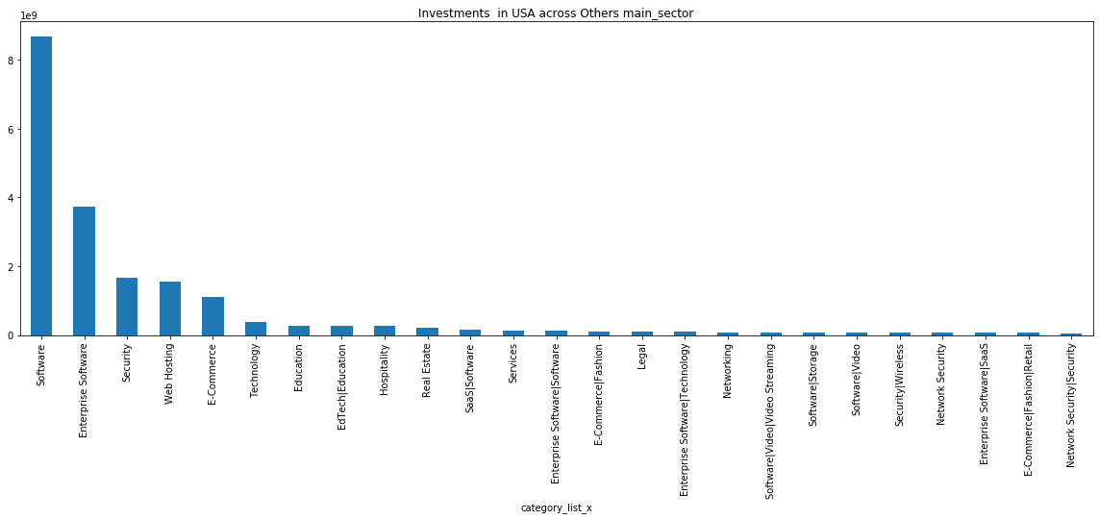
<Conclusions>
Based on the above analysis, all the top 3 countries are mostly invested in main_sector – ‘Others’. Investment is more appropriate to invest in Software category among the top 3 countries.
My opine would be to invest in India – Software category as the percentile and Mean/Median is in range with most appropriate return and spread through a period of time

