Slide 1

Bhavna Corp
KYB-Know Your Bus
By: Thula Dhanasheela, Annavarapu Sahithi, Boda Naresh, Shaik Shameema, Akankshi Priya

Slide 2

TABLE OF CONTENTS
INTRODUCTION
OBJECTIVES
EXISTING SYSTEM

Slide 3
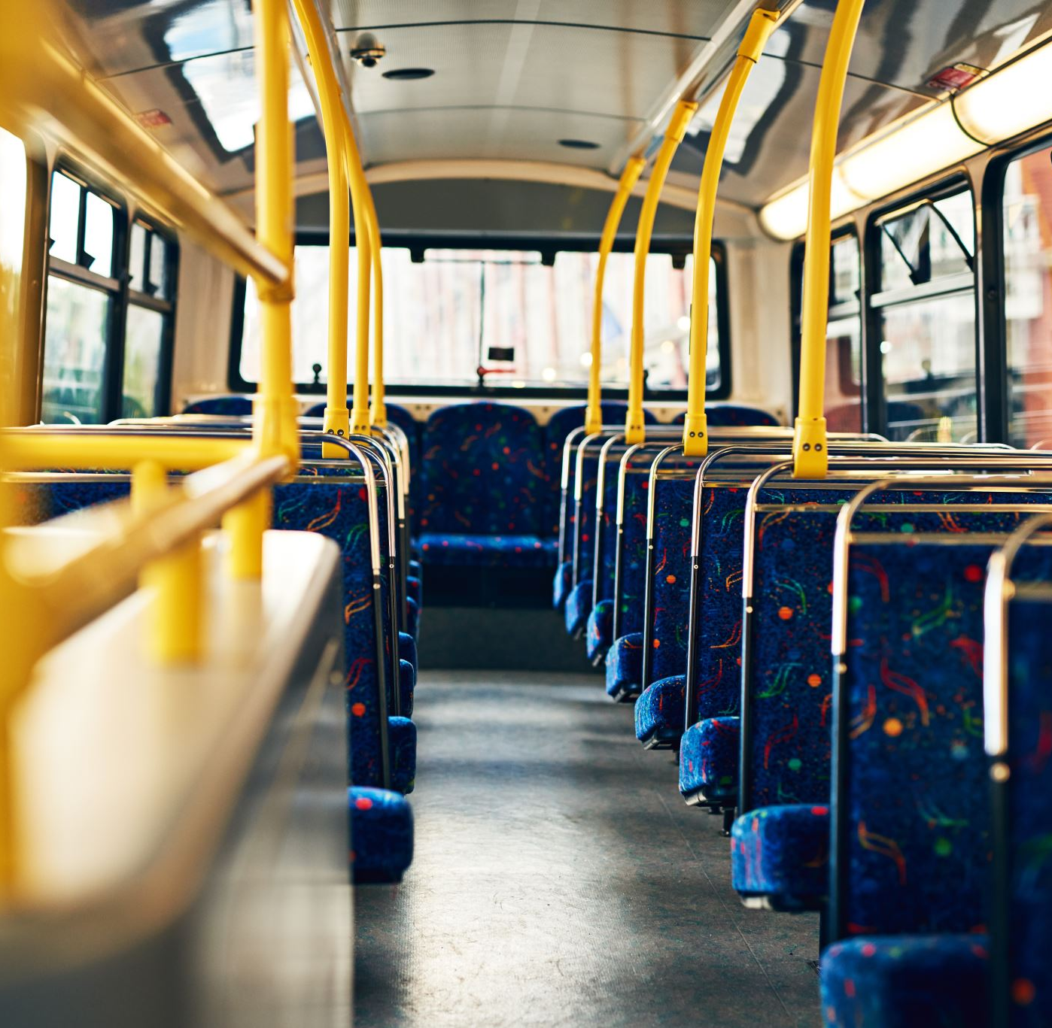
INTRODUCTION
KYB(Know your bus) is an online bus booking system, it provides facility to reserve seats, cancellation of seats.
Providing the facility like customers can book their desired seats and they can check the availability of posts on a specific date.
The customer can check availability, book a ticket, or cancel a ticket 24X7. The online system is available to use anytime. The user doesn’t require to visit any office.

Slide 4
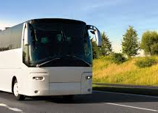
Requirements
Front End :
•HTML
• CSS,
•JS,
•Bootstrap,
•Angular
Backend :
.NET Core API,SQL Server

Slide 5

Modules
Login/Register Module
Route Module
Bus-Info Module
Booking Module
Payment Module
Cancellation Module
Passenger Module

Slide 6
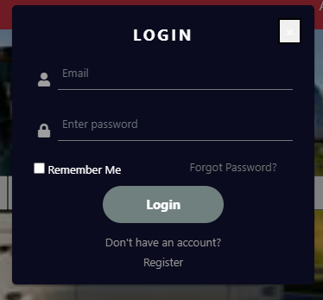
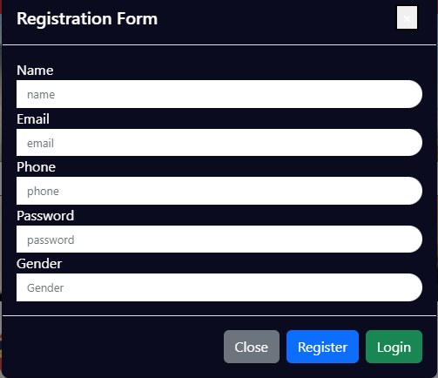
Login/Register Module
User can register with his/her Name, Email, Phone, Password, Gender
User can Login with his/her Registered Email and Password.
Login and Register are optional for user while searching Bus-Info.

Slide 7
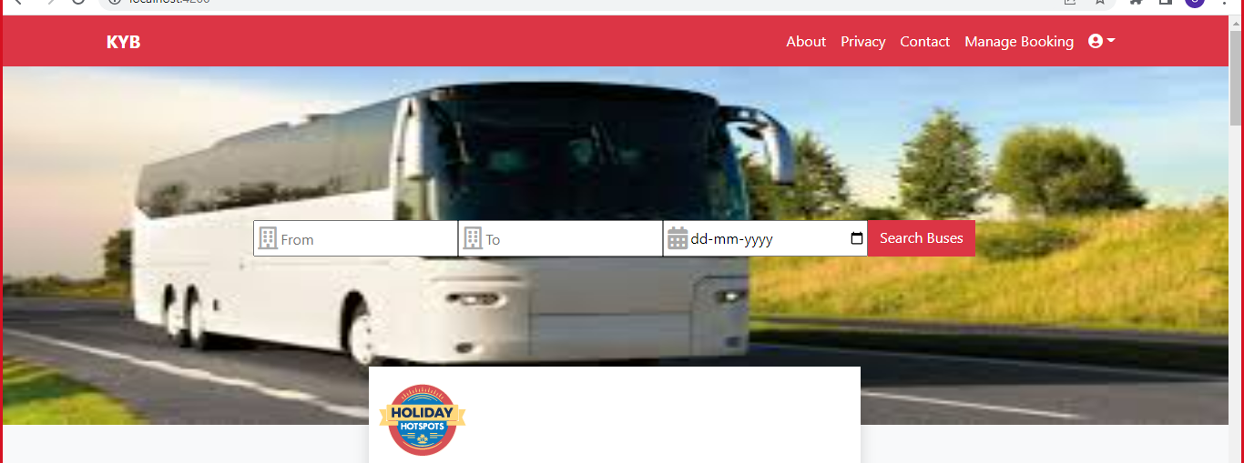
Route Module
User can search Bus-info based on source and destination on their available date.

Slide 8
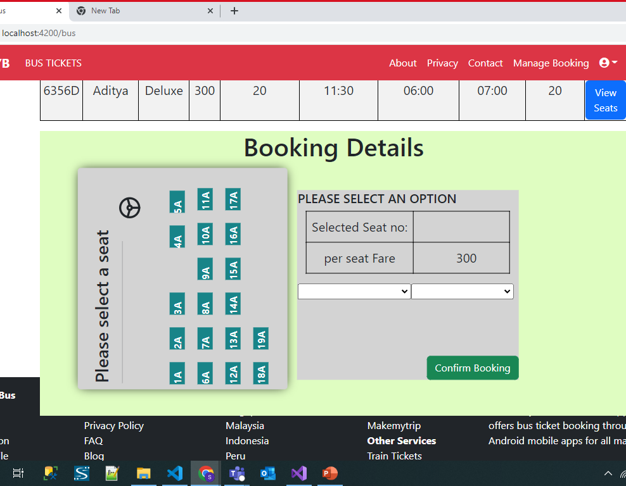
Booking Module
User can select a desired seat and can select Boarding point and Dropping point.
Confirming your booking details

Slide 9
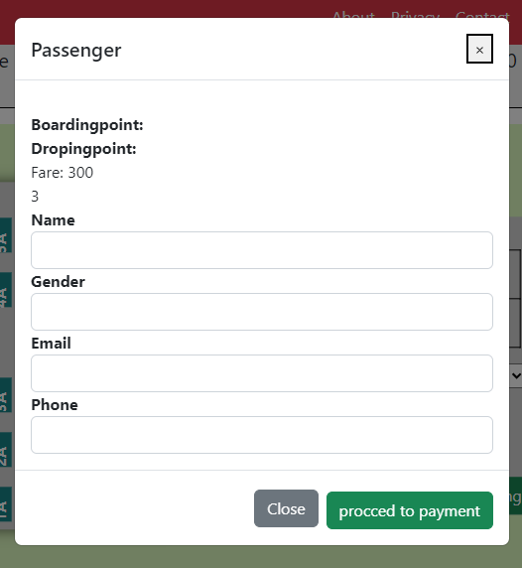
Passenger Module
User will provide the passenger details who is going to travel with their details like
Name,
Phone,
Email,
Gender
The passenger and Travel details will be stored.

Slide 10
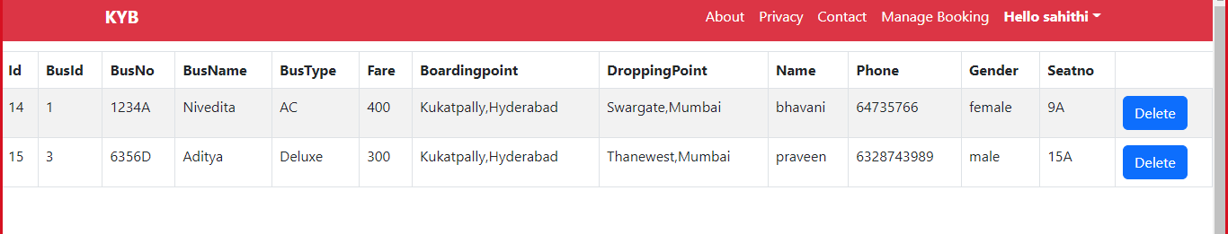
Cancellation Module
Tickets will be available in manage booking we can cancel the ticket by deleting them.

Slide 11
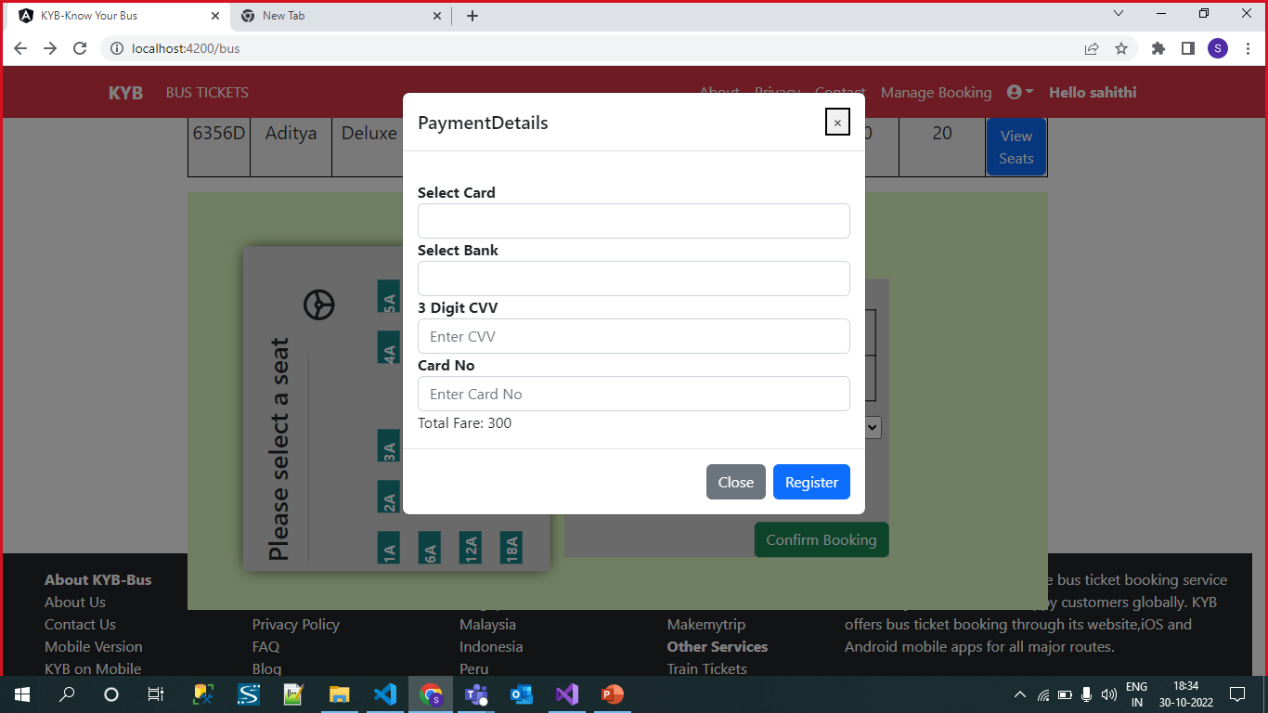
Payment Module
Passenger will complete bus booking by completing the payment process.
The mode of payment can be either by credit or debit card.

Slide 12
Existing System
Low quality customer service
Slow response about refund
They increase the bus ticket fare during festival time and public holidays

Slide 13
Proposed System
No third-party involvement
Less fare for ticket comparatively with other
Providing discount with regular customers
We provide 24/7 services.

Slide 14
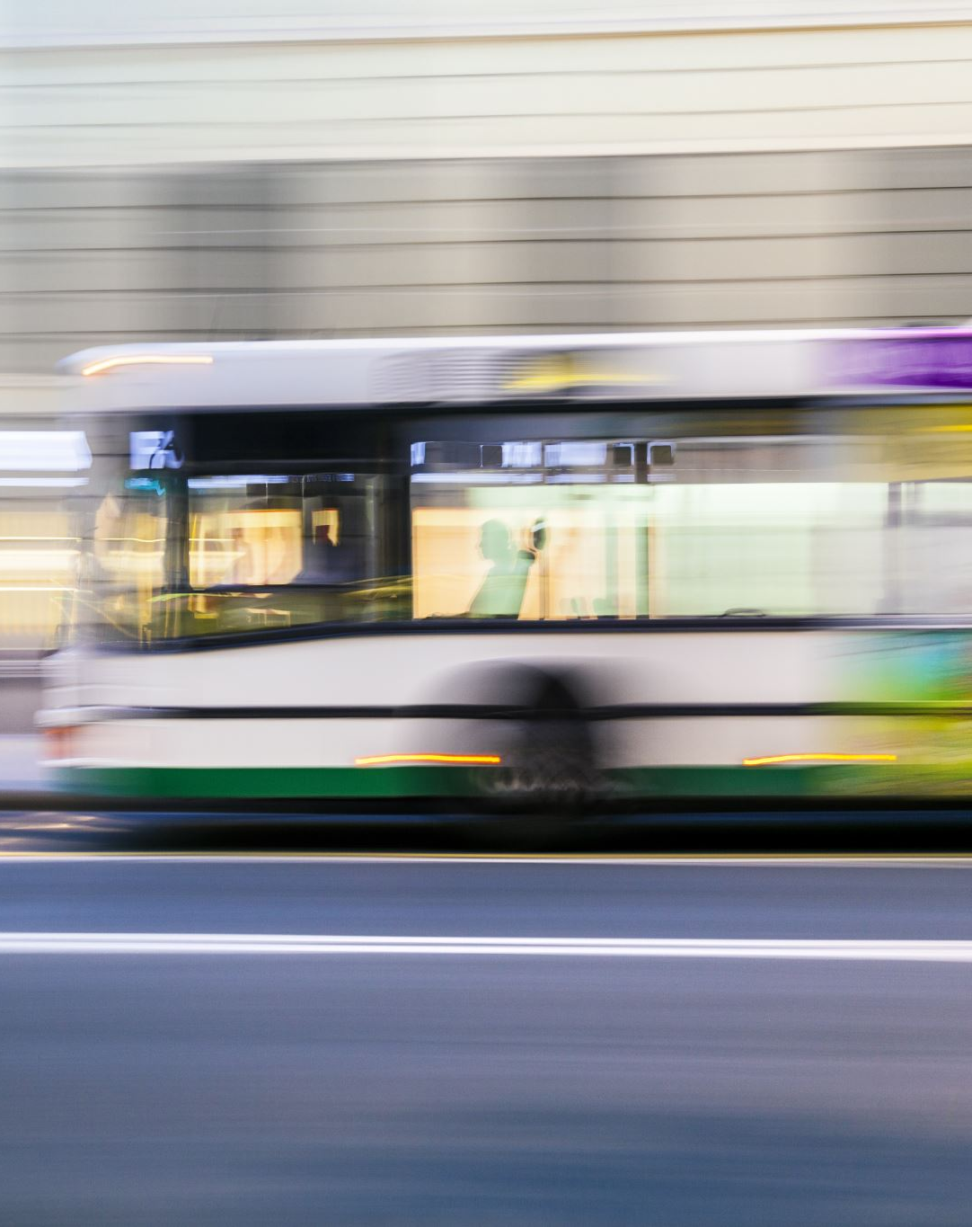
Conclusion
Finally, in Online Bus Booking System, we have developed a secure, user-friendly Bus Reservation System. This Project basically provides Bus information. First of all, on our website any user or visitors view our system and search the bus and how many seats are available in our buses. The user can also register their own seats on the bus on this website.

Slide 15
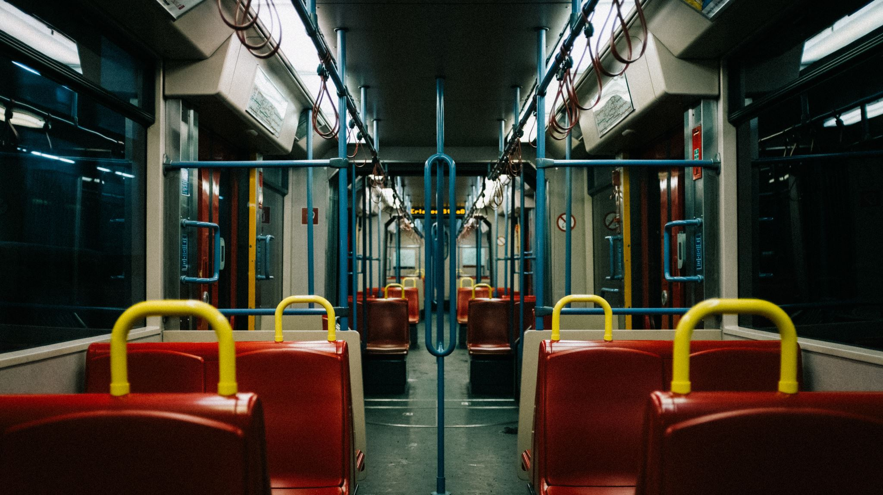
THANK YOU

