Slide 1
Project Presentation Election analysis using classification techniques Team 8
Gurjot Singh (B00811724)
Bhavneet Kaur Sachdeva (B00809769)

Slide 2
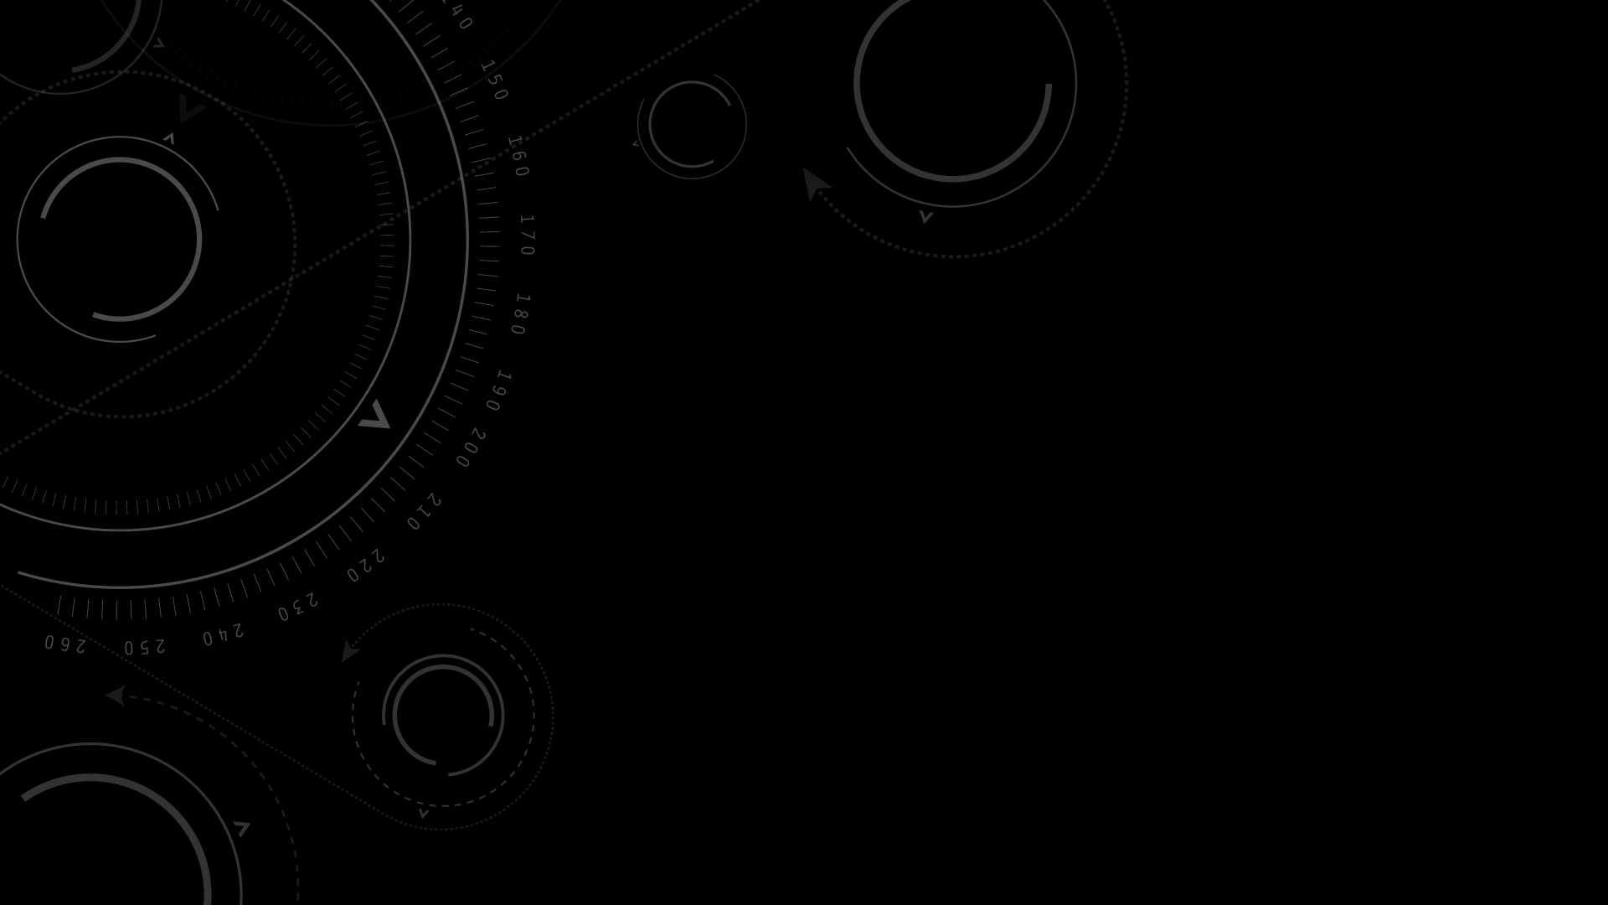
OUTLINE
INTRODUCTION
PROJECT TIMELINE
DATASET
DATA CLEANING
METHOD
RANDOM FOREST CLASSIFIER
LOGISTIC REGRESSION
DECISION TREE
RESULTS
ANALYSIS AND CONCLUSION
REFERENCES

Slide 3
Introduction
Elections: A formal group decision-making process by which a population chooses an individual to hold public office.
Elections Canada is the independent, non-partisan agency responsible for conducting federal elections and referendums
Algorithms Used:
Random Forest Classifier
Logistic Regression
Decision Tree
Libraries Used in Python:
Pandas
Google-translate
Scikit-learn
Numpy

Slide 4
Project TimeLine
Task | Week | Status
Dataset Analysis | 10 March – 16 March | Complete
Data Cleaning | 16 March – 20 March | Complete
Generating X and y values | 21 March – 27 March | Complete
Random Forest Classifier | 28 March – 30 March | Partially Pending – Finding precision, recall scores
Logistic Regression | 28 March – 30 March | Partially Pending – Finding precision, recall scores
Decision Tree Classifier | 28 March – 30 March | Partially Pending – Finding precision, recall scores
Comparisons | 1 April – 4 April | Partially Pending – Comparing the generated precision, recall scores
Results and Conclusion | 1 April – 4 April | Partially Pending – Comparing the generated precision, recall scores

Slide 5

Dataset
The dataset is obtained from Elections Canada official website.
There were multiple files from which we choose the file named table table_tableau11.
The dataset had multiple columns relating to the province wise data of the party, party name, percentage of votes, etc.
The sample dataset is shown in the next slide.

Slide 6
Province | Electoral District Name/Nom de circonscription | Valid Ballots/Bulletins valides | Percentage of Valid Ballots /Pourcentage des bulletins valides | Rejected Ballots/Bulletins rejetés | Percentage of Rejected Ballots /Pourcentage des bulletins rejetés | Total Ballots Cast/Total des bulletins déposés | Percentage of Voter Turnout/Pourcentage de la participation électorale | Elected Candidate/Candidat élu
Newfoundland and Labrador/Terre-Neuve-et-Labrador | Avalon | 42086 | 99.6 | 162 | 0.4 | 42248 | 61.7 | McDonald, Ken Liberal/Libéral
Newfoundland and Labrador/Terre-Neuve-et-Labrador | Bonavista--Burin--Trinity | 35092 | 99.5 | 173 | 0.5 | 35265 | 56.5 | Foote, Judy M. Liberal/Libéral
Newfoundland and Labrador/Terre-Neuve-et-Labrador | Coast of Bays--Central--Notre Dame | 35448 | 99.6 | 145 | 0.4 | 35593 | 55.4 | Simms, Scott Liberal/Libéral
Newfoundland and Labrador/Terre-Neuve-et-Labrador | Labrador | 12373 | 99.6 | 53 | 0.4 | 12426 | 62 | Jones, Yvonne Liberal/Libéral
Newfoundland and Labrador/Terre-Neuve-et-Labrador | Long Range Mountains | 41824 | 99.7 | 108 | 0.3 | 41932 | 58.3 | Hutchings, Gudie Liberal/Libéral
Newfoundland and Labrador/Terre-Neuve-et-Labrador | St. John's East/St. John's-Est | 44880 | 99.8 | 111 | 0.2 | 44991 | 67.9 | Whalen, Nick Liberal/Libéral
Newfoundland and Labrador/Terre-Neuve-et-Labrador | St. John's South--Mount Pearl/St. John's-Sud--Mount Pearl | 44801 | 99.7 | 133 | 0.3 | 44934 | 66.5 | O'Regan, Seamus Liberal/Libéral

Slide 7
Data Cleaning
The Elected Candidate/Candidat élu column had both French and English, hence we had to segregate it to obtain them separately.
To identify the party name, we converted the French to English using the Google-translate library in python.
Using the Pandas library, we loaded the CSV file in Jupyter Notebook and selected the rows in the data frame which needs to be kept and wrote the final version into the cleaned_version_v3.csv file.
The labels were generated from the party column for using as a target in the classifier where different parties were assigned different numbers.

Slide 8
Province | Electoral District Name/Nom de circonscription | Electoral District Number/NumÃ©ro de circonscription | Percentage of Valid Ballots /Pourcentage des bulletins valides | Rejected Ballots/Bulletins rejetÃ©s | Percentage of Rejected Ballots /Pourcentage des bulletins rejetÃ©s | Total Ballots Cast/Total des bulletins dÃ©posÃ©s | Percentage of Voter Turnout/Pourcentage de la participation Ã©lectorale | Elected Candidate/Candidat Ã©lu | Party | Candidates
Newfoundland and Labrador/Terre-Neuve-et-Labrador | Avalon | 10001 | 99.6 | 162 | 0.4 | 42248 | 61.7 | McDonald, Ken Liberal/LibÃ©ral | Liberal | McDonald, Ken
Newfoundland and Labrador/Terre-Neuve-et-Labrador | Bonavista--Burin--Trinity | 10002 | 99.5 | 173 | 0.5 | 35265 | 56.5 | Foote, Judy M. Liberal/LibÃ©ral | Liberal | Foote, Judy
Newfoundland and Labrador/Terre-Neuve-et-Labrador | Coast of Bays--Central--Notre Dame | 10003 | 99.6 | 145 | 0.4 | 35593 | 55.4 | Simms, Scott Liberal/LibÃ©ral | Liberal | Simms, Scott
Newfoundland and Labrador/Terre-Neuve-et-Labrador | Labrador | 10004 | 99.6 | 53 | 0.4 | 12426 | 62 | Jones, Yvonne Liberal/LibÃ©ral | Liberal | Jones, Yvonne
Newfoundland and Labrador/Terre-Neuve-et-Labrador | Long Range Mountains | 10005 | 99.7 | 108 | 0.3 | 41932 | 58.3 | Hutchings, Gudie Liberal/LibÃ©ral | Liberal | Hutchings, Gudie

Slide 9
Method
To use this data in the Machine Learning models, we had to setup a classifier for labels.
We assigned labels to different parties as shown:
Party Name | Label Assigned
Liberal | 0
NDP-New Democratic Party | 1
Bloc Québécois | 2
Conservative | 3

Slide 10
Method(Cont.)
The next step was to assign the X and y values for training our model. But, the dataset had text data which cannot be used for Machine learning models.
To convert the text data to vector form which can be used in the model, we used tf-idf vectorizer in which we assigned vector form to each text word.
We then assigned the columns District and Province as our X values, and the party name as our y value to be classified and split the dataset into training and test data.
The Random Forest, Logistic Regression and Decision Tree were then used as model to calculate the accuracy of our model and to predict which party wins. 5-fold cross validation was used to determine the accuracy.
Notes:
The next step was to assign the X and y values for training our model. But, the dataset had text data which cannot be used for Machine learning models.
To convert the text data to vector form which can be used in the model, we used tf-idf vectorizer in which we assigned vector form to each text word.
We then assigned the columns District and Province as our X values, and the party name as our y value to be classified and split the dataset into training and test data.
The Random Forest, Logistic Regression and Decision Tree were then used as model to calculate the accuracy of our model.

Slide 11
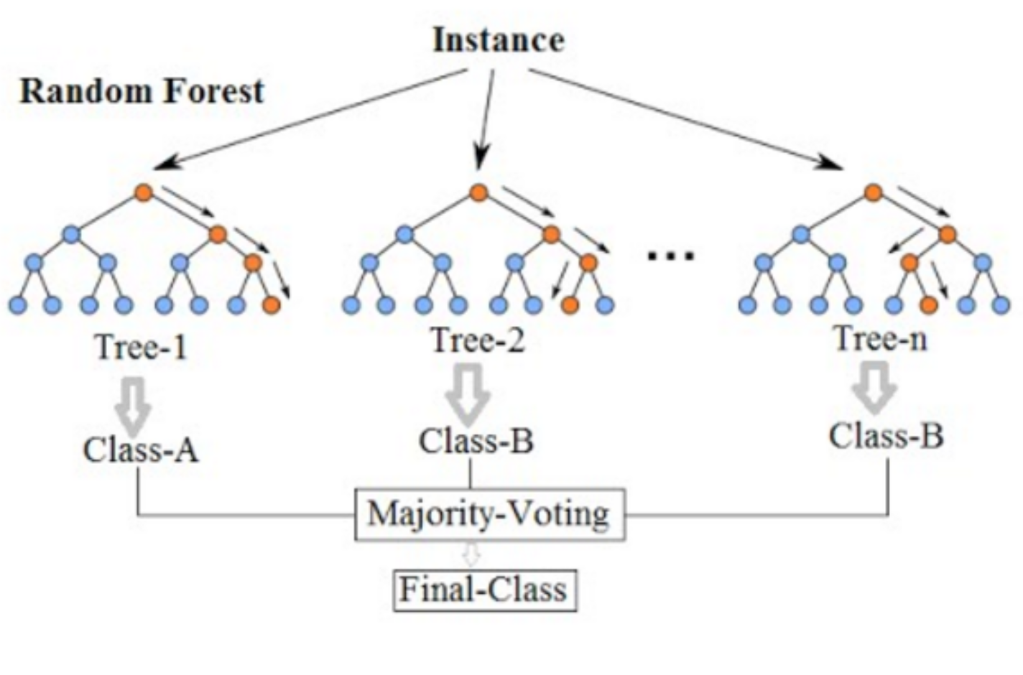
Random Forest Classifier
Random forests is a supervised learning algorithm. It can be used both for classification and regression.
Advantage: Random forests is considered as a highly accurate and robust method because of the number of decision trees participating in the process.
Disadvantage: The model is difficult to interpret compared to a decision tree, where you can easily make a decision by following the path in the tree.
Source: https://medium.com/@williamkoehrsen/random-forest-simple-explanation-377895a60d2d

Slide 12
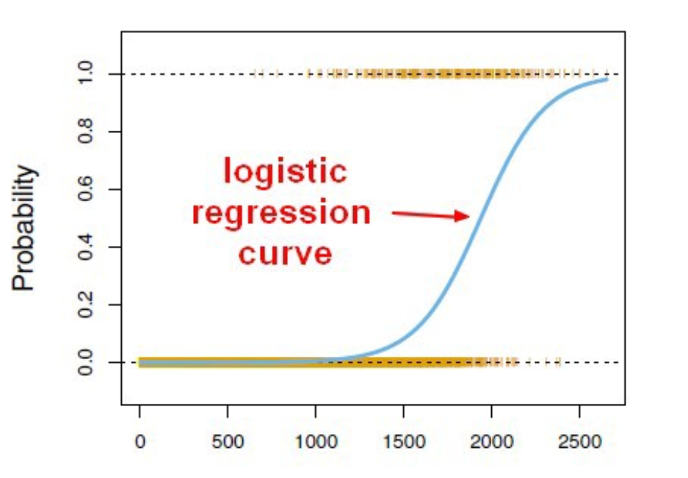
LOGISTIC REGRESSION
Logistic regression is a statistical machine learning algorithm that classifies the data by considering outcome variables on extreme ends and tries makes a logarithmic line that distinguishes between them.
Advantages: One of the simplest machine learning algorithms yet provides great efficiency.
Disadvantages: They are not flexible enough to naturally capture more complex relationships. Doesn’t handle large number of categorical variables well.
Source: https://towardsdatascience.com/logistic-regression-b0af09cdb8ad

Slide 13
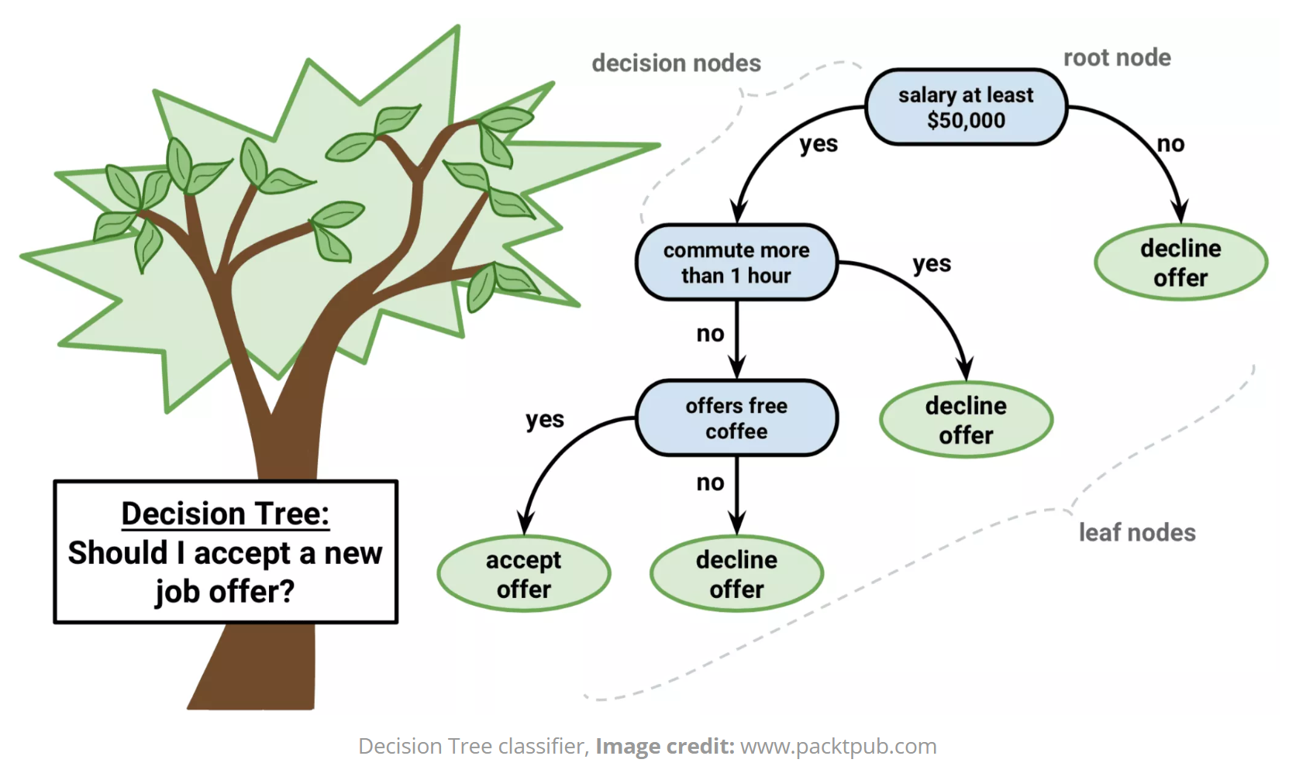
DECISION TREE
The general motive of using Decision Tree is to create a training model which can use to predict class or value of target variables by learning decision rules inferred from prior data(training data).
Advantages: Decision Trees are easy to explain. It results in a set of rules. The Number of hyper-parameters to be tuned is almost null.
Disadvantages: Generally, it gives low prediction accuracy for a dataset as compared to other machine learning algorithms. There is a high probability of overfitting in Decision Tree.
Source: http://dataaspirant.com/2017/01/30/how-decision-tree-algorithm-works/

Slide 14
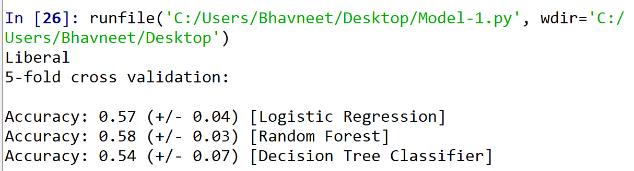
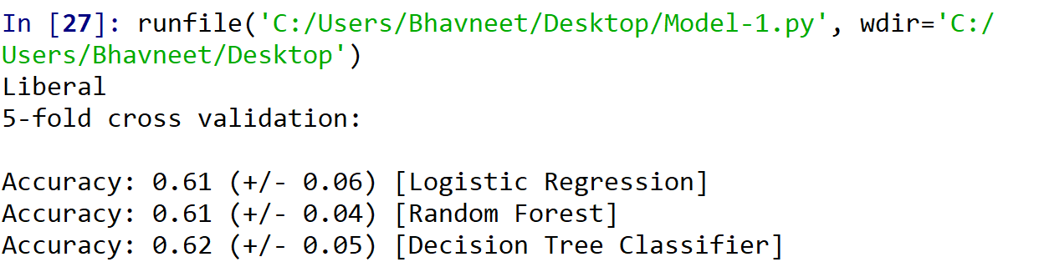
Results
As you can see from the results, it was predicted that the Liberal party wins. This was applied on the test data set.
The output also shows the accuracy generated using three algorithms namely: Logistic Regression, Random Forest and Decision Tree Classifier.

Slide 15
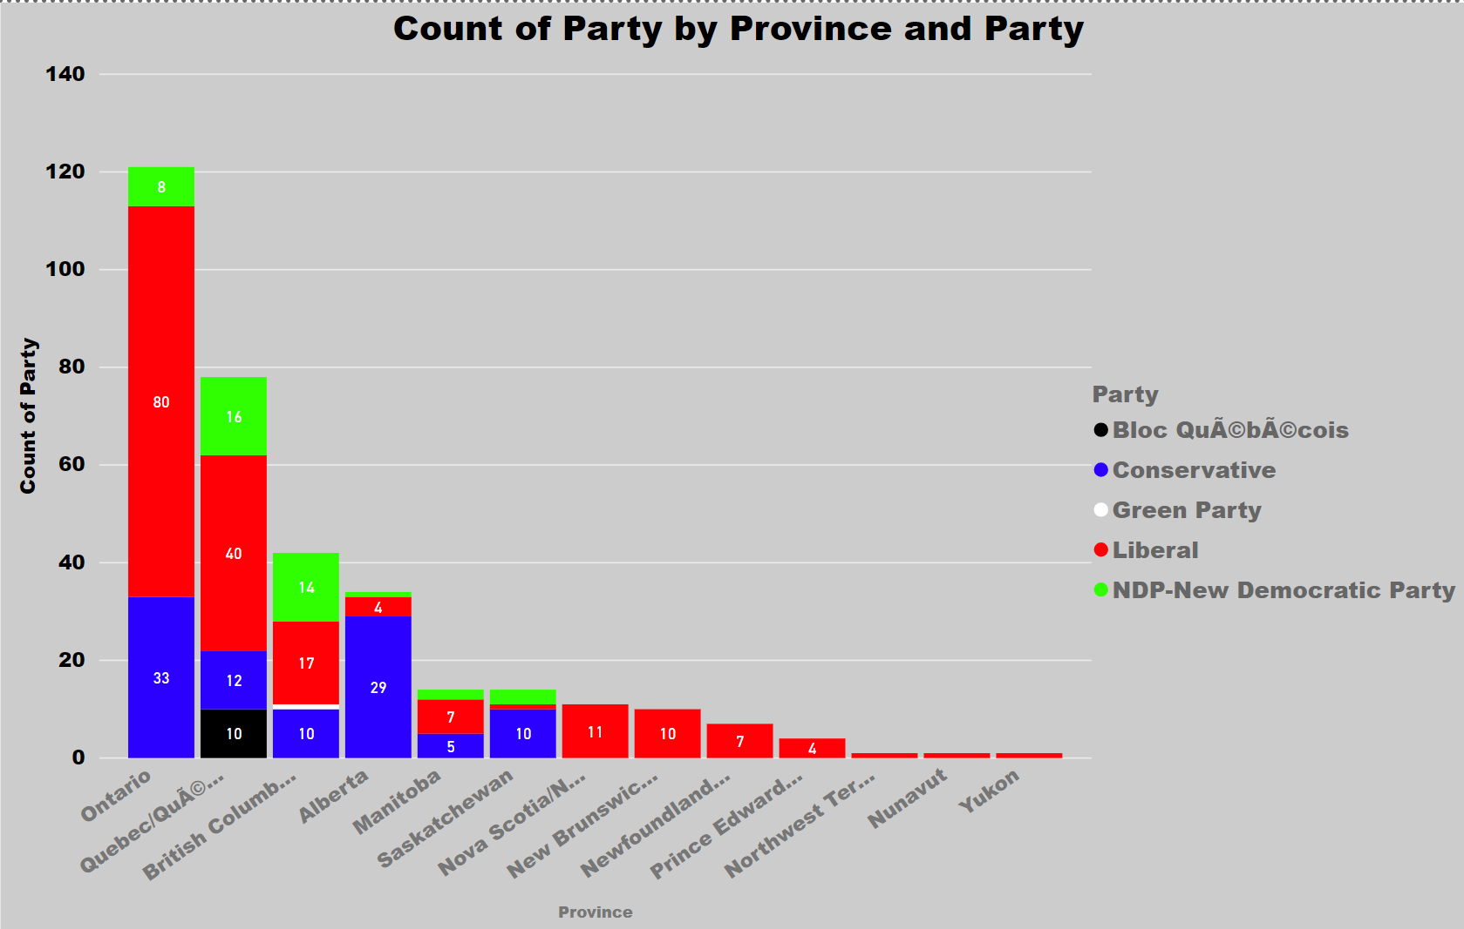
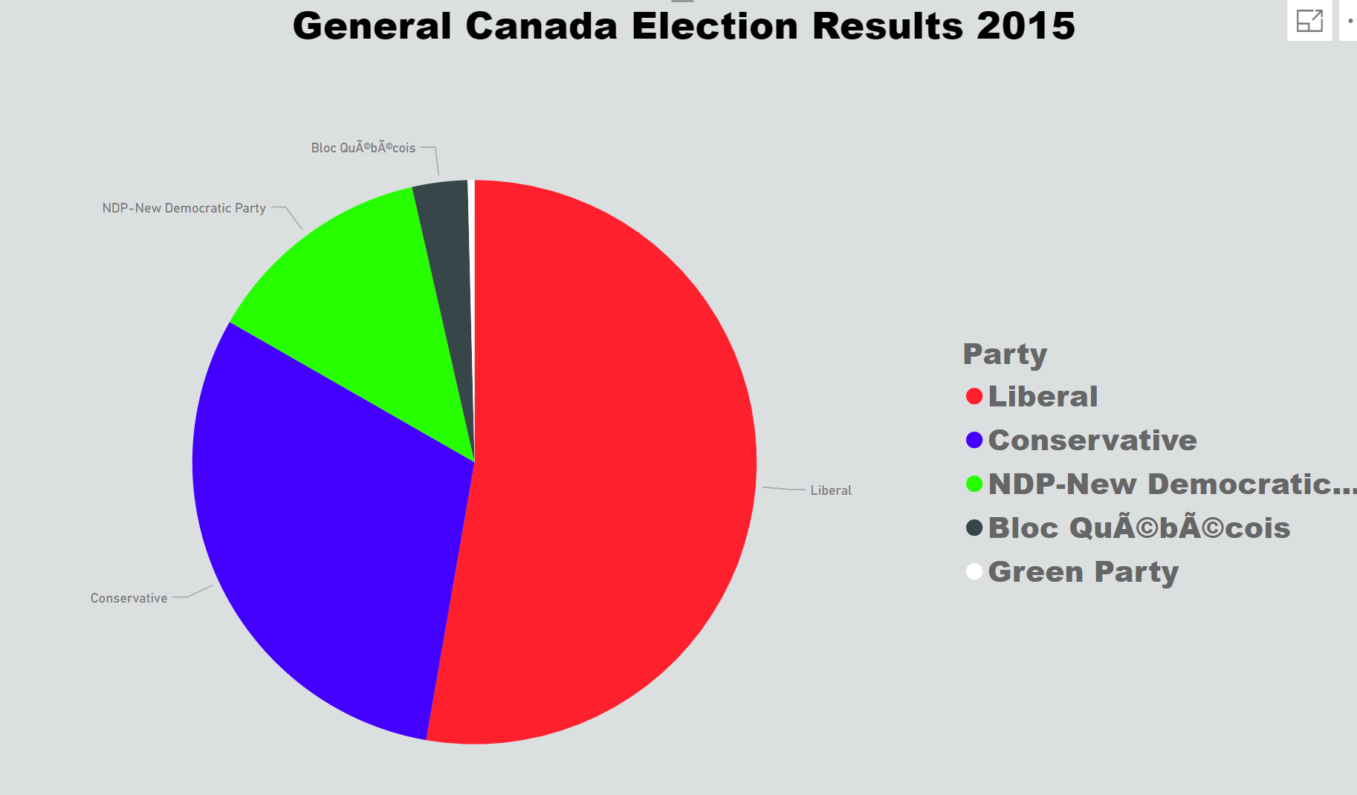
Results(cont.)

Slide 16
Analysis AND CONCLUSION
On comparing the accuracy score obtained from the three algorithms, we can see that the accuracy is similar in all the three algorithms.
The dataset was not extensive, due to which, the accuracy obtained is almost similar in the three. Also, the parameters were not fine tuned yet, due to which we obtained the similar accuracy.
But, all the three algorithms predicted the winning label as the Liberal party which was expected to be the output.

Slide 17
Thank You

