Slide 1
DeepComp: Deep reinforcement learning-based renewable energy forecasting
BY
BHAVY GOEL
2019B4A70586P
Under the supervision of
DR. RAKHEE
DR. SUMANTA PASARI
MATH F266: STUDY PROJECT

Slide 2
Abstract
Existing forecasting algorithms only focused on reducing forecasting errors without considering error compensability by using a large-scale battery. To incorporate it, a novel strategy called error compensable forecasting is proposed.
The objective of forecasting is switched from reducing errors to making errors compensable by leveraging a battery, which in turn reduces the dispatched error, the difference between forecasted value and dispatched value.
Extensive experiments with solar and wind power generations show that DeepComp outperforms the conventional forecasting methods by up to 90% and achieves accurate forecasting, e.g., 0.58–1.22% of the mean absolute percentage error.

Slide 3
Highlights
A novel forecasting strategy is proposed to make errors compensable using a battery.
A framework having forecasting in the loop of control is developed.
Deep reinforcement learning is applied for continuous control of forecasting.
Any forecasting algorithms can be combined with the proposed framework.
Accurate forecasting is achieved by outperforming the existing methods by up to 90%.

Slide 4
Introduction and Methodology
Literature considered that the forecasting error is proportional to the dispatched error that is smaller the dispatched error, the smaller the forecasting error.
Forecasting algorithms considered reducing forecasting errors by using advanced DNN algorithms.
The problem with these is that they consider MSE/MAE as the objective function which does not consider error polarity but simply reduces error distance which cannot consider error compensability
by using the battery.
In this regard, DeepComp is proposed.
The objective of forecasting is now switched to making errors compensable.
Deep reinforcement learning (DRL) which is a combination of classic reinforcement learning and traditional DNN architecture.
To enable the continuous control, proximal policy optimization (PPO) based on the actor–critic policy gradient methods is used and easily which is known to be much simpler to implement with outstanding performance.

Slide 5
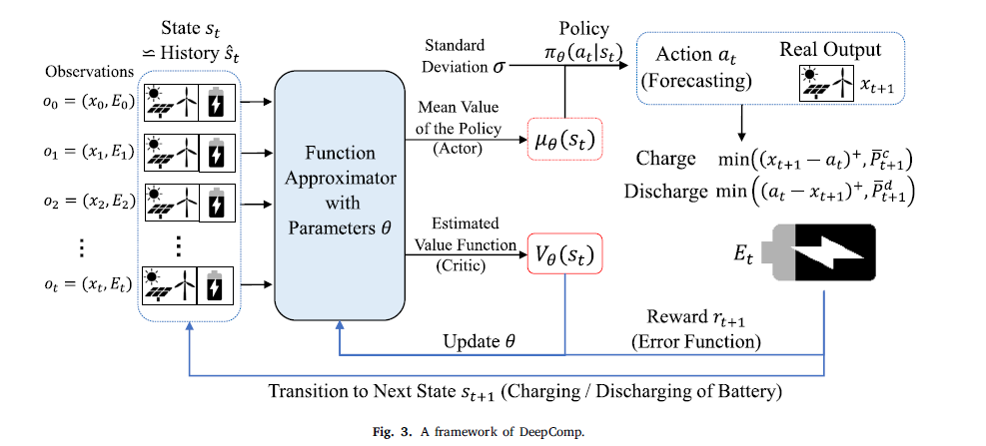
Framework of DeepComp

Slide 6
How does this approach differs from other forecasting algorithms?
All subsequent error compensability is considered. This implies, future impacts, as well as the following outputs, are considered when determining the forecasted power.
The currently stored energy is considered as an input of the forecasting algorithm in addition to traditional inputs.
The loss function is made by considering error compensability, not simply by the error distance, which aims to reduce the dispatched error, the eventual goal of forecasting.

Slide 7
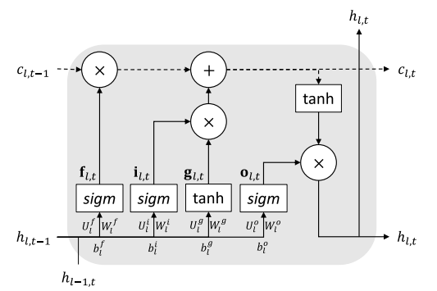
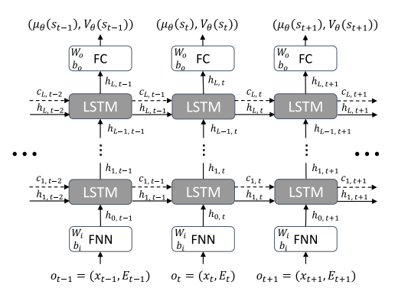
Implementation
Deep Learning Architecture
LSTM CELL
LSTM structure

Slide 8
Implementation
RNN is considered for time-series forecasting as using RNN with entire time-series history shows better performance in partially observable environment than using FNN.
In particular, LSTM networks that have better learning performance compared to the basic RNN are used by resolving the vanishing gradient problem.
LSTM networks are also widely used to forecast the renewable energy generation and show better performance than FNN. At each hidden layer 𝑙 and time slot 𝑡, the variables such as 𝐟_{l,t}, 𝐢_{l,t}, 𝐠_{l,t}, 𝐨_{l,t}, 𝑐_{l,t}, and ℎ_{l,t} are vectors that denote forget gate, input gate, input modulation gate, output gate, cell state vector, and hidden output vector, respectively.

Slide 9
Experimental Results
Data Description
We used the 60-min time series real-world open datasets for GHI and WIND SPEED from January 1st, 2011 to December 31st, 2014 provided by NSRDB.
The forecasting horizon of the very short-term forecasting is up to one hour, and the bids are generally made in an hourly manner.
We normalize the data by the generation capacity and denormalize the forecasting result to obtain valid outputs. In solar power datasets, the data during the night (zero-value data) is excluded.
To generalize the proposed DRL model, we isolate the datasets into training datasets, validation datasets, and test datasets as in conventional supervised learning.
The ratio of training, validation, and test sets is normally, 7:1.5:1.5, or 6:2:2. Hence, our evaluation uses more validation and test sets, which implies better generalization.

Slide 10

Experimental Results
Battery Model:
For initializing phase, E₀ = 0.5xE_{max} is set, i.e. half stored energy. Also, 𝛽𝑐 = 𝛽𝑑 = 0.01, which is much smaller than 1, to make 𝑒^{D}_{t+1} = 0 as the primary objective and discourage the use of battery when 𝑒^{D}_{t+1} = 0.
Other parameters are as follows:

Slide 11

Experimental Results
Comparison methods
Battery-no-use: At first, the conventional forecasting method is evaluated, and the performances are evaluated without using a battery. The focus is on LSTM-based architecture as it shows the best performance in renewable energy forecasting problems.
Naive error compensation (NEC): The forecasted value 𝑎_{t} is the same as the Battery-no-use case. However, in each time slot, the errors are naively compensated as much as possible without concerning the future.
Error compensation control (ECC): Unlike NEC, it determines the charging or discharging power of the battery concerning the future error as well. Thus the charging power, denoted by 𝑞_{t}, becomes the actions of the RL. The action 𝑞_{t} is determined by the expected SARSA.
ECC+: This is an advanced version of ECC. The overall process is the same with the ECC case except that the 𝑃̄^{c}_{t+1} and 𝑃̄^{d}_{t+1} are not 0 and are set by
That is, for each time, the remaining errors are additionally compensated by the amount that can be compensated from the battery.

Slide 12

Experimental Results
Hypermeter Selection
All networks are trained by the Adam optimizer with the learning rate 𝛼 = 0.001 and the mini-batch size 𝑇 = 128. The framework is built using Pytorch.
The first critical hyperparameter is 𝜖, which is a key hyperparameter for PPO methods. The selected 𝜖 is 0.01 for the solar case and 0.1 for the wind case.
The second critical hyperparameter is the discount factor 𝛾 to tradeoff the immediate reward and future reward. Under 𝛾 = 0.99, the proposed method shows the best final performance.
The third critical hyperparameter is the standard deviation 𝜎 to tradeoff exploration and exploitation. The final performance is similar for the case of 𝜎 = 0.05 and 𝜎 = 0.1, but convergence becomes much faster when 𝜎 = 0.1 because exploitation is too much prioritized under 𝜎 = 0.05.

Slide 13
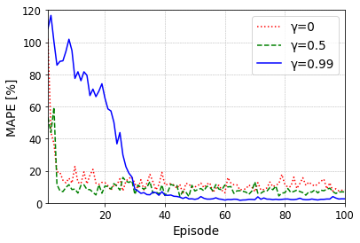
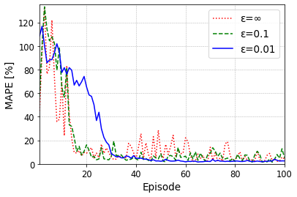
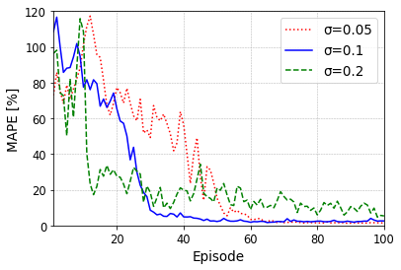
Experimental Results
Performance Evaluation
Solar dataset. E_{max} = 0.4 p.u.
Discount factor Clipping Standard Deviation

Slide 14
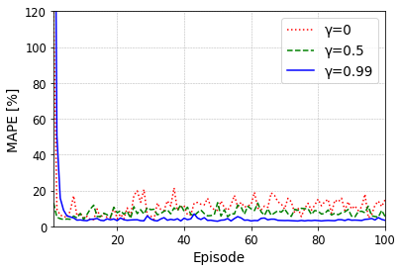
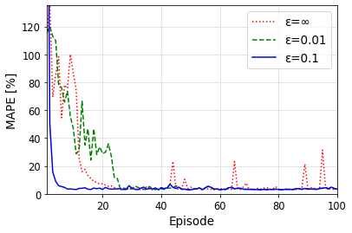
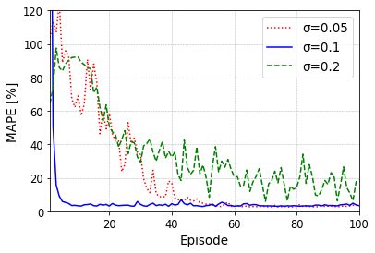
Experimental Results
Performance Evaluation
Wind dataset. E_{max} = 0.3 p.u.
Discount factor Clipping Standard deviation

Slide 15
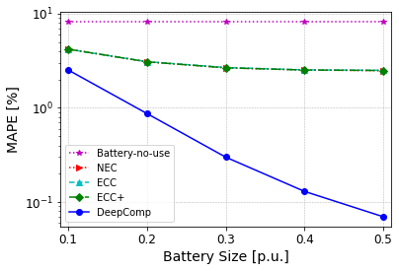
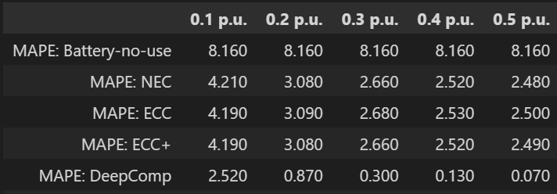
Experimental Results – Wind Dataset
E_{max}

Slide 16
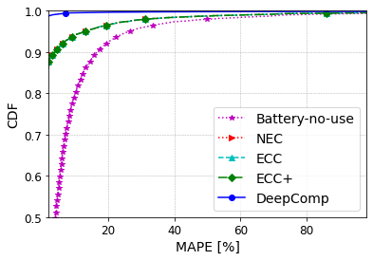
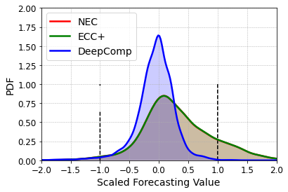
Experimental Results – Wind Dataset
CDF of the MAPE(E_{max} = 0.3) PDF of the scaled forecasting value(E_{max} = 0.3)

Slide 17
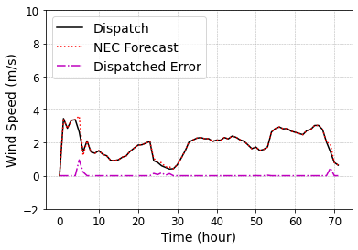
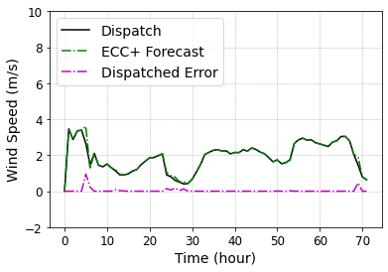
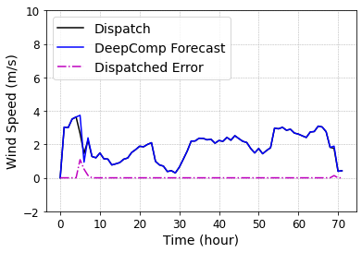
Experimental Results – Wind Dataset

Slide 18
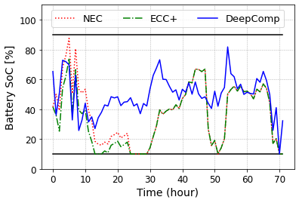
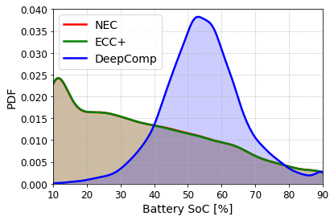
Experimental Results – Wind Dataset
Charging/Discharging Patterns(E_{max} = 0.3) PDF of the battery SoC(E_{max} = 0.3)

Slide 19
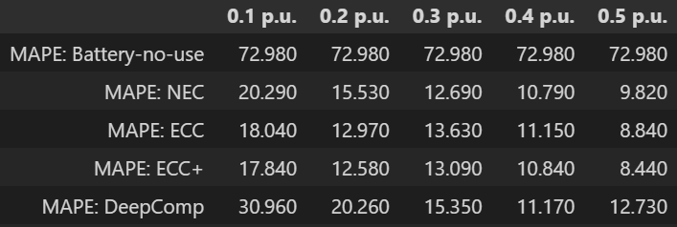
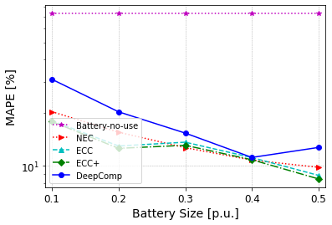
Experimental Results – Solar Dataset
E_{max}

Slide 20
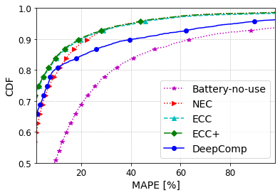
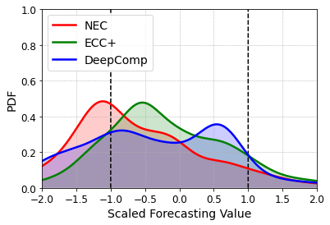
Experimental Results – Solar Dataset
CDF of the MAPE(E_{max} = 0.4) PDF of the scaled forecasting value(E_{max} = 0.4)

Slide 21
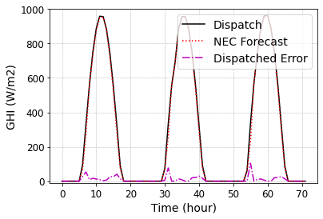
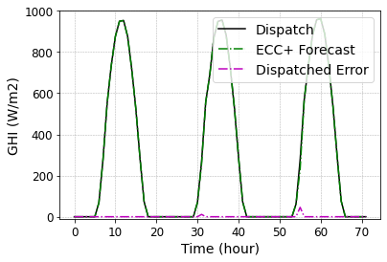
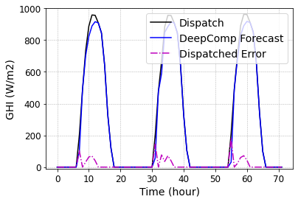
Experimental Results – Solar Dataset
Dispatched solar power and forecasting over 3 days(E_{max} = 0.4)

Slide 22
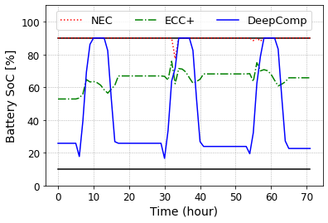
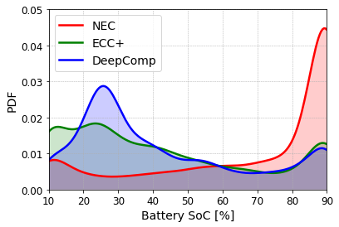
Experimental Results – Solar Dataset
Charging/Discharging Patterns(E_{max} = 0.4) PDF of the battery SoC(E_{max} = 0.4)

Slide 23
Conclusion
A novel forecasting strategy called DeepComp for renewable energy is proposed where the objective is switched from reducing errors to making errors compensable by using the battery.
The proposed framework can be easily combined with new forecasting algorithms to come because it does not require changing the model structure.
The proposed model showed outstanding performance for the wind dataset but the same was not observed for the solar dataset where the model lagged other traditional models.
Github link: Bhavy0906/DeepCom (github.com)

Slide 24
Future Goals
Future research can be extended in two possible directions.
One is to generalize our one-step ahead forecasting into a multi-step ahead (such as day ahead) short-term forecasting algorithm. It requires multiple action RL as we need to output the forecasted value for each time slot.
The other is to examine the economic impact such as bidding profit in renewable energy markets.

Slide 25
References
Mashlakov A, Kuronen T, Lensu L, Kaarna A, Honkapuro S. Assessing the performance of deep learning models for multivariate probabilistic energy forecasting. Appl Energy 2021;285:116405.
Zheng J, Zhang H, Dai Y, Wang B, Zheng T, Liao Q, et al. Time series prediction for output of multi-region solar power plants. Appl Energy 2020;257:114001.
Kim JH, Powell WB. Optimal energy commitments with storage and intermittent supply. Oper Res 2011;59(6):1347–60.
Ryu S, Bae S, Lee J-U, Kim H. Gaussian residual bidding based coalition for two-settlement renewable energy market. IEEE Access 2018;6:43029–38.
Ryu S, Noh J, Kim H. Deep neural network based demand side short term load forecasting. Energies 2017;10(1):3.
Zhang C, Vinyals O, Munos R, Bengio S. A study on overfitting in deep reinforcement learning. 2018, arXiv preprint.
Bae KY, Jang HS, Sung DK. Hourly solar irradiance prediction based on support vector machine and its error analysis. IEEE Trans Power Syst 2017;32(2):935–45.
Bae KY, Jang HS, Jung BC, Sung DK. Effect of prediction error of machine learning schemes on photovoltaic power trading based on energy storage systems. Energies 2019;12(7):1249.
Oh E, Wang H. Reinforcement-learning-based energy storage system operation strategies to manage wind power forecast uncertainty. IEEE Access 2020;8:20965–76.
Oh E. Reinforcement-learning-based virtual energy storage system operation strategy for wind power forecast uncertainty management. Appl Sci 2020;10(18):6420.
NSRDB Data Viewer (nrel.gov)
DeepComp: Deep reinforcement learning based renewable energy error compensable forecasting

