Slide 1


Slide 2
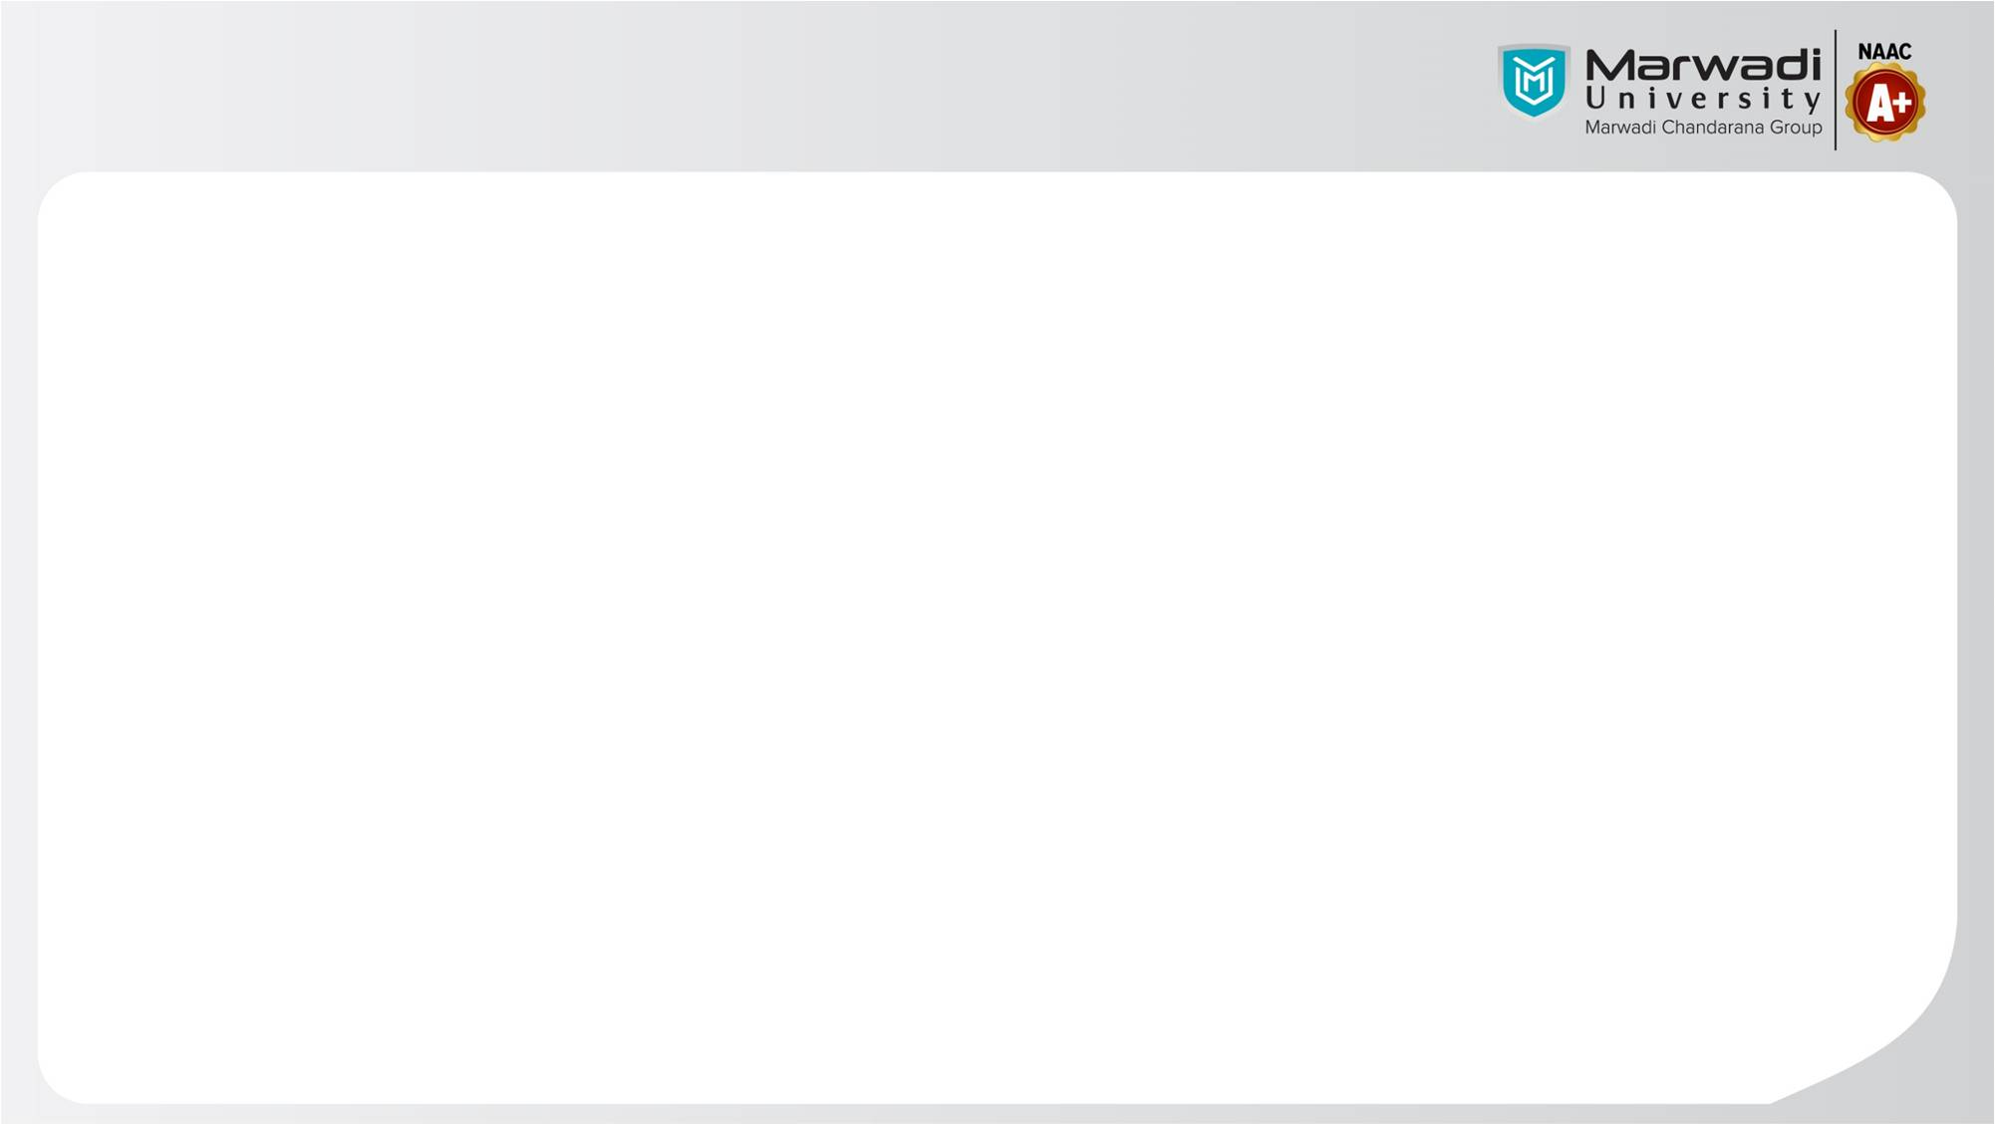
UniCanteen .

Slide 3
📘 group members details:
92300527083 : Uday Faliya
92300527183 : Bhavy Atkotiya
📍 Internal Guide:
Prof. Tejas Chauhan Faculty of Computer Applications.
🏫 Institution Address:
Marwadi University, Rajkot - Morbi Road, At & PO: Gauridad, Rajkot

Slide 4
INTRODUCTION
UniCanteen is a mobile-based application developed to modernize the food ordering experience at the Marwadi University campus.
By digitizing the traditional canteen workflow, the app provides a convenient platform for students and faculty to browse menus and manage orders directly from their smartphones.
​The project focuses on solving common campus challenges, such as long waiting times and crowded counters during peak hours.
Through an intuitive user interface, UniCanteen aims to enhance operational efficiency for canteen staff while providing a seamless, "click-and-collect" service for the university community.

Slide 5
OBJECTIVES OF THE PROJECT
​Reduce Wait Times: To minimize physical standing time in queues through pre-ordering.
​Digital Menu Management: To provide students with a real-time view of available food items and prices.
​Efficiency: To help canteen staff manage peak-hour traffic by organizing orders digitally.
​Transparency: To allow users to track their order status from "Received" to "Ready for Pickup".

Slide 6
TECHNOLOGIES USED
​Frontend: Android Studio (Java/Kotlin) and XML for UI design.
​Backend: Firebase (for real-time database and authentication) or SQLite for local storage.
​Design: Material Design components for a modern Android interface.

Slide 7
KEY FEATURES
​Digital Menu Browsing: Allows users to view the full canteen menu with real-time pricing and availability.
​User Authentication: Provides secure login and profile management for students and faculty.
​Order Management: Enables users to place food orders and track their status through different stages.
​Admin Dashboard: Empowers canteen staff to update the menu and manage incoming orders efficiently.
​UI Screen Design: Features a mobile-optimized interface with clear navigation and output displays.

Slide 8
MODULES IN UNICANTEEN
User Authentication Module: Handles secure login and registration for students and faculty using email and password verification.
​Menu Management Module: A dynamic interface where users can browse food items categorized by type.
​Order Processing Module: Manages the "Add to Cart" functionality, order placement, and generates a unique order ID for each transaction.
​Admin/Canteen Module: A specialized backend interface for canteen staff to add or remove menu items and manage
the queue of incoming orders.

Slide 9
TECHNICAL DESCRIPTION
Software Requirements:
​Operating System: Windows 10/11.
​IDE: Android Studio.
​Database: Firebase.
se.
​Hardware Requirements:
​Processor: Intel i3/i5 or higher.
​RAM: Minimum 4GB (8GB recommended).
​Device: Android Smartphone with API level 21 or higher for testing.

Slide 10
APP FEATURE SCREEN DESIGN
1.Splash Screen
​Visual: Displays the UniCanteen logo (the one you selected) in the center of a clean white or navy blue background.
​Description: This is the initial entry screen that appears for 2–3 seconds while the app initializes resources.
​2. Authentication Screen (Login/Sign-up)
​Visual: Minimalist input fields for University Email and Password, with a "Login" button and a "Register" link.
​Description: Provides secure access for Marwadi University students and faculty.
​3. Digital Menu / Dashboard
​Visual: A scrollable list of food items categorized by "Breakfast," "Lunch," and "Snacks." Includes images, prices, and an "Add to Cart" button.
​Description: The main interface where users browse real-time food availability.
​4. Calculation / My Cart Screen
​Visual: A summary list of selected items showing quantity, individual prices, and the total bill amount (similar to the Scientific Calculator layout in your template).
​Description: Allows users to review their selection and total cost before placing the order.

Slide 11

APP LOGO PICTURE

Slide 12
DATABASE DESIGN
The database schema includes tables for: ​Users: (UserID, Name, Email, Role) ​Products: (ItemID, Name, Price, Category, Status) ​Orders: (OrderID, UserID, TotalAmount, Timestamp, OrderStatus)

Slide 13
LEARNING DURING PROJECT
​Android App Architecture: Gained hands-on experience in structuring an application using Java and XML.
​Database Management: Learned how to design and manage a database schema for real-world applications using SQLite.
​UI/UX Design: Developed skills in creating user-friendly layouts and screen designs for a mobile interface.
​Problem Solving: Understood how to translate a physical workflow (canteen ordering) into a digital solution to solve real-world campus issues.
​Version Control & Documentation: Learned the importance of maintaining technical descriptions and organized code for project scalability.

Slide 14
BIBLIOGRAPHY
​Online References:
​Android Developers Documentation: Official guides for UI design, activity lifecycle, and SQLite integration (https://developer.android.com).
​Firebase Documentation: Reference for cloud messaging and real-time database management (https://firebase.google.com/docs).
​W3Schools: SQL and SQLite tutorials for database schema design and queries
(https://www.w3schools.com/sql/).
​Stack Overflow: Community-driven solutions for debugging Java and XML code during development.
​Offline References:
​Head First Android Development: A comprehensive guide to building mobile apps with Java and XML.
​Database System Concepts: Textbooks covering relational database design and normalization.

Slide 15
CONCLUSION
The UniCanteen project successfully demonstrates a digital solution for the Marwadi University campus.
By implementing core modules like user authentication and order management, the application reduces congestion and improves the overall efficiency of the university's canteen services.
This project highlights the practical application of Android development and database management in solving everyday logistics problems.

Slide 16


