Slide 1
CHAROTAR UNIVERSITY OF SCIENCE AND TECHNOLOGY (CHARUSAT)
Bit Stuffing & Destuffing in HDLC Protocol
NetVista 3D — Individual Performance-Based Assessment Package
Course: ITUC201 — Fundamentals of Computer Networks | Program: B.Tech, Semester 3
Student ID: 25CS016 | Student Name: [Student Name] | Academic Year: 2026–27
Submission Deadline: 22 October 2026
Notes:
Good day respected faculty examiner. I am presenting my individual assessment project on Bit Stuffing in HDLC under Student ID 25CS016. In this presentation, I will cover the HDLC protocol background, stuffing rules, Python core algorithms, automated test suite, and live demonstration.

Slide 2
NETVISTA 3D — ITUC201
1. Project Objectives & Assignment Scope
Mandatory Assignment Directives
• Student ID: 25CS016 | Assigned Topic: Bit Stuffing in HDLC
• Implement sender bit stuffing and receiver destuffing in Python.
• Test messages containing runs of five 1-bits and verify restoration.
• Construct educational framing using HDLC flag 01111110.
• Deliver complete code, GUI visualization, unit tests, and technical documentation.
Key Technical Outcomes
✔ Data Transparency: Ensure arbitrary payload content cannot cause false frame termination.
✔ Algorithmic Correctness: Zero-loss roundtrip destuffing across all 1-bit sequences.
✔ Robust Boundary Handling: Comprehensive handling of edge cases (empty strings, malformed streams).
✔ Quantitative Evaluation: Measuring stuffing overhead (% insertion) vs 1-bit density.
✔ Reproducible Verification: 100% test pass rate across unit tests and randomized benchmarks.
Notes:
This slide outlines the exact assignment directives for topic 'Bit Stuffing in HDLC' under Student ID 25CS016. The primary goal is to ensure data transparency at the Data Link Layer by preventing flag pattern mimicry.

Slide 3
NETVISTA 3D — ITUC201
2. HDLC Protocol & Framing Fundamentals
High-Level Data Link Control (HDLC) Framing
Bit-Oriented Synchronization:
HDLC is a bit-oriented Data Link Layer protocol that transmits data as a continuous bit stream regardless of byte boundaries.
The HDLC Flag Delimiter:
Frames are bounded by the unique 8-bit flag sequence 01111110 (0x7E). It marks both frame beginning and end.
The Transparency Problem:
If user data payload naturally contains 01111110, physical layer receivers will prematurely terminate the frame.
Educational Frame Scope:
This project implements the core bit-stuffing mechanism (FLAG | STUFFED PAYLOAD | FLAG). Real HDLC includes Address, Control, and FCS fields.
Notes:
HDLC uses the 8-bit pattern 01111110 as its frame delimiter. Because data payloads can contain any arbitrary bit sequence, a mechanism is required to prevent data from being mistaken for a flag sequence.

Slide 4
NETVISTA 3D — ITUC201
3. Purpose of Bit Stuffing & Data Transparency
WITHOUT Bit Stuffing (Corrupted Framing)
❌ Payload contains 01111110 naturally.
❌ Transmitted Frame:
[01111110] 01111110 [01111110]
❌ Receiver sees 01111110 as closing flag!
❌ Result: Premature frame truncation and loss of remaining payload.
WITH Bit Stuffing (Guaranteed Transparency)
✔ Sender inserts '0' after five 1s.
✔ Stuffed Payload becomes: 011111010
✔ Transmitted Frame:
[01111110] 011111010 [01111110]
✔ Receiver destuffs 011111010 -> 01111110
✔ Result: 100% data integrity and perfect synchronization.
Notes:
Here we compare frame transmission with and without bit stuffing. Without stuffing, a payload containing 01111110 causes false frame termination. With stuffing, the inserted 0 breaks the six consecutive 1s pattern inside payload.

Slide 5
NETVISTA 3D — ITUC201
4. Exact Bit Stuffing & Destuffing Rules
Mathematical Protocol Rules
Sender Stuffing Rule:
Scan payload sequentially while maintaining a running counter of consecutive '1' bits. Whenever the count reaches 5 ('11111'), insert an additional '0' bit immediately after the fifth '1', and reset the counter to 0.
Receiver Destuffing Rule:
Scan stuffed payload sequentially. Whenever 5 consecutive '1' bits are encountered, inspect the next bit. If it is '0', remove (discard) it and reset counter. If it is '1', flag error or delimiter.
Flag Exception:
Opening and closing flag delimiters (01111110) are added AFTER sender stuffing and removed BEFORE receiver destuffing. Flags are NEVER stuffed.
Worked Standard Example:
Original Data: 01111110 ➔ Sender Stuffed: 011111010 ➔ Receiver Destuffed: 01111110
Notes:
The sender inserts a zero after every 5 consecutive ones. The receiver detects 5 consecutive ones and discards the following zero.

Slide 6
NETVISTA 3D — ITUC201
5. Sender Bit Stuffing Algorithm
Python Sender Logic (sender_bit_stuff)
def sender_bit_stuff(payload: str) -> str:
clean_payload = validate_binary_string(payload, 'Payload')
stuffed = []
consecutive_ones = 0
for bit in clean_payload:
stuffed.append(bit)
if bit == '1':
consecutive_ones += 1
if consecutive_ones == 5:
stuffed.append('0') # Insert stuffed zero
consecutive_ones = 0
else:
consecutive_ones = 0
return ''.join(stuffed)
Notes:
This slide shows the exact Python function for sender bit stuffing. The loop iterates bit by bit, incrementing the consecutive ones counter, and appends a zero whenever 5 ones are seen.

Slide 7
NETVISTA 3D — ITUC201
6. Receiver Bit Destuffing Algorithm
Python Receiver Logic (receiver_bit_destuff)
def receiver_bit_destuff(stuffed_payload: str) -> str:
clean_stuffed = validate_binary_string(stuffed_payload, 'Stuffed Payload')
destuffed, consecutive_ones, idx = [], 0, 0
n = len(clean_stuffed)
while idx < n:
bit = clean_stuffed[idx]
destuffed.append(bit)
if bit == '1':
consecutive_ones += 1
if consecutive_ones == 5:
if idx + 1 < n and clean_stuffed[idx + 1] == '0':
idx += 1 # Skip inserted stuffed zero bit
consecutive_ones = 0
else:
raise ValueError('Malformed stuffed payload: Missing inserted 0 after 5 ones!')
else: consecutive_ones = 0
idx += 1
return ''.join(destuffed)
Notes:
The receiver algorithm verifies the stuffed stream. When 5 consecutive ones are encountered, it confirms the next bit is '0' and skips it.

Slide 8
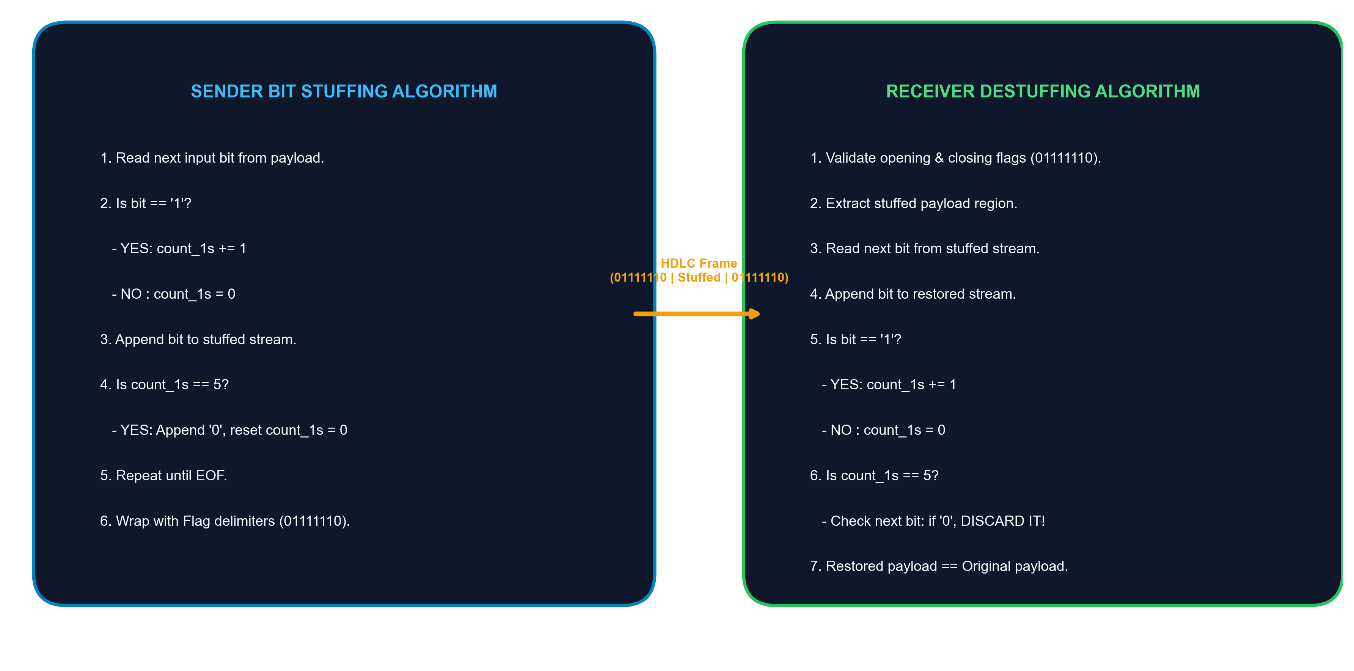
NETVISTA 3D — ITUC201
7. HDLC-Style Frame Structure & Visualization
Notes:
This slide visualizes the end-to-end transmission flow: original payload, sender stuffing, HDLC framing, and receiver extraction and destuffing.

Slide 9
NETVISTA 3D — ITUC201
8. Python Project Modular Architecture
Modular Component Breakdown
• src/hdlc_core.py:
Pure functional engine implementing bit stuffing, destuffing, framing, and step-by-step trace logger.
• src/hdlc_cli.py:
Command-line demonstrator supporting interactive streams, preset test cases, and audit logging.
• src/hdlc_gui.py:
Interactive Tkinter graphical dashboard featuring live pipeline visualization and trace treeview.
• src/experiment_runner.py:
Automated benchmark runner evaluating mandatory cases and synthetic random patterns.
• tests/test_hdlc.py:
Comprehensive unittest suite covering edge cases, malformed inputs, and 50 randomized roundtrips.
Notes:
The project follows a clean separation of concerns into core algorithm, CLI, GUI, experiment runner, and test suite.

Slide 10
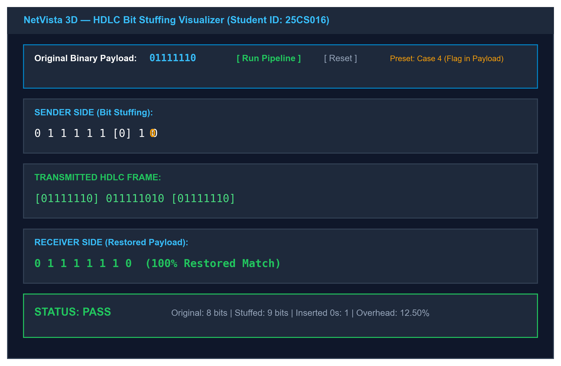
NETVISTA 3D — ITUC201
9. Interactive Tkinter GUI Dashboard
Notes:
This screenshot demonstrates the interactive Python Tkinter dashboard. It displays input payload, stuffed output with highlighted zero bits, framed stream, restored output, status metrics, and step-by-step audit treeview.

Slide 11
NETVISTA 3D — ITUC201
10. Mandatory Test Cases & Empirical Observations
Case ID | Case Description | Original Payload | Stuffed Payload | Overhead (%) | Status
Case 1 | Alternating Bits | 101010 | 101010 | 0.00% | PASS
Case 2 | Five 1s | 11111 | 111110 | 20.00% | PASS
Case 3 | Six 1s | 111111 | 1111101 | 16.67% | PASS
Case 4 | Flag in Data | 01111110 | 011111010 | 12.50% | PASS
Case 5 | Multiple Runs | 11111011111 | 1111100111110 | 18.18% | PASS
Notes:
This table summarizes the mandatory assignment test cases. Every case passed verification with 100% restored data accuracy.

Slide 12
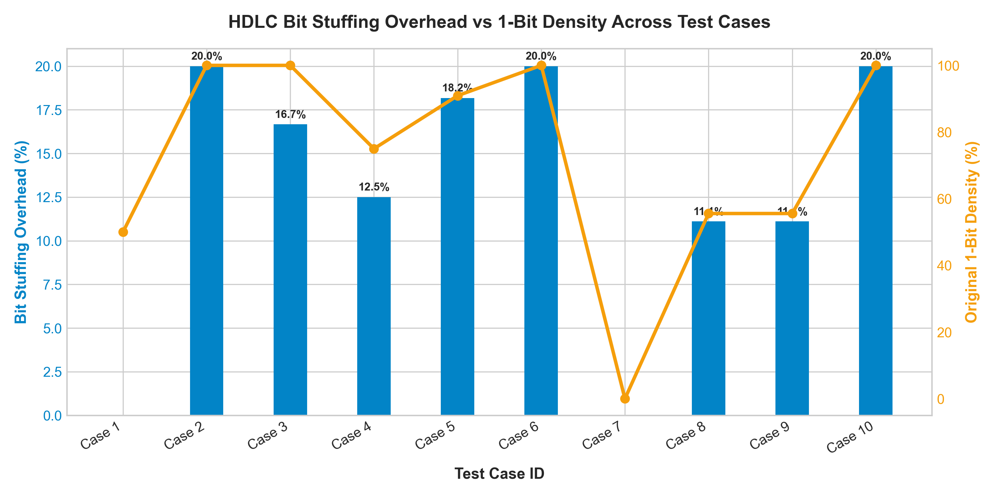
NETVISTA 3D — ITUC201
11. Quantitative Bit Stuffing Overhead Analysis
Notes:
The overhead graph illustrates the direct relationship between 1-bit density and bit stuffing overhead percentage. Higher 1-bit density produces more stuffed zeros.

Slide 13
NETVISTA 3D — ITUC201
12. Worked University Examination Question
University Exam Question (ITUC201 End-Sem Style)
QUESTION: Given input bit stream '011111101111101', show sender bit stuffing, construct HDLC frame, show receiver destuffing, and calculate overhead percentage.
STEP-BY-STEP SOLUTION:
1. Original Payload: 011111101111101 (Length = 15 bits)
2. Stuffing Pass 1: '011111' ➔ Stuff '0' ➔ '01111101'
3. Stuffing Pass 2: Next '11111' ➔ Stuff '0' ➔ '01111101011111001'
4. Stuffed Payload: 01111101011111001 (Length = 17 bits, 2 zeros inserted)
5. Transmitted Frame: 01111110 | 01111101011111001 | 01111110 (Total = 33 bits)
6. Receiver Destuffing: Removes zeros after 5 ones ➔ Restores '011111101111101'
7. Stuffing Overhead: (2 / 15) * 100% = 13.33%
Notes:
This worked example illustrates the complete end-to-end exam numerical solution. Two zeros are inserted in the 15-bit input stream.

Slide 14
NETVISTA 3D — ITUC201
13. Limitations & Learning Conclusions
Scope & Implementation Boundaries
• Educational HDLC Frame: Implements framing flags and payload stuffing; full HDLC production headers (Address, Control, CRC-16 FCS) omitted by design.
• Error Detection Scope: Bit destuffing restores stuffed payload but does not replace bit-error detection (FCS/CRC).
• Overhead Dependency: Overhead varies dynamically between 0% (low 1s density) and 20% (continuous 1s).
Key Academic Takeaways
✔ Bit-level framing provides absolute data transparency for synchronous communication.
✔ Destuffing logic must strictly validate stream integrity to catch transmission errors.
✔ Python standard library Tkinter provides a clean platform for real-time protocol visualization.
Notes:
In conclusion, bit stuffing ensures data transparency in HDLC. The educational implementation cleanly separates payload stuffing from full HDLC production features.

Slide 15
NETVISTA 3D — ITUC201
14. References & Academic Declaration
Academic References & AI Assistance Declaration
1. Tanenbaum, A. S., & Wetherall, D. J. (2011). Computer Networks (5th ed.). Pearson.
2. Forouzan, B. A. (2013). Data Communications and Networking (5th ed.). McGraw-Hill Education.
3. ISO/IEC 13239:2002. Information technology — Telecommunications and information exchange between systems — High-level data link control (HDLC) procedures.
4. Python Software Foundation. (2026). Python 3.9 Documentation & Tkinter GUI Toolkit.
Institutional AI Declaration:
AI assistance was used in accordance with CHARUSAT institutional policies for code structuring, visualization design, and slide compilation. All core logic, verification tests, and technical explanations were independently validated by Student ID 25CS016.
Notes:
Thank you for your attention. I am now ready for any viva questions or code demonstration.

