Slide 1

अनन्तसूत्र · ANANTASUTRA
AnantaSutra
Not a project. A dedicated expert.
Vetted domain professionals — any field — embedded inside your team, for as long as you need. You pay just the salary.
Bhavya Duneja — Co-founder · Delhi, India
anantasutra.com · contact@anantasutra.com

Slide 2
WHAT WE DO
We don't sell deliverables. We place a person.
Most agencies hand you a project and disappear. AnantaSutra assigns a vetted expert who becomes part of your team — they attend your standups, learn your product, and own your KPIs, because they're not splitting time across ten clients.
One domain or many. In-house or remote. An afternoon or a full year.
“You run your business.
Your expert runs your execution.”
AnantaSutra · anantasutra.com
2

Slide 3
THE PROBLEM
Hiring is slow. Agencies are detached.
Hiring takes months
Job posts, interviews, notice periods.
By the time someone finally starts,
the opportunity has already passed.
Agencies juggle ten clients
And mark talent up 30–50%. You pay
₹1.5L for someone earning ₹1L —
and you're just one account of many.
Freelancers aren't embedded
No ownership, no context, no real
accountability. Work slips through
the cracks between hand-offs.
AnantaSutra · anantasutra.com
3

Slide 4
OUR MODEL
Dedicated domain experts, on demand.
Any Domain, One Partner
An engineer today, a lawyer next
month — every field through a single
relationship. No juggling vendors.
Embedded, Not Outsourced
Your expert works inside your team,
under your direction — in-house or
remote. Real ownership, not tickets.
Flexible by Design
Scale up when you grow, wind down
when you don't. Add experts, pause
anytime — no lock-ins.
AnantaSutra · anantasutra.com
4

Slide 5
ANY DOMAIN
Whatever expertise you need.
Engineering & Software
Full-Stack · Backend · DevOps · Infra
AI & Data
ML · Data Science · Automation
Design & Creative
Product · Brand · UI/UX · Motion
Marketing & Growth
Performance · Growth · SEO · Social
Video & Content
Editors · Writers · Producers
Legal & Compliance
Corporate · Immigration · Contracts
Healthcare
Clinical Advisory · Health Ops · Telehealth
Finance & Business
Analysts · FP&A · Ops · Strategy
Property & Real Estate
Sales · Funnels · Listings · CRM
E-commerce & Retail
Store Ops · Catalogue · CRO · Retention
Immigration & Mobility
Case Mgmt · Visa · Documentation
Academic & Research
Researchers · Subject Experts · Writers
If it's a profession, we can embed an expert in it. The domain can be anything.
AnantaSutra · anantasutra.com
5

Slide 6
HOW IT WORKS
From need to on boarded in 14 days.
01
Tell us your need
A 30-minute call on your business, the role you need, and the outcomes you want.
02
We match & vet
We handpick 2–3 vetted pros from our network. You interview them and choose.
03
They join your team
Into your Slack, Notion and project tools — working as part of your team within 7 days.
04
You stay focused
Weekly reviews, monthly reports, and one accountable point of contact.
AnantaSutra · anantasutra.com
6

Slide 7
WHY IT WORKS
Built for founders who value time.
Dedicated, not shared
Your expert works only on your business — never juggling five clients.
Ramp-up in 7 days
Skip the 3-month hiring cycle. Productive from week one.
Replace anytime
Wrong fit? We replace them within 48 hours. No long contracts.
Scale on demand
Start with one expert. Add more as you grow. Pause when you don't.
Backed by AnantaSutra
Every expert has our processes, tools and leadership behind them.
Partnership mindset
We grow when you grow — that's the whole reason this model exists.
AnantaSutra · anantasutra.com
7

Slide 8
PRICING
You pay just the salary.
What you pay
The expert's monthly salary —
exactly what they earn.
That's it.
What you don't pay
No agency markup (save 30–50%).
No recruitment fees. No overheads.
No hidden charges.
How we earn
A small, transparent coordination
fee — agreed upfront.
You see every rupee.
Agencies charge ₹1.5L for someone earning ₹1L. We flipped it — you pay the salary, we earn a transparent fee, and you save lakhs every year.
AnantaSutra · anantasutra.com
8

Slide 9
TRACTION
Numbers that speak.
12+
Expert Domains
10+
Brands Delivered
4
Continents Served
7-Day
Avg. Onboarding
0%
Agency markup
48h
Replacement guarantee
100%
Dedicated to your business
A vetted network spanning 12+ disciplines — embedded, accountable, and aligned to your outcomes.
AnantaSutra · anantasutra.com
9

Slide 10
CLIENT RESULTS
Real brands. Real outcomes.
₹25L → ₹40L
Awish Clinic
Monthly revenue in 2 months — embedded web, CRM & ads experts (Dermatology).
₹23L
BotWot
Average deal size closed across India, UAE & Nigeria via an embedded marketing team.
+46%
Zoom Wheels
Revenue growth driven by a dedicated ads expert (Automotive, Delhi).
+38%
Royal Properties
Traffic lift from embedded funnel & landing-page experts (Real Estate).
AnantaSutra · anantasutra.com
10

Slide 11










TRUSTED BY
Across industries and continents.
Awish Clinic
Dermatology · India
Education Aspire
EdTech · Faridabad
Giant Migrations
Immigration · Qatar·UAE
BotWot
AI · India·UAE·Nigeria
Zoom Wheels
Automotive · Delhi
Royal Properties
Real Estate · Delhi
BlueMoon Marketing
Advertising · Delhi
Smile With Kris
Dental · UK
Walk Through My Lens
Travel · London
Wisdom of Mind
Vedic & Wellness · Haryana
AnantaSutra · anantasutra.com
11

Slide 12
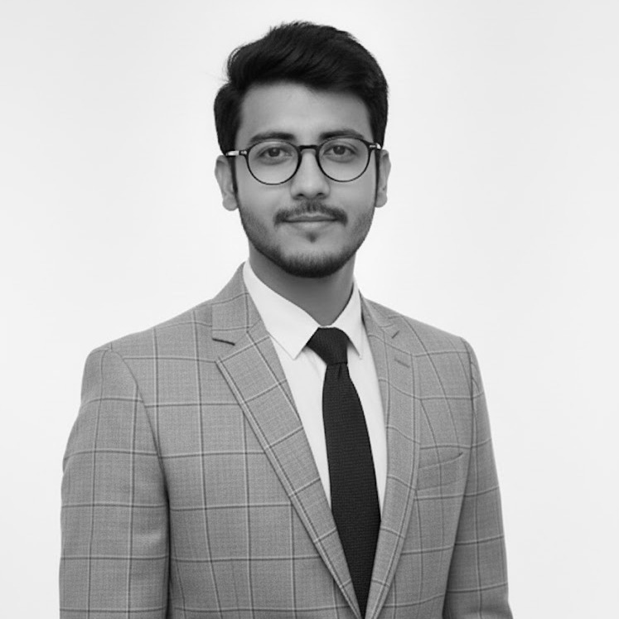
LEADERSHIP
Backed by a technologist-entrepreneur.
Bhavya Duneja
Co-founder, AnantaSutra
A software engineer and entrepreneur (.NET, React, AWS, Azure) bridging Delhi and Osaka, Japan. Bhavya leads a vetted network of professionals across 12+ domains — every expert backed by AnantaSutra's processes, tools and hands-on leadership.
We grow when our clients grow — that's the whole reason this model exists.
AnantaSutra · anantasutra.com
12

Slide 13
STOP JUGGLING. START GROWING.
Get your expert in 7 days.
Tell us the role you need — we'll introduce your dedicated expert within a week. Free consultation, zero commitment.
contact@anantasutra.com
anantasutra.com · Delhi, India
Bhavya Duneja — Co-founder

