Slide 1


PROBABLISTIC FORECASTING OF SEA LEVEL ANAMOLY(SLA) AND SEA WAVE HEIGHT(SWH)
Bhavya Boda Tirth Gandhi
202301037 202301016
BTech ICT
Faculty Mentor : Prof. Pritam Anand
Notes:
1

Slide 2
MOTIVATION
Notes:
1

Slide 3

MOTIVATION
Why Probabilistic Ocean Forecasting?
The Indian Ocean supports vast amount of coastal inhabitants and drives the monsoon system
The Challenge
Our Approach
Sea level and wave height affect port operations, offshore energy, fisheries, and disaster response
Instead of one number, predict a RANGE:
"Wave height will be 1.9–2.7 m with 95% confidence"
Classical models give only a POINT ESTIMATE:
"Tomorrow's wave height = 2.3 m"
95% Prediction Interval means: in 100 days, the true value is inside the interval on ≥95 days
But operators need to know the UNCERTAINTY to make safe decisions
Compare 9 deep learning architectures to find which produces the sharpest, best-calibrated intervals
A wrong forecast can cost crores in port damage, equipment loss, or unnecessary evacuations
Translate model quality into operational monetary value using expected return calculations
2
Notes:
2

Slide 4
MOTIVATION
The Flaw in Point Estimates
A single number forecast hides the risk that decision-makers need to see
Point Forecast Says:
Reality — Scenario A:
Reality — Scenario B:
SLA = +0.02 m
SLA = +0.025 m
SLA = −0.03 m
Port operator grants entry to a deep-draft vessel based on this single estimate
Actual SLA is close to forecast. Vessel enters safely. No problem.
Actual SLA drops below safe draft clearance. Grounding risk. Salvage cost: ₹3.5 Crore
The point estimate cannot distinguish Scenario A from Scenario B. A probabilistic forecast would have given: [−0.01 m, +0.04 m] with 95% confidence — the lower bound (−0.01 m) immediately tells the operator there is a non-trivial chance of reduced draft clearance.
3
Notes:
3

Slide 5
MOTIVATION
Why Probabilistic Forecasting?
Calibrated prediction intervals enable risk-aware decision making
Quantified Uncertainty
Risk-Aware Decisions
Monetary Value of Accuracy
Instead of trusting a single number, operators get a confidence-bounded range. A 95% interval that genuinely covers 95% of the time is called calibrated.
Port operators can use the LOWER BOUND for draft clearance. Wave energy operators can use the UPPER BOUND for structural safety limits. Each boundary has a specific meaning.
We show that GRU-Quantile produces ₹4.5L more expected value PER BERTHING than ARIMA. Better calibration = better decisions = real money saved.
4
Notes:
4

Slide 6
MOTIVATION
The Cost of Forecasting Error
Model quality has direct monetary consequences
SLA — Port Tidal Gate (Bay of Bengal)
SWH — Wave Energy Converter (Lakshadweep)
GRU-Quantile (PICP=95.07%, MPIW=1.01 cm):
Expected Return = ₹4,54,945 per berthing
ARIMA Baseline (PICP=86.76%, MPIW=1.89 cm):
Expected Return = ₹77,360 per berthing
Annual difference at JNPT scale:
₹45.3 Crore / year
MDN-GRU (PICP=95.62%, MPIW=0.556 m):
Expected Return = ₹64,843 per day
Transformer-Tube (PICP=93.33%, MPIW=0.686 m):
Expected Return = ₹62,259 per day
10-device array, 200-day season:
₹51.7 Lakh / season
5
Notes:
5

Slide 7
DATA
Notes:
1

Slide 8
DATA
Data Sources & Study Locations
Copernicus Marine Service (CMEMS) satellite data · January 2021 – December 2023
SLA Product:
CMEMS SEALEVEL_GLO_PHY_L4
0.125° grid · Variable: sla
Location | Coords | Key Forcing
Arabian Sea | 15°N 65°E | Somali Current reversal
Bay of Bengal | 12°N 87°E | Bay gyre; cyclone tracks
Andaman Sea | 11°N 95°E | Irrawaddy eddies
Lakshadweep | 10°N 73°E | IOSD influence
Southern IO | 5°S 75°E | Mixed swell + wind waves
SWH Product:
CMEMS Wave Model
0.2° grid · Variable: VHM0
Period:
1,096 daily observations
Train: 877 days · Test: 219 days
Preprocessing:
NaN interpolation (≤14 days)
RobustScaler (median + IQR)
Why These 5 Locations?
Each location represents a distinct oceanographic regime: open ocean (Arabian Sea), semi-enclosed basin (Bay of Bengal), marginal sea with river forcing (Andaman Sea), shallow shelf (Lakshadweep), and open subtropical ocean (Southern IO). Together they capture the full diversity of Indian Ocean conditions. Using the same 5 locations for both SLA and SWH enables direct cross-variable comparison.
6
Notes:
6

Slide 9
DATA
Data Preprocessing Pipeline
Identical treatment for SLA and SWH — ensuring fair model comparison
1. Load
2. Clean
3. Constrain
4. Split
5. Scale
6. Sequence
CMEMS NetCDF files
Extract daily time series at
5 lat/lon coordinates
Linear interpolation for
NaN gaps ≤ 14 consecutive
days; forward/backward fill
SWH clipped at zero
(wave height is physically
non-negative)
80% Train (877 days)
20% Test (219 days)
Chronological — no shuffle
RobustScaler fitted on
train only (median + IQR)
Applied to test set
Sliding window SEQ=30
846 training sequences
Input → [lower, upper]
→
→
→
→
→
7
Notes:
7

Slide 10
MODELS
Notes:
1

Slide 11
MODELS
9 Deep Learning Architectures
All share: Input(30,1) → Encoder(64) → Dropout(0.2) → Dense(32,ReLU) → Output(2)
SimpleRNN
~18K params
GRU
~33K params
LSTM
~44K params
Basic recurrent
Single state update
Gated Recurrent Unit
2 gates, no cell state
Captures long-term deps
Long Short-Term Memory
3 gates, cell state
More Expressive
Transformer
~90K params
Mamba SSM
~90K params
DeepAR
~33K params
Multi-head attention
4 heads, key_dim=16
Selective state space
Input-dependent scan
GRU + Gaussian output
[μ, logσ] → p10/p90
MDN-GRU
K=3 mixture
LSTM-KDE
3-layer
ARIMA(2,1,1)
Classical
Mixture Density Net
3 Gaussian components
Monte Carlo sampling
Point forecast + KDE
Calibration holdout
AR(2), I(1), MA(1)
Bootstrap CI (2000)
8
Notes:
8

Slide 12
METHOD
Notes:
1

Slide 13
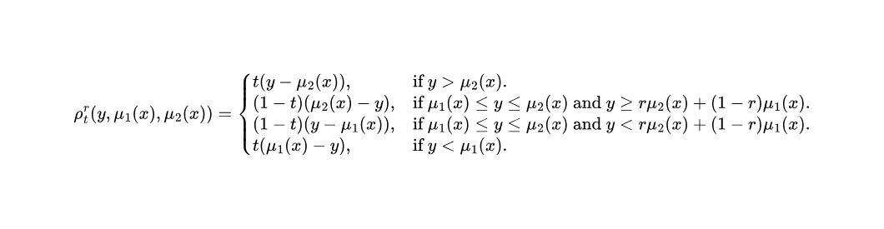
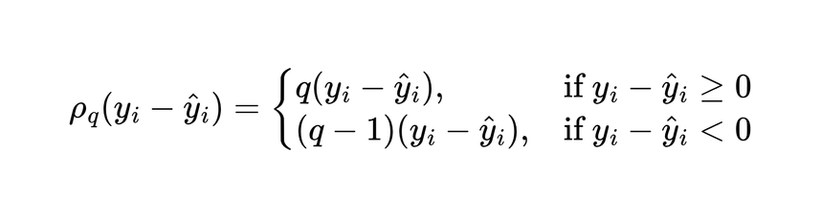
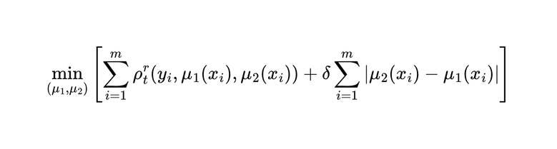
METHOD
Loss Functions: Quantile & Tube
Two training objectives for producing calibrated prediction intervals
Quantile (Pinball) Loss
Tube Loss
q_lo = 0.10 (lower bound)
q_hi = 0.90 (upper bound)
For q=0.10: under-prediction penalised 9× more than over-prediction. This asymmetry teaches the model where the 10th percentile is.
Directly targets specific quantile values — no distributional assumption.
r = 0.5 (symmetric)
δ = 0.01 (SLA) / 0.03 (SWH)
δ controls width-coverage tradeoff:
Large δ → wide intervals, high PICP
Small δ → narrow intervals, risk of under-coverage
9
Notes:
9

Slide 14
METHOD
Evaluation Metrics
Four complementary metrics — each captures something different
PICP
MPIW
WIS
CWC
Prediction Interval
Coverage Probability
Mean Prediction
Interval Width
Winkler Interval
Score
Coverage Width
Criterion
mean(y ∈ [L,U]) × 100%
mean(U − L) in metres
MPIW + (2/α)·miss_penalty
MPIW · exp(−50·(PICP/100−0.95))
if PICP < 95%, else MPIW
Target: ≥ 95%
Lower = sharper
Lower = better
Lower = better
95% = one of every 20 days missed
Best: 0.89 cm (GRU-Q, Arabian Sea)
PRIMARY RANKING METRIC
α = 0.20 for p10/p90
Exponential penalty for under-coverage
At PICP=90%: CWC = 12.2×MPIW
10
Notes:
11

Slide 15
SLA
Sea Level Anomaly — What & Why
Deviation of instantaneous sea surface height from the long-term mean
What is SLA?
Why SLA Prediction Matters
SLA (Sea Level Anomaly) = the difference between today's sea surface height and the long-term average at that location.
• Positive SLA = sea level higher than usual
• Negative SLA = sea level lower than usual
• Typical range: ±0.05 to ±0.10 m (centimetre scale)
• Driven by: mesoscale eddies, steric heating, monsoon winds, remote teleconnections
This subtle, cm-scale signal is the harder forecasting variable in our study — only 51% of model-location pairs achieve ≥95% PICP.
Port Operations
SLA modulates effective water depth. A −3 cm SLA at a port with 11.5 m draft clearance can cause a deep-draft vessel to run aground.
Coastal Flooding
SLA acts as a "background sea level" on top of which storm surges are added. A +5 cm SLA during a cyclone can mean the difference between a surge overtopping a seawall or not.
Cable & Infrastructure
Sustained SLA anomalies drive bottom currents that increase sediment transport risk to submarine cables.
Climate Monitoring
Long-term SLA trends indicate regional sea level rise and ocean heat content changes.
11
Notes:
12

Slide 16
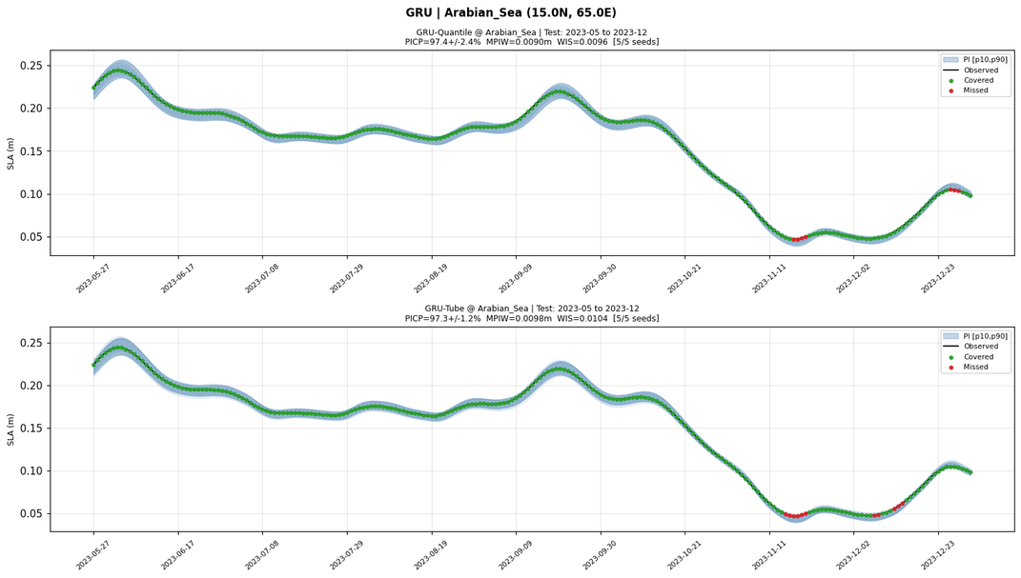
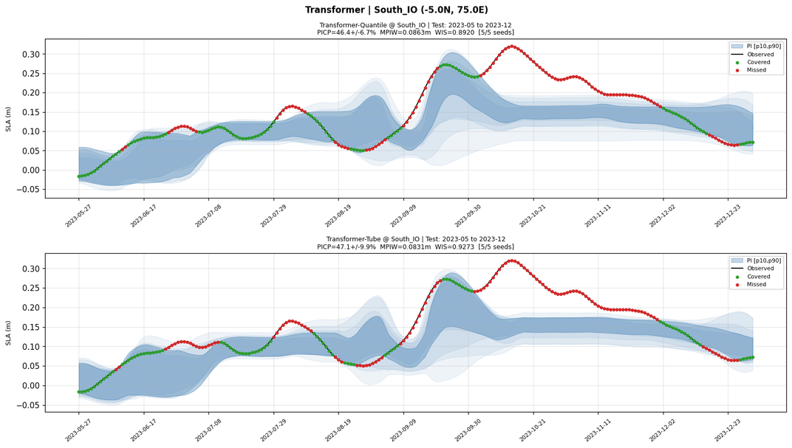
SLA RESULTS
SLA Prediction Intervals: Best vs Worst
98.99%
0.89cm
5 / 5
4 / 5
46.6%
Best PICP
(GRU-Q, Arabian)
Best MPIW
(narrowest interval)
SimpleRNN-Q
passes all locations
GRU-Q passes
(misses Andaman)
Worst PICP
(Transformer, S.IO)
12
Notes:
13

Slide 17
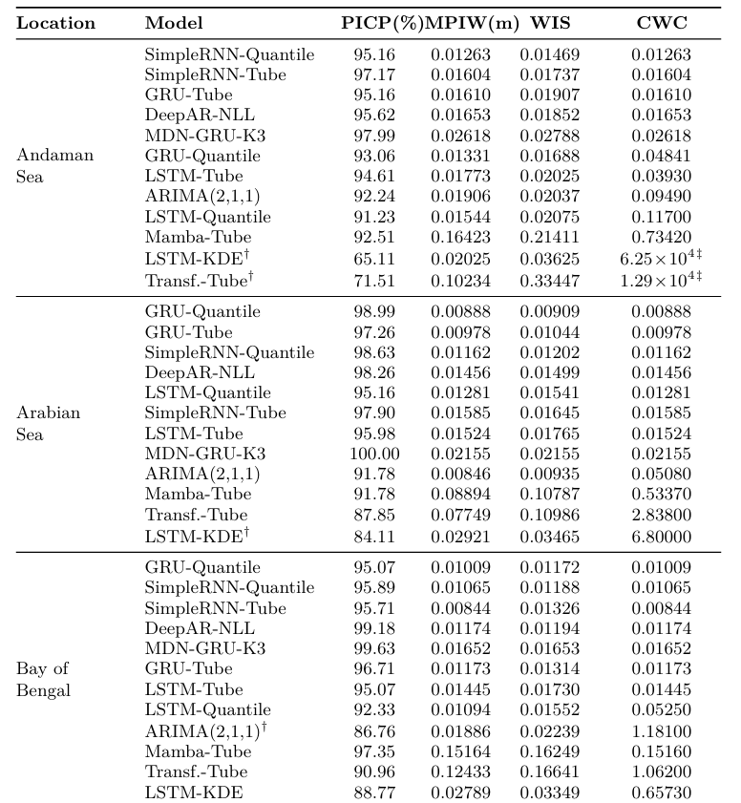
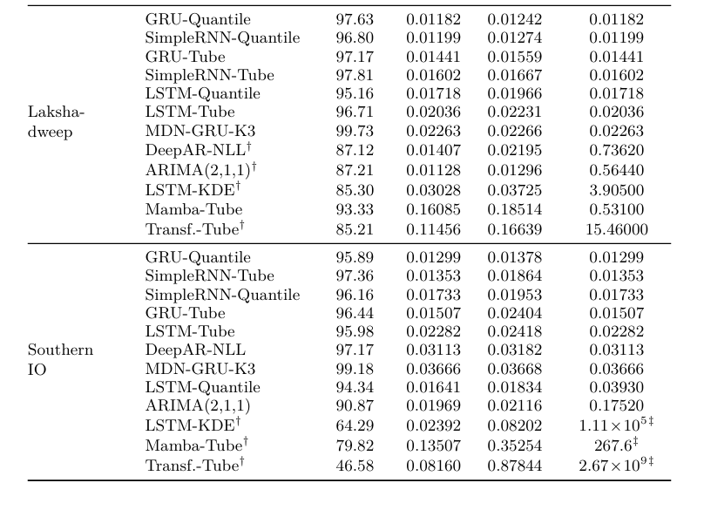
SLA RESULTS
Complete SLA evaluation metrics across all five Indian Ocean locations
12
Notes:
13

Slide 18
SWH
Significant Wave Height — What & Why
Average height of the highest one-third of waves in a sea state
What is SWH?
Why SWH Prediction Matters
SWH (Significant Wave Height, H_s) = the statistical measure of wave energy in a sea state.
• Typical Indian Ocean range: 0.5 – 4.0 m
• SW Monsoon (Jun–Sep): peaks at 2–4 m
• NE Monsoon (Dec–Feb): 0.5–1.5 m
• Dominated by the annual monsoon cycle — a strong, regular, large-amplitude forcing
SWH is the EASIER forecasting variable: 62% of model-location pairs achieve ≥95% PICP (vs 51% for SLA). Even Transformer recovers to 95%+.
Maritime Safety
Small fishing boats (<10 m) cannot operate in SWH > 1.5 m. INCOIS issues wave warnings for 4 million Indian fishers.
Wave Energy
WEC devices have structural limits (SWH ≤ 3.5 m). Operations scheduled using probabilistic SWH intervals.
Offshore Wind
Crew transfer vessels (CTVs) for turbine maintenance operate only in SWH ≤ 1.5 m. 1 cancelled deployment = ₹85,000.
Shipping Routes
Bulk carriers slow down 20% in SWH > 3.5 m. Route choice (Great Circle vs detour) saves $52,200/voyage with accurate SWH forecast.
13
Notes:
14

Slide 19
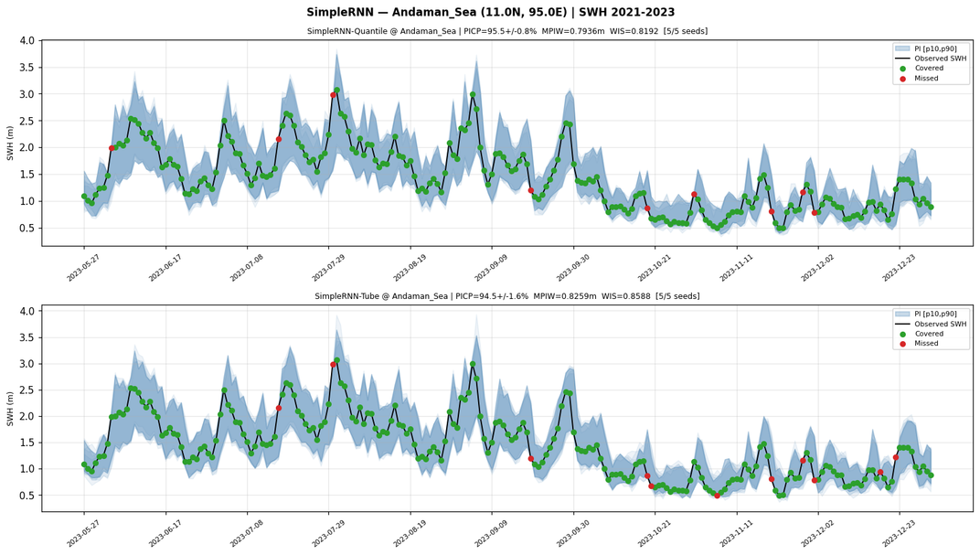
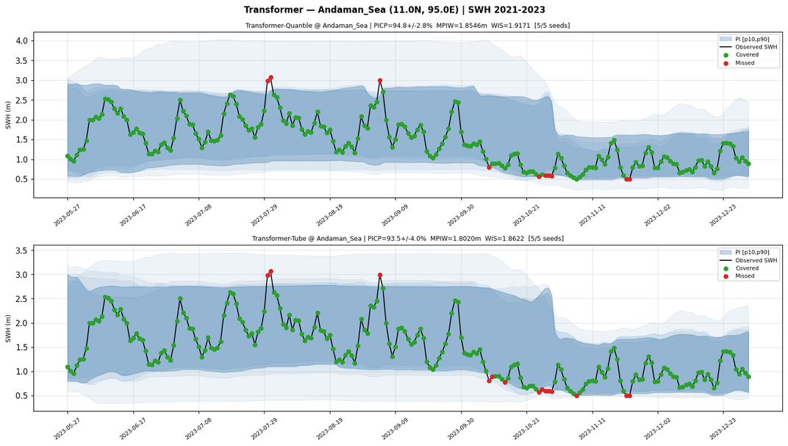
SWH RESULTS
SWH Prediction Intervals: Architecture Recovery
Key Insight: Same Transformer architecture: 46.6% PICP on SLA → 95.5% on SWH. This architecture-variable interaction is the central finding. SWH MPIW is 29-77× larger than SLA — not a model failure, just the physical scale of wave height vs sea level anomaly.
14
Notes:
15

Slide 20
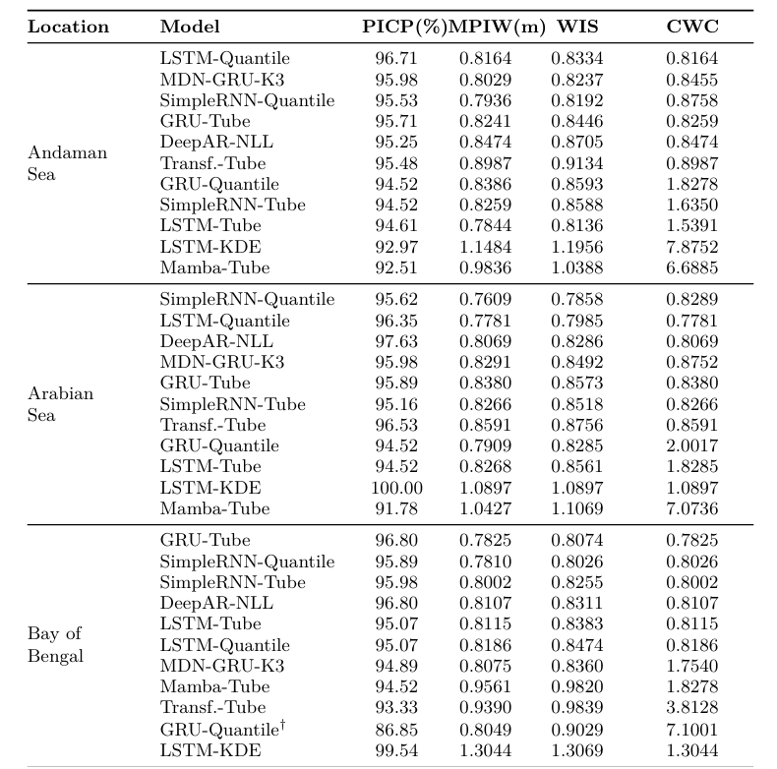
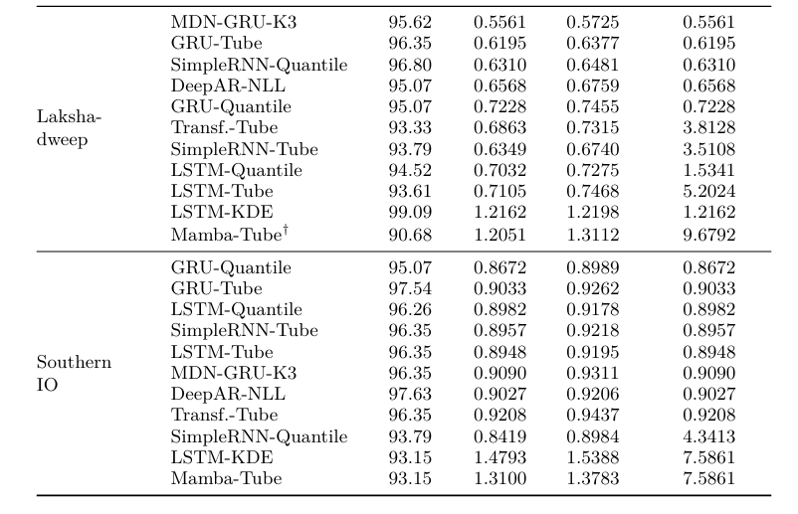
SWH RESULTS
Complete SWH evaluation metrics across all five Indian Ocean locations.
14
Notes:
15

Slide 21
ANALYSIS
14
Notes:
15

Slide 22
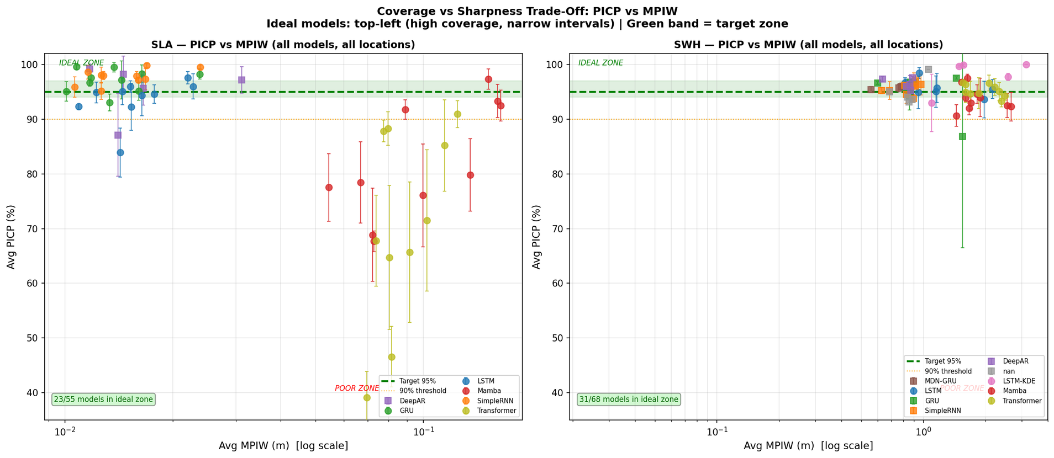
ANALYSIS
PICP vs MPIW: Coverage–Sharpness Trade-off
The core result — ideal models are in the top-left corner (high PICP, low MPIW)
Wider intervals do NOT mean better coverage. Transformer has 10× wider intervals than GRU yet 46-88% PICP vs 93-99%.
15
Notes:
16

Slide 23
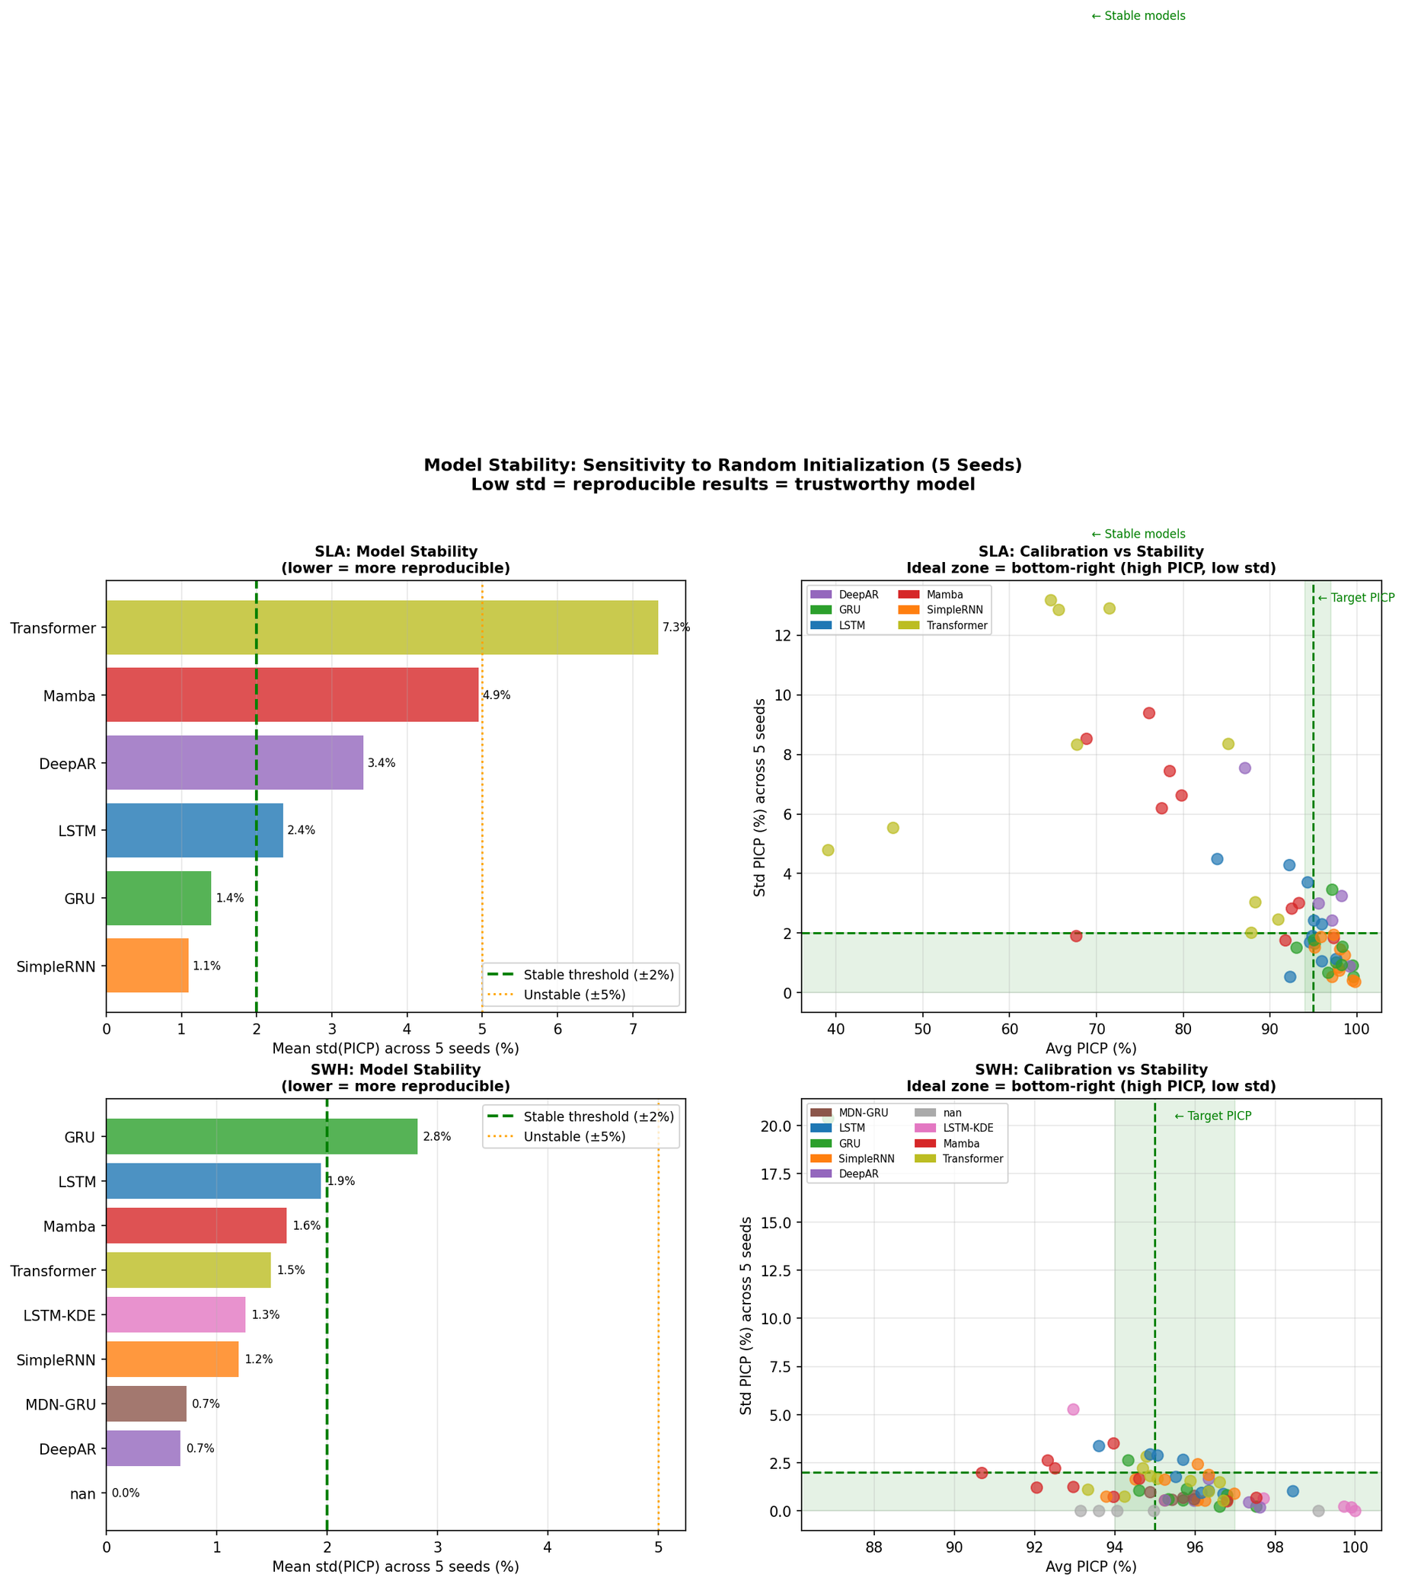
ANALYSIS
Stability Analysis
16
Notes:
16

Slide 24
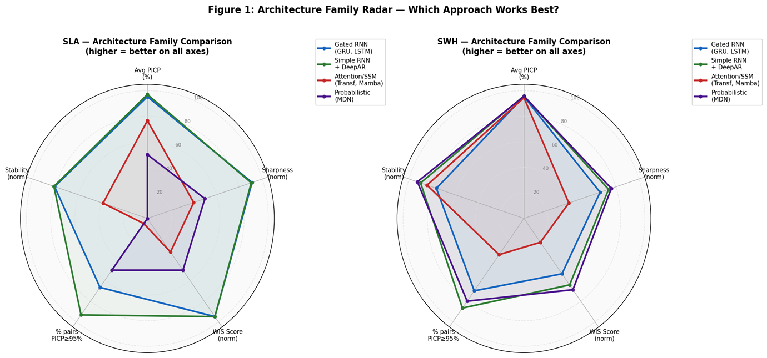
ANALYSIS
Architecture Family Comparison: Radar Chart
RNN Family vs SSM/Attention vs Probabilistic — 5 metrics on each axis
RNN Family dominates all axes for SLA. SSM/Attention recovers dramatically on SWH. Probabilistic (MDN) has highest coverage but widest intervals.
17
Notes:
17

Slide 25
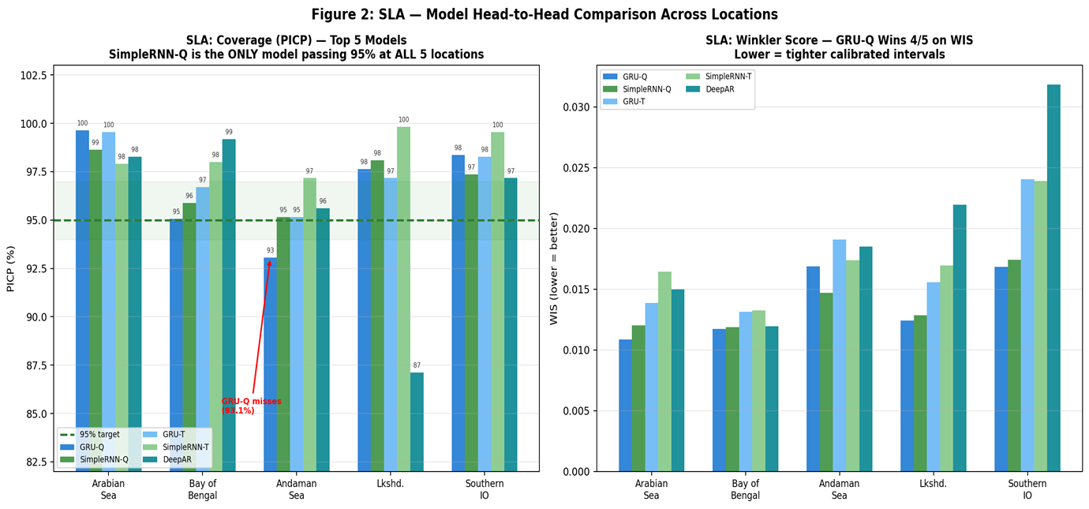
ANALYSIS
SLA — Model Head-to-Head: PICP & WIS per Location
GRU-Q wins 4/5 on WIS (sharpest calibrated intervals). SimpleRNN-Q wins at Andaman Sea — bias-variance tradeoff in action.
18
Notes:
17

Slide 26
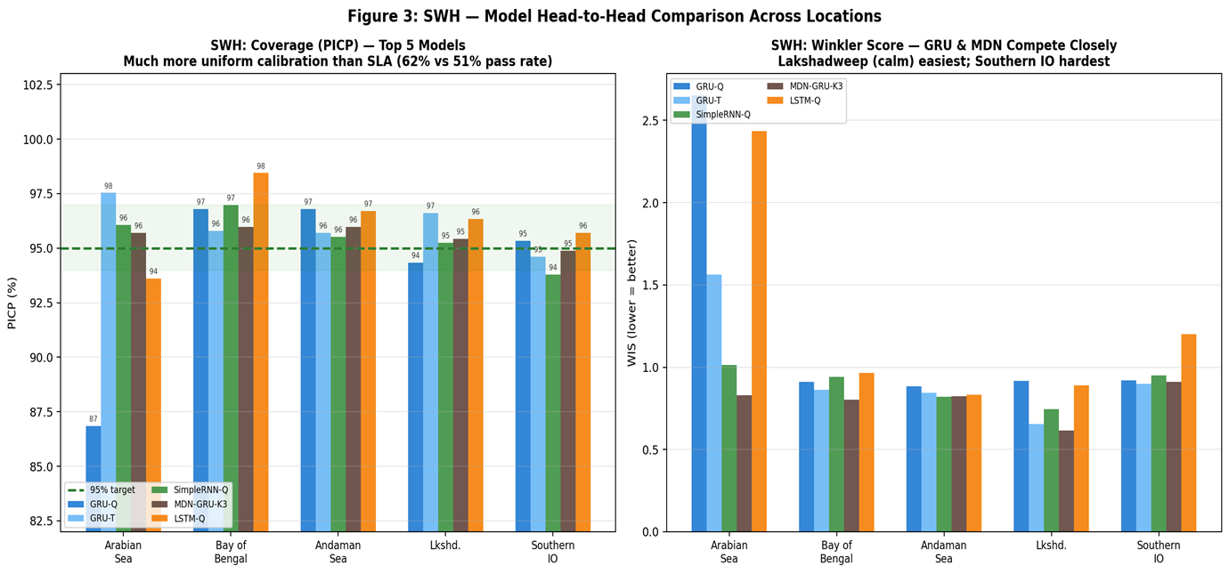
ANALYSIS
SWH — Model Head-to-Head: PICP & WIS per Location
MDN-GRU-K3 dominates at Arabian Sea, BoB, and Lakshadweep. GRU-Q best at Southern IO. Much tighter competition than SLA.
19
Notes:
17

Slide 27
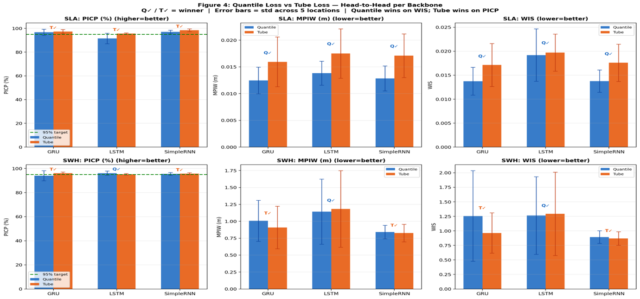
ANALYSIS
Quantile vs Tube Loss — Paired Comparison (SLA & SWH)
RNN Family vs SSM/Attention vs Probabilistic — 5 metrics on each axis
Quantile wins on WIS (narrower intervals). Tube gives slightly higher PICP but at 15–30% wider intervals. 2×3 grid: rows=SLA/SWH, cols=PICP/MPIW/WIS.
20
Notes:
17

Slide 28
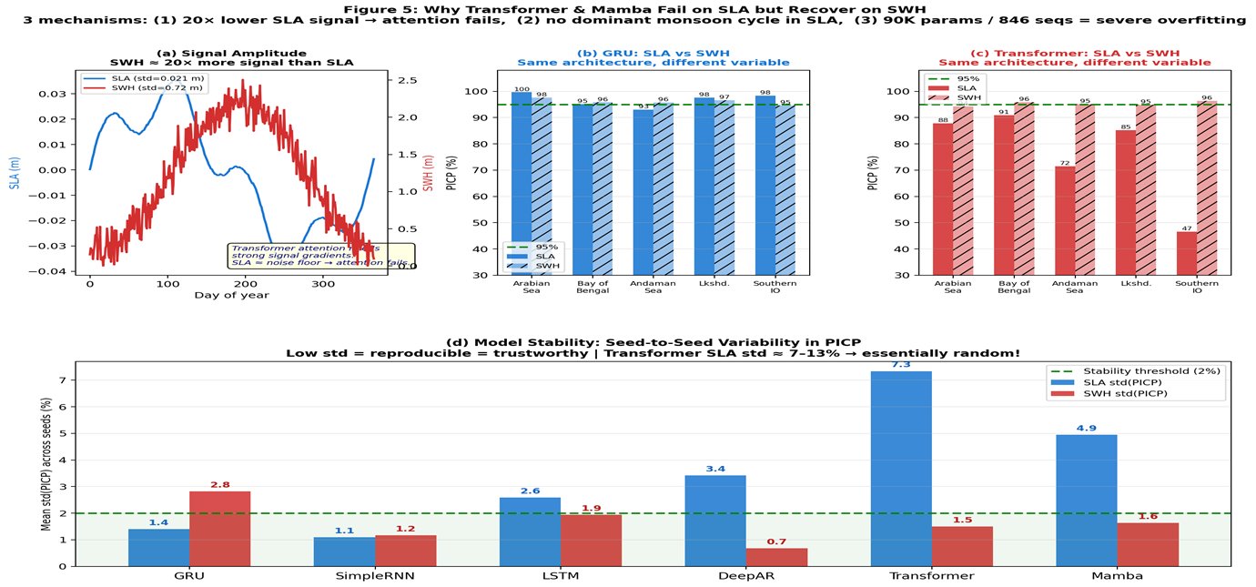
ANALYSIS
Why Transformer & Mamba Fail on SLA but Recover on SWH
RNN Family vs SSM/Attention vs Probabilistic — 5 metrics on each axis
3 mechanisms: (1) 20× lower SLA signal amplitude, (2) no dominant monsoon cycle in SLA, (3) 90K params / 846 seqs = severe overfitting. Stability plot confirms.
21
Notes:
17

Slide 29
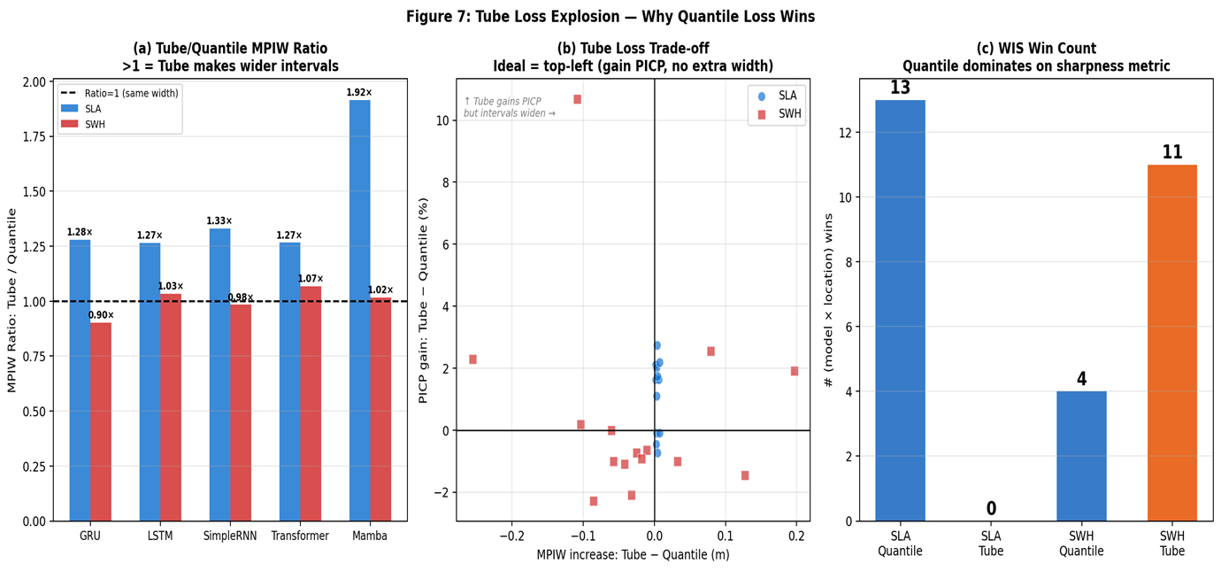
ANALYSIS
Tube Loss Explosion — Deep Dive Analysis
RNN Family vs SSM/Attention vs Probabilistic — 5 metrics on each axis
Left: MPIW ratio (Tube/Quantile). Middle: PICP gain vs MPIW cost scatter. Right: WIS win count. Quantile dominates on WIS; Tube causes 2–18× interval widening.
23
Notes:
17

Slide 30
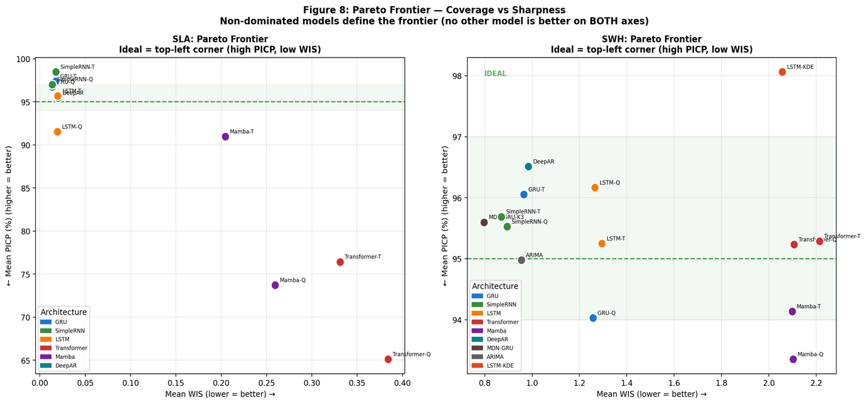
ANALYSIS
Pareto Frontier — Coverage vs Sharpness
RNN Family vs SSM/Attention vs Probabilistic — 5 metrics on each axis
Only 4 non-dominated SLA models: GRU-Q, SimpleRNN-Q, SimpleRNN-T, MDN. All others are redundant. SWH frontier is tighter.
24
Notes:
17

Slide 31
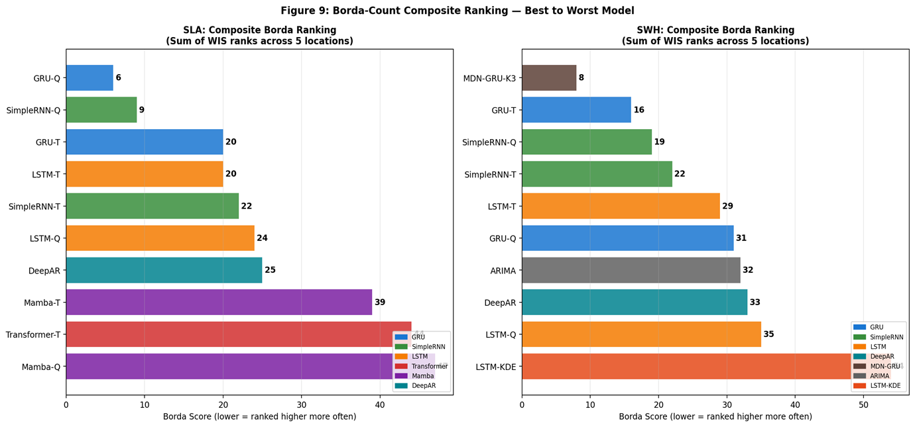
ANALYSIS
Borda Count Composite Ranking — Best to Worst
RNN Family vs SSM/Attention vs Probabilistic — 5 metrics on each axis
Sum of WIS ranks across 5 locations. SLA: GRU-Q #1, SimpleRNN-Q #2. SWH: MDN-GRU-K3 #1. Transformer/Mamba consistently bottom-ranked.
25
Notes:
17

Slide 32
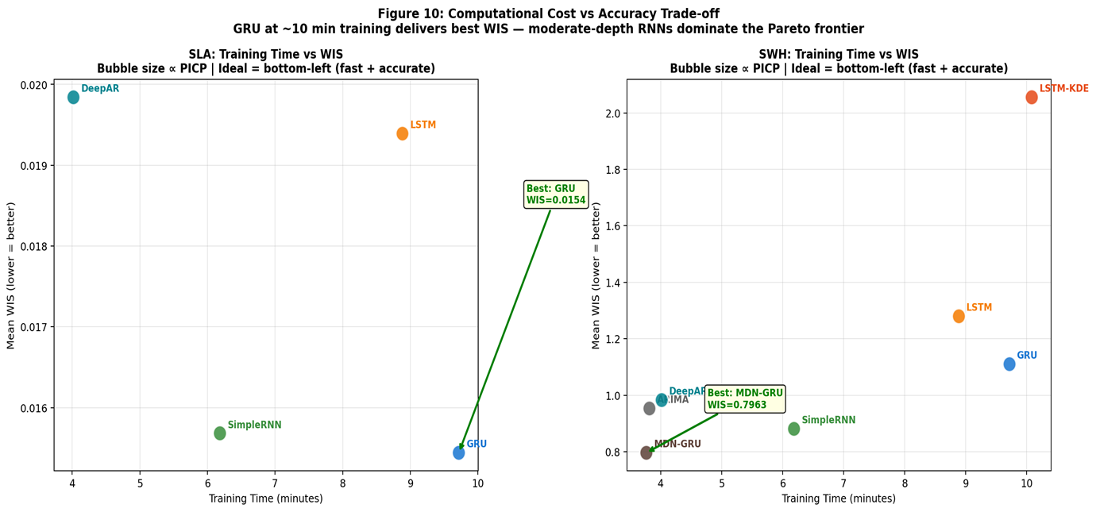
ANALYSIS
Training Time vs Accuracy — Computational Cost Trade-off
RNN Family vs SSM/Attention vs Probabilistic — 5 metrics on each axis
GRU at ~10 min training delivers best WIS. SimpleRNN at 6 min is the most cost-effective. MDN at 3:46 is fast but over-covers.
26
Notes:
17

Slide 33
FUTURE
Limitations & Future Work
Longer Training Period
Multi-Step Forecasting
Exogenous Inputs
3 years misses ENSO/IOD multi-year cycles. Extend to 10+ years of daily data for capturing interannual climate variability.
Current: next-day prediction (1-step). 3–7 day probabilistic horizon for maritime planning.
Add wind stress, SST, current velocity as model inputs. Much of SLA's predictive information resides in forcing fields, not SLA history.
Spatial Forecasting
Advanced Uncertainty
Operational Deployment
Predict 2D SLA/SWH fields (not just 5 points) using ConvLSTM or Graph Neural Networks for regional coverage.
Normalising flows, diffusion models, or conformal prediction wrappers for distribution-free calibration guarantees.
Real-time ingestion of CMEMS data, automated retraining, and API integration for port/energy decision systems.
27
Notes:
24

Slide 34
REFERENCES
Key References & Bibliography
[1] Pritamanand et al. (2023) — Tube Loss for Probabilistic Forecasting. GitHub.
[2] P. Anand, T. Bandyopadhyay, and S. Chandra, “Tube Loss: A Novel Approach for Prediction Interval Estimation and probabilistic forecasting,” arXiv preprint arXiv:2412.06853, 2024.
[3] Vaswani et al. (2017) — Attention Is All You Need. NeurIPS.
[4] Gu & Dao (2023) — Mamba: Selective State Spaces. arXiv:2312.00752.
[5] Salinas et al. (2020) — DeepAR: Probabilistic Forecasting with Autoregressive RNNs. IJF.
[6] Bishop (1994) — Mixture Density Networks. Aston University Technical Report.
[7] Khosravi et al. (2011) — Neural Network Prediction Intervals. IEEE Trans. Neural Netw.
[8] Hochreiter & Schmidhuber (1997) — Long Short-Term Memory. Neural Computation.
[9] Cho et al. (2014) — GRU: Learning Phrase Representations. EMNLP.
[10] Zeng et al. (2023) — Are Transformers Effective for Time Series? AAAI.
[11] Angelopoulos & Bates (2022) — Conformal Prediction. arXiv:2107.07511.
[12] Copernicus Marine Service (2024) — SEALEVEL_GLO_PHY_L4_MY_008_047.
28
Notes:
25

Slide 35
Thank You
Bhavya Boda (202301037) · Tirth Gandhi (202301016)
Faculty Mentor: Prof. Pritam Anand · DA-IICT · May 2026
Code: github.com/Bhavya-2805/Ocean-Probabilistic-Forecasting
29
Notes:
26

