Slide 1
Smart Energy Metering and Theft Detection System
Engineering Clinics Fall Semester 2025-26:
Review-3
• K. Dheeraj- 24BCA7891
• M. Chanakya- 24BCA7839
• S. Bhavya Sri- 24BCE8375
• A. Dhana Lakshmi- 24BCE8519
• P. Pushna Hiranmai- 24BCA8149
• K. Sri Lakshmi- 24BCS7106

Slide 2
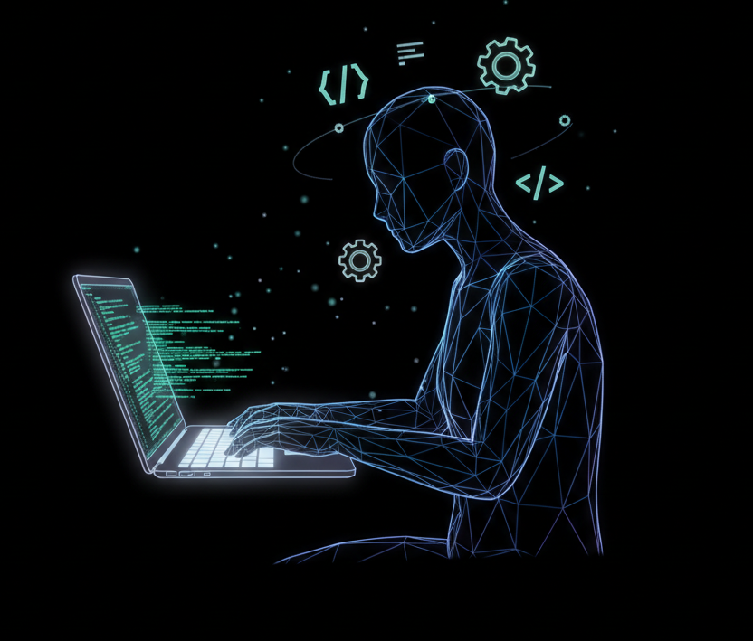
Progress After Review-2
• Focused on completing software coding for ESP32.
• Gathered working code from Electro Gadget, YouTube, ResearchGate, GitHub, etc.
• Integrated, modified, and tested the final code.
• Verified Hall Effect sensor functionality for theft detection.
Software Implementation
• IDE: Arduino IDE
• Board: ESP32 Dev Module
• Core Features:
- Reads voltage and current using sensors
- Detects tampering via Hall sensor
- Controls relay for power cutoff

Slide 3
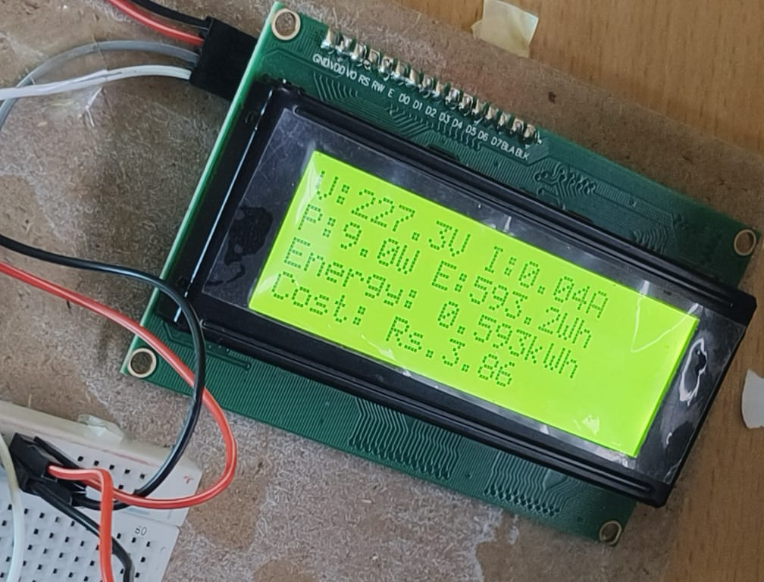
Testing and Results
• Tested theft detection using Hall Effect sensor.
• Relay successfully turned off during theft simulation.
• LCD displayed real-time readings (Voltage, Current, Power).
Demonstration
• Power supplied → Sensors capture data → ESP32 processes → LCD displays output.
• Theft simulated by applying magnetic field near Hall sensor.
• Relay cuts power supply instantly

Slide 4
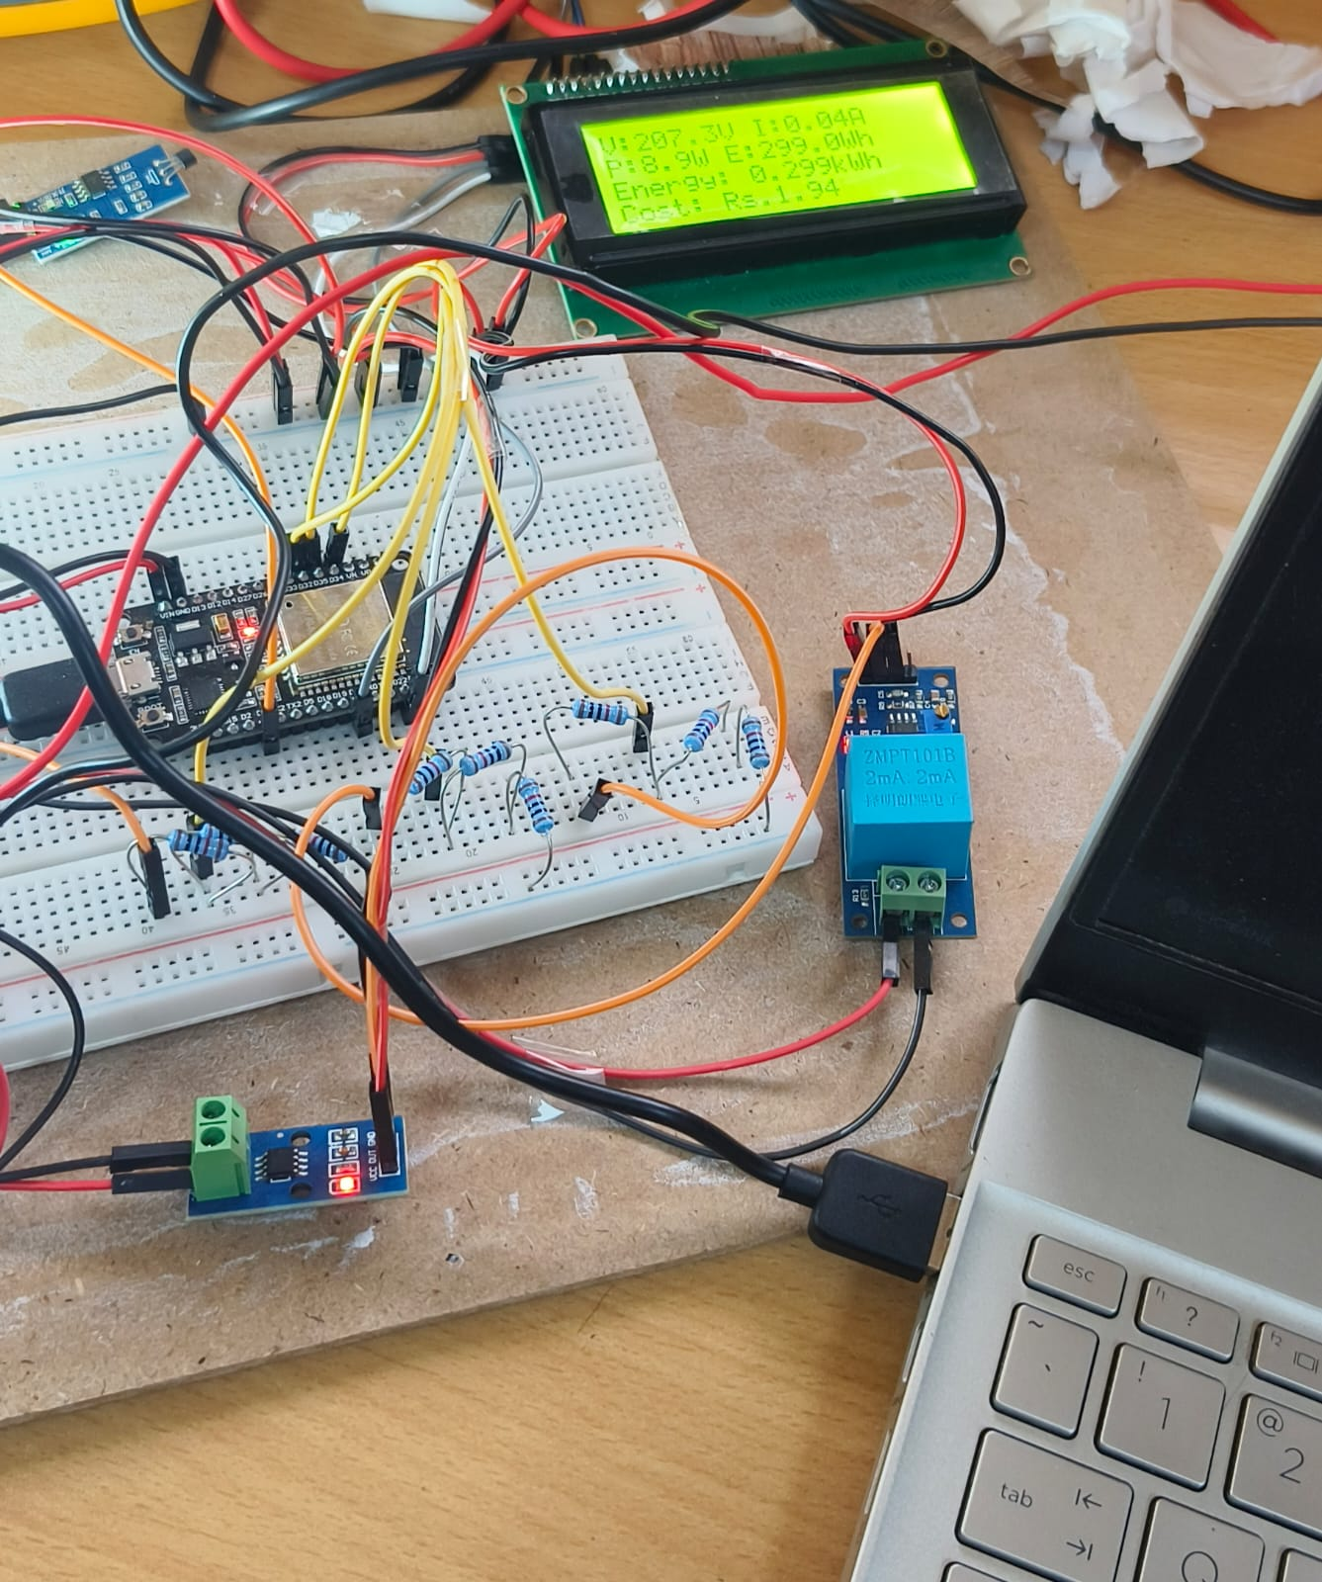
Blynk and Website Integration
• The ESP32 Smart Meter measures voltage, current, power, and energy in real time.
• These readings are sent to the Blynk Cloud through Wi-Fi using the Blynk API.
• Blynk acts as a bridge, storing and managing sensor data securely online.
• Our custom website (https://smart-energy-portal.onrender.com) fetches live readings from Blynk using its HTTP API.

Slide 5
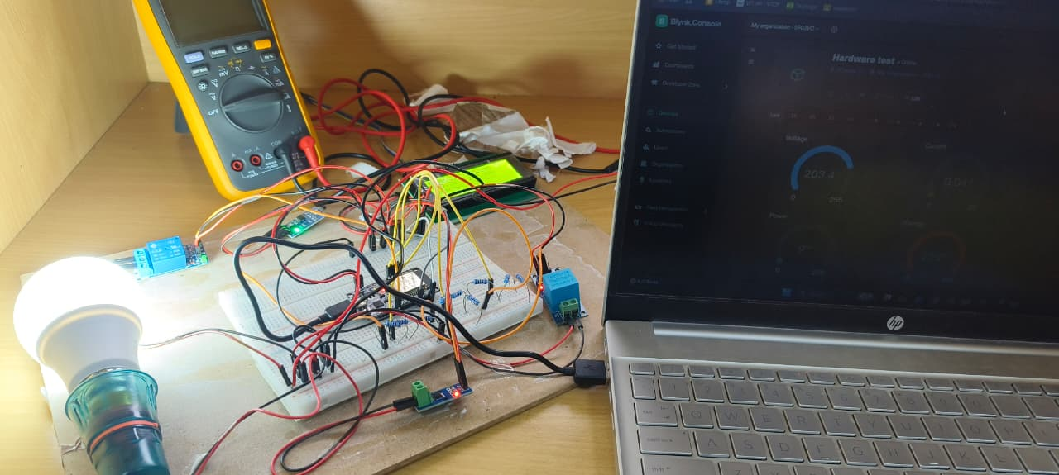
Final Output and Observations
Hardware Integration
• Voltage: ~230V | Current: ~0.05A | Power: ~10W
• Theft detection response time: Instantaneous.
• System accuracy verified through repeated testing.
• Stable readings observed on LCD and serial monitor.
• All components fixed neatly on a wooden pad.
• ESP32, sensors, relay, and LCD arranged clearly.
• Wires managed for a clean final look.

Slide 6
Conclusion
• Successfully built and demonstrated a working smart energy meter.
• Achieved accurate measurement and theft detection.
• Gained practical experience in IoT, sensors, and microcontrollers.
Thank You!

