Slide 1


A. D. Patel Institute of Technology
Subject : DAA (202045601)
Project : Warehouse Box Packaging Optimization Using Greedy Algorithm
JETHVA ARYA - 1006
BHAVYA CHHEDA - 1011
GOHIL DINESH - 1022

Slide 2
Problem Definition
  A warehouse contains multiple products having different weights.
  Each box has a fixed maximum weight capacity.
  All products must be packed without exceeding the capacity of any box.
  Using unnecessary boxes increases packaging and transportation requirements.
  Therefore, an efficient method is required to assign products to boxes while reducing unused capacity.
  This project uses a Greedy-based First Fit Decreasing approach for product packing.
  Problem: To efficiently pack all warehouse products into fixed-capacity boxes while reducing the number of boxes and unused space.

Slide 3
Objective
  To efficiently pack products into available boxes.
  To ensure that the weight of each box does not exceed its capacity.
  To sort products in decreasing order of weight before packing.
  To place each product in the first suitable existing box.
  To create a new box when the product cannot fit into any existing box.
  To calculate total boxes used, used capacity, unused capacity and space utilization.

Slide 4
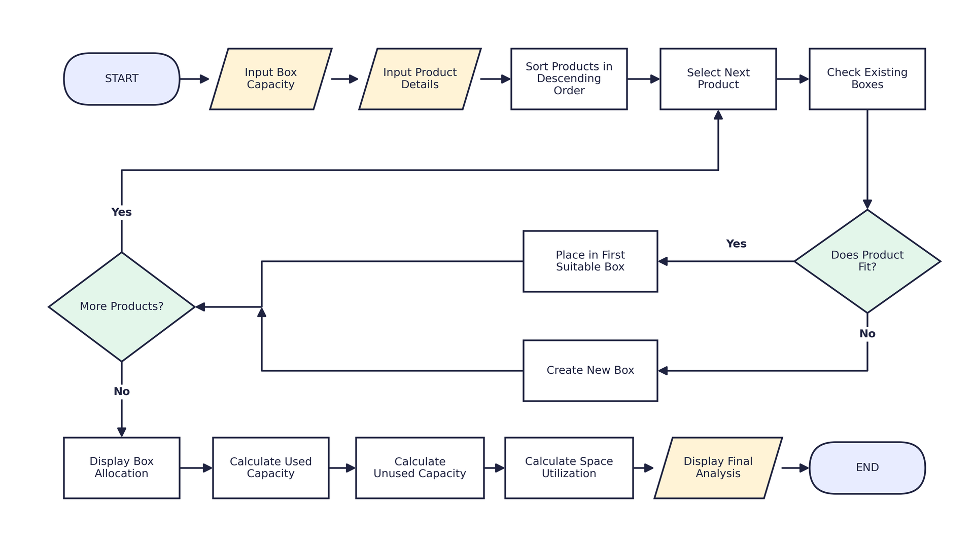
Flowchart and Algorithm of the Solution

Slide 5
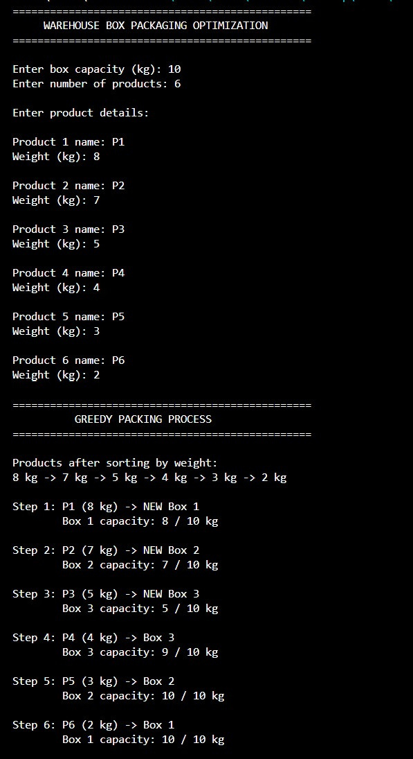
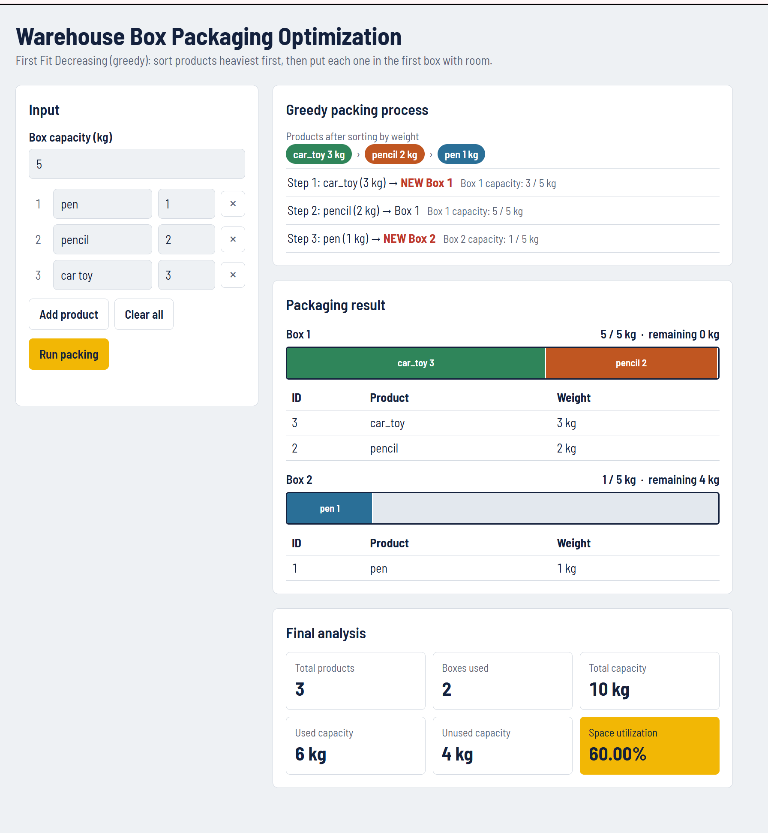
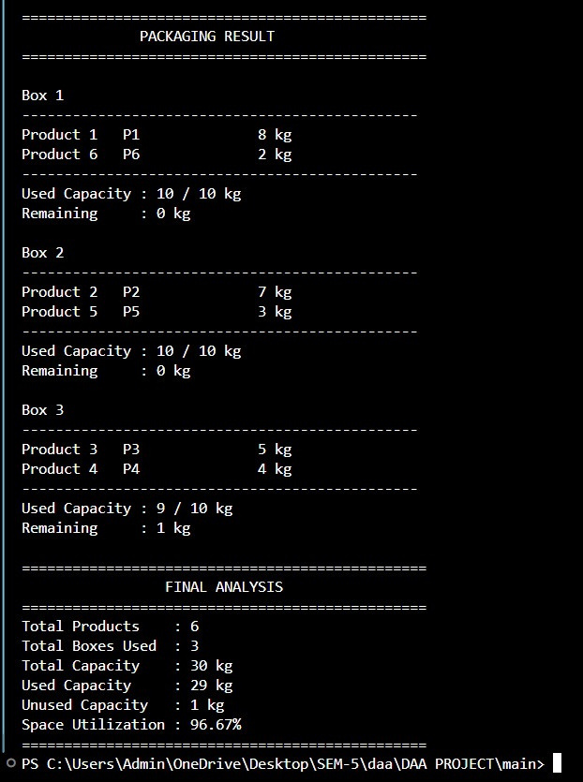
Results

Slide 6
Result Analysis / Observations
  Products are first arranged from highest to lowest weight.
  Larger products are considered before smaller products.
  The program checks boxes sequentially and uses the first box where the product fits.
  A new box is created only when the product cannot fit in existing boxes.
  No box exceeds its specified capacity.
  In the sample, 29 kg out of 30 kg capacity is utilized.
  The resulting space utilization is 96.67%.
  The program also shows the remaining capacity of every box.
  Complexity: Sorting = O(n²); Box allocation = O(n²) in the worst case; Overall time complexity = O(n²).
  Note: The Greedy approach gives an efficient packing solution but does not guarantee the mathematically
  optimal solution for every input.

Slide 7
Scope of Work
  Warehouse Packaging — Packing products into shipping boxes efficiently.
  E-Commerce — Selecting suitable boxes for multiple products in an order.
  Logistics — Reducing unused space during transportation.
  Manufacturing — Organizing finished products for shipment.
  Courier Services — Efficient parcel and package grouping.• Cargo Management — Improving utilization of available carrying capacity.
  Inventory Management — Optimizing storage and packaging space.

Slide 8
Conclusion and Future Scope
Conclusion: The project demonstrates the practical use of a Greedy Algorithm for warehouse box packaging.
Products are sorted by decreasing weight and assigned to the first suitable box without exceeding its capacity.
The program provides the number of boxes used, capacity utilization and unused space, making the packing
process simple and efficient.
Future Scope:
• Support different box capacities.
• Consider product length, width and height.
• Extend the system to 3D box packing.
• Include product priority and fragility.
• Consider transportation and packaging costs.
• Add a graphical user interface.
• Integrate with warehouse and inventory management systems.
• Explore advanced optimization algorithms for better resu

