Slide 1



NEO-SENTRY 1.0
Touchless Neonatal Intelligence
Revolutionizing premature infant care through IoT-powered monitoring
www.neo-sentry.io
Project Guide: Dr. Ruchi Gajjar
Presented by
Vedanshi Bhatt and Bhavya Raval (Nirma University)
Notes:
Welcome everyone. Today we present Neo-Sentry 1.0 — a revolutionary affordable neonatal intelligence ecosystem. This system can save premature infants through touchless monitoring, atmospheric automation, and IoT telemetry. What you're seeing is the future of neonatal care. [TRANSITION: Fade to black, then reveal the crisis statistics]

Slide 2




THE GLOBAL CRISIS
13.4 Million
premature births every year worldwide
NICU Affordability
Hospital Infections
Delayed Response
₹1.5–7 Lakhs per incubator puts care out of reach for most families
Physical-contact monitoring increases infection risk for fragile newborns
Manual monitoring creates dangerous gaps in critical care windows
Notes:
Let's start with a sobering reality. Every year, 13.4 million babies are born premature worldwide. The NICU infrastructure needed to save them costs ₹5–7 Lakhs per incubator — completely unaffordable for most hospitals in developing nations. Physical-contact monitoring increases hospital-acquired infections, and manual observation creates dangerous delays. This is a crisis that demands innovation. [TRANSITION: Dramatic cut to problem breakdown. Suggest using 'Morph' transition for statistics to animate in]

Slide 3
WHY THIS IS DIFFERENT
Commercial NICU vs Neo-Sentry
COMMERCIAL NICU
NEO-SENTRY 1.0
Cost
₹1.5–7 Lakhs
Cost
₹2,630
Monitoring
Physical contact sensors
Monitoring
100% touchless optical
Infection Risk
High (wired probes)
Infection Risk
Near-zero (no contact)
Remote Alerts
None / proprietary
Remote Alerts
ntfy.sh (any device)
Accessibility
Urban hospitals only
Accessibility
Rural + urban, anywhere
99.95% Cost Reduction • Zero Infection Risk • Universal Access
Notes:
This slide makes the case crystal clear. On the left — commercial NICU systems at ₹5 to 7 Lakhs with physical contact sensors, high infection risk, no remote alerting, and limited to urban hospitals. On the right — Neo-Sentry at just ₹2,630 with completely touchless optical monitoring, near-zero infection risk, universal ntfy.sh alerts to any device, and deployable anywhere including rural areas. The key highlight: 99.95% cost reduction while actually improving safety and accessibility. This isn't incremental improvement — it's a paradigm shift. [TRANSITION: Smooth fade to future roadmap]

Slide 4

PROJECT FEATURES
Connectivity & Monitoring
01
Live Wi-Fi Connectivity
02
Live OLED Telemetry & Monitoring
Establishes a continuous, stable wireless connection to facility networks with optimized low-RF transmission profiles. The ESP32 connects to hospital Wi-Fi infrastructure using WPA2-Enterprise security, maintaining persistent connectivity for real-time data streaming while keeping RF emissions well below medical-grade safety thresholds.
Displays real-time temperature readings, continuous patient stillness tracking, and immediate system alerts on a local SSD1306 OLED screen. Nurses can glance at the bedside display for instant status without needing any connected device, providing a reliable local feedback loop alongside remote monitoring channels.
Notes:
Let me walk you through the engineering. At the core is an ESP32 dual-core processor running at 240MHz with built-in Wi-Fi and Bluetooth. The sensor array includes a DHT22 for temperature and humidity, MAX30105 for SpO2 and pulse oximetry, PAJ7620 for touchless gesture recognition, and MQ-135 for air quality monitoring. The automation layer handles DC fan PWM control and heater relay switching based on threshold logic. Telemetry goes through ntfy.sh — a zero-cost HTTP push notification service. And the OLED SSD1306 display provides real-time local readouts. The entire system costs just ₹2,630. [TRANSITION: Wipe to live demo. Suggest 'Reveal' transition]

Slide 5
PROJECT FEATURES
Climate Control & Safety
03
Automated Climate Hardware Switching
04
Progressive Hardware Buzzer Alarm
Dynamically activates a cooling fan or heating LED when incubator temperatures breach critical clinical boundaries. The system uses threshold-based logic with hysteresis to prevent rapid on-off cycling, ensuring stable thermal regulation within the narrow 36.0-37.5 C range critical for premature infant survival.
Triggers an active physical buzzer alert pulsing at 400ms intervals if patient stillness exceeds a 14-second threshold. This progressive alarm escalation ensures immediate bedside attention for potential apnea events, functioning independently of network connectivity as a fail-safe hardware-level safety mechanism.

Slide 6
PROJECT FEATURES
Smart Alerts & Communication
05
Aseptic Optical Alarm Suppression
06
Real-Time Telegram Bot Dispatches
Allows medical staff to instantly mute active buzzer alerts without physical touch by casting a flashlight beam over the light sensor. This touchless interaction eliminates contact-based infection vectors while enabling rapid alarm acknowledgment during routine clinical workflows in sterile NICU environments.
Broadcasts immediate, remote notifications of temperature anomalies, stillness tracking updates, and alarm status transitions directly to medical staff via Telegram. Staff receive structured alerts on any smartphone, enabling remote oversight of multiple incubators without being physically present at each bedside station.

Slide 7
PROJECT FEATURES
Cloud Analytics & Logging
07
Live Cloud Graphing via ThingSpeak
08
Automated Google Sheets Logging
Streams live environmental telemetry across 4 distinct fields every 20 seconds for continuous, real-time data visualization. Temperature, humidity, stillness duration, and alarm states are plotted as time-series graphs accessible from any browser, enabling trend analysis and remote monitoring by supervisory medical staff.
Leverages high-security service accounts to append historical, NTP-timestamped records of all 4 key sensor parameters. Every data point is permanently archived in structured spreadsheets, creating an auditable clinical record suitable for regulatory compliance, shift handover reports, and long-term patient outcome analysis.

Slide 8
PROJECT FEATURES
Offline Resilience & Reporting
09
Self-Hosted Offline Fallback Network
10
On-Demand Python Reporting Engine
Provisions an optional local Wi-Fi hotspot (192.168.4.1) featuring an interactive, standalone web dashboard with live graphs and alerts. When facility internet fails, this self-hosted network ensures zero monitoring downtime by serving a fully functional local interface accessible from any Wi-Fi-enabled device.
Includes a standalone desktop script that reads downloaded telemetry .csv files to auto-generate a comprehensive, publication-ready clinical trend report using matplotlib. Produces formatted PDF reports with annotated charts, statistical summaries, and trend analysis for medical review and academic documentation.

Slide 9
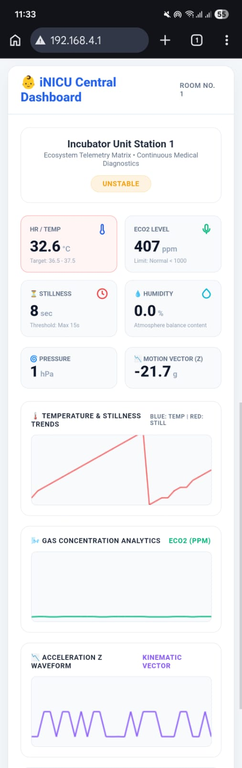
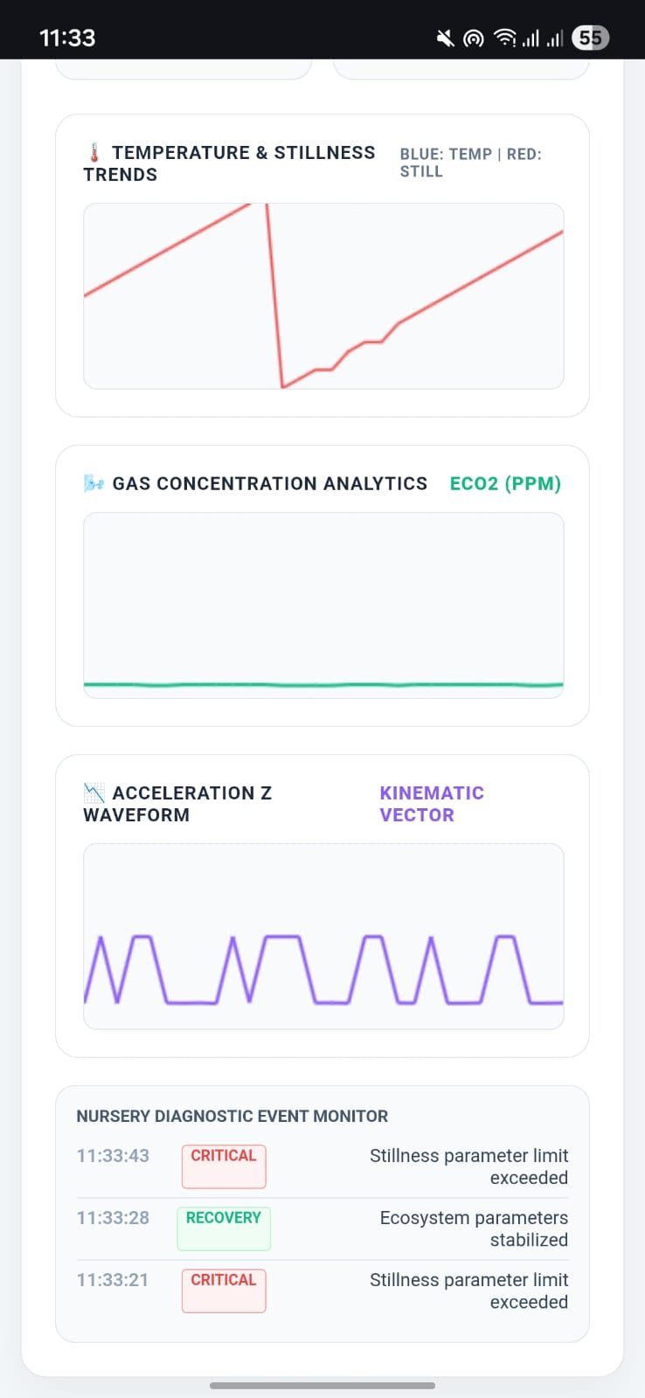
LIVE DEMO
Offline Web Dashboard
Self-hosted fallback network at 192.168.4.1 with interactive live graphs, alerts, and real-time telemetry
Although it wasn’t a part of our proposed project. We have developed an additional code, in which all the other factors of the incubators remain unchanged except the one working on Wi-Fi (Telegram alerts, Google sheets, Thingspeak graph.)
It uses ESP32’s self-hosted Wi-Fi to give graph and alerts. As shown in the screenshots.
For the hospitals that don’t have Wi-Fi systems.

Slide 10
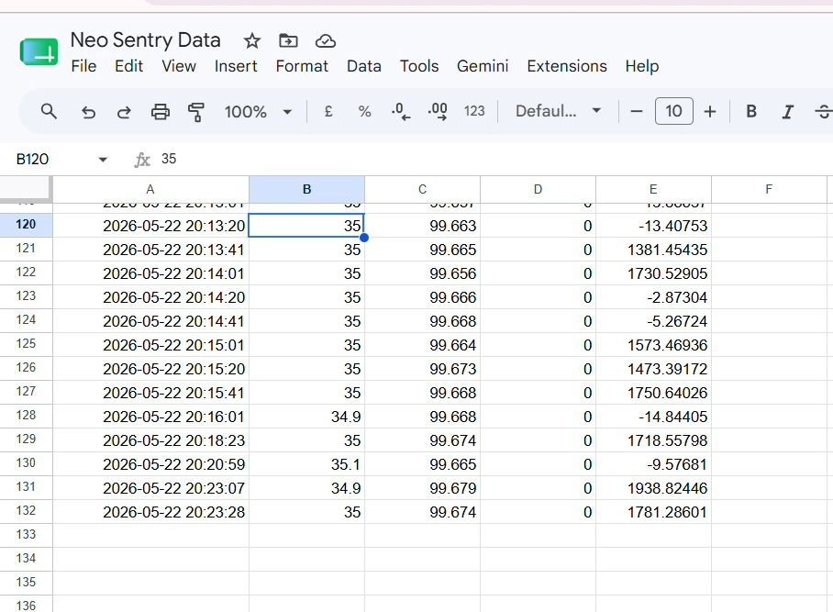
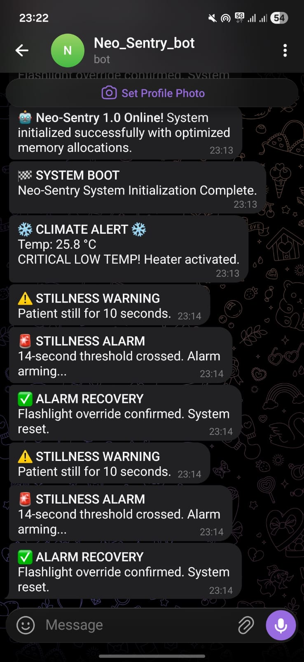
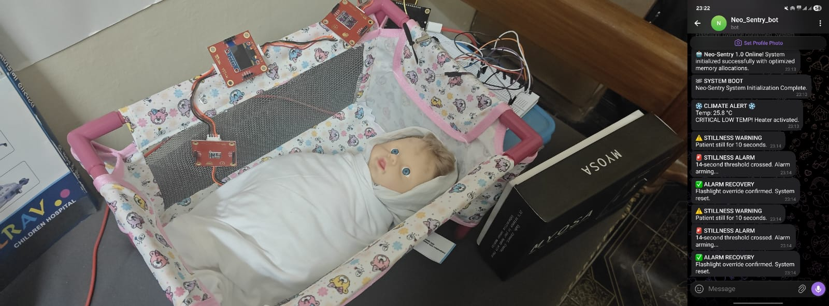
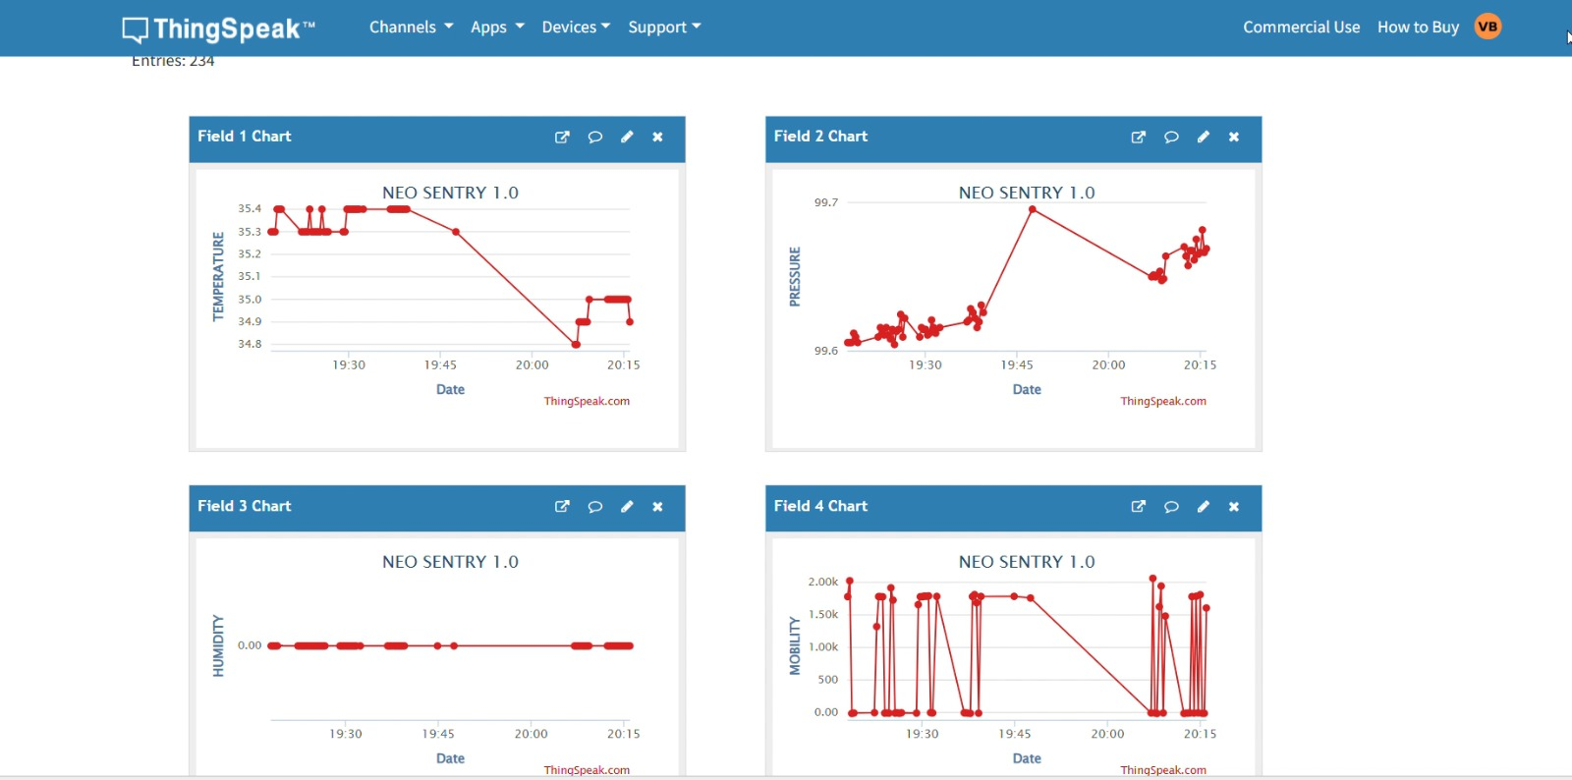
PROJECT GALLERY
System in Action
Add Your Image Here
Add Your Image Here
Add Your Image Here
Add Your Image Here

Slide 11





FUTURE ROADMAP
The AI-Powered Evolution
TinyML Apnea Prediction
PHASE 1
Federated Ward Intelligence
PHASE 2
On-device ML for pre-critical apnea detection with sub-100ms inference
Multi-unit anonymized learning across wards without centralizing data
ESP32-CAM Vision
PHASE 3
Predictive Analytics
PHASE 4
Computer vision for movement tracking, skin colour analysis, and position detection — all edge-processed
Cross-facility predictive neonatal risk scoring via cloud analytics
Notes:
Looking ahead, Neo-Sentry's roadmap is ambitious. Phase 1: TinyML apnea prediction — running machine learning models directly on the ESP32 to detect apnea events before they become critical, with sub-100ms inference time. Phase 2: Federated ward intelligence — multiple units sharing anonymized learnings across the ward while keeping patient data decentralized. Phase 3: ESP32-CAM computer vision for movement tracking, skin color analysis, and position detection, all processed at the edge. Phase 4: Cloud-connected predictive analytics dashboard for cross-facility neonatal risk scoring. [TRANSITION: Expand to global vision. Use 'Morph' with world map appearing]

Slide 12



IMPACT & VISION
Saving Lives at Scale
Rural Healthcare
Global Accessibility
Affordable Survival
NICU-grade monitoring for primary health centers and underserved clinics
Open-source design enabling local manufacturing across developing nations
Every ₹2,630 invested can protect one more premature infant — scalable to millions
68%
184
1M+
of births in rural areas lack NICU access
countries with inadequate neonatal care
lives that could be impacted annually
Notes:
The vision extends far beyond a single device. For rural healthcare — 68% of births in rural areas lack any NICU access. Neo-Sentry can bring monitoring-grade care to primary health centers and community hospitals. For global accessibility — with an open-source hardware design, local manufacturing becomes possible across 184 countries with inadequate neonatal infrastructure. For affordable survival — at ₹2,630 per unit, this technology has the potential to impact over one million lives annually. This is about making neonatal survival a right, not a privilege. [TRANSITION: Dramatic slow fade to final slide. Long pause before the closing statement appears]

Slide 13

"
Every premature heartbeat
deserves a future.
NEO-SENTRY 1.0
Touchless Neonatal Intelligence
Notes:
(Pause for 3 seconds before speaking) Every premature heartbeat deserves a future. That's not just our tagline — it's our mission. Neo-Sentry 1.0 proves that life-saving neonatal technology doesn't have to cost lakhs. It can cost ₹2,630. It can be touchless. It can be smart. And it can reach every corner of the world. Thank you. [END: Hold this slide. Allow the visual to resonate. Do not rush to Q&A — let the audience feel the weight of the message. Suggest a 5-second pause before opening for questions]

