Slide 1

Term Deposit Subscription Prediction
Analysing Telemarketing Data to Forecast Client Subscriptions Using Python

Slide 2

About the Project
Predict Term Deposit Subscriptions Using Client Data from Telecom Campaigns
The goal is to predict whether a client will subscribe to a term deposit based on data from a Portuguese banking institution's direct marketing campaigns (phone calls).
Identify clients likely to convert to term deposit subscriptions to optimise marketing efforts and reduce investment in broad campaigns.

Slide 3

The Dataset
Details of the dataset:
Size and Timeframe: 45,211 rows and 18 columns, spanning May 2008 to November 2010.
Target Variable: Binary indicator of whether a client subscribed to a term deposit ("yes" or "no").
Features: Includes demographic, financial, and contact history information such as age, job, balance, contact type, and previous campaign outcomes.
Contact Data: Details of marketing interactions, including the duration of the last contact, the number of contacts, and the time since the last contact.
Campaign Context: Data from phone-based marketing campaigns used to identify potential term deposit subscribers.
It consists of 45,211 records from a Portuguese bank’s phone-based marketing campaigns, spanning over two years

Slide 4

Summary Statistics & Analysis
Reviewing the Summary Details and Drawing Analysis

Slide 5
Summary Statistics
Standard Industry Figures
Current Dataset Figures
Age of Clients: The average age of banking clients typically ranges between 35-55 years, with a slight upward trend as younger clients increasingly engage with digital banking services. (Source: S&P Global and BAI Research)
Balance per Client: Average balances can vary widely, but in many regions, they range between €1,000 - €5,000. (Source: European Central Bank (ECB) data and industry reports from McKinsey & Company)
Duration of Contact: The average duration of contact, especially for digital channels, is around 200-300 seconds. (Source: BAI Research)
Number of Contacts Performed During the Campaign: Typically, successful campaigns involve 2-5 contacts per client. (Source: S&P Global and McKinsey & Company)
Marital Status of the Clients: The distribution often sees married clients making up the majority at around 50-60%, followed by single clients at around 30-40%, and divorced clients at about 10% (Source: S&P Global)
Job Type of the Clients: The most common job types include white-collar professionals (e.g., management, technical roles) at around 40%, blue-collar workers at about 30%, and service roles at 20%. (Source: S&P Global)
Credit Subscription by the Clients: The credit default rate varies but generally hovers around 5-10% of total clients. (Source: McKinsey & Company)
Term Deposit Subscription by the Clients: The subscription rate for term deposits typically ranges between 10-20%. (Source: BAI Research and McKinsey & Company)
Age of Clients: Mean: 40, Min: 18, Max: 95
Balance per Clients: Mean: €1,362.28, Min: - €8,019.00, Max: €102,127.00
Duration of Contact: Mean: 258.17 seconds, Min: 0 seconds, Max: 4,918 seconds
Number of Contacts Performed During the Campaign: Mean: 2.76, Min: 1, Max: 63
Marital Status of the Clients: Married (27K), Single (12K), Divorced (5K)
Job Type of the Clients: Blue-collar (9K), Management (9K), Technician (7K)
Credit Subscription by the Clients: No default (44K), Default (800)
Term Deposit Subscription by the Clients: No (39K), Yes (5K)

Slide 6
Insights – Industry Figures vs Figures in Hand
Analysis and Insights Derived by Comparing Industry and Available Figures
Analysis and Interpretation
Insights
Client Age: The average age is 40 years with a broad range, including a notable number of older clients (55+). This contrasts with the narrower age range typical in the industry.
Client Balance: The average balance is at the lower end of the industry standard, but there are a few clients with very high balances and some with negative balances.
Contact Duration: The mean contact duration is within the industry standard range, though there are variations with some exceptionally long calls.
Number of Contacts: The average number of contacts per client is within industry norms, but some clients have unusually high contacts, suggesting potential inefficiencies.
Marital Status: Marital status distribution aligns with industry norms, with married clients being the largest group, followed by single and divorced clients.
Job Type: The dataset significantly represents blue-collar and management roles, emphasising white-collar and service roles less than industry standards.
Credit Subscription: A low credit default rate indicates good credit management among clients.
Term Deposit Subscription: The subscription rate for term deposits is within the industry standard, but there’s room for improvement.
Age-Based Marketing: Develop targeted marketing and services for older clients (55+) and support their digital literacy to enhance engagement.
Financial Advisory: To improve overall client satisfaction and retention, offer personalised advisory services for high-balance clients and financial planning for those with negative balances.
Contact Optimization: Maintain efficient contact duration while addressing cases with excessively long calls and refining strategies to reduce unnecessary contacts.
Campaign Efficiency: Optimize the number of contacts per client by improving initial engagement strategies and reducing redundant follow-ups.
Marital Status Targeting: Create financial products and campaigns tailored to the needs of married, single, and divorced clients, focusing on their specific financial requirements.
Job-Specific Products: Tailor financial products and marketing messages to the predominant job types, emphasising investment opportunities for management and secure savings for blue-collar workers.
Credit Product Promotion: Leverage the low default rate to promote favourable credit products and provide targeted debt management solutions for clients with defaults.
Term Deposit Strategy: Enhance marketing efforts to increase term deposit subscriptions by analysing the characteristics of existing subscribers and offering personalised incentives.

Slide 7

Deriving Preliminary Observations
Interpreting Data via Metrics and Providing Actionable Insights

Slide 8
Analysis, Interpretation and Recommendations
Metric | Analysis | Interpretation | Recommendation
Conversion Rate: 11.71% | Indicates that 11.71% of contacted clients subscribed to the term deposit. | Majority of clients do not subscribe despite marketing efforts. | Improve targeting strategies to focus on more promising leads to increase this rate.
Average Contact Duration: 258.16 seconds | Average call duration is approximately 4 minutes and 18 seconds. | Duration is reasonable for explaining product details and convincing clients. | Analyse if longer or shorter calls have a higher conversion rate to optimize call durations.
Average Yearly Balance for Subscribed Clients: 1804.18 Rs. | Subscribed clients have a higher average yearly balance compared to non-subscribed clients. | Clients with higher balances are more likely to subscribe to term deposits. | Focus marketing efforts on clients with higher balances.
Average Yearly Balance for Non-Subscribed Clients: 1303.74 Rs. | Non-subscribed clients have a lower average yearly balance compared to subscribed clients. | Clients with lower balances are less likely to subscribe to term deposits. | Develop targeted campaigns to address the needs and concerns of clients with lower balances.
Loan Default Rate: 1.80% | Low default rate among clients. | Clients are generally financially healthy and capable of considering additional financial products. | Continue monitoring default rates and maintain client financial health.
Average Number of Contacts per Client: 2.76 | Each client was contacted approximately 2.76 times during the campaign. | Multiple contacts may be necessary to convert clients but can cause fatigue. | Analyse the optimal number of contacts that maximize conversion without causing client fatigue.
Previous Campaign Success Rate: 18.34% | Previous campaign had a higher success rate than the current one. | Previous strategies were more effective. | Learn from previous successful campaigns and replicate effective strategies.
Churn Rate: 14.04% | Indicates that 14.04% of previously contacted clients who did not subscribe are considered churned. | Can be a concern if it indicates client dissatisfaction or lack of interest in the bank's products. | Investigate reasons behind churn and implement measures to reduce it, improving retention.

Slide 9
Primary Visualisations
Plotting the Given Data on Various Graphs to Drive Insights

Slide 10
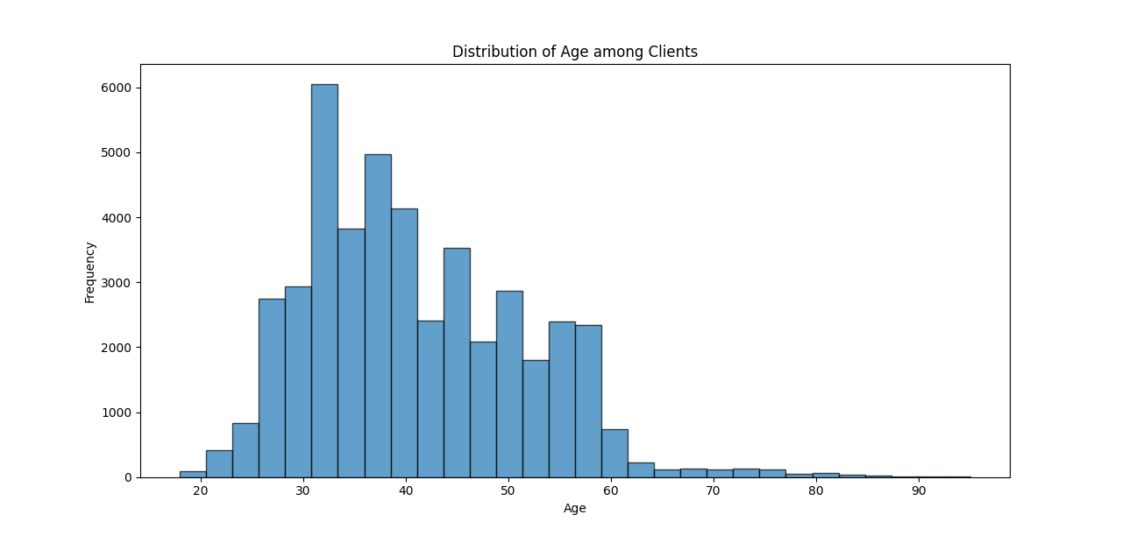
Distribution of Clients by Age
Analysis: The histogram shows the distribution of ages among the clients. The summary statistics indicate that the average age is approximately 40.94, with a standard deviation of about 10.62. The ages range from 18 to 95.
Interpretation and Insights
Age Distribution: The histogram shows a right-skewed distribution, with most clients between 30 and 50 years old.
Target Demographics: The mean age is about 41 years, suggesting that middle-aged individuals are the primary clientele. Marketing strategies could be tailored to this age group.
Age Range: The bank serves a diverse age group, with clients ranging from 18 to 95. Consider developing products or services for different life stages.
Potential Segments
  Young adults (18-30): Tailor products for early career professionals.
  Middle-aged (30-50): Focus on family-oriented financial products.
  Seniors (60+): Offer retirement and estate planning services.
5. Customer Retention: Analyse how age correlates with other variables to improve retention strategies across different age groups.

Slide 11
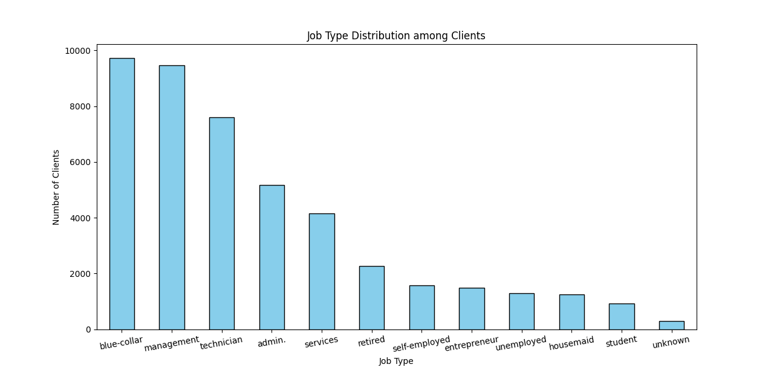
Distribution of Clients by Job Type
Analysis and Interpretation
1. Dominant Job Types: The most common job types among clients are:
  Blue-collar: 9,732 clients
  Management: 9,460 clients
  Technician: 7,597 clients
2. Least Common Job Types: The least common job types are:
  Student: 938 clients
  Housemaid: 1,240 clients
  Unemployed: 1,303 clients
Actionable Insights
Targeted Marketing: Focus marketing efforts on the most common job types (blue-collar, management, and technician) as they represent a significant portion of the client base.
Product Development: Develop financial products tailored to the needs of the dominant job types. For example, offer specialised loans or savings plans for blue-collar workers and management professionals.
Engagement Strategies: Create engagement strategies for less common job types to understand their needs better and potentially increase their numbers.
Data Quality Improvement: Investigate the unknown job types to improve data quality and ensure accurate segmentation.

Slide 12
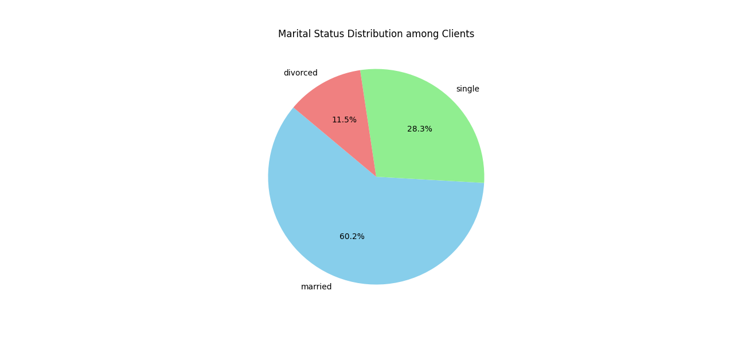
Distribution of Clients by Marital Status
Analysis and Interpretation
Married clients form the majority at 60.2%
Single clients represent 28.29%
Divorced clients account for 11.52%
Actionable Insights:
Actionable Insights
Tailor financial products for married couples (e.g., joint accounts, family insurance)
Develop targeted marketing for each segment
Consider specialised services for divorced clients (e.g., financial planning post-divorce)

Slide 13
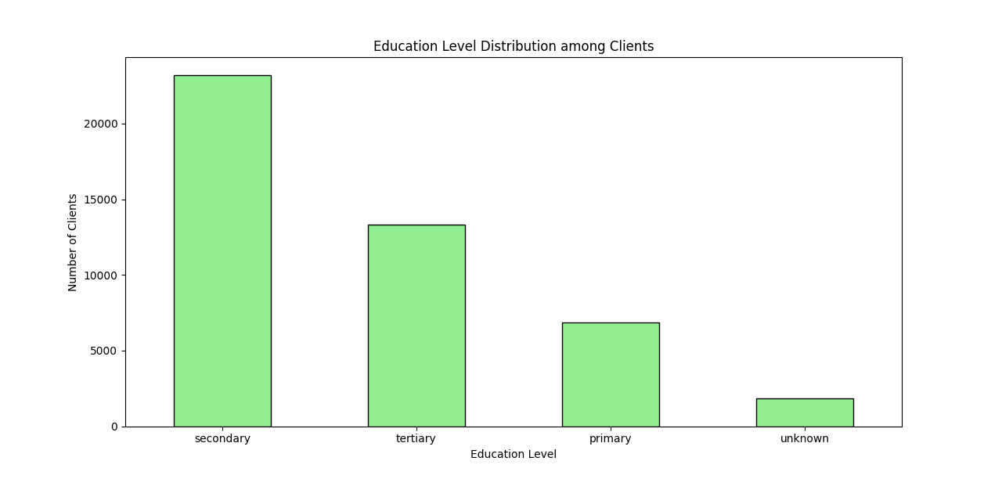
Distribution of Clients by Education Level
Analysis and Interpretation
Secondary education is the most common level among clients, with 23,204 individuals.
Tertiary education follows with 13,301 clients.
Primary education accounts for 6,851 clients.
1,857 clients have an unknown education level.
Actionable Insights
Focus on financial products and services catering to secondary and tertiary education clients.
Develop educational programs or financial literacy workshops for clients with primary education.
Investigate the unknown category to better understand and address their needs.

Slide 14
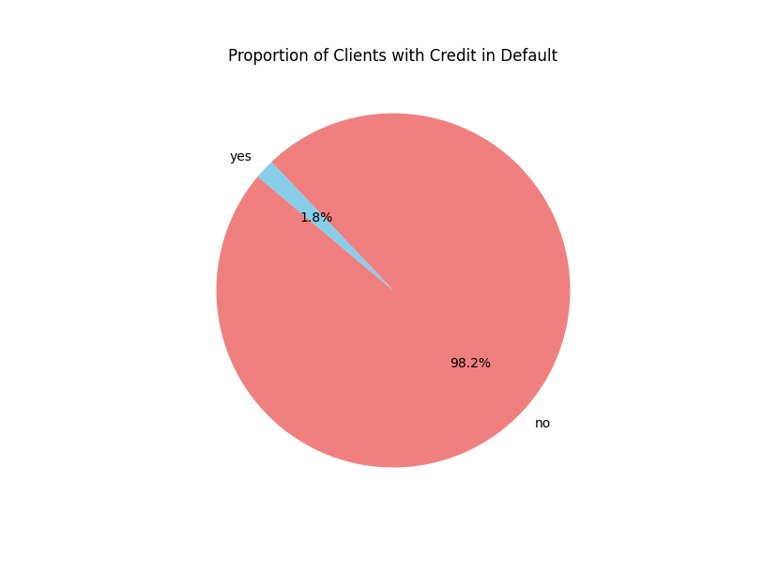
Clients with Credit in Default
Analysis and Interpretation
Most clients (98.2%) do not have credit in default.
A small proportion (1.8%) of clients have credit in default.
Actionable Insights
Focus on maintaining the low default rate by offering financial education and support.
Develop targeted interventions to help the small group of clients with credit in default manage their finances better.

Slide 15
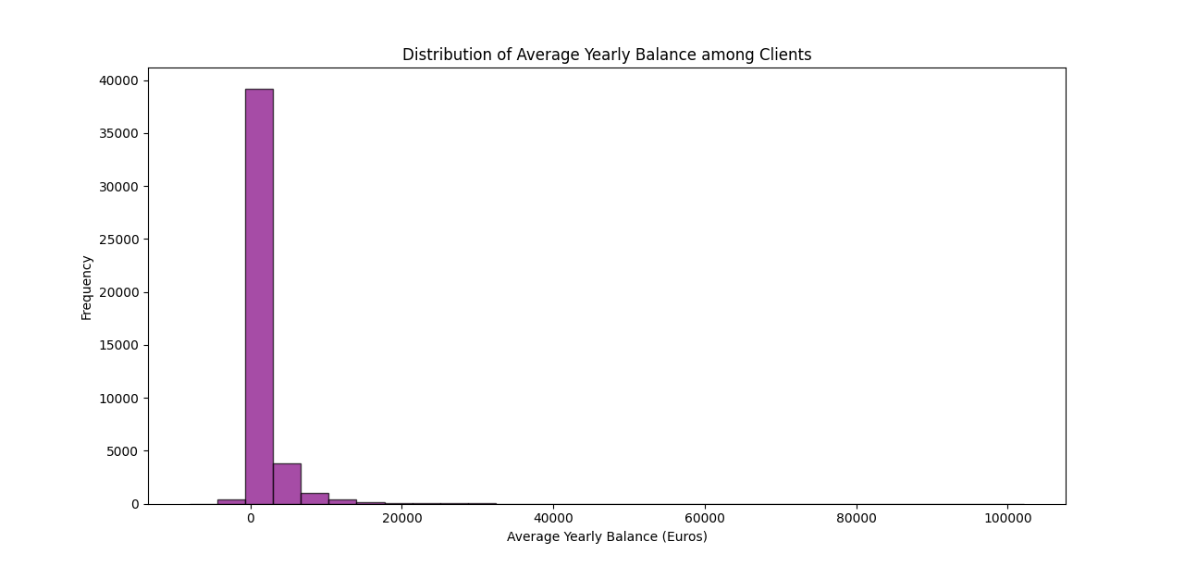
Average Annual Balance
Analysis and Interpretation
The average yearly balance among clients is approximately 1,362 Euros.
The distribution is highly skewed, with a standard deviation of 3,045 Euros.
The minimum balance is -8,019 Euros, indicating some clients have negative balances.
The maximum balance is 102,127 Euros, showing a wide range of balances.
The median balance is 448.5 Euros, with the 25th percentile at 72 Euros and the 75th percentile at 1,428 Euros.
Actionable Insights
Focus on clients with negative or low balances to provide financial advice and support.
Develop targeted savings programs for clients with higher balances to encourage investment and growth.
Investigate the reasons behind the high standard deviation and address any underlying issues.

Slide 16
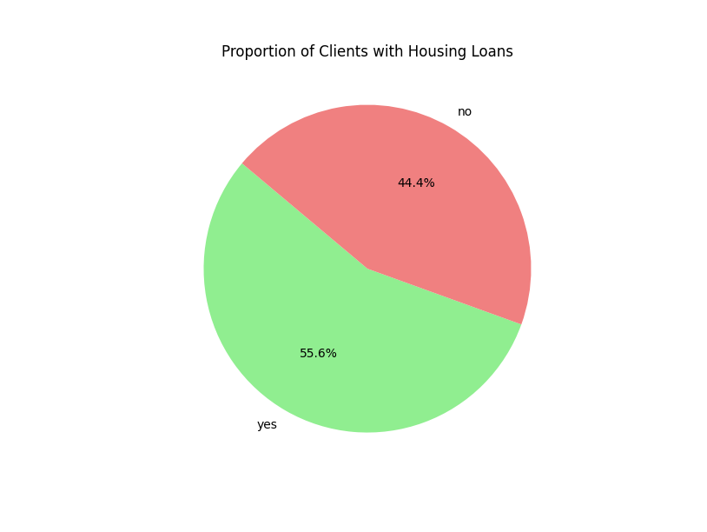
Clients with Housing Loans
Analysis
55.6% of clients have housing loans
44.4% of clients do not have housing loans
Actionable insights
Develop targeted products for clients without housing loans
Assess risks and opportunities in the housing loan portfolio

Slide 17
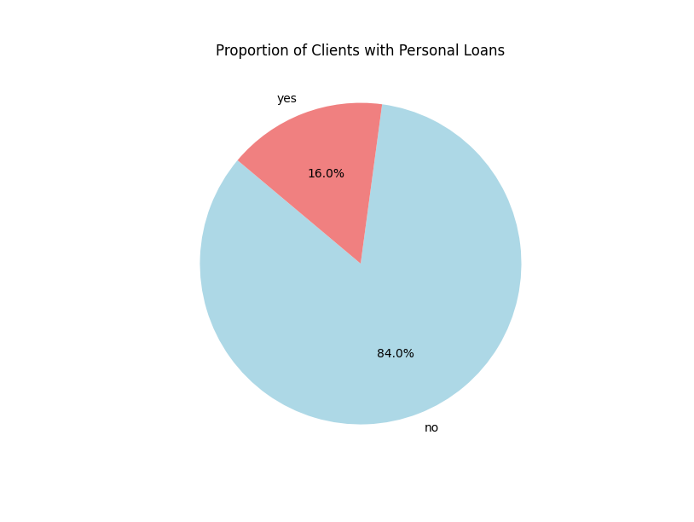
Clients with Personal Loans
Analysis
84% of clients do not have personal loans.
16% of clients have personal loans.
Actionable insights
Develop targeted marketing strategies for clients without personal loans to offer them suitable loan products.
Assess clients’ risk profiles with personal loans and provide financial advice to manage their loans effectively.

Slide 18
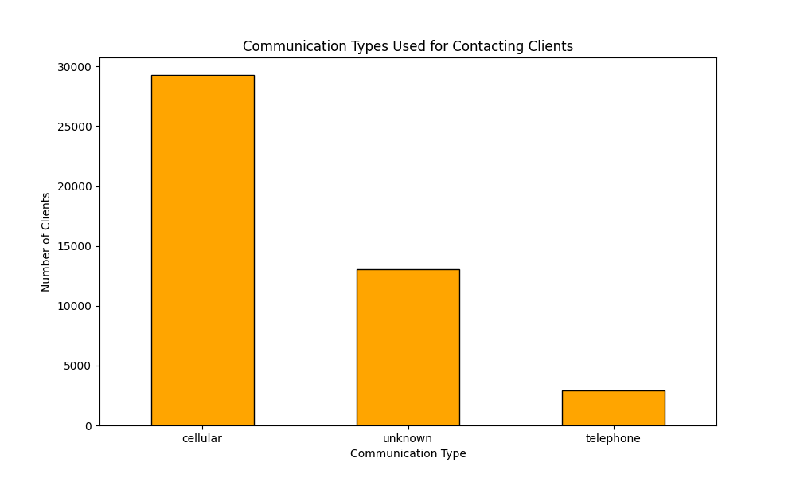
Communication Channels Used
Analysis
The majority of clients (64.8%) are contacted via cellular.
28.8% of clients have an unknown contact type.
Only 6.4% of clients are contacted via telephone.
Actionable insights
Focus on improving the quality and reach of cellular communication, as it is the most used method.
Investigate the reasons behind the many unknown contact types and update client contact information.
Consider strategies to increase the effectiveness of telephone communication for the small percentage of clients who prefer it.

Slide 19
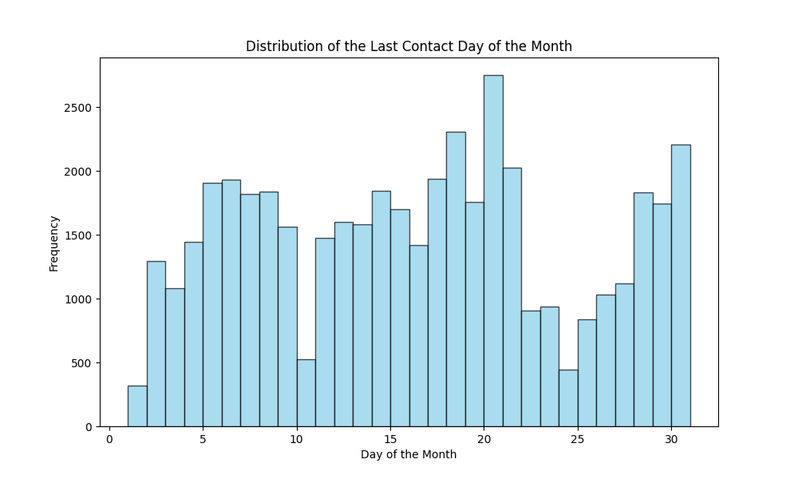
Distribution of Last Contact Day
Analysis
The distribution of last contact days is relatively even across the month, with some notable patterns.
There's a peak in contacts around the middle of the month (days 14-16).
The frequency of contacts decreases towards the end of the month (after day 25).
The mean last contact day is approximately the 16th of the month.
The median (50th percentile) is also the 16th day, indicating a symmetrical distribution.
There are fewer contacts on the month’s first and last few days.
Actionable insights
Optimize contact strategies: Focus more resources on the middle of the month when contact frequency is highest. Investigate why there are fewer contacts at the beginning and end of the month. This could be due to operational reasons or customer preferences.
Workload distribution: Consider redistributing the workload more evenly throughout the month to avoid potential bottlenecks mid-month.
Customer preferences: Analyse if the mid-month peak in contacts correlates with better response rates or conversion rates. If so, prioritise this period for important campaigns.
Resource allocation: Adjust staffing levels to match the contact pattern, ensuring adequate coverage during peak times.
Campaign timing: Plan marketing campaigns and product launches to align with the periods of higher contact frequency, potentially increasing their effectiveness.

Slide 20
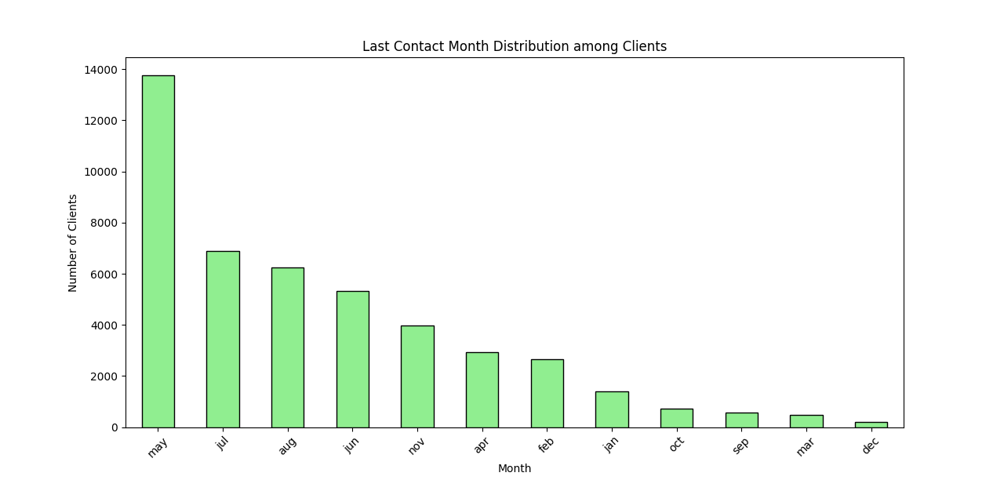
Distribution of Last Contact Month
Analysis
The highest number of client contacts occurred in May (13,766 clients).
July and August also saw high contact numbers, with 6,895 and 6,247 clients, respectively.
The lowest number of contacts occurred in December (214 clients).
A noticeable contact drop during winter (December, January, February).
Actionable insights
Campaign Planning:
  Focus marketing and outreach campaigns in May, July, and August when client contact rates are highest.
  Investigate the reasons behind the high contact rates in these months to replicate successful strategies.
Resource Allocation:
  Allocate more resources (e.g., staff, budget) during peak contact months to handle the increased volume efficiently.
  Consider reducing resources during low-contact months (e.g., December) or using this time for training and planning.
Seasonal Trends:
  Analyse the impact of seasonal trends on client behaviour and contact rates.
  Develop strategies to boost engagement during low-contact months, such as special promotions or targeted communications.
Client Preferences:
  Understand client preferences and behaviours during different months to tailor communication strategies accordingly.
  Use data-driven insights to optimise the timing of product launches and promotional offers.

Slide 21
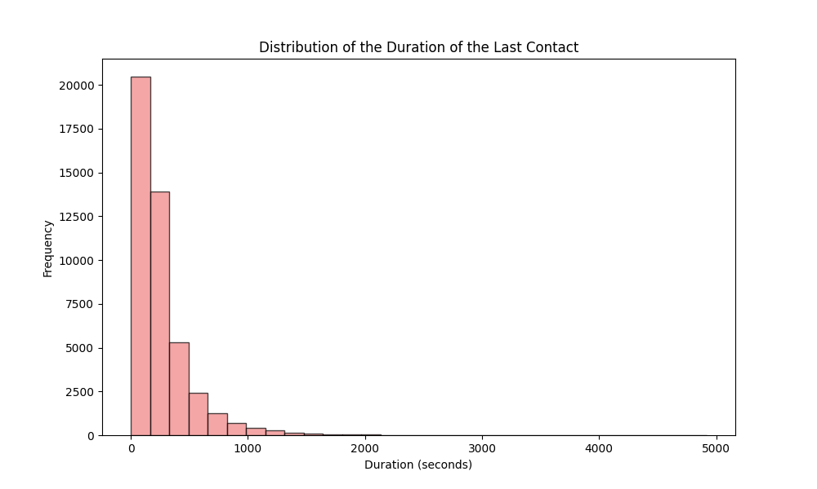
Duration of the Last Contact
Analysis and Interpretation
The distribution is right-skewed, with most contacts lasting less than 500 seconds.
A peak of around 200-300 seconds suggests many calls are relatively short.
A long tail extends to the right, indicating some calls last much longer, potentially up to 3000 seconds or more.
Actionable Insights
Focus on optimising short calls (200-300 seconds) as they're most common.
Investigate factors contributing to extremely long calls to improve efficiency.
Consider segmenting customers based on call duration for targeted strategies.

Slide 22
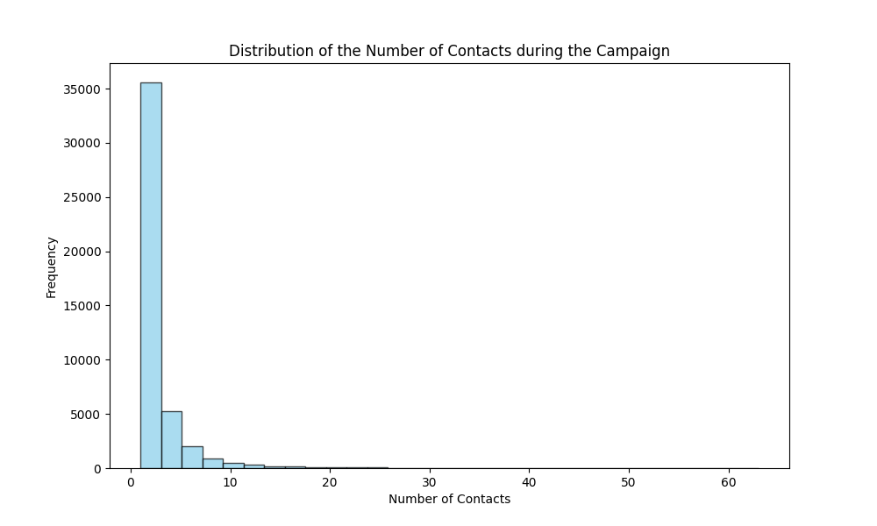
Number of Contacts During the Campaign
Analysis and Interpretation
Distribution Shape: The histogram indicates that most clients were contacted only a few times during the campaign, with a peak of around 1 to 3 contacts. The right-skewed distribution suggests that while most clients received fewer contacts, a small number received more.
Summary Statistics:
  Mean: The average number of contacts is approximately 2.76, indicating that clients were contacted just under three times on average.
  Median: The median is 2, which aligns with the histogram's peak, confirming that most clients received two or fewer contacts.
  Interquartile Range: The 75th percentile is 3, meaning 75% of clients were contacted thrice or less.
Actionable Insights
Targeting Strategy: Since most clients are contacted only a few times, consider optimising the communication strategy for those who receive more contacts. Analyse whether these additional contacts led to successful conversions or resulted in client fatigue.
Resource Allocation: Given the right-skewed distribution, resources could be better allocated to clients who have shown interest but have not been contacted multiple times. This could help in improving engagement without overwhelming clients.
Follow-Up Campaigns: For clients who received more contacts, evaluate the effectiveness of those interactions. If they did not convert, adjusting the approach or frequency of contact in future campaigns may be beneficial.

Slide 23
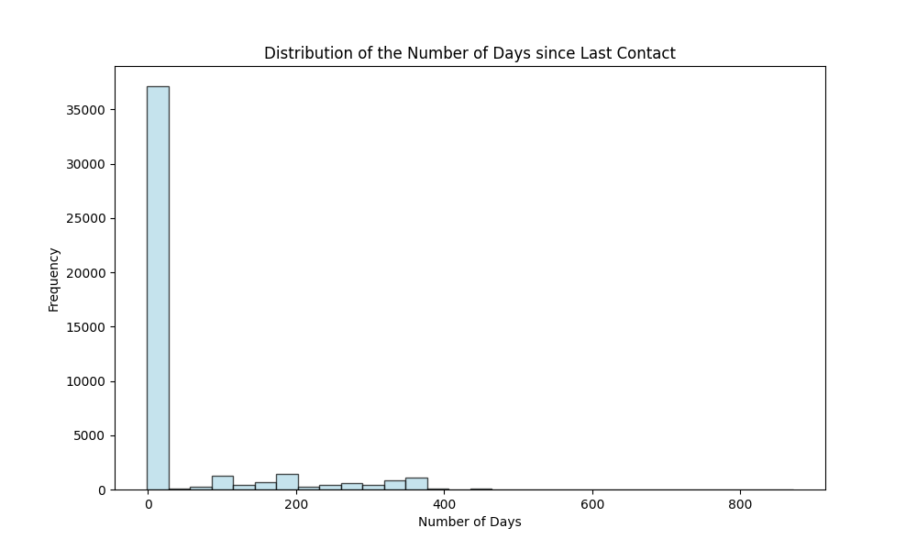
Number of Days Since Last Contact
Analysis and Interpretation
Distribution Shape: The histogram indicates that many clients have a value of -1, typically representing clients who were never contacted. This creates a peak at -1, while the rest of the distribution shows a long tail extending to higher values, indicating that some clients were contacted many days ago.
Summary Statistics:
  Mean: The average number of days since the last contact is approximately 40.2 days, skewed by -1 values.
  Median: The median is -1, suggesting that most clients have not been contacted recently.
  Maximum: The maximum value is 871 days, which indicates that some clients have not been contacted for a very long time.
Actionable Insights
Client Engagement Strategy: The high number of clients with a value of -1 suggests that a significant portion of the client base has not recently engaged. Developing a re-engagement strategy for these clients to understand their current needs and interests may be beneficial.
Targeted Campaigns: For clients who have not been contacted for a long time (e.g., those with high 'pdays' values), consider targeted campaigns to re-establish communication. This could involve personalised outreach or special offers to encourage re-engagement.

Slide 24
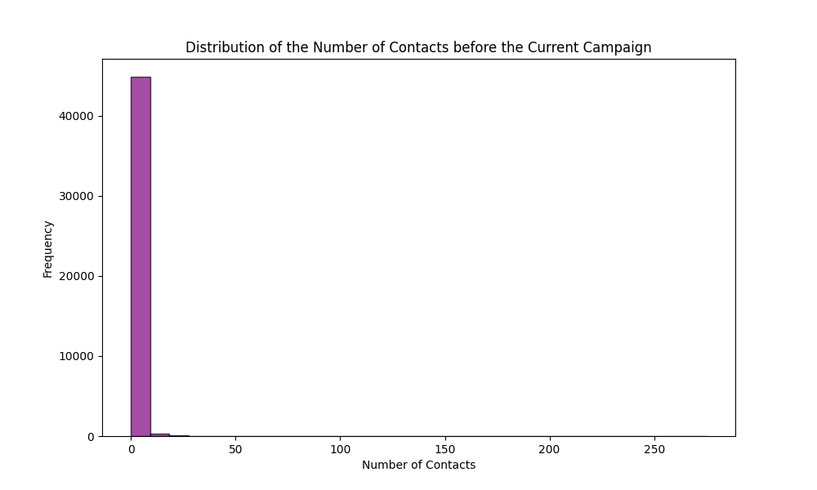
Number of Contacts Before the Campaign
Analysis
Most clients have not been contacted before (0 previous contacts).
The distribution has a long tail, with some clients being contacted many times.
The mean is about 0.58 contacts, but the median is 0, indicating a right-skewed distribution.
The maximum number of previous contacts is 275, which is quite high.
Actionable Insights
Focus on re-engaging clients with 0 previous contacts.
Investigate why some clients have been contacted so many times.
Consider segmenting clients based on previous contact frequency for targeted marketing.

Slide 25
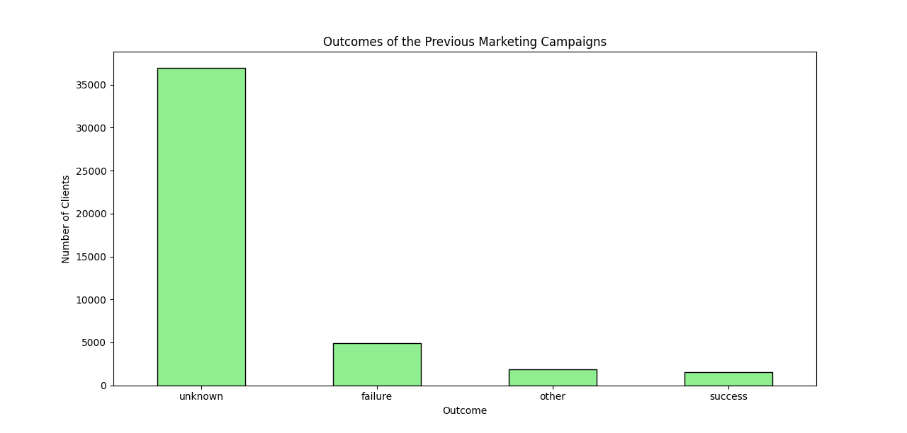
Outcomes of the Previous Campaign
Analysis and Interpretation
The chart indicates the distribution of outcomes from previous marketing campaigns.
The categories typically include "success," "failure," and "other," with varying numbers of clients in each category.
Many clients have outcomes categorised as "failure," suggesting that previous campaigns may not have been effective for a large portion of the client base.
Actionable Insights
Focus on Successful Strategies: Analyse the characteristics of clients who had successful outcomes to replicate those strategies in future campaigns.
Reassess Campaign Approaches: Given the high number of failures, it may be beneficial to reassess the marketing strategies used in previous campaigns and identify areas for improvement.
Targeted Follow-ups: For clients with previous failures, consider personalised follow-up strategies to understand their needs better and improve engagement.

Slide 26
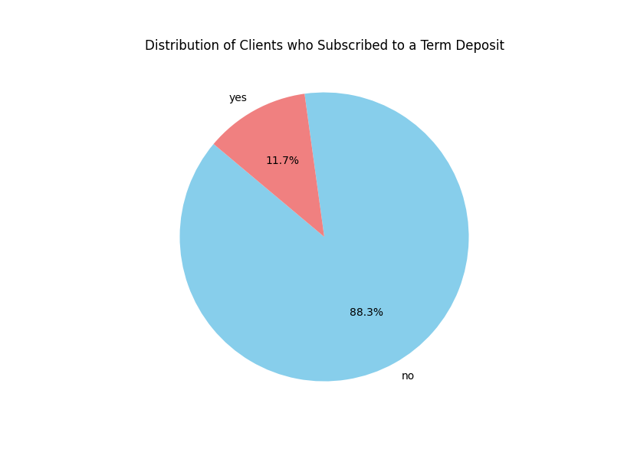
Clients Subscribed to Term Deposit
Analysis and Interpretation
The pie chart illustrates the proportion of clients who subscribed to a term deposit versus those who did not.
The majority of clients did not subscribe, indicating a potential area for improvement in marketing strategies to increase subscriptions.
Actionable Insights
Targeted Marketing: Focus on understanding the characteristics of clients who subscribed to tailor marketing efforts toward similar profiles.
Engagement Strategies: Develop strategies to engage clients who did not subscribe, possibly through personalised offers or follow-up communications.
Feedback Mechanism: Implement a feedback mechanism to understand why clients chose not to subscribe, which can inform future campaigns.

Slide 27
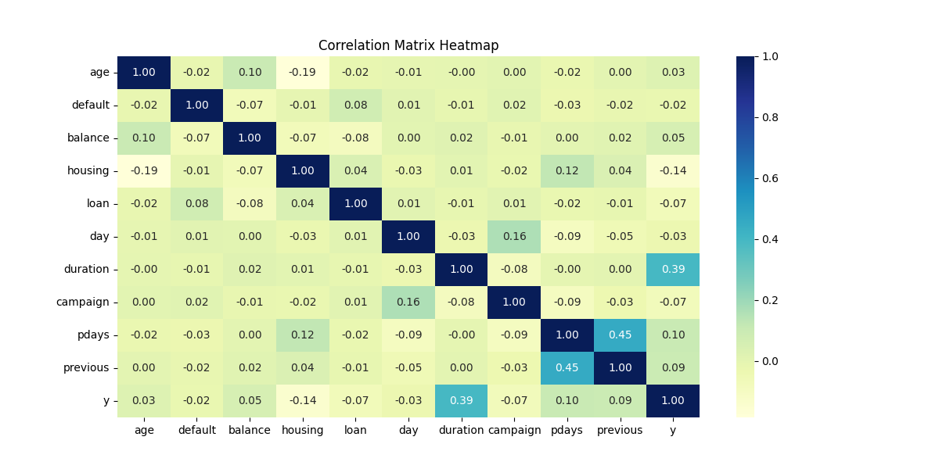
Correlation Matrix Heatmap
FIND THE INTERPRETATION ON THE FOLLOWING PAGE

Slide 28
Correlation Matrix Heatmap
Analysis and Interpretation:
Duration (0.39): This shows the strongest positive correlation with the likelihood of subscribing to a term deposit. Longer call durations are associated with a higher chance of subscription.
Pdays (0.10) and Previous (0.09): These have weak positive correlations. 'Pdays' represents the days since the client was last contacted, and 'Previous' indicates the number of contacts before this campaign. This suggests that clients who haven't been contacted for a while or have been contacted multiple times before might be slightly more likely to subscribe.
Balance (0.05) and Age (0.03): These have very weak positive correlations, indicating a slight tendency for older clients or those with higher account balances to subscribe, but the relationship is not strong.
Housing (-0.14) and Loan (-0.07) show weak negative correlations. Clients with existing housing or personal loans are slightly less likely to subscribe to a term deposit.
Campaign (-0.07): This weak negative correlation suggests that as the number of contacts during this campaign increases, the likelihood of subscription slightly decreases.
Default (-0.02) and Day (-0.03): These have very weak negative correlations, indicating minimal impact on the subscription likelihood.
Actionable Insights:
Focus on Call Duration: Train staff to engage clients in longer, more meaningful conversations. Develop strategies to keep clients interested and on the call longer.
Optimize Contact Frequency: Implement a balanced approach to client contact. While multiple contacts can be beneficial, avoid excessive contact quickly. Consider a follow-up strategy for clients who haven't been contacted.
Targeted Marketing: In marketing campaigns, slightly prioritize older clients and those with higher account balances. Develop specific strategies for clients with existing loans, as they might need more convincing.
Personalized Approach: Use the weak correlations with age and balance to create personalised offers, but don't rely on these factors too heavily.
Efficient Campaign Management: Monitor the contacts made during a campaign. If a client doesn't show interest after a few attempts, it might be better to focus resources elsewhere.
Product Development: Consider developing term deposit products that are attractive to clients with existing loans, potentially offering better rates or terms.
Further Analysis: Investigate why longer call durations lead to higher subscription rates. Is it due to better explaining benefits, building rapport, or addressing concerns? To understand their motivations, conduct a deeper analysis of the clients who subscribed despite having loans.
Training and Quality Control: Implement training programs focused on effective communication and engagement techniques to increase call durations naturally. Regularly review call recordings to identify best practices that lead to longer, more productive conversations.

Slide 29
Additional Visualisations
Plotting Graphs with One or More Variables and Driving Insights

Slide 30
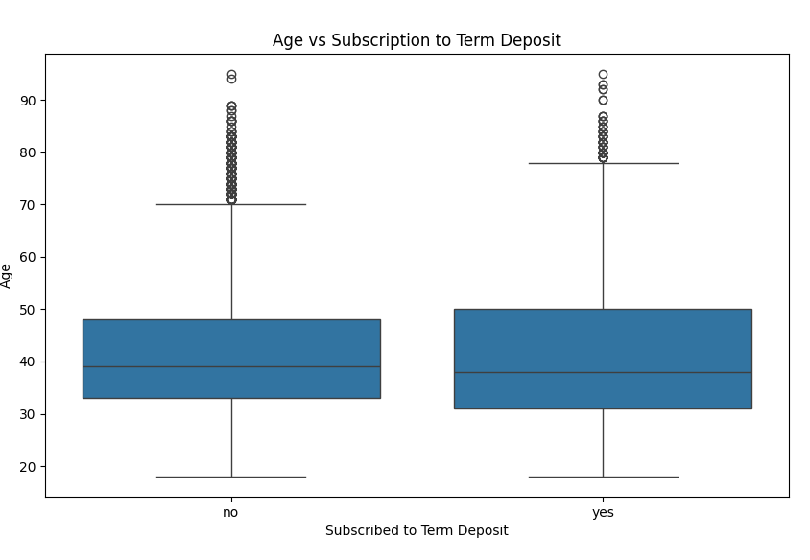
Age vs Subscription to Term Deposit
Analysis and Interpretation
The box plot illustrates the distribution of ages for clients who subscribed to a term deposit versus those who did not.
Clients who subscribed tend to be older, with a higher median age than those who did not subscribe.
There are also some outliers in both categories, indicating that while most clients fall within a certain age range, there are individuals outside of this range.
Actionable Insights
Target Older Demographics: Given the trend that older clients are more likely to subscribe, marketing efforts could be tailored to appeal to this demographic.
Personalized Campaigns: Consider developing personalised campaigns that address different age groups' specific needs and preferences.
Further Analysis: Investigate other factors influencing subscription rates among different age groups, such as income or previous banking history.

Slide 31
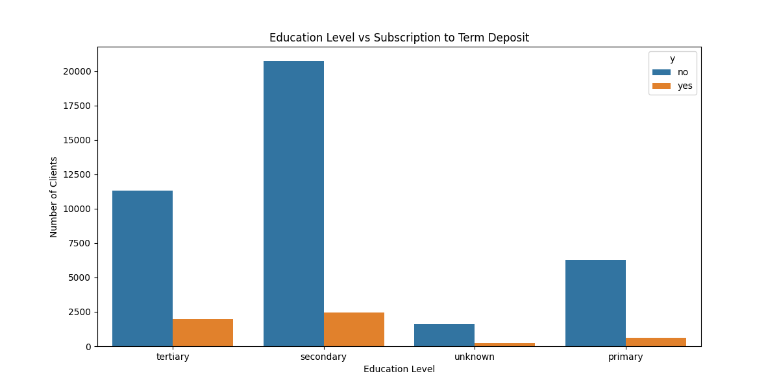
Education Level vs Term Deposit
Analysis and Interpretation
Higher Subscription Rates in Higher Education: There appears to be a trend where higher education levels (like tertiary) might correlate with a higher likelihood of subscribing to term deposits, although exact subscriber counts for tertiary and unknown categories need further confirmation.
Dominance of Secondary Education: The overwhelming number of individuals with secondary education could skew overall subscription rates and might suggest that financial products like term deposits are more commonly marketed or more accessible to this demographic.
Actionable Insights
Further Data Collection: Obtain complete subscription data for all education levels to better assess the impact.
Targeted Marketing Strategies: Financial institutions might consider tailored marketing strategies for different education levels, especially promoting term deposits to higher education levels where subscription rates appear favourable.

Slide 32
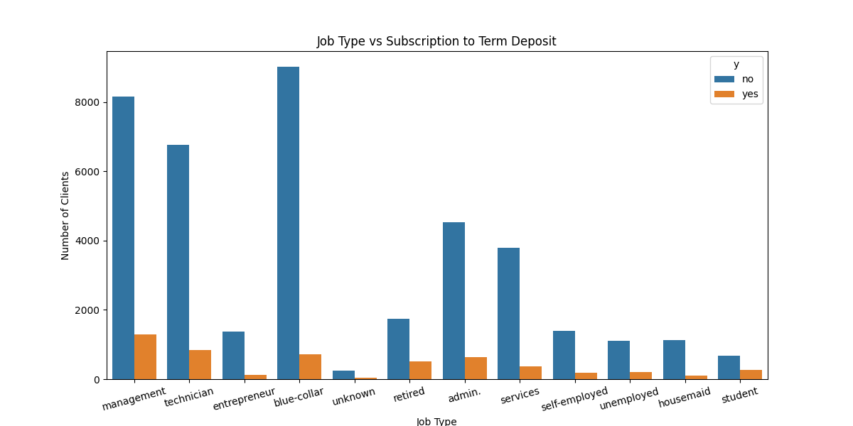
Job Type vs Term Deposit
Analysis and Interpretation
Highest Subscription Rates: The job categories 'retired' and 'student' show the highest subscription rates, significantly above the average. This could be attributed to these groups having more time to consider and the capacity to invest in long-term savings options.
Lowest Subscription Rates: 'blue-collar' workers have the lowest subscription rate, which might be due to lower disposable income or a lack of access to banking advice.
Moderate Subscription Rates: Job types like 'admin.', 'management', and 'technician' show moderate subscription rates, indicating a potential area for increased focus.
Actionable Insights
Targeted Marketing: Financial institutions should tailor their marketing strategies to target job types with lower subscription rates by addressing their specific financial needs and concerns.
Financial Education Programs: Implementing educational programs that help individuals from lower subscribing job categories understand the benefits of term deposits could increase subscription rates.
Special Offers for High Subscription Categories: Banks could offer special rates or packages for job types with high subscription rates to retain and attract even more customers from these segments.

Slide 33
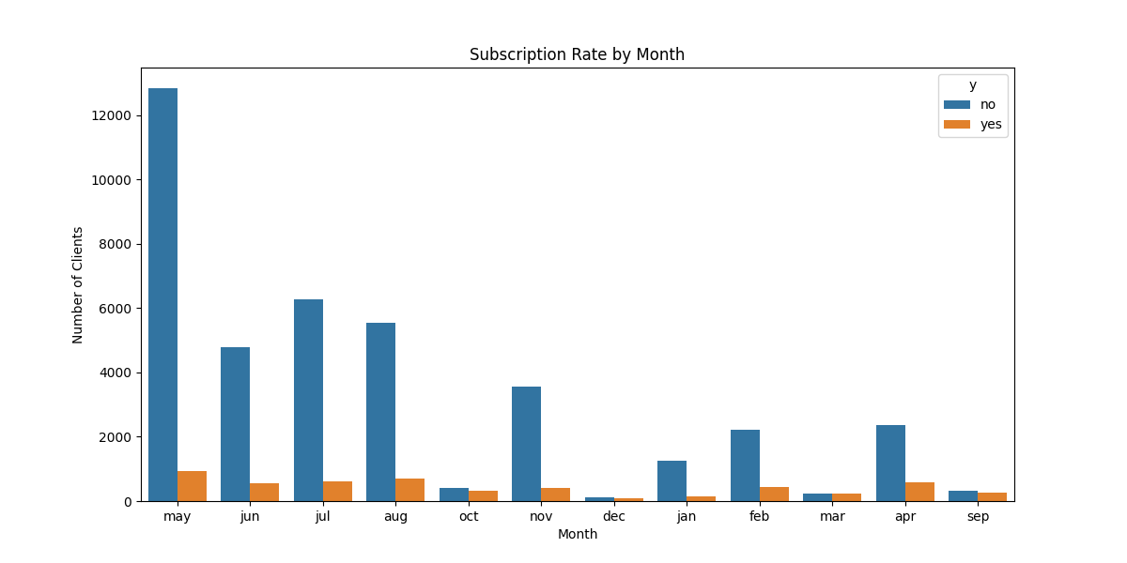
Subscription Rate by Month
Analysis and Interpretation
Highest Subscription Rates: December, March, and October show the highest subscription rates, with December's peak at approximately 0.47.
Lowest Subscription Rates: August and January have the lowest subscription rates, with January slightly above 0.1 and August around 0.11.
Moderate Subscription Rates: April, February, and November show moderate subscription rates, ranging from approximately 0.17 to 0.20.
Insights and Actionable Recommendations
Capitalize on Peak Months: Given the high subscription rates in December, March, and October, these months should be targeted for increased marketing efforts. Special promotions or incentives could be offered to maximise the subscription rate during these peak periods.
Investigate Low-Performance Months: For months like August and January, with the lowest subscription rates, it is crucial to investigate the underlying reasons. This could involve analysing customer feedback, market conditions, or competing offers during these months and tailoring strategies accordingly
Adjust Resource Distribution: Allocate marketing and sales resources more heavily during months with historically higher subscription rates. Conversely, consider reducing expenditure or reallocating resources during lower-performing months unless specific strategies are implemented to boost performance.
Track Changes and Adapt: Continuously monitor the effectiveness of strategies and campaigns across different months. Be prepared to make adjustments based on real-time data and emerging trends to ensure optimal performance throughout the year.

Slide 34
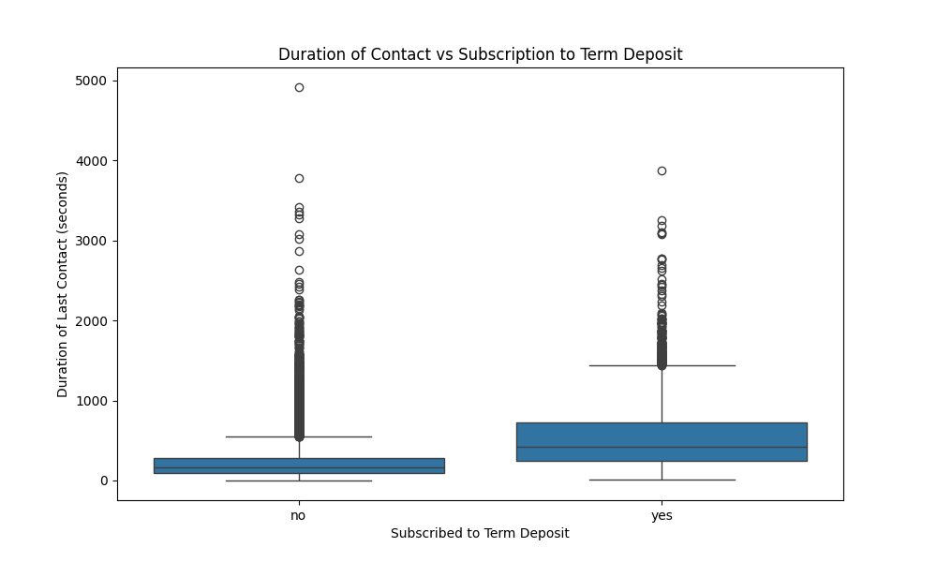
Contract Duration vs Term Deposit
Analysis and Interpretation
Longer Contact Duration Correlates with Higher Subscription Rates: Clients who engage longer with the bank are more likely to subscribe to term deposits. This could be due to more comprehensive explanations or building better rapport during longer calls.
Optimal Duration Window: While longer durations generally correlate with higher subscription rates, outliers and a wide range in the 'no' category suggest an optimal duration window beyond which additional time might not increase the likelihood of subscription.
Actionable Insights
Focus on Quality and Efficiency: Banks should train their staff to balance call duration and effectiveness. Ensuring the client receives all necessary information and feels heard without unnecessarily prolonging the conversation could enhance subscription rates.
Tailored Communication Strategies: Analysing individual client profiles and tailoring the conversation’s length and style might help optimise outcomes.

Slide 35
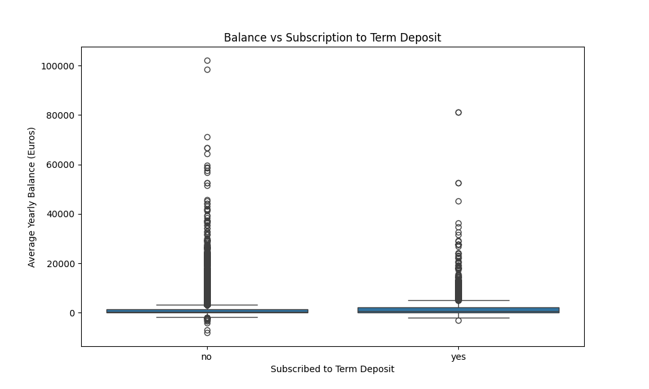
Balance vs Term Deposit
Analysis and Interpretation
Median Balance: The median balance for clients who subscribed to a term deposit (yes) is higher than those who did not (no). This suggests customers with higher average yearly balances are more likely to subscribe to term deposits.
Interquartile Range (IQR): The IQR for both groups is wide, indicating substantial variability in balances within each group. However, the variability seems higher for those who did not subscribe (no).
Outliers: Both groups have several outliers, particularly in the no group. This indicates that some clients have significantly higher or lower balances than most.
Actionable Insights
Target Higher Balance Customers: Since higher balances correlate with a higher likelihood of subscription, focus marketing efforts on customers with higher average yearly balances.
Tailored Marketing Strategies: Develop specific strategies to engage clients with lower balances, possibly by offering more attractive terms or highlighting the benefits of term deposits for wealth accumulation.
Outlier Analysis: Investigate the characteristics of outliers, especially those with very high balances who did not subscribe. Understanding their reasons might reveal opportunities to convert these high-balance non-subscribers.

Slide 36
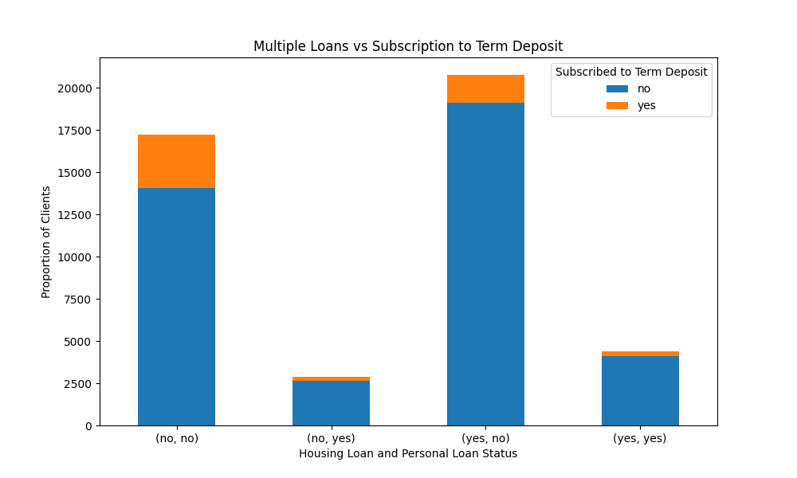
Multiple Loans vs Term Deposit
Analysis and Interpretation
No Loans: Clients with neither housing nor personal loans show a higher proportion of term deposit subscriptions (yes). This suggests financial freedom or fewer existing obligations might make clients more inclined to invest in term deposits.
Only Housing Loan: Clients with only a housing loan have a lower subscription rate than those without. This indicates that a housing loan might slightly deter term deposit subscriptions.
Only Personal Loan: Clients with only a personal loan also show a lower subscription rate than those with a housing loan.
Both Loans: Clients with both housing and personal loans show the lowest subscription rate. This could imply that multiple financial obligations make clients less likely to commit to a term deposit.
Actionable Insights
Focus on Clients with No Loans: Marketing efforts should prioritise clients without loans, as they tend to subscribe to term deposits.
Address Loan-Related Concerns: Develop marketing messages that address clients’ concerns about existing loans, possibly highlighting how term deposits can still be a viable option for them.
Incentivize Multi-Loan Holders: Offer special incentives or tailored products to clients with housing and personal loans to encourage them to consider term deposits despite their existing financial commitments.

Slide 37
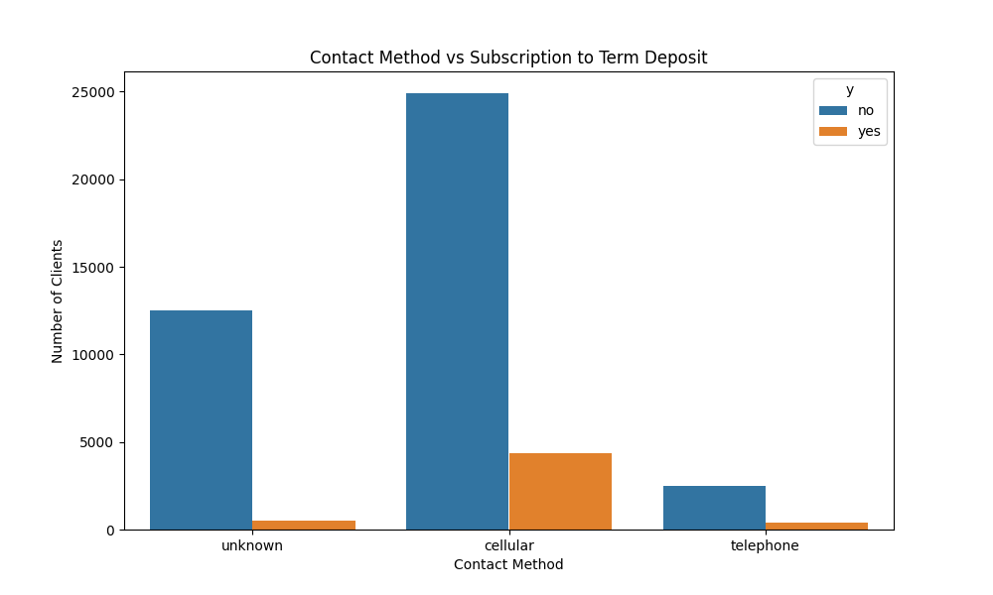
Contact Method vs Term Deposit
Analysis and Interpretation
Cellular: The majority of contacts were made via cellular phones. Among these, a significant number resulted in subscriptions (yes), suggesting that this method is relatively effective.
Telephone: Fewer contacts were made via traditional telephones compared to cellular, and the proportion of successful subscriptions is lower.
Actionable Insights
Prioritize Cellular Contact: Since contacting clients via cellular phones yields more subscriptions, continue prioritising this method for future campaigns.
Enhance Telephone Strategy: Re-evaluate the strategy for telephone contacts. Consider improvements or additional training for agents to increase the effectiveness of this method.
Multi-Channel Approach: Implement a multi-channel contact strategy, starting with the most effective method (cellular) and followed by follow-up attempts using less effective methods (telephone) to maximise outreach and potential subscriptions.

Slide 38
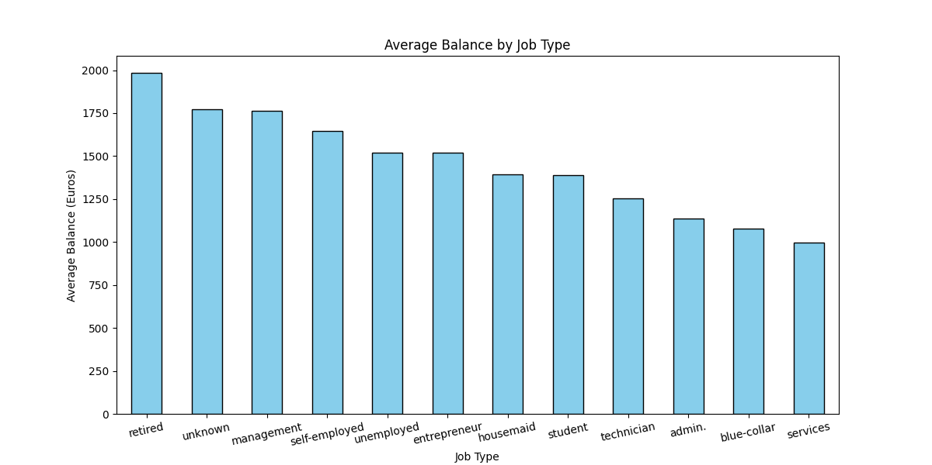
Average Balance by Job Type
Analysis and Interpretation
Higher Average Balances in Specific Jobs: Retired clients, those in management positions, and self-employed individuals have the highest average balances, indicating they may have more disposable income or savings.
Lower Average Balances in Service and Blue-Collar Jobs: Clients in service-related and blue-collar jobs have the lowest average balances, suggesting they may have less disposable income for investment in term deposits.
Actionable Insights
Target High-Balance Segments: Focus marketing efforts on retirees, management, and self-employed clients with higher average balances and may be more inclined to invest in term deposits.
Personalised Marketing Strategies: Develop customised marketing messages for different job types to increase the relevance and effectiveness of campaigns, such as highlighting financial stability for retirees and growth opportunities for self-employed individuals.

Slide 39
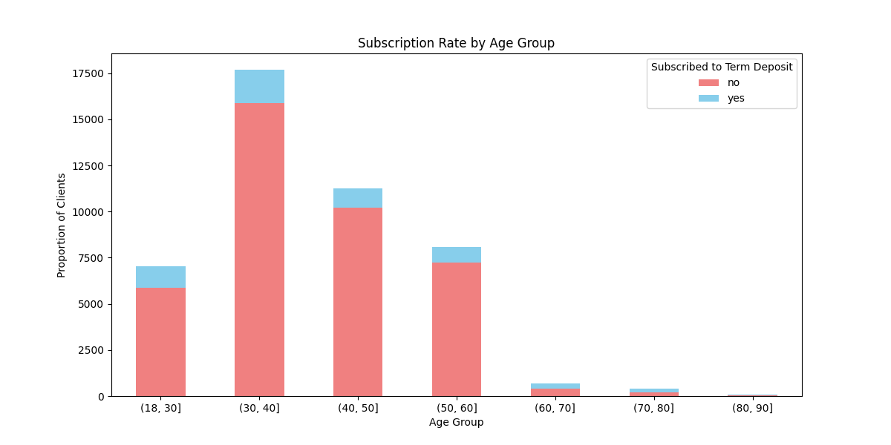
Subscription Rate by Age Group
Analysis and Interpretation
Younger Clients (18-30): This age group has the lowest subscription rates for term deposits. This may be due to their focus on short-term financial needs such as education, starting careers, or managing initial financial independence. They may also have less disposable income to invest.
Middle-Aged Clients (40-50): This group shows higher subscription rates, likely due to greater financial stability, higher disposable incomes, and a focus on long-term financial planning, such as retirement savings and investment.
Older Clients (60+): Clients in this age group also demonstrate a high likelihood of subscribing to term deposits, driven by a need for secure investment options that offer stability and reliable returns as they approach or are in retirement.
Actionable Insights
Target Middle-Aged and Older Clients: Develop targeted marketing campaigns that specifically address the needs and interests of clients aged 40-50 and above 60. Highlight benefits such as financial security, retirement planning, and stable investment options that appeal to these age groups.
Customized Campaigns for Younger Clients: Create appealing offers and incentives for younger clients (18-30) to increase their subscription rates. This could include features like higher interest rates for shorter-term deposits, flexible terms, or educational content on the benefits of early investment.

Slide 40
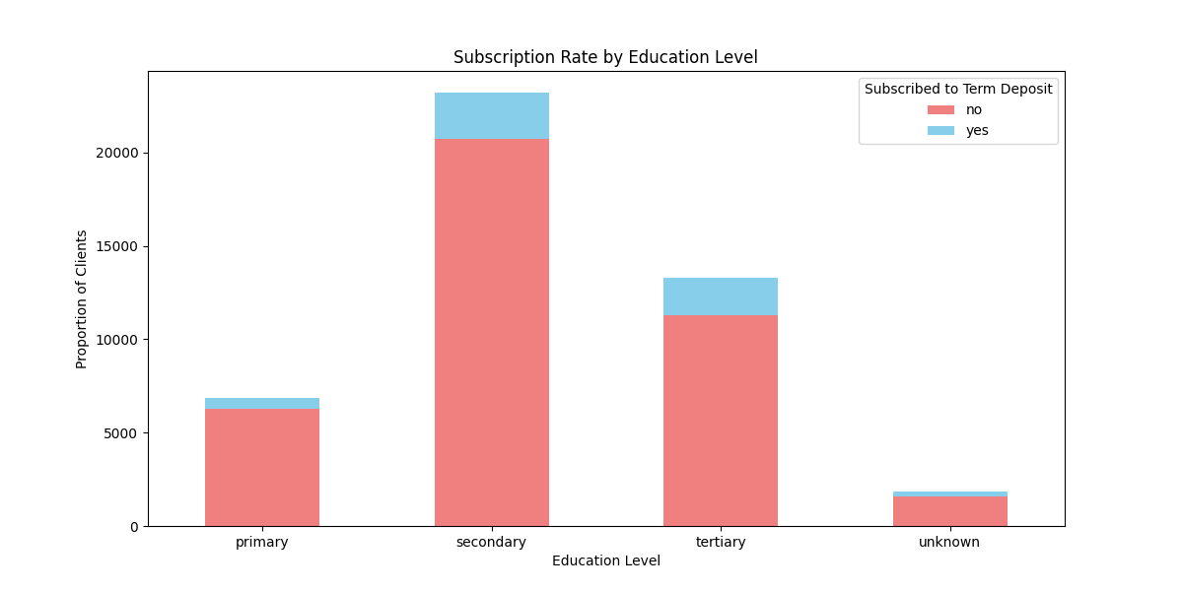
Subscription Rate by Education Level
Analysis and Interpretation
Tertiary Education: Clients with tertiary education have higher subscription rates. This could be due to their better understanding of financial products, higher incomes, and greater focus on long-term financial planning.
Primary and Secondary Education: These clients have lower subscription rates, possibly due to lower incomes, less financial literacy, or different financial priorities.
Unknown Education Levels: The varied subscription patterns in this group suggest that it might include a mix of different education levels, making it harder to generalise their behaviour.
Actionable Insights
Educational Campaigns: Tailor campaigns to emphasise the benefits of term deposits to clients with tertiary education, leveraging their higher likelihood of subscribing. Use sophisticated financial terminology and highlight long-term financial growth and security.
Address Knowledge Gaps: Develop educational content and workshops targeting clients with primary or secondary education. Simplify the concept of term deposits and illustrate their benefits through relatable examples and testimonials.
Clarify Unknown Education Levels: Investigate and address the reasons behind the 'unknown' education levels. If possible, update client profiles to better tailor marketing efforts.

Slide 41
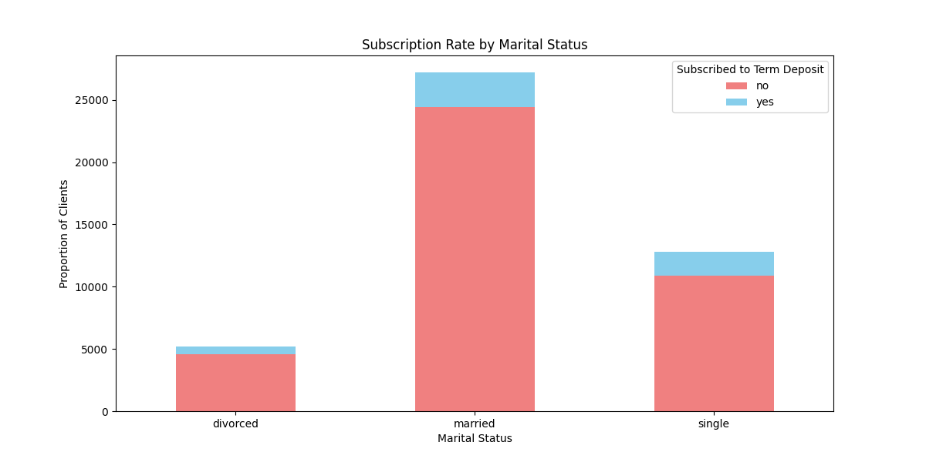
Subscription Rate by Marital Status
Analysis and Interpretation
Married Clients: This group shows the highest subscription rates. They may have a greater focus on financial stability and future planning for their families, making them more inclined to invest in secure financial products.
Single Clients: Single clients have the lowest subscription rates, potentially due to different financial priorities or focusing on more immediate financial needs and personal investments.
Divorced Clients: This group's subscription rate is higher than that of single clients but lower than that of married clients, possibly reflecting a focus on rebuilding financial stability post-divorce.
Actionable Insights
Focus on Married Clients: Create marketing strategies that emphasise financial stability and family security for married clients. Highlight benefits such as joint account advantages, long-term growth, and financial planning for children’s education.
Engage Single Clients: Develop targeted messaging for single clients that underscores the importance of individual financial independence and future planning. To capture their interest, offer attractive short-term deposit options or higher interest rates.
Divorced Clients: Tailor messages for divorced clients that focus on rebuilding and securing their financial future post-divorce.

Slide 42
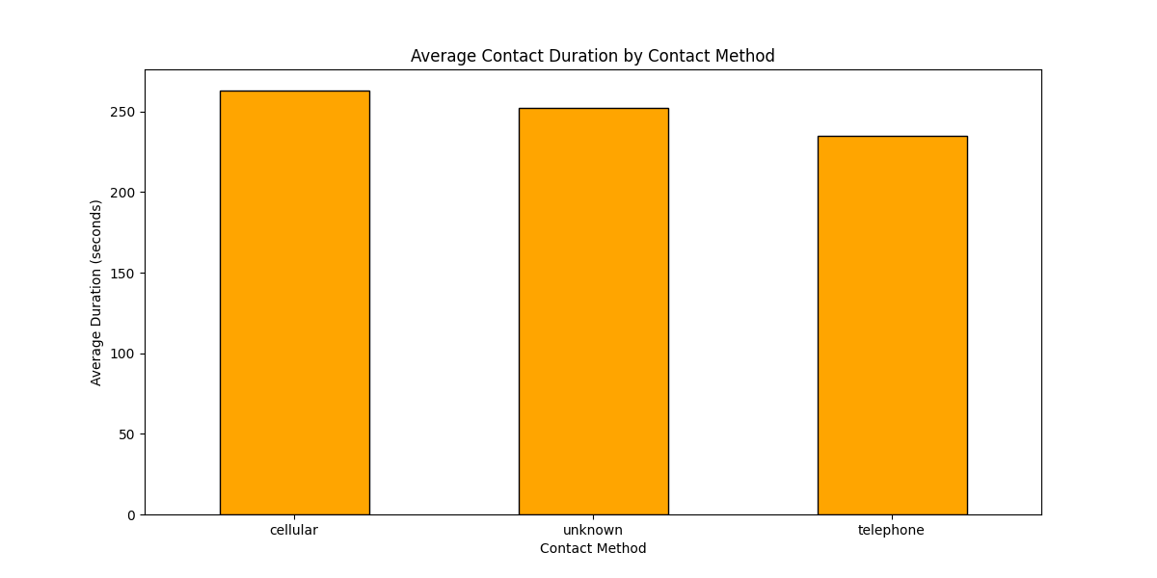
Average Contact Duration by Method
Analysis and Interpretation
Cellular Phone Contacts: These have longer average durations, suggesting that clients are more engaged or receptive when contacted via mobile phones. This could be due to the convenience and personal nature of cellular communication.
Unknown Contact Methods: These methods show shorter average durations, indicating less effective engagement. This could be due to less personalised or less effective communication strategies.
Actionable Insights
Optimize Contact Methods: Due to their longer engagement times, allocate more resources to cell phone contacts, which could lead to higher conversion rates. Train call centre agents on effective communication techniques specific to cell phone interactions.
Evaluate and Improve Unknown Methods: Investigate why the "unknown" contact method has shorter durations. Improve training for agents using this method or consider phasing it out if it’s ineffective.

Slide 43
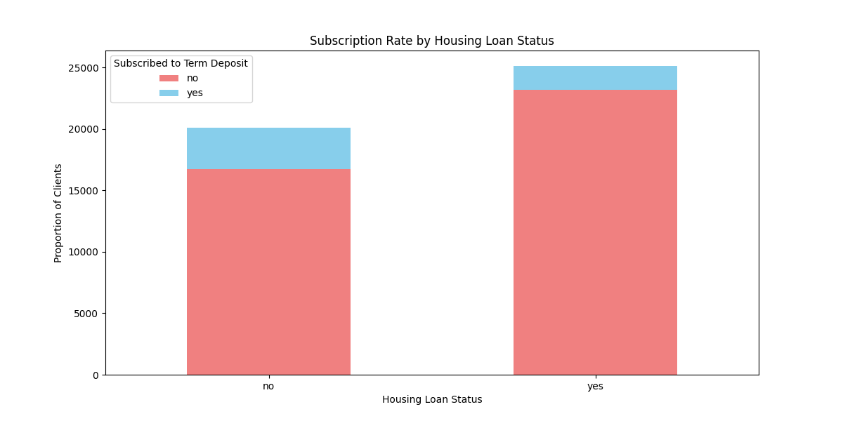
Subscription Rate by Housing Loans
Analysis and Interpretation
Clients Without Housing Loans: These clients show higher subscription rates, possibly because they have more disposable income and fewer financial obligations, making them more likely to invest in term deposits.
Clients With Housing Loans: These clients are less likely to subscribe, likely due to their existing financial commitments and a focus on repaying their housing loans.
Actionable Insights
Target Clients Without Housing Loans: Focus marketing efforts on clients without housing loans, highlighting the additional financial flexibility they have to invest in term deposits. Emphasise benefits such as saving for future home purchases or other large investments.
Address Housing Loan Concerns: Develop offers and messaging that address clients’ financial constraints with housing loans. Highlight how term deposits can be a secure way to grow savings while paying off a loan, possibly offering higher interest rates or flexible deposit terms.

Slide 44
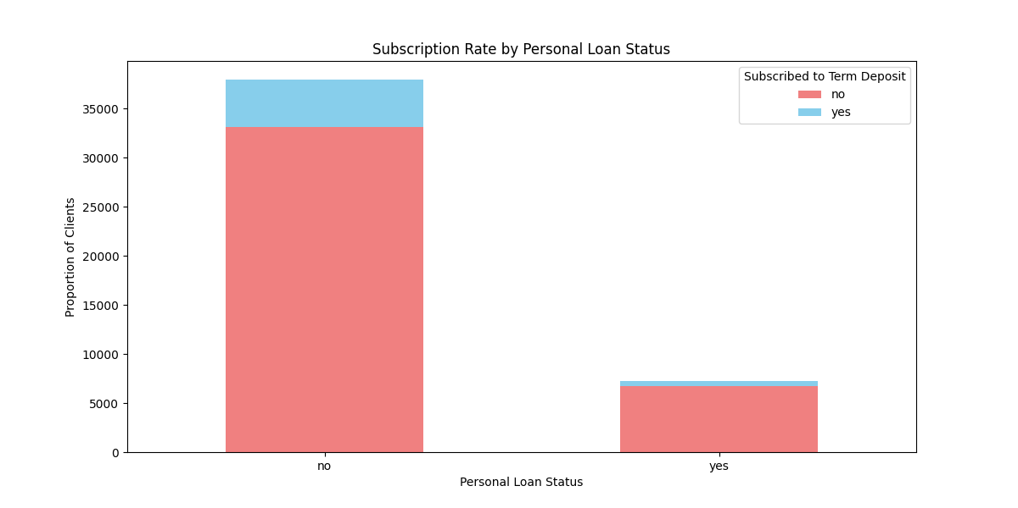
Subscription Rate by Personal Loans
Analysis and Interpretation
Clients Without Personal Loans: This group has higher subscription rates, indicating they have more disposable income, are potentially more financially stable, and are able to consider additional investments like term deposits.
Clients With Personal Loans: These clients have lower subscription rates, likely due to existing debt obligations and a focus on repaying their personal loans.
Actionable Insights:
Focus on Clients Without Personal Loans: Develop marketing strategies targeting clients without personal loans, emphasising their financial freedom to invest in term deposits. Highlight benefits such as high returns and low risk.
Mitigate Personal Loan Impact: Create messaging that alleviates financial concerns for clients with personal loans. Offer special incentives such as higher interest rates or flexible deposit terms to help them see term deposits as a viable option despite their loan obligations.

Slide 45
Summary and Conclusion
Overview of All the Observations Obtained and Final Conclusion

Slide 46
Summary and Conclusion
This project aimed to predict whether a client would subscribe to a term deposit based on data from a Portuguese banking institution's direct marketing campaigns. The goal was to optimise marketing strategies and improve conversion rates by analysing various client attributes and campaign details. Key findings include that the average age of clients is 40 years, with a significant portion being older than 55. Additionally, the average balance of clients is relatively low, with a wide range of values, indicating financial diversity among the client base. Furthermore, the average duration of contact is within industry standards, though some calls are excessively long, and the term deposit subscription rate is 11.71%, which aligns with industry expectations but indicates room for improvement.
To improve campaign effectiveness, targeted marketing for older clients (55+) should be developed, enhancing their digital literacy and engagement to yield better conversion rates. Additionally, offering personalised financial advisory services to clients with high balances can help retain them, while assisting clients with negative balances can improve their financial health. Optimising contact strategies by analysing the effectiveness of call durations and the optimal number of contacts can prevent client fatigue while maximising conversions. Designing specialised financial products and marketing campaigns tailored to different client segments based on marital status, job type, and education level will address their specific needs and improve engagement.
Improving data quality by investigating and updating unknown or missing client information (e.g., job types and contact types) will enhance segmentation and targeting accuracy. Learning from past campaigns by analysing successful strategies and replicating effective approaches can improve the current campaign's performance. By implementing these insights and recommendations, the bank can enhance its marketing efficiency, improve client conversion rates for term deposits, and achieve better overall campaign outcomes.

Slide 47





Thank You
Bhavya Sinha
+91 9818443695
bhavya3154@outlook.com
LinkedIn

