Slide 1


Navyug Vidyabhavan Trust
C. K. Pithawala College of Engg. & Tech.
Information Technology Engineering Department
Thread Track: Smart Factory Management
Winter Internship Presentation[2025-26]
Date of Internship: 1 Jan to 30 April
Internship / Project
(3181601)
BE IV, Sem VIII
Presented By
Bhavya Dani
220090116010
Faculty Guide
Prof. Priyanka Afini
Professor

Slide 2
Outline
Company Brief
Brief overview of company at which you are working. Should also include the contact details of the company and the resource person or a leader to which your are work are reported.
Domain and Technology Stack
Brief explanation of the domain in which you are working
Overview of technology stack in which your are working (Language / Framework / Tools / Technologies)
Work Profile
Work assigned to you by the company (Project based or task based)
Type of engagement
How many hours per day? What is the timing?
Weekly diary
Snapshots of Weekly diary maintained since the beginning of internship till date
Documents
Snapshot of Joining letter or contract agreement between you and your company.

Slide 3

Company Brief
Inside InfoTech Solutions
Established in 2004, a leading IT solutions provider.
Expertise in:
OMR/OCR & Digitization
Data Integration & Web Development
Customized Software Development
Systems Integration
Sales & setup of computer systems, printers, peripherals, and networking products
Services include strategic digital business solutions, networking setup, on-site support, and data processing.
Known for innovation, customer focus, teamwork, integrity, and safety excellence.

Slide 4
Company Brief
Contact Details:
Head Office: 📍 Inside InfoTech Solutions 606/607/608,A-Wing,River Palace, Opp Ramji Mandir, Near Bahumali Bhavan, Navdi Owara, Nanpura, Surat-395001
Contact: 📞 Phone: +91-99247 83883
📧 Email: info@iisdigital.com 🌐 Website: www.iisdigital.com
Reporting Leader / Resource Person: 👤 Name: Mr. Jagdish Baldaniya 📌 Designation: Director 📞 Phone: 9924783883 📧 Email: info@iisdigital.com

Slide 5
Domain and Technology Stack
Domain: Full Stack Developer
Development Stack:
Frontend: React Native (Expo) with Material Design 3.
Backend: Node.js & Express.js for scalable RESTful services.
Intelligence: Python (FastAPI) for predictive stockout analysis.
Database: Microsoft SQL Server 2022 (Relational Management).

Slide 6
Work Profile
Project: Thread Track: Smart Factory Management
Backend & API Engineering:
Implemented secure JWT-based Multi-Role Access Control (RBAC).
Engineered automated material consumption logic via SQL triggers.
Data Science & Predictive Analysis:
Built a Python/FastAPI microservice for "Days-to-Stockout" calculations.
Designed moving average algorithms for consumption forecasting.
Frontend & App Development:
Designed three distinct, role-specific mobile dashboards (Admin, Worker, Buyer).
Integrated real-time progress visualizations for order fulfillment.

Slide 7


Type of Engagement
Engagement: Full-time Industrial Internship.
Timeline: 10:00 AM to 6:00 PM (Monday – Saturday).
Daily Effort: 7–8 active development hours per day.
Methodology: Followed Agile Sprints with daily progress tracking and mentor-led technical reviews.
Total Hours
7 – 8 hours per day
Timing
10:00 AM to 6:00 PM
Timing
10:00 AM to 6:00 PM

Slide 8
Weekly Diary – Week 1 (Jan 1-7)
This week, I focused on the foundational stages of the ThreadTrack project. I spent the initial days onboarding at Inside InfoTech Solutions and discussing the project vision with my mentor, Mr. Jagdish Baldaniya. We analyzed the existing manual processes in the garment manufacturing sector to identify critical pain points, such as inventory stockouts and lack of order transparency for B2B buyers. By the end of the week, I had established a clear set of goals and a well-defined project scope for development.
Project Orientation & Scoping:
Analyzed industrial supply chain bottlenecks in local manufacturing units.
Defined role-based requirements for Factory Admin, Worker, and Buyer portals.
Conducted a technical feasibility study for integrating AI-driven stock forecasting.

Slide 9
Weekly Diary – Week 2 (Jan 8-14)
During the second week, I transitioned from conceptual requirements to technical system design. I mapped out the complex workflows for each user role and created initial UI wireframes for the mobile application to ensure a user-friendly experience. A significant portion of the week was dedicated to architecting the relational database schema in MSSQL Server, focusing on maintaining high data integrity and establishing efficient relationships between raw materials, products, and logs.
Architectural Design & UI Wireframing:
Created stakeholder workflow diagrams for production and order fulfillment.
Designed a normalized SQL schema including tables for Users, Raw Materials, and Orders.
Developed conceptual mobile wireframes following Material Design 3 guidelines.

Slide 10
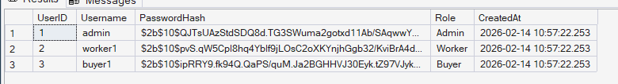
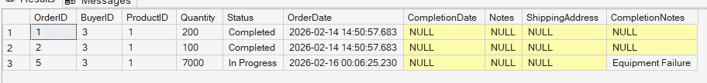
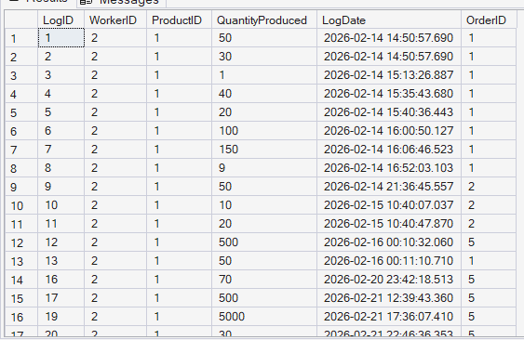
Weekly Diary – Week 2 (Jan 8-14)

Slide 11
Weekly Diary – Week 3 (Jan 15 - 21)
This week was dedicated to building the core backend infrastructure using Node.js and Express.js. I focused on setting up a secure development environment and implementing the system's authentication layer. I integrated JSON Web Tokens (JWT) to manage secure user sessions and created specialized middleware to enforce role-based access control. This ensures that only authorized users, such as factory owners, can access sensitive inventory analytics and private business data.
Backend Foundations & Authentication:
Initialized the Express server and configured the professional RESTful directory structure.
Developed secure Login and Registration endpoints using Bcrypt for password hashing.
Implemented JWT-based session management and Role-Based Access Control (RBAC).

Slide 12
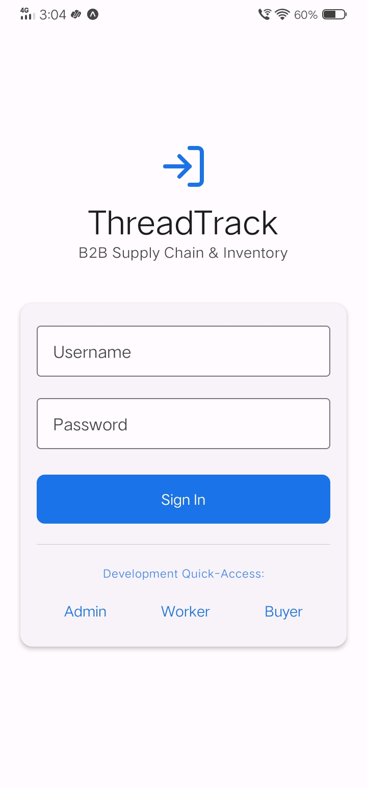
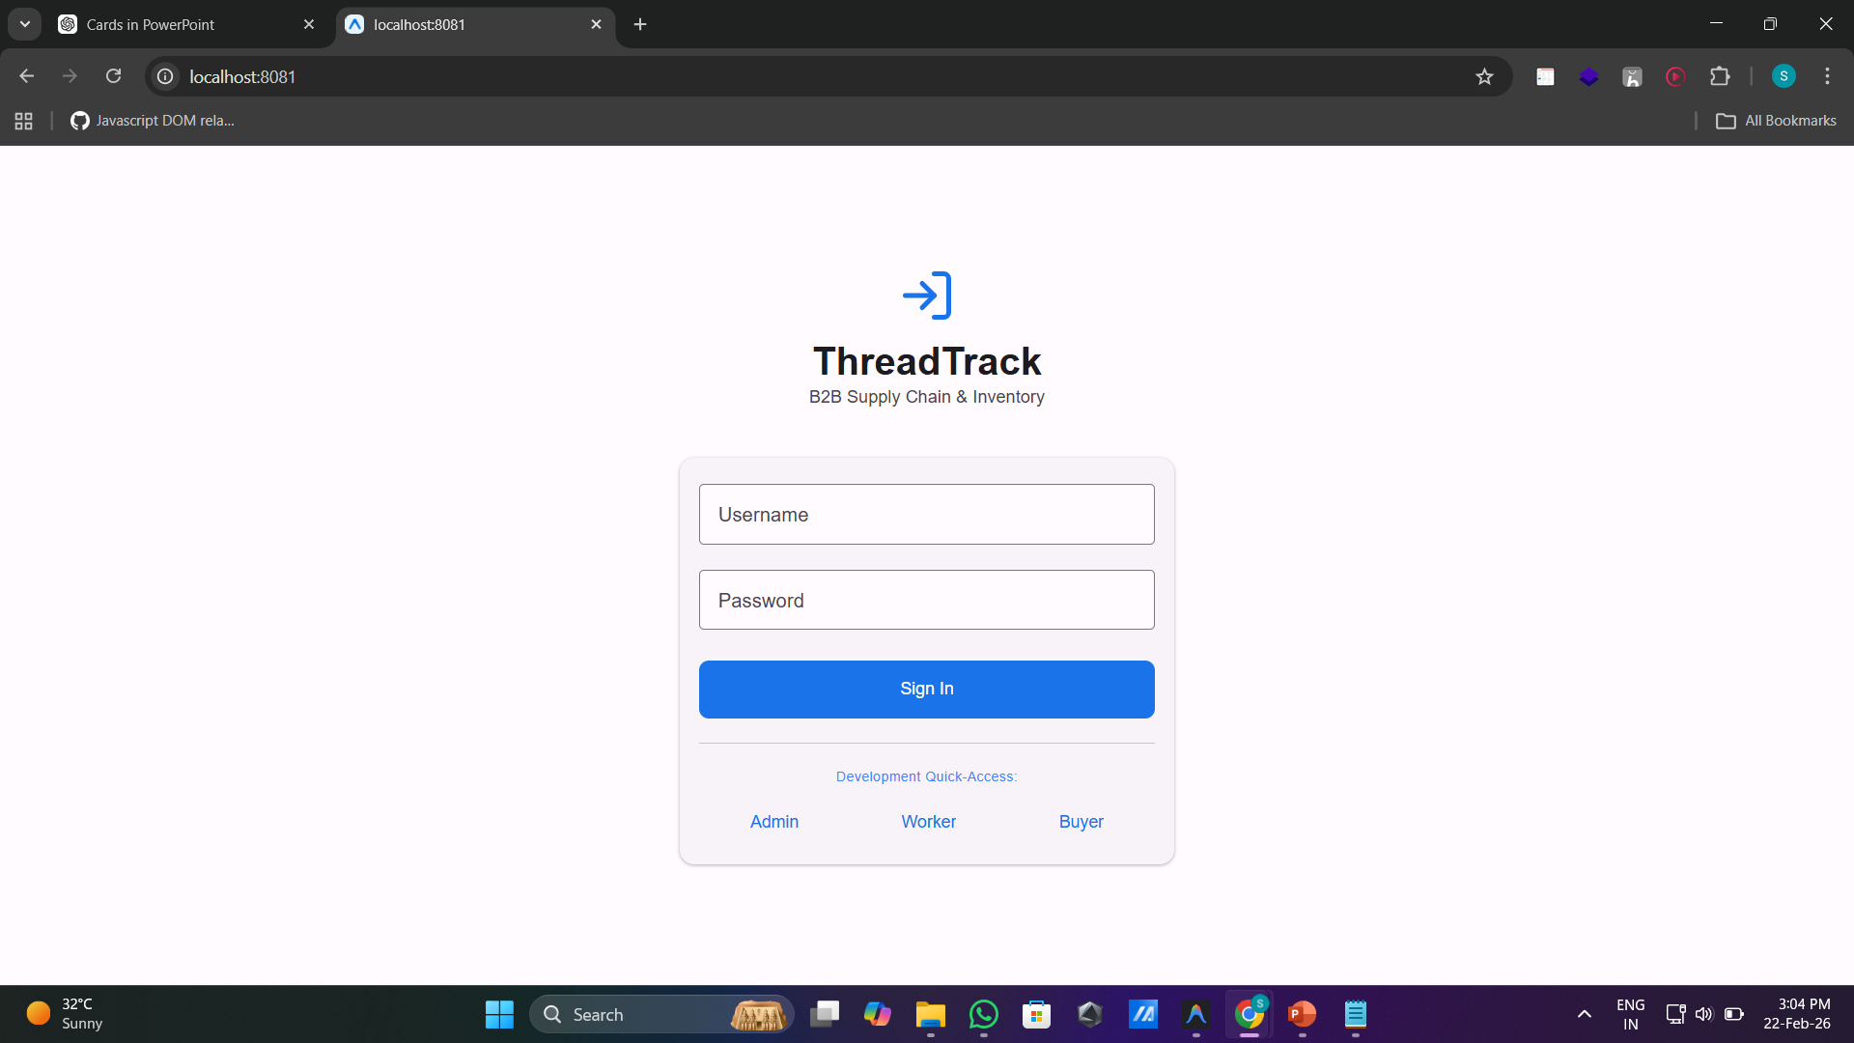
Weekly Diary – Week 3 (Jan 15 - 21)

Slide 13
Weekly Diary – Week 4 (Jan 22-28)
In the fourth week, I focused on integrating the backend server with the SQL database and developing the core inventory management logic. I created various APIs to handle raw material operations and mapped complex "Bill of Materials" rules. This allows the system to understand exactly how much fabric or thread is used for each product. By the end of the week, the core logic for managing factory stock and tracking production goals was fully functional and ready for mobile integration.
Database Integration & CRUD Operations:
Established secure connectivity between Node.js and MS SQL Server using the 'mssql' library.
Developed CRUD modules for Raw Materials and Product-to-Material mapping logic.
Implemented the automated math logic for material consumption per unit of production.

Slide 14
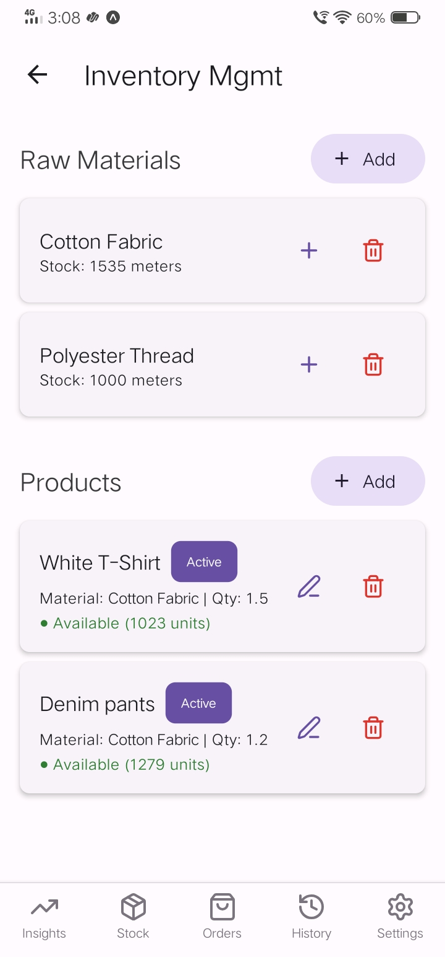
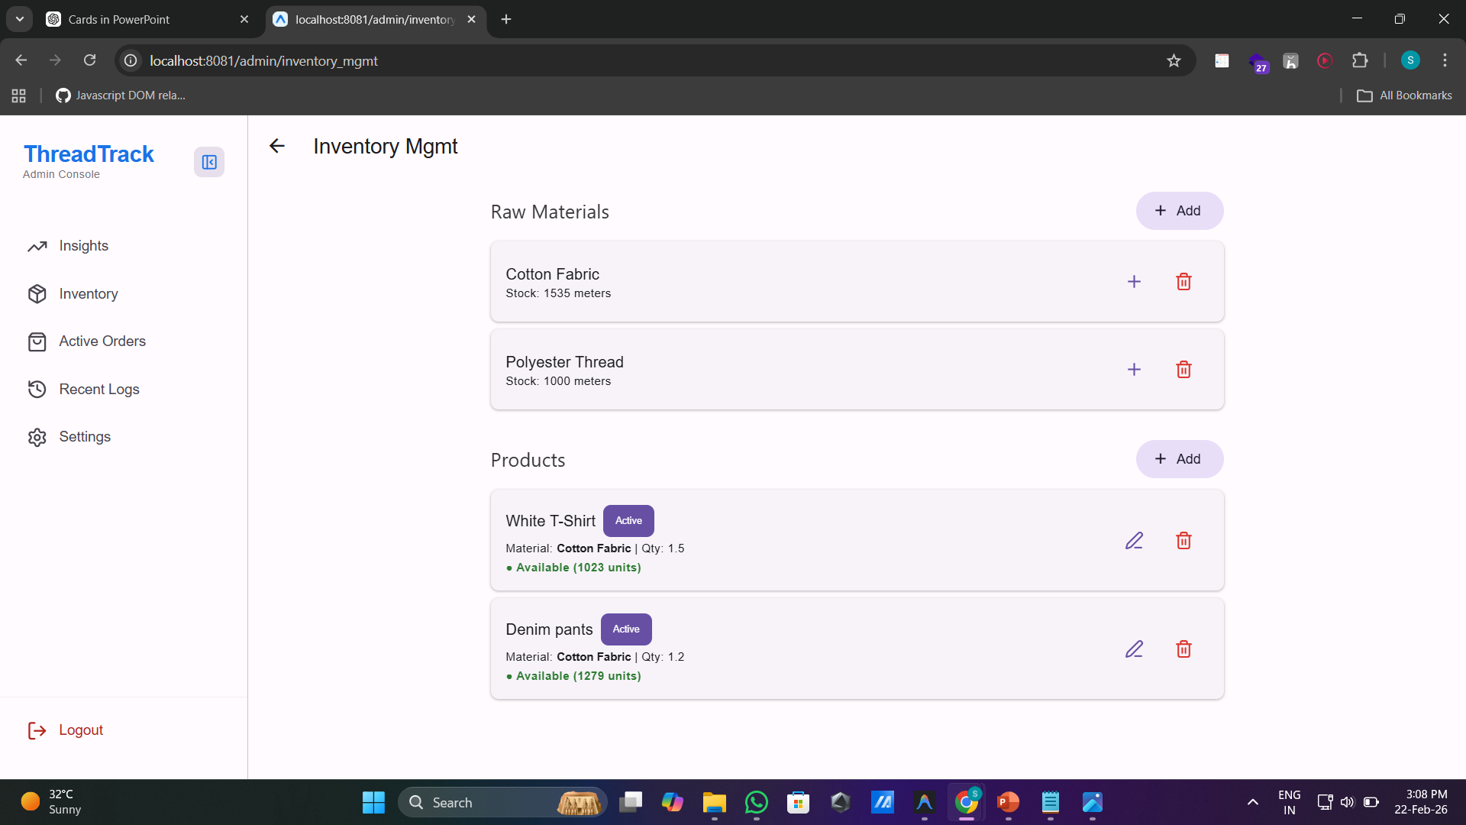
Weekly Diary – Week 4 (Jan 22-28)

Slide 15
Weekly Diary – Week 5 (Jan 29-Feb 4)
This week marked the start of the mobile development phase using React Native and Expo. I focused on building the shared UI components and setting up the global navigation hierarchy. I designed the primary dashboards for the Admin and Worker portals, emphasizing a clean and modern professional look. The priority was to create a simplified interface that floor workers could use easily, while still providing high-density data analytics for the management team.
React Native Framework & Dashboard Design:
Initialized the Expo project and configured the navigation container for all roles.
Designed high-fidelity Admin dashboards with interactive production charts.
Implemented a global styling system using the React Native Paper component library.

Slide 16
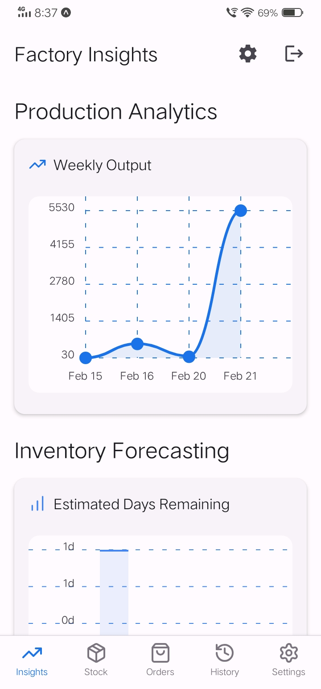
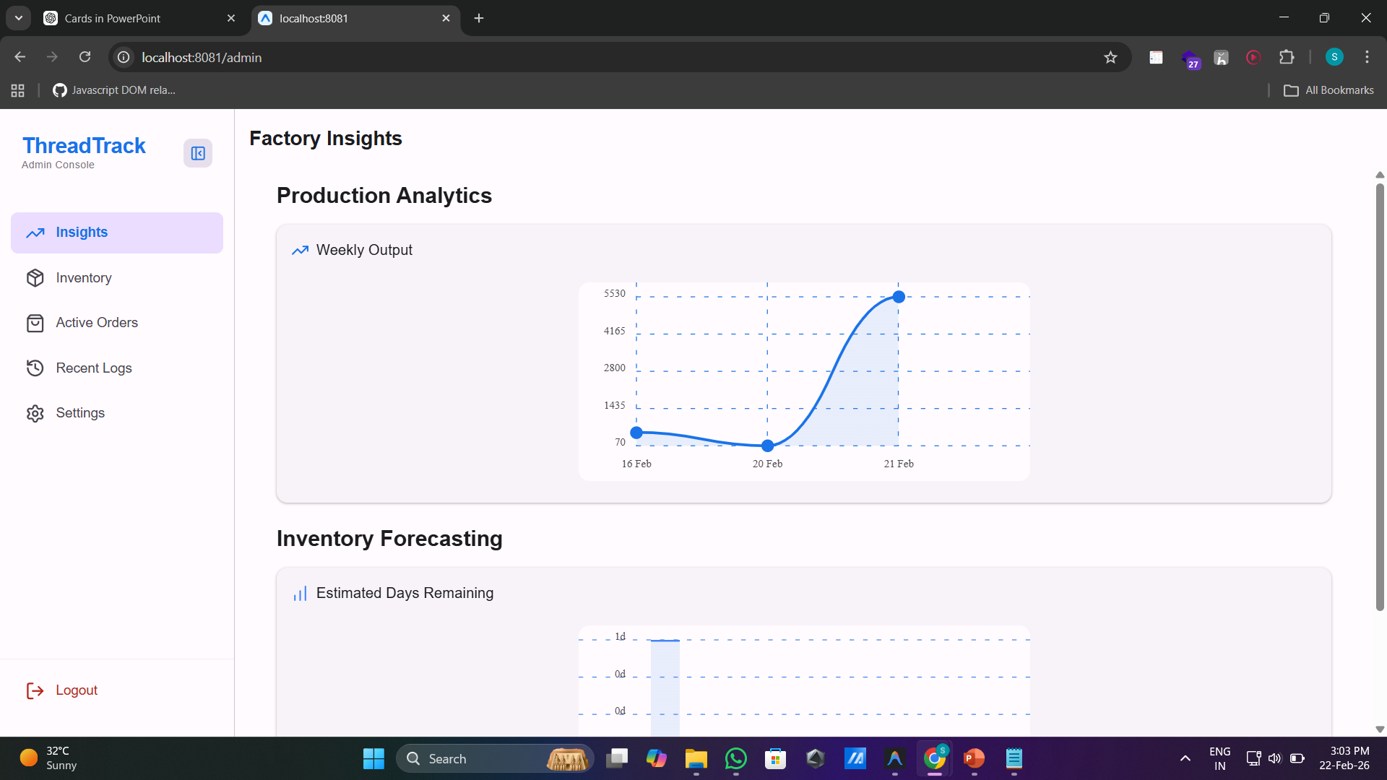
Weekly Diary – Week 5 (Jan 29-Feb 4)

Slide 17
Weekly Diary – Week 6 (Feb 5-11)
During week six, I developed the most critical part of the floor worker's interface: the production logging portal. I implemented the logic that links daily output to specific B2B orders. I also successfully integrated database triggers that automatically deduct raw materials whenever a worker submits a production log.
Operational Logic & Sync Implementation:
Developed the mobile logging form with real-time field validation for quantity entry.
Engineered the backend triggers for automated, real-time inventory adjustments.
Conducted cross-platform testing on physical Android devices to ensure connectivity.

Slide 18
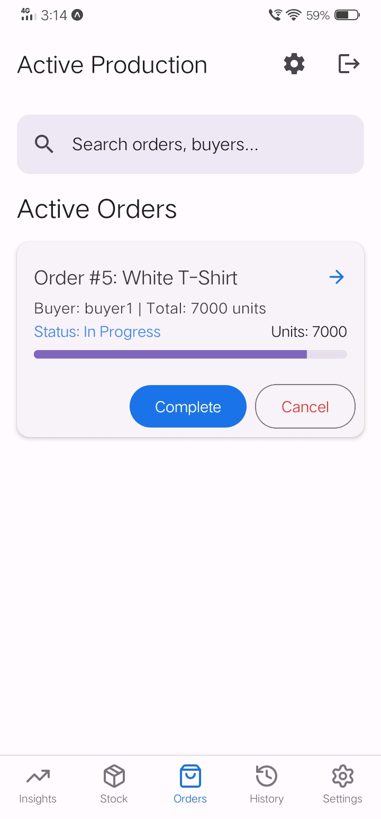
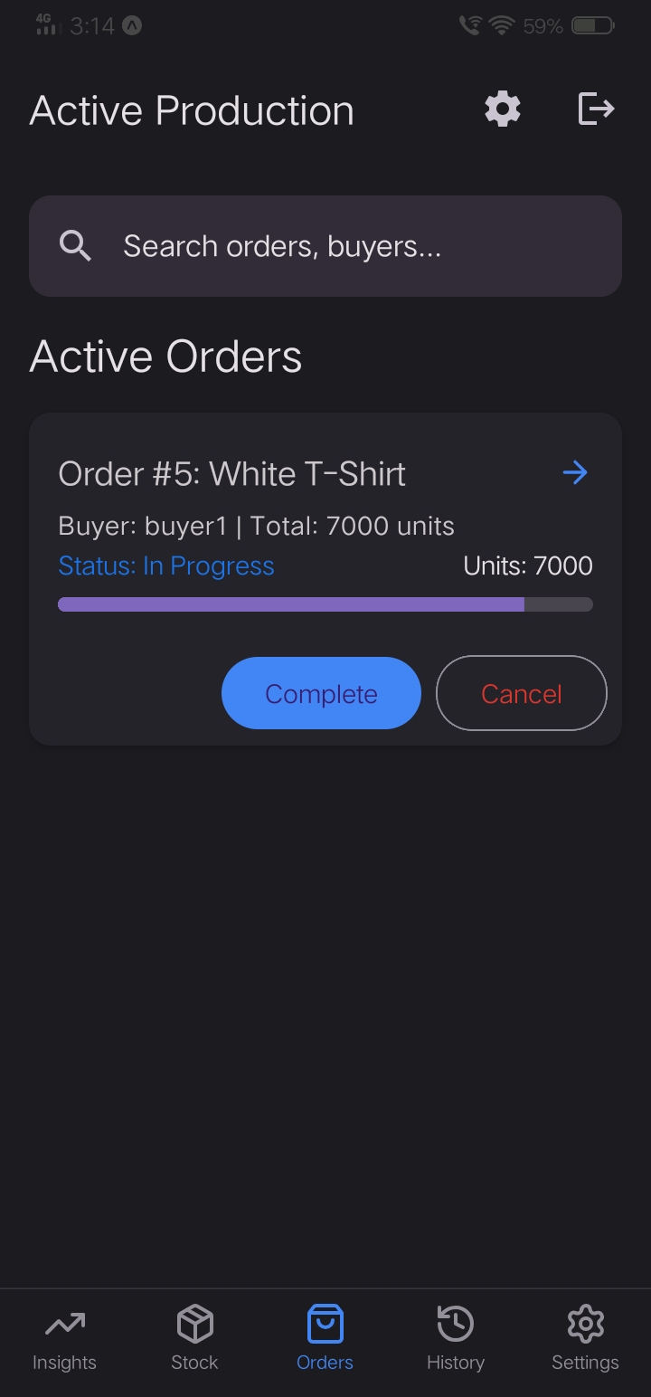
Weekly Diary – Week 6 (Feb 5-11)
Dark Theme

Slide 19
Weekly Diary – Week 7 (Feb 12-18)
This week was focused on adding intelligence to the platform through predictive analytics. I built a separate microservice using Python and FastAPI to analyze historical production trends. I developed an algorithm that calculates a 7-day moving average to forecast exactly when a specific material might run out. These predictions are then served back to the Admin portal as visual stockout alerts, allowing management to prevent material shortages before they happen.
Data Intelligence & Forecasting Service:
Developed a Python FastAPI service layer for complex stockout forecasting.
Implemented a rolling average algorithm to track daily material consumption rates.
Integrated visual 'Critical Alert' indicators (Yellow/Red) on the Admin dashboard.

Slide 20
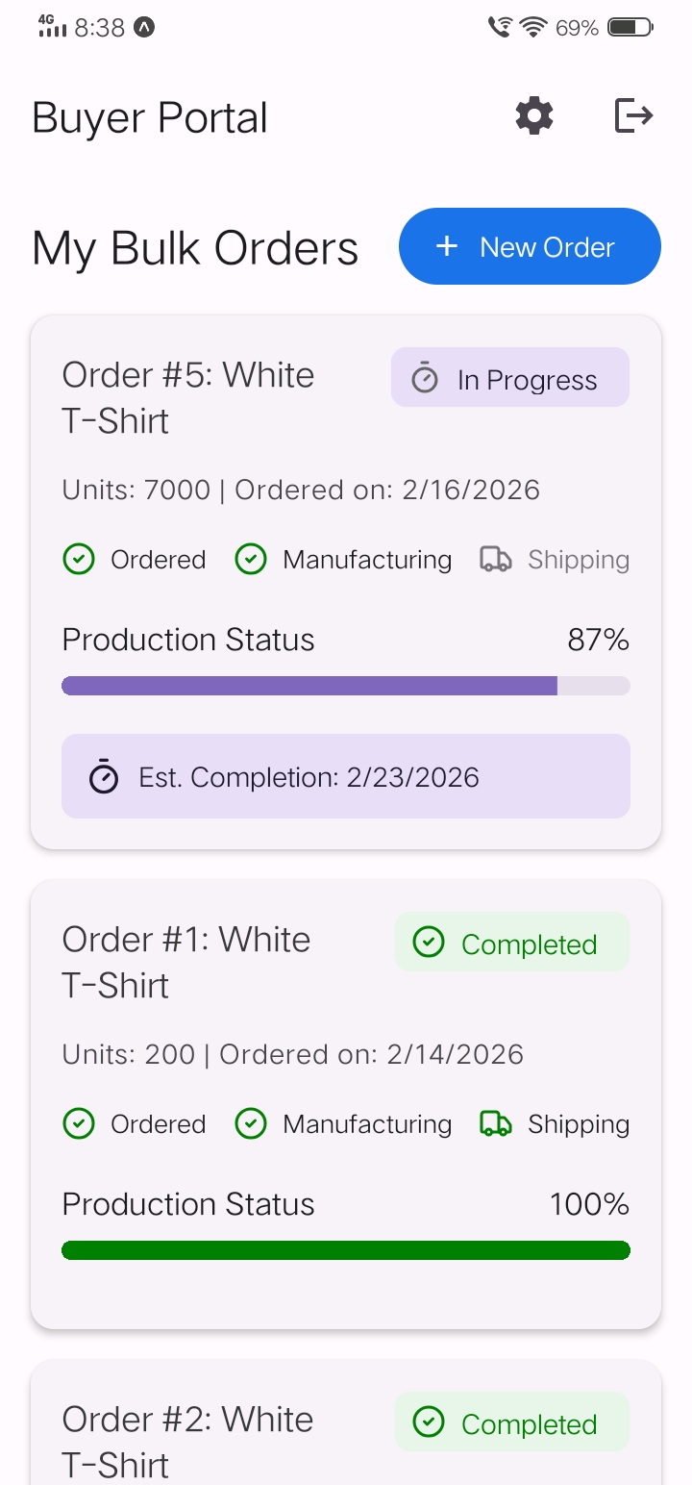
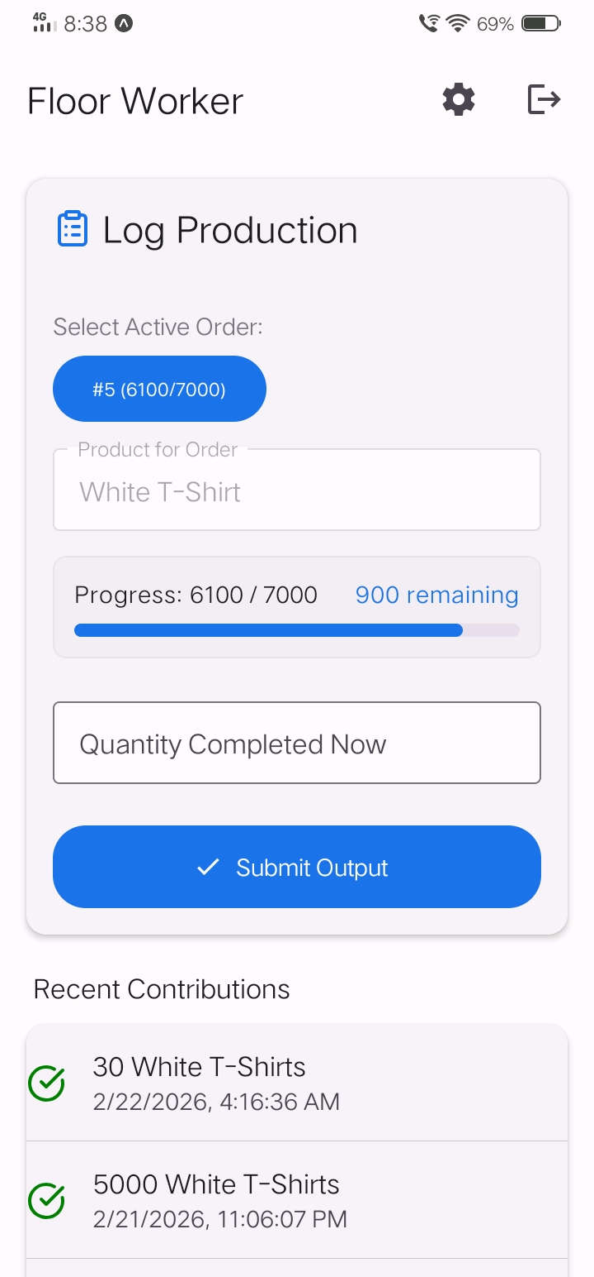
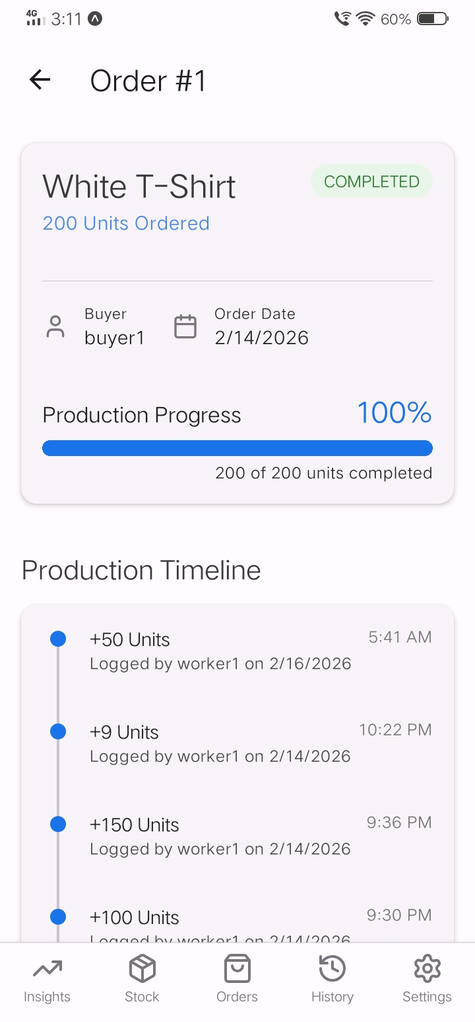
Weekly Diary – Week 7 (Feb 12-18)

Slide 21
Weekly Diary – Week 8 (Feb 19)
In the final week, I focused on final system polishing and comprehensive reporting. I integrated the buyer-side tracking features, including real-time progress bars that show buyers exactly how much of their order is completed. I also refactored the mobile codebase to improve app performance by moving high-intensity styles into external TypeScript modules. Finally, I concluded the phase by generating a detailed system inspection report and finalizing all technical documentation.
Buyer Transparency & Progress Tracking:
Designed and implemented real-time fulfillment progress indicators for B2B clients.
Performed system-wide style refactoring to enhance mobile responsiveness and speed.
Documented system architecture and prepared finalized reports for the technical review.

Slide 22
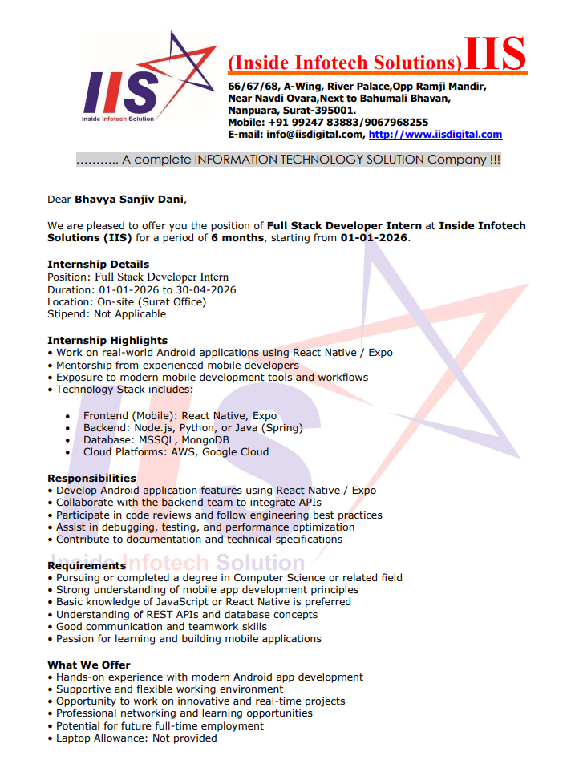
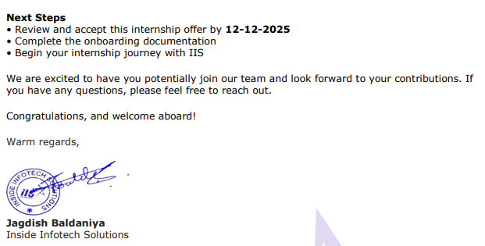
Documents

Slide 23
Thank You

