Slide 1

Analysis of Best Fictional Books
Batch No. : 202

Slide 2
Objective Of The Project :
To know the name of the book of the series which is mostly preferred by the nominees, on the basis of votes, score, ratings.

Slide 3
PROCESS FOLLOWED :
1. Importing Libraries
2. Data Collection
3. Web Scrapping
4. Data cleaning
5. Data Analysis
6. Univariate Analysis
7. Bivariate Analysis
8. Multivariate Analysis
9. Observation

Slide 4
LIBRARIES USED :
1. Data Collection:
Requests , Beautifulsoup , Pandas, Numpy , RE
2. Data Cleaning:
Pandas , RE(Regular Expressions)
3. Data Visualization:
Seaborn , matplotlib

Slide 5
DATA COLLECTION:
Website:
goodreads.com
Website link:
https://www.goodreads.com/list/show/1381.Best_Series

Slide 6
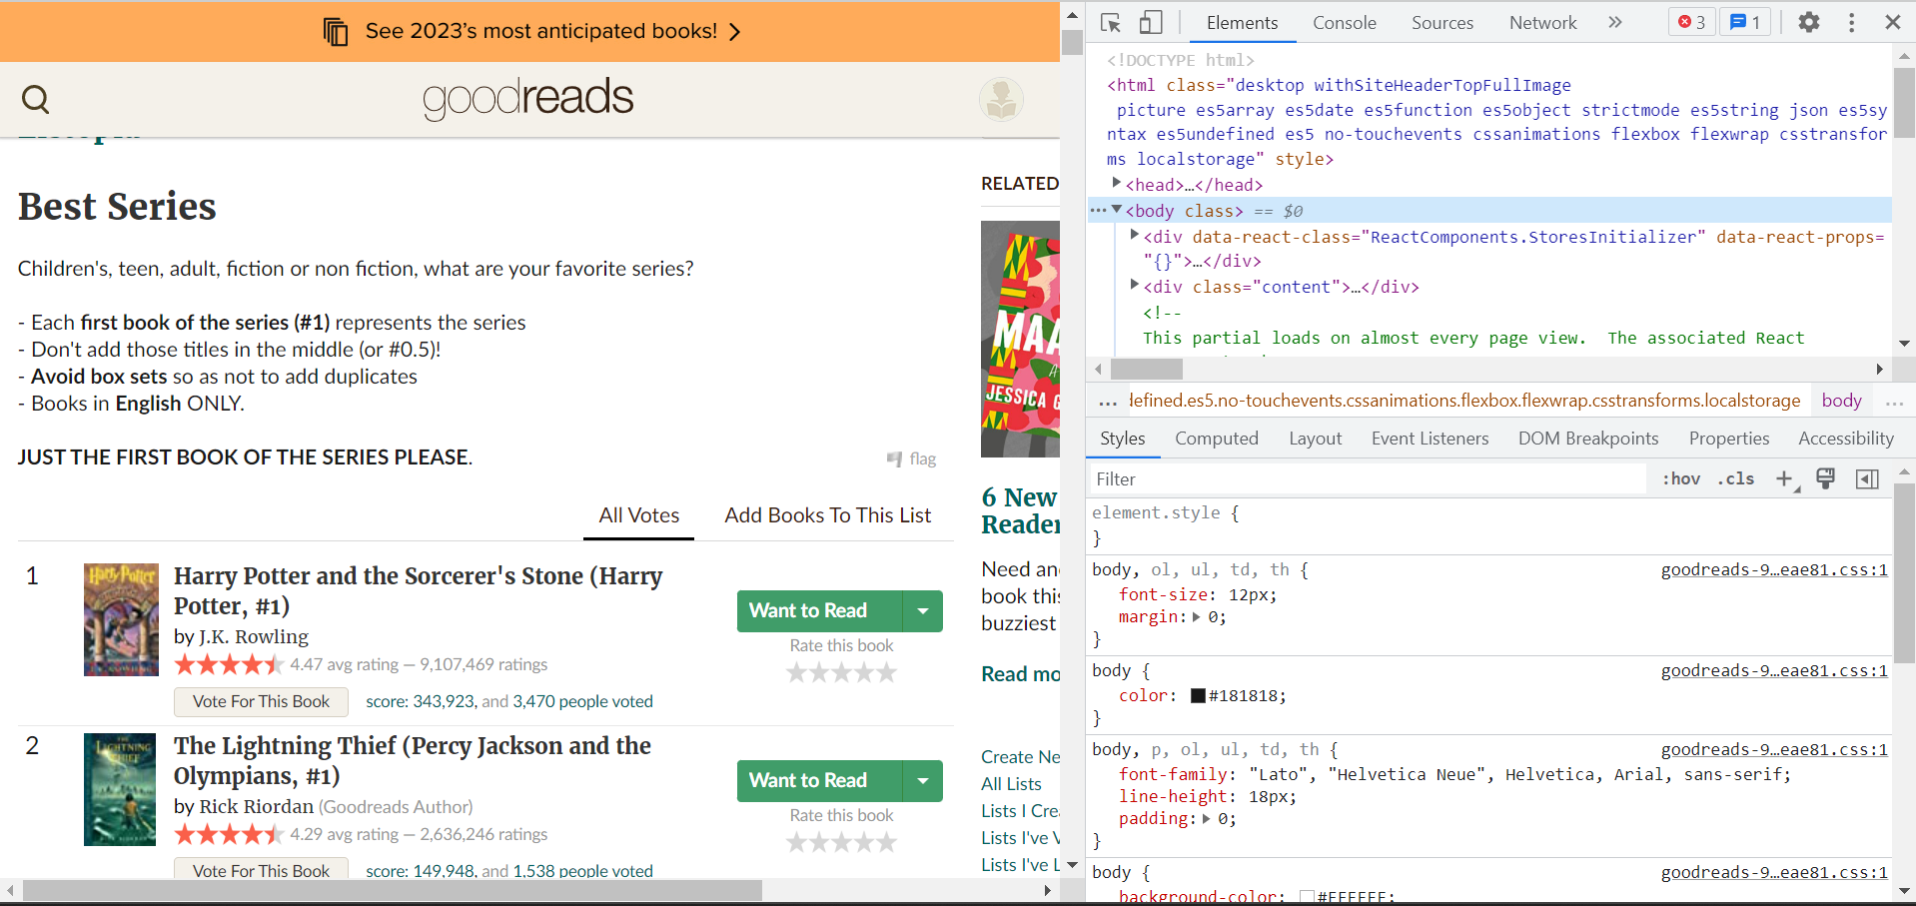
Website view :

Slide 7
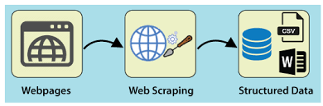
WEB SCRAPING:
Web scraping refers to the extraction of data from a website. This information is collected and then exported into a format that is more useful for the user. Be it a spreadsheet or an API.

Slide 8
Data collection process:
First step was to extract links from each page of website using request.get() and BeautifulSoup.
Inspect the class name by websites page and by using soup.find_all() extract the features.
Store the extracted features in empty lists by using if condition.
Check if the above lists are of the same length so as to form a DataFrame.
The DataFrame formed is of 500 rows and 5 columns.
Finally we store the above DataFrame to csv and Excel files.

Slide 9
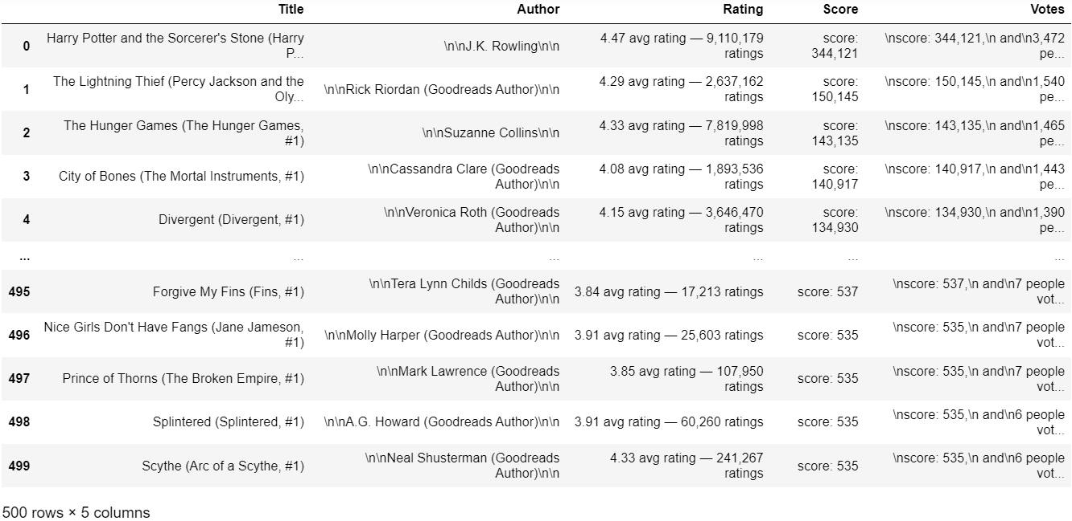
Data Collected:

Slide 10
Data Cleaning:
Identifying the Null and missing values.
Using split() and Regex on Rating column to create two new columns Ratings and Reviews.
Dropping Rating column.
Applying Regex and split() on Author , Score and Votes columns.
Adding Overview column.
Extracting the required data from the Title column using Regex to create new columns.(Hashtag , Denotes, Series)
Converting the required columns which are of object type into int and float.

Slide 11
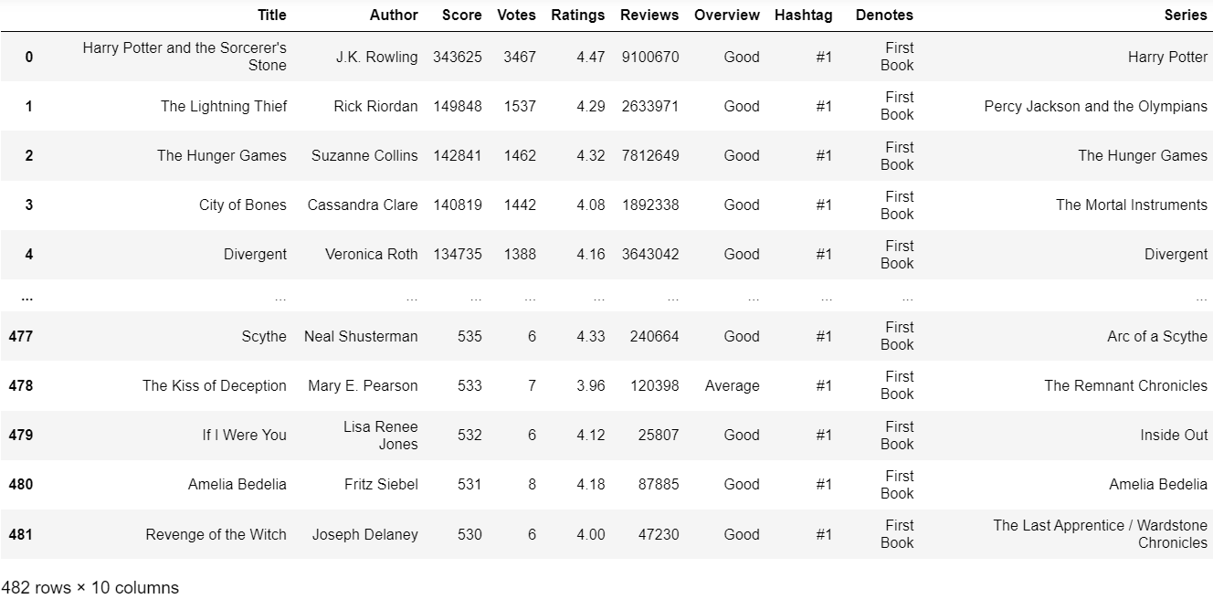
Cleaned Data Frame:

Slide 12
Data Visualization:
Univariate Analysis
Bivariate Analysis
Multivariate Analysis

Slide 13
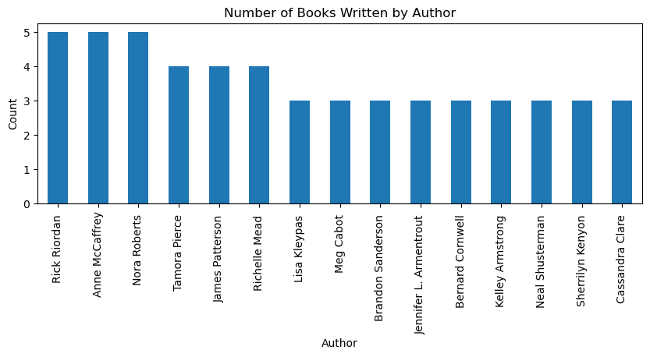
To know which Author has written highest number of Books.
Observation:
From the above plot we can see that there are three Authors who wrote five Books, which means the three Authors are repeated for five times in the Data Frame.

Slide 14
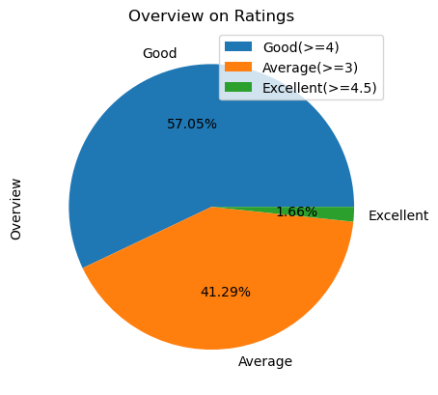
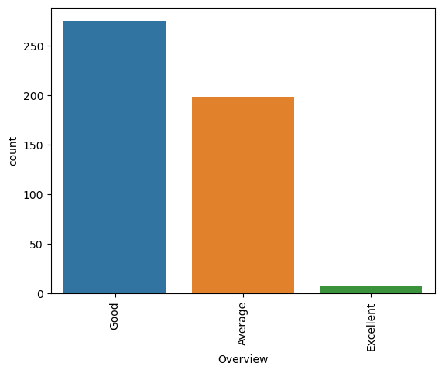
To know the percentage and count of Individual Overview.
Observation:
From the above plots we can observe that maximum number of Books are rated between 4 - 4.5 has Good Overview and are above 250.

Slide 15
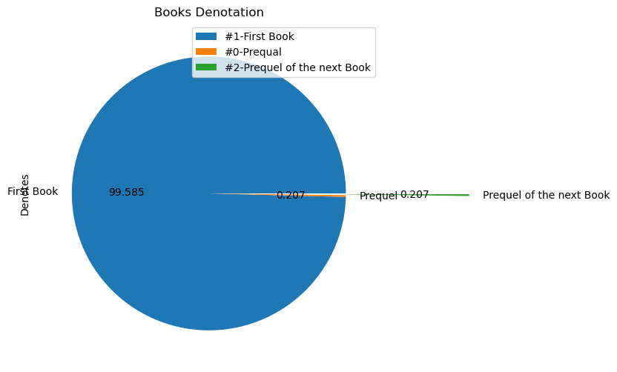
Relation between Hashtag and Denotes columns
Observation:
We can see many Books are printed with a Hashtag, which has a specific meaning. In the Data Frame we can see three types of Hashtags.
From the pie plot we can observe most of the books are First Book of the series, so as it is given #1.
We have 1 Prequel Book which narrates the past story of the series, so as it is given #0.
There is 1 Prequel of the next Book(second book) of the series, so as it is given #2

Slide 16
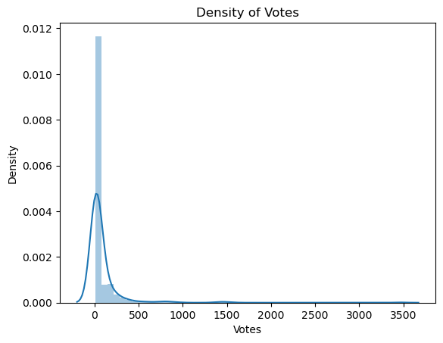
To know the density of Votes
Observation:
From the dist plot we can observe that most of the books got Votes between 0 and 500 and very few books got votes above 1000.

Slide 17
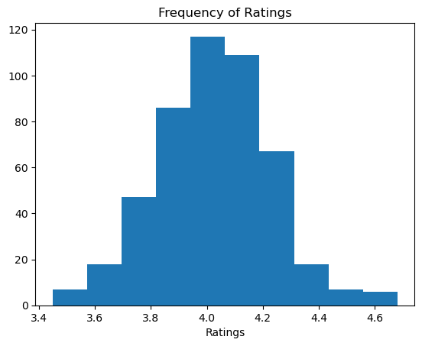
To know the Frequency of Ratings
Observation:
From the hist plot we can observe the frequency of Ratings. We can see 4.1 has highest frequency of Ratings.

Slide 18
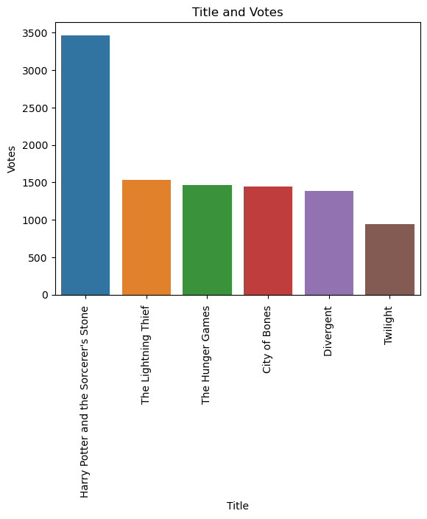
Bivariate Analysis:
To know the Title of the Books, that got Votes above 1000
Observation:
There are five books that got Votes above 1000
From the bar plot we can observe that the Book Harry Potter and the Sorcerer’s Stone got the highest number of Votes which are above 3000.

Slide 19
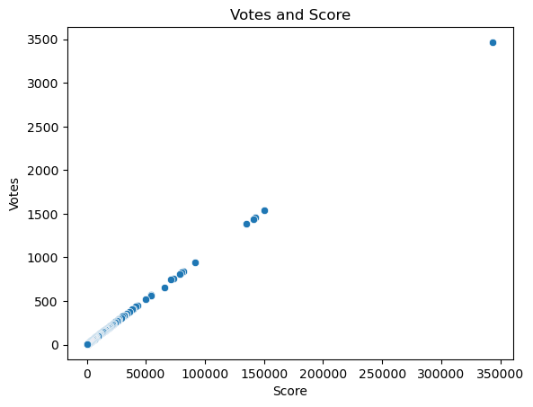
To know the relation between Votes and Score
Observation:
We can observe Score and Votes have positive correlation which is nearly equal to 1.
Votes and Score depend on each other.

Slide 20
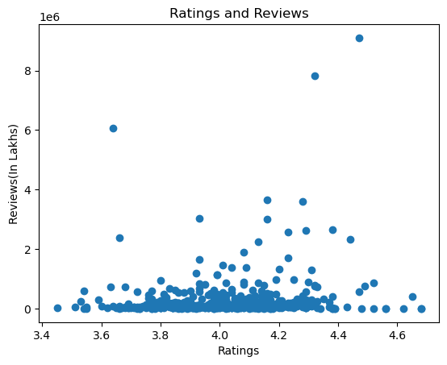
To know the relation between Reviews and Ratings
Observation:
From the Scattered plot we can observe Ratings and reviews are not correlated.
They don’t depend on each other.

Slide 21
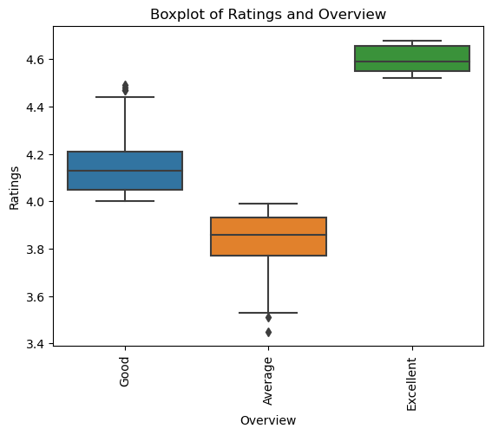
Ratings and Overviews
Observation:
From the Box plot we can observe that only Good and Average Overviewed Books has outlayers.

Slide 22
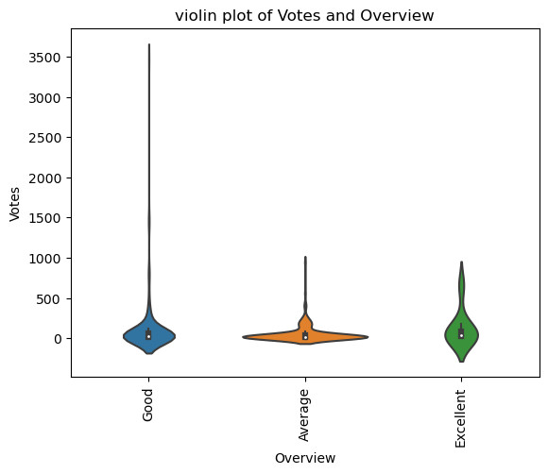
Votes and Overviews
Observation:
From the violin plot we can observe Average Overviewed books have high density.

Slide 23
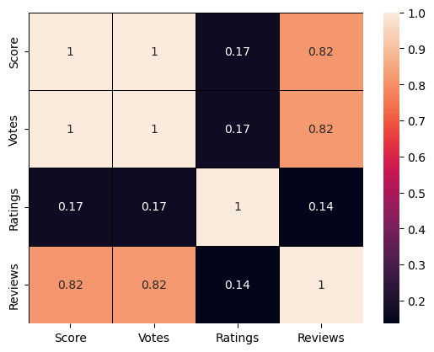
Multivariate Analysis
Heatmap
Observation:
From the heatmap plot we can observe that all numerical values are positively correlated
Score and Votes are highly correlated which means as Votes increases Score increases.
Ratings and Reviews are less correlated which is nearly equal to zero

Slide 24
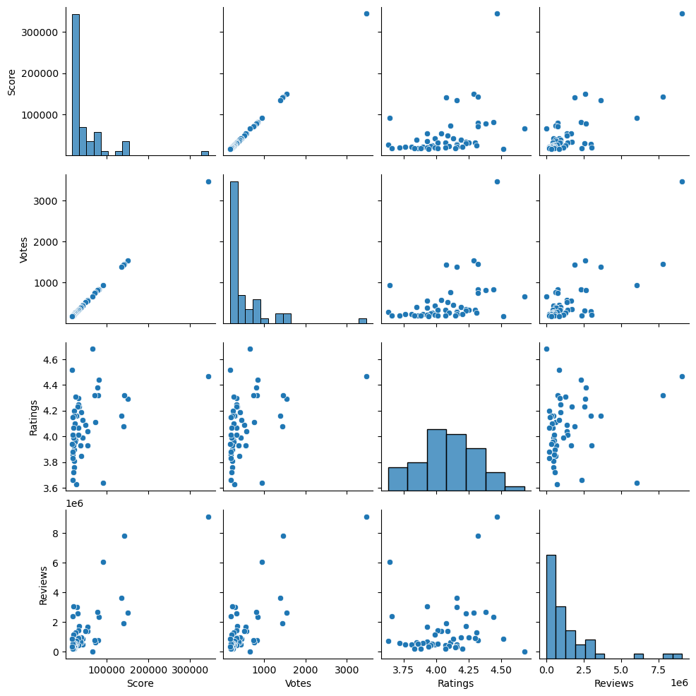
Pair plot
Observation:
From the pair plot we can observe the both distribution of single variable and relation between two variable

Slide 25
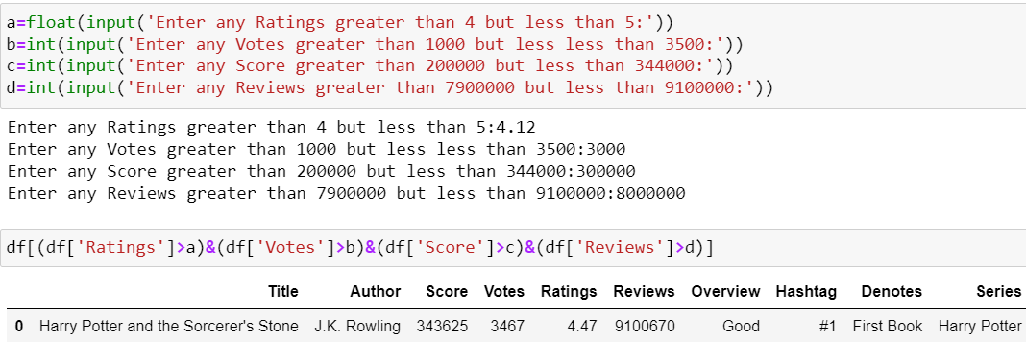
Scenario:

Slide 26
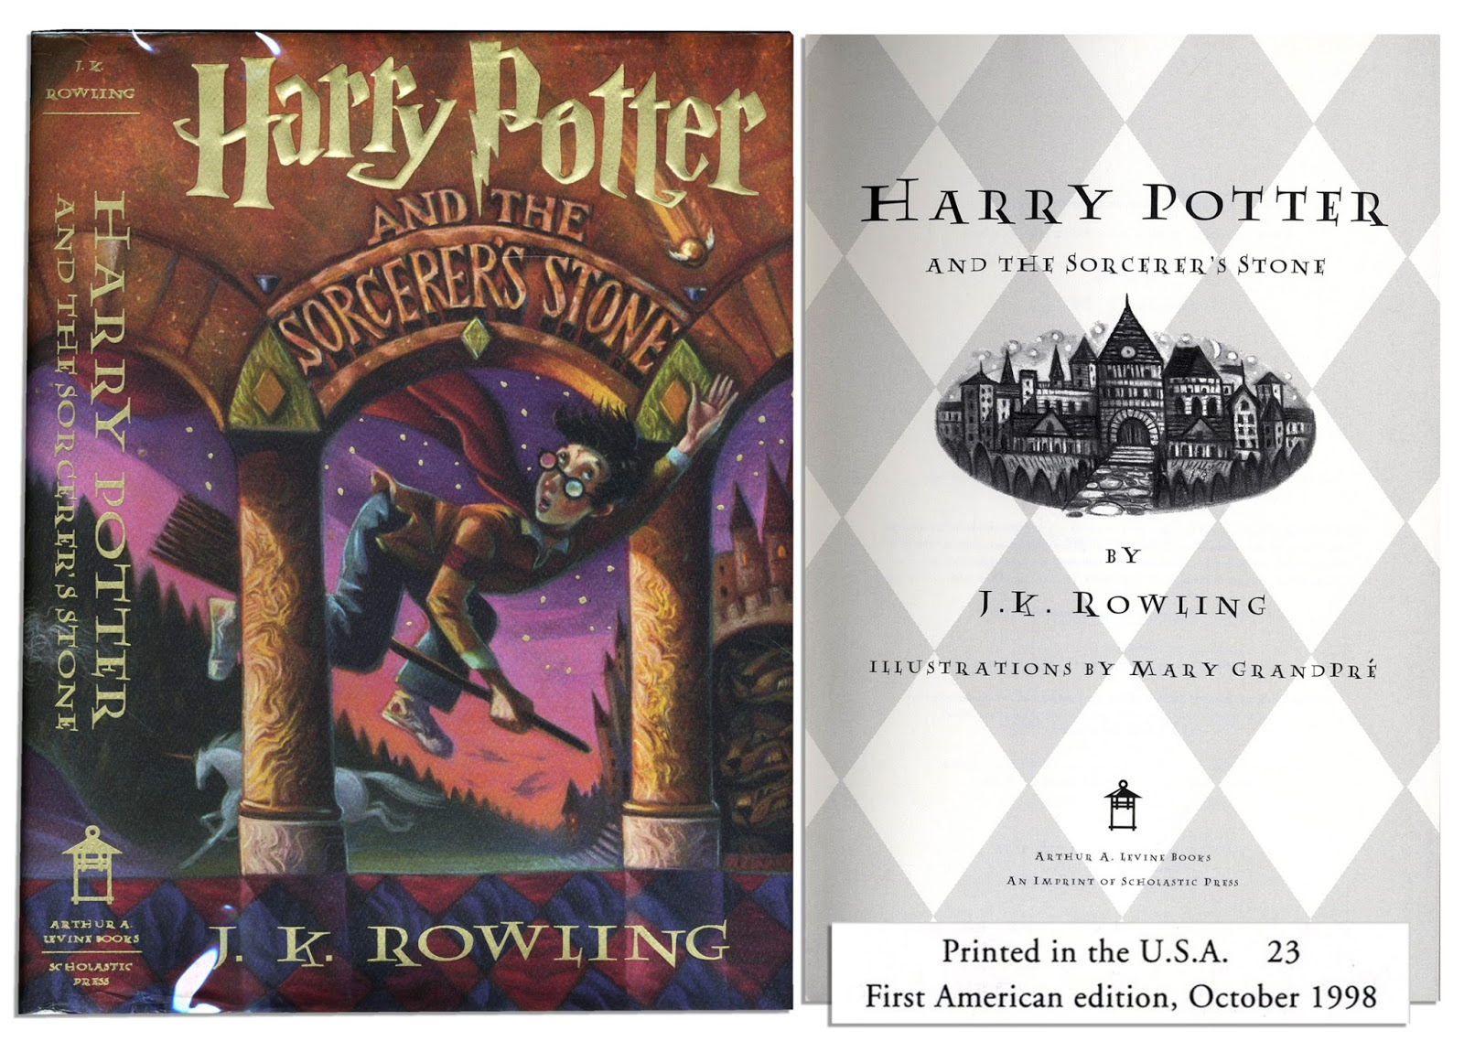
Conclusion:
From the above Scenario we can say that Harry Potter and the Sorcerer’s Stone the First book of Harry Potter Series, is mostly read and highly recommended by the nominees.
This Photo by Unknown Author is licensed under CC BY-NC-ND

Slide 27
Question and Answers

Slide 28

THANK YOU

