Slide 1

Web Scarpping Project

Slide 2
INTRODUCTION
Web Scraping is the process of extracting structured information from websites automatically.
In this project, we scraped NBA player data from Basketball Reference.
The collected dataset includes details like Player Name, College, Birth Date, Height, Weight, Position, and Career Span.
After scraping, we perform Exploratory Data Analysis (EDA) to better understand the dataset and derive meaningful insights.

Slide 3
Objectives
Collect Data:
- Use web scraping to gather NBA player information directly from the website.
2. Clean & Transform Data:
- Convert raw strings into meaningful numerical values.
3. Perform EDA:
Analyze player demographics (age, height, weight)
Study career spans across players.
Identify trends across positions and colleges.
4. Generate Insights:
- Use analysis and visualizations to understand patterns and present findings.

Slide 4
Data Source
Basketball Reference (NBA player stats website).
Tools & Libraries
requests → to fetch web pages.
BeautifulSoup → to parse and extract HTML data.
pandas → to structure, clean, and analyze data.
matplotlib & seaborn → to visualize distributions, boxplots, scatterplots, and heatmaps.

Slide 5
Data Cleaning and Preparation
Converted height strings (e.g., "6-7") into total inches.
Converted weight and career years into integers.
Calculated Career Length = To Year – From Year.
Extracted Birth Year from Birth Date.
Checked for missing values and duplicates.
Final dataset stored in a pandas DataFrame for analysis.

Slide 6
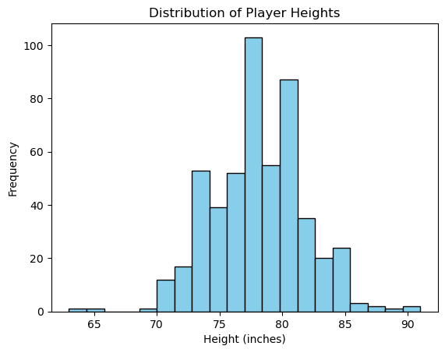
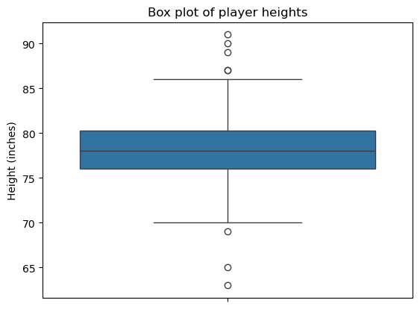
Univariate Analysis
Examines one variable at a time.
1. Numerical Data:
Height: Histogram & Boxplot.
Weight: Histogram & Boxplot.
Career Length: Histogram.
2. Categorical Data:
Position: Value counts.
Colleges: Top colleges by players.
Purpose: Understand distributions, detect outliers, and spot trends.

Slide 7
Bivariate & Multivariate Analysis
Examines relationships between two or more variables.
1. Scatter Plot:
Height vs Weight (colored by Position).
2. Boxplots by Position:
Height by Position.
Weight by Position.
3. Correlation Heatmap:
Relationship between Height, Weight, Career Length.
4. Grouped Analysis:
Average Height, Weight, Career Length by Position.
College vs From Year (player recruitment).

Slide 8
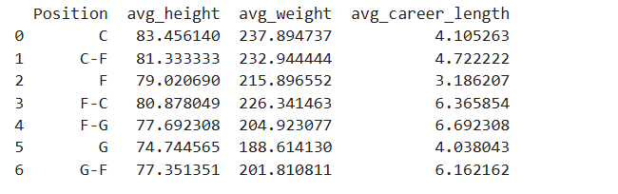
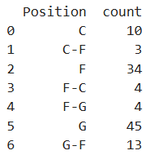
Avg Statistics(Height,Weight,CareerLength) of Players by Positions
Players born after 1990 grouped by positions

Slide 9
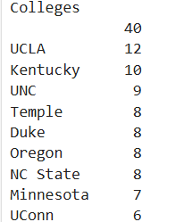
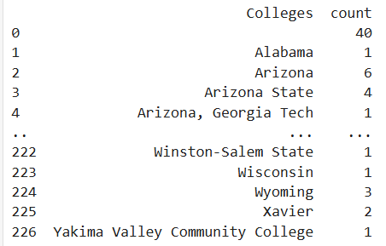
Top colleges by number of players recruited
Group by colleges and positions

Slide 10
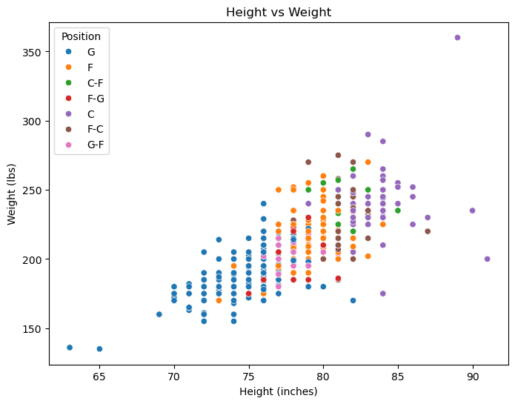
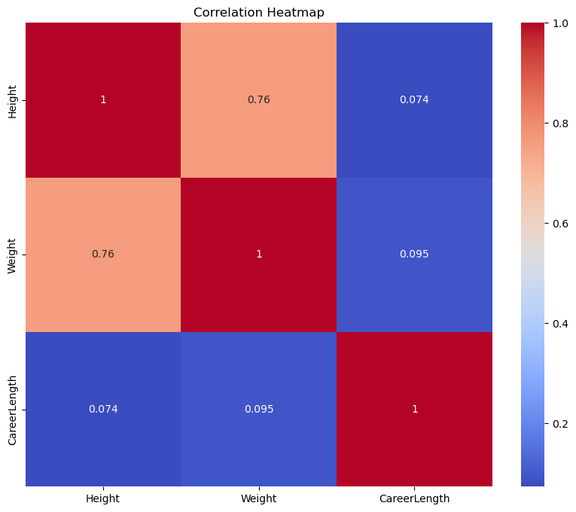

Slide 11
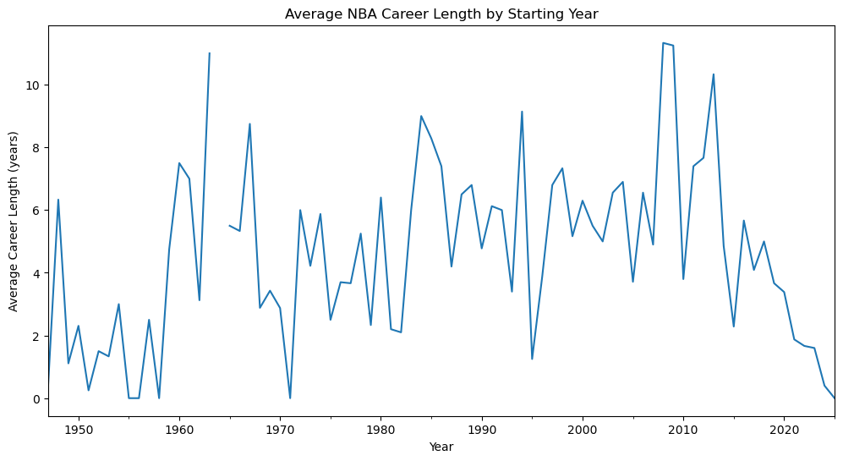

Slide 12
Key Insights from EDA
Height & Weight are strongly correlated.
Centers (C) tend to be the tallest and heaviest players.
Guards (G) are generally shorter and lighter.
Most careers last less than 10 years, but some exceed 15+ years.
Certain colleges dominate NBA recruitment (e.g., Duke, Kentucky).
Player recruitment varies significantly by year.

Slide 13

THANK YOU

