Slide 1
EdgeFogSim
Where should a task run: Edge, Fog or Cloud? A rule-based placement simulator with VMs, tenant security and QoS results.
ARM 305 – Cloud, Dev, Edge and Fog Computing · Mini Project
Moksh 06719051624 · Bhavya Bisht 05019051624 · Dhruv Sharma 05719051624 · Bhuwan Chugh 04219051624
Notes:
Introduce the problem: urgent jobs need nearby, small edge nodes; heavy jobs can wait for the big, distant cloud. EdgeFogSim simulates choosing where each task runs and measures the result.

Slide 2
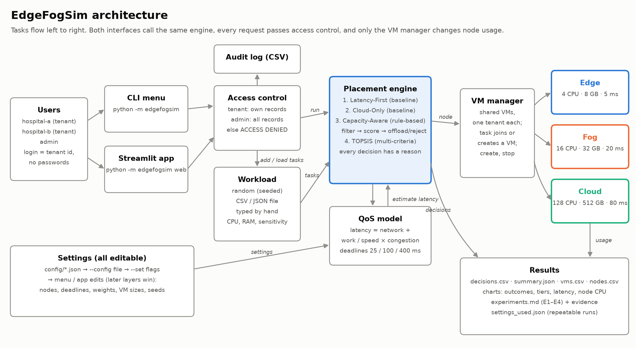
Every task passes access control, a policy and a shared VM
Notes:
Walk left to right: tenants log in through the CLI menu or the Streamlit app; access control refuses other tenants' records; the placement engine picks a node using the QoS model; the VM manager runs the task inside one of that tenant's VMs; results are exported as CSV, JSON and charts.

Slide 3
Capacity-Aware: filter, score, then offload or reject
1
Prefer tiers by urgency
Latency model
high → Edge, medium → Fog, low → Cloud
network + (work ÷ speed) × congestion
congestion = 1 ÷ (1 − CPU load)
2
Filter out nodes
Deadlines: high 25 ms · medium 100 ms · low 400 ms
no room for the task's VM, CPU load over 85%, or the deadline would be missed
Task | Sensitivity | Result
T01 | high | edge-1, 18 ms
T02 | high | fog-1 (offload), 25 ms
T03 | low | cloud-1, 101 ms
T04 | high | rejected
3
Score the rest
0.5 × tier preference + 0.3 × time to spare + 0.2 × free CPU
4
Place or reject
best score wins (offload if not first tier); if none fits, reject with the reason
Sample tasks T01–T04 on empty nodes.
Notes:
Capacity-Aware is the rule-based algorithm the brief asks for. Explain the four steps, then the worked example: T01 fits on Edge; T02 is offloaded to Fog because Edge would be full; T03 goes to Cloud; T04 is too big for Edge and Fog and Cloud is too far for a high-urgency deadline.

Slide 4
Smart policies run 0 late; baselines run 10 and 12 of 20 late
0
late with Capacity-Aware
10
late with Latency-First
20 generated tasks, seed 42 (11 high, 5 medium, 4 low sensitivity).
Notes:
E1: 20 generated tasks, seed 42 (11 high, 5 medium, 4 low sensitivity). Each policy starts from empty nodes. Capacity-Aware and TOPSIS check the deadline before placing, so they reject what they cannot finish in time instead of running it late.

Slide 5
Overload is offloaded or rejected; other tenants are refused
E2 · Overload
E3 · Unauthorised access
Workload: 10 generated tasks, seed 7 (10 high sensitivity). Before the burst: edge-1 already 90% busy
Logged in as hospital-b, trying another tenant's records:
DENIED
read task T01
4
6
0
DENIED
read VM vm-0001
offloaded to Fog
rejected, with a reason
late
DENIED
stop VM vm-0001
Latency-First, same burst: 1 on time, 9 late.
Each refusal is one line in the audit log; the VM keeps running; the admin can read both records (4/4 checks).
No node is ever allocated beyond its capacity.
Notes:
E2 shows the brief's overload scenario: tasks that don't fit are moved to another suitable node or rejected with a reason. E3 shows the unauthorised access attempt: ACCESS DENIED for every attempt, recorded in a CSV audit log.

Slide 6
More Edge CPU helps; a slower Cloud pushes medium tasks out
edge-1 cpu_cores 4 → 8
cloud-1 base_latency_ms 80 → 150
Metric | Before | After
on time | 11 | 12
rejected | 9 | 8
avg latency ms | 70.9 | 65.3
tasks on edge | 1 | 2
tasks on cloud | 6 | 6
Metric | Before | After
on time | 11 | 9
rejected | 9 | 11
avg latency ms | 70.9 | 96.6
tasks on edge | 1 | 1
tasks on cloud | 6 | 4
✓ edge-1 takes at least as many tasks (1 → 2)
✓ At least as many tasks on time (11 → 12)
✓ No more tasks rejected (9 → 8)
✓ Tasks on cloud-1 are slower on average (104 → 179 ms)
✓ Low-sensitivity tasks all still finish on time (4 / 4)
✓ No task runs late (late 0 → 0)
Notes:
E4 changes one node at a time and re-runs the same 20 tasks. Doubling Edge CPU lets Edge take more urgent tasks. Raising Cloud latency from 80 to 150 ms makes Cloud too slow for medium tasks' 100 ms deadline, while low-sensitivity tasks still finish on time.

Slide 7
What we learned
Limitations
All 4 experiments matched their expected outcome (19/19 checks)
Checking the deadline before placing beats placing on the nearest node
Shared tenant VMs and one access rule keep tenants apart
Every number is a setting; runs are repeatable from settings_used.json
No task duration or arrival time; tasks run until their VM stops
Latency is a formula, not a measurement
Greedy, one task at a time; GA/PSO or Q-learning could do better
No VM migration; login is a tenant id by design
Try it: python -m edgefogsim · python -m edgefogsim web · python run_experiments.py
Notes:
Close with the takeaways, then the limitations; offer a live demo of the menu or the Streamlit app.

