Slide 1
Digital Prescription
Record Analysis
Project P1 |Presented By B.Bhavya
Notes:
Introduce yourself and the project. This is a data engineering project focused on managing and analyzing healthcare prescriptions. Tools used are Python, MySQL, Pandas, Matplotlib, and Seaborn.

Slide 2
Problem & Objective
❌ The Problem
✅ Our Objective
Paper-based prescriptions cause errors
No central tracking of prescriptions
Data scattered across departments
No trend analysis or quality monitoring
Drug inventory not monitored in real time
Digitize prescription management
Automate ingestion and cleaning of data
Store clean data in MySQL database
Analyze trends using SQL queries
Build a CLI tool for instant insights
Notes:
Explain the real-world problem first. Hospitals use paper prescriptions — this causes errors, duplication, and no way to track trends. Our project solves this by building a Python-based tool that automates everything from loading data to showing insights.

Slide 3
Project Scope & Outcome
Outcome: A robust Python-based CLI tool that automates ingestion, cleaning and storage of healthcare data,
enabling users to run predefined analytical queries and get insights directly from the terminal.
ETL Pipeline
SQL Analytics
CLI Tool
Load 10 CSV files
Apply 6 business rules
Clean & validate data
Store in MySQL
10 predefined queries
Top medicines & diseases
Doctor outlier detection
Inventory alerts
Interactive menu
11 analytics options
Instant terminal output
No re-querying DB
Notes:
The project has three main parts: ETL Pipeline for data cleaning, SQL Analytics for insights, and a CLI Tool as the final deliverable. Explain each briefly.

Slide 4
How the Pipeline Works
CSV Files
(Raw Data)
ETL +
Business Rules
MySQL
Database
SQL
Queries
CLI
Insights
6 Business Rules Applied:
1. Remove duplicates from all tables
4. Missing dosage/frequency → 'Not Provided'
2. Age must be between 0 and 100
5. Prescriptions with invalid FK removed
3. Unknown gender → filled as 'U'
Notes:
Walk through the pipeline step by step. CSV files are loaded with Pandas, cleaned using 6 business rules, then pushed into MySQL using SQLAlchemy. SQL queries are run and results are shown in the CLI.

Slide 5
Tools & Technologies
Python
MySQL
Pandas
Core programming language. Used for ETL, data cleaning, and running the CLI tool.
Database to store all cleaned tables. SQLAlchemy used to push DataFrames from Python.
Data manipulation library. Used for loading CSVs, cleaning data, and applying business rules.
Matplotlib
& Seaborn
Jupyter
Notebook
Visualization libraries. Used to draw bar charts, pie charts, line graphs, and heatmaps.
Used to run the ETL pipeline, SQL queries, and visualizations in an organized manner.
Notes:
Talk about each tool briefly. Python is the main language, MySQL stores the data, Pandas handles data cleaning, Matplotlib and Seaborn create the charts, and Jupyter Notebook is used for the analysis workflow.

Slide 6
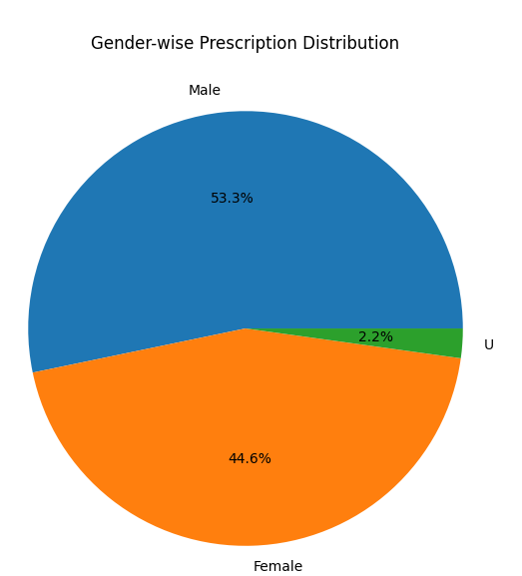
Data Insights & Visualizations
10 charts generated from MySQL queries using Matplotlib and Seaborn
Notes:
Explain that all charts are built using Matplotlib and Seaborn from the SQL query results. The top chart shows the most prescribed medicines. The pie chart shows the gender split of patients. You have 10 charts total in your notebook.

Slide 7
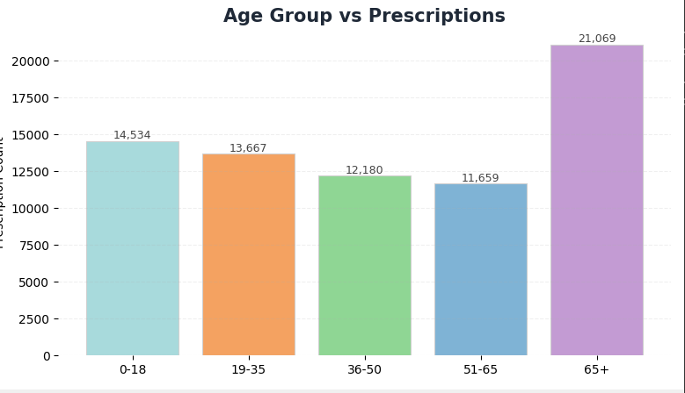
More Visualizations
All 10 Analytical Insights:
1. Top 10 Most Prescribed Medicines
6. Doctor-wise Volume + Outlier Detection
2. Gender-wise Prescription Distribution
7. Top 10 Diseases by Admission
3. Age Group vs Prescriptions
8. Drug Category Breakdown
4. Department-wise Prescription Volume
9. Low Drug Inventory Alert
5. Monthly Prescription Trend
Notes:
Show the monthly trend chart. Explain the red dotted line is a 3-month moving average that smooths out spikes. The age group chart shows which age group has the most prescriptions. The full list of 10 insights is shown at the bottom.

Slide 8
THANK YOU

