Slide 1
Predicting Survival chances for stroke patients 80 years and above
By: Bhavya Balasubramanya
May 2019

Slide 2
For complete project please visit my repository

Slide 3
Outline
Introduction
Data Cleaning
Exploratory Data Analysis
Unsupervised Modelling
Supervised modelling for patients 80 years and above
Best model for patients 80 years and above
Conclusions
Next Steps
Credits
Thank You
Understanding the Dataset

Slide 4
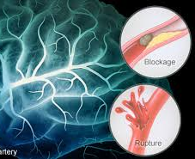
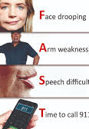

Introduction
According to WHO, 15 million people suffer from stroke every year. Of these 5 million die and other 5 million are permanently disabled. In, U.S., stroke is the 3rd leading cause of death. More than 140,000 people die due to stroke and it is also a leading cause of serious and long-disability in US. On an average someone in US has a stroke every 40 seconds. Risk of having stroke more than doubles each decade after age of 55. It can occur at any age and nearly 1/4th occur in people under age of 65. Risk factors increase with preconditions like diabetes, high blood pressure, high cholesterol, Atrial fibrillation. However, out of these, high blood pressure is the most common factor for stroke. In developed countries, incidence of stroke is declining, largely due to efforts to lower blood pressure and reduced smoking. However, overall rate of stroke remains high due to aging of the population.

Slide 5
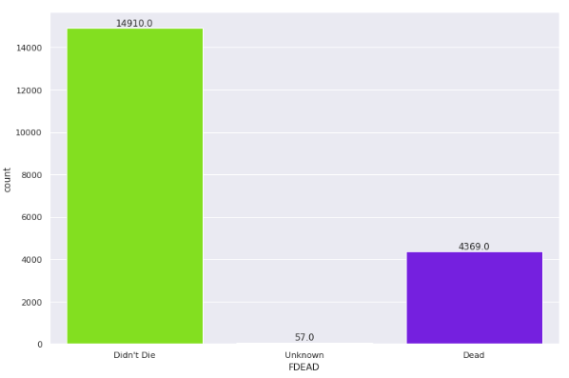
Understanding the dataset
This dataset has been taken from the International Stroke trial database (version 2) which was one of the biggest randomized trials in actual stroke.
The data was collected worldwide in 43 different countries.
There were a total of 19,432 records and 112 attributes.
The data was recorded from 1991 to 1996.
Data from 1991 to 1993 was considered pilot phase. We haven’t considered this phase in our capstone since there was lot of missing data during this period. So for future reference our data is only from the period March 1993 – April 1996
Target variable chosen for modelling purposes is ‘FDEAD’ which indicates if the person is alive or not at sixth month follow up
The initial distribution of target variable is as shown in Fig A.
Though there appears to be a bias in data, we will be using this data by removing just the unknowns and not really balancing the data as our predictions actually compares survival rate of patients aged 80 and above to those below.

Slide 6
Data Cleaning
10
19
53
1
Remove Unwanted columns
Remove columns and rows that don’t have much data
Convert categorical data to indicator variables
Replace unreadable data to readable data
There were a lot of columns in our data which was not necessary. Since this data was collected worldwide, the dates didn’t make sense as it was not uniform and didn’t tell anything important
There were some columns for comments which didn’t have significant data to use imputation, so they were removed. Also most of the data was missing during pilot phase, so pilot phase rows were removed
We used dummy data for Stroke types. While doing this, we also replaced most common categorical data like Can’t access (C) to 0, No (N) to 1, Yes (Y) to 2 and Unknown (U) to 3
Most of the months in our data had Polish names and English names. Since Polish names are not understandable by the majority, we have converted them to English

Slide 7
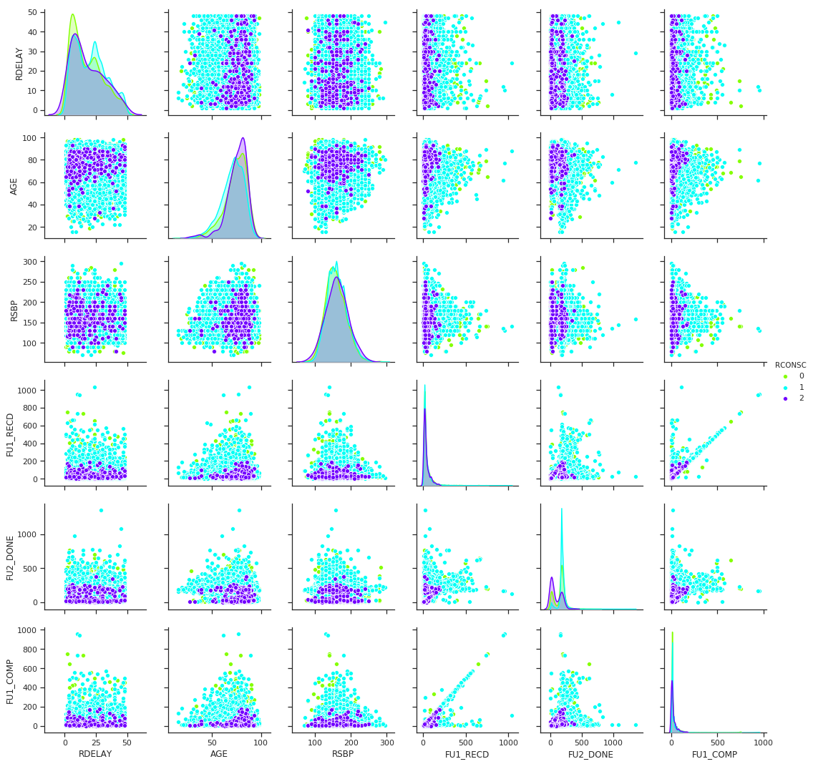
Exploratory Data Analysis
Let us try to explore our data and see how the attributes are related to each other and with our target.

Slide 8
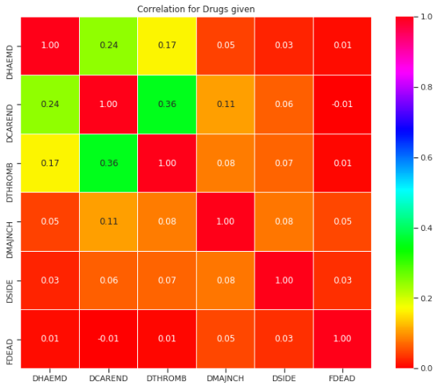
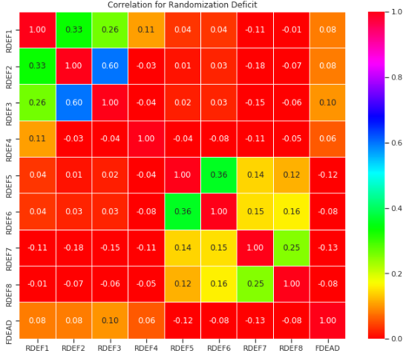
Correlations

Slide 9
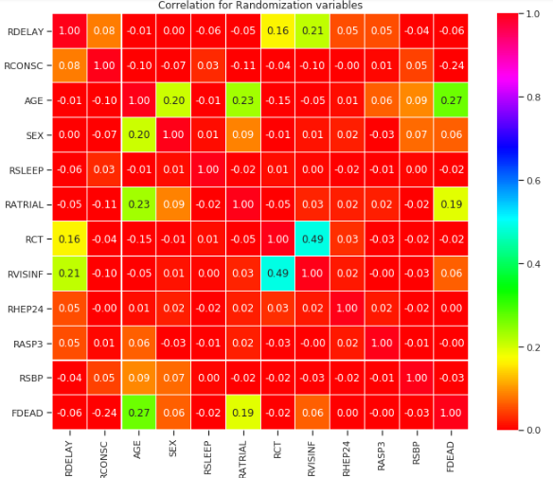
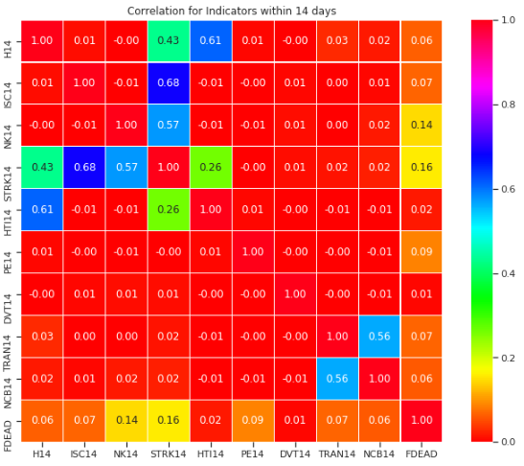
Correlations Continued..

Slide 10
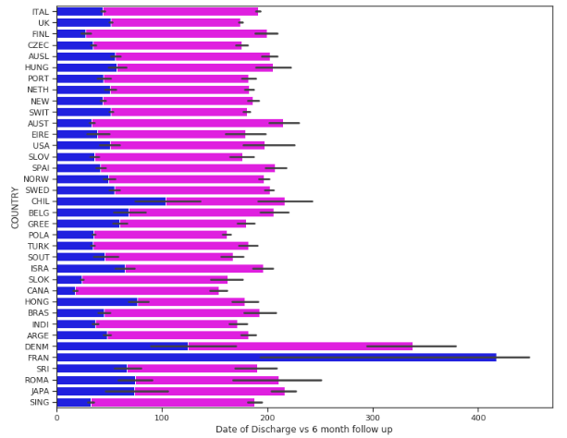
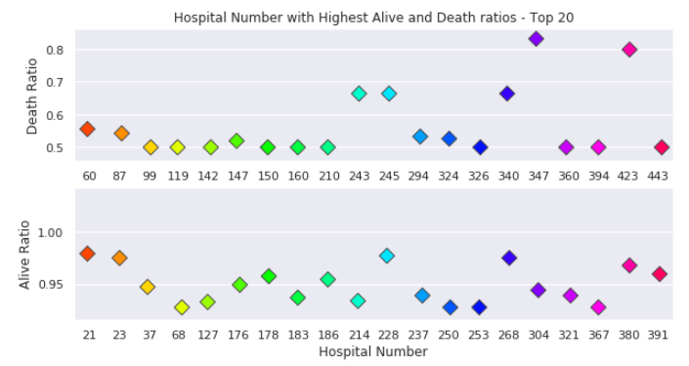
Geographical Data

Slide 11
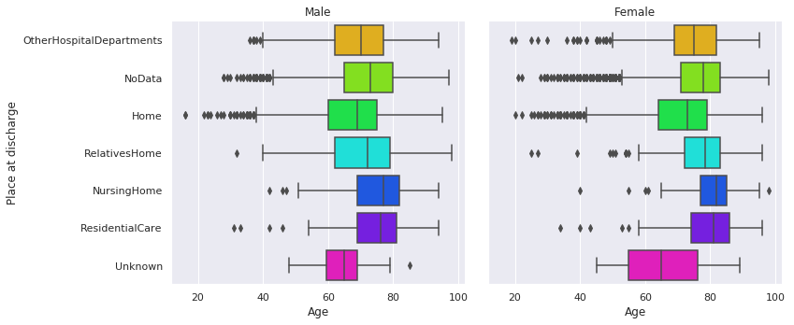
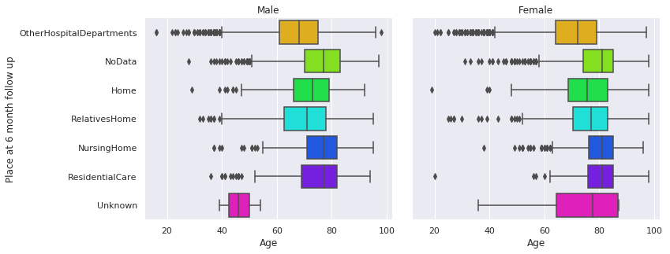
Where do they end up?

Slide 12
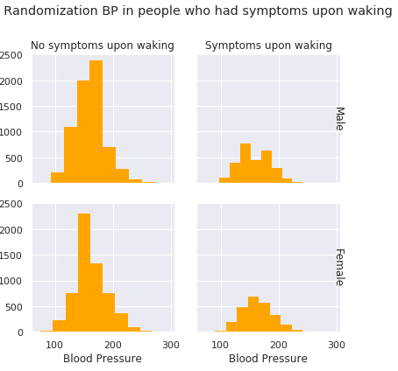
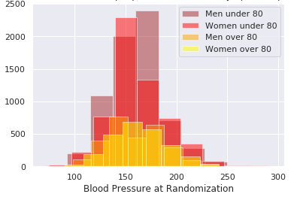
Blood pressure and Symptoms

Slide 13
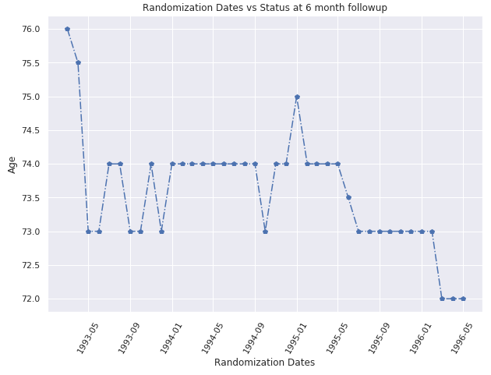
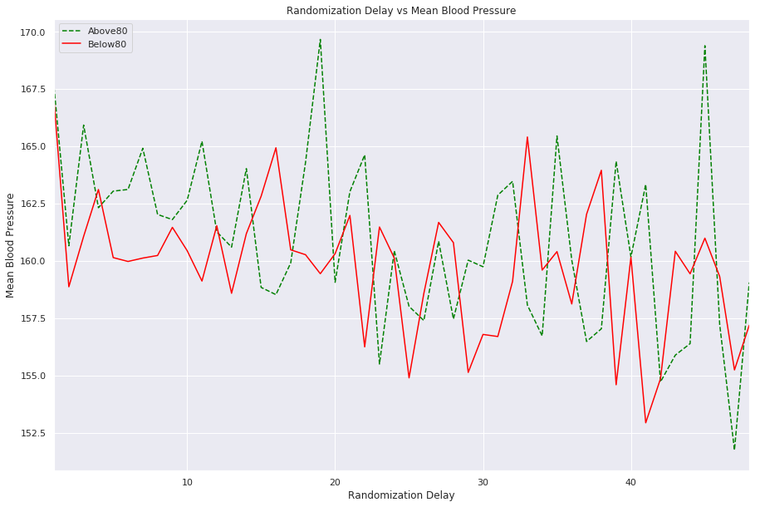
Randomization data

Slide 14
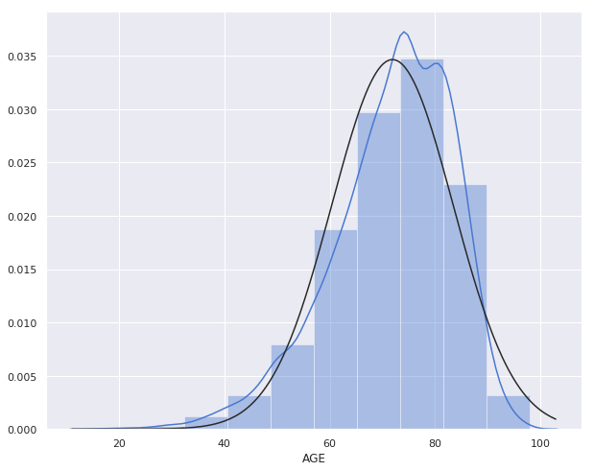
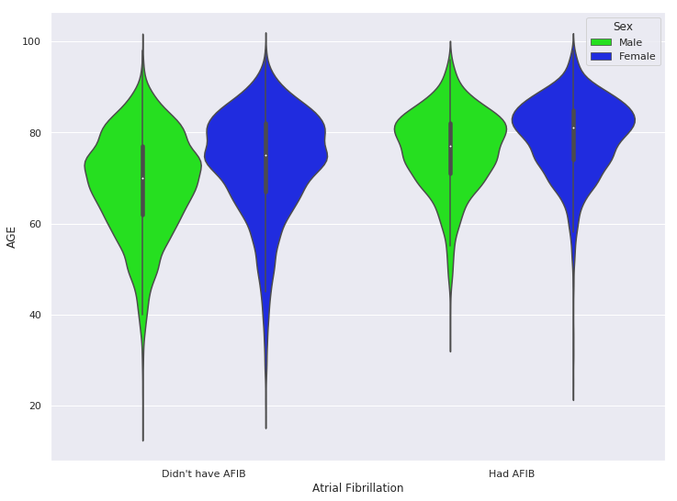
Age distribution and Atrial Fibrillation

Slide 15
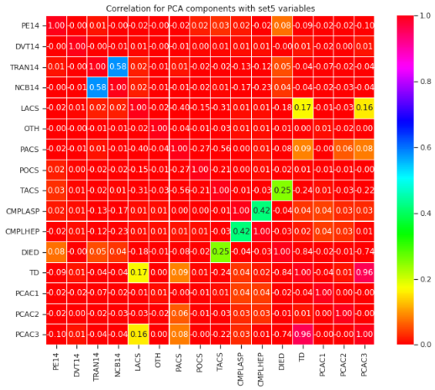
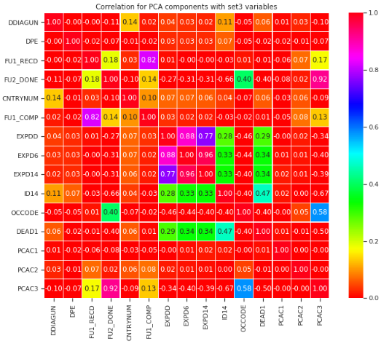
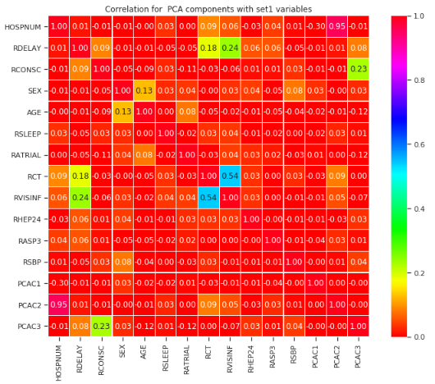
Unsupervised Modelling - PCA
Correlations of PCA components with other components in dataset containing patients 80 years or older.

Slide 16

Supervised modelling
Let us try some of the supervised modelling techniques on patients 80 years and above and hence predict survival chances. Older people have been substantially under represented in stroke trials to date, so we hope the number of patients aged over 80 in this data set could also facilitate planning of trials in the ‘older old’.

Slide 17
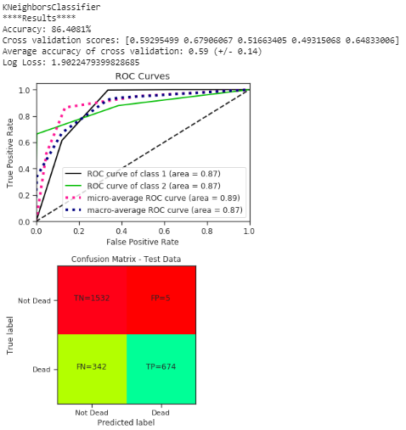
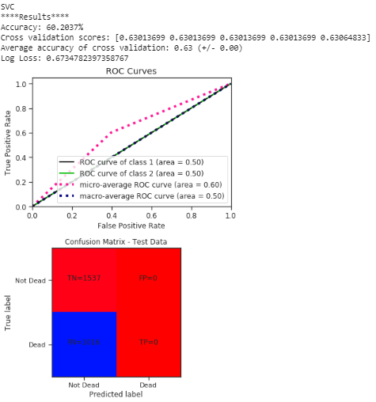
Supervised Modelling Continued..
KNN Classifier Model
SVM Classifier Model

Slide 18
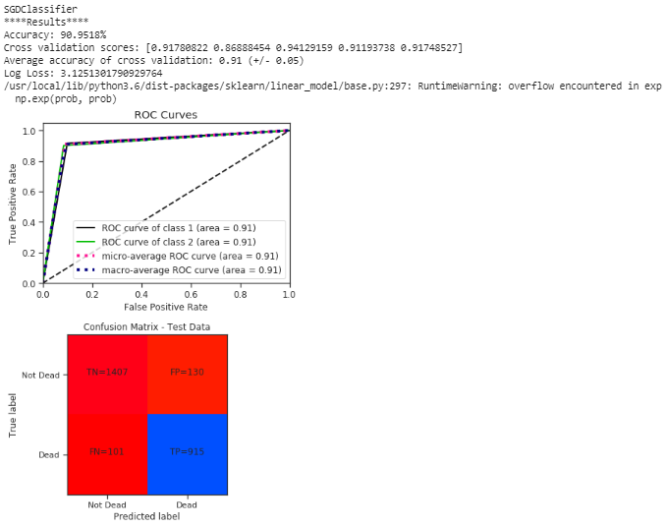
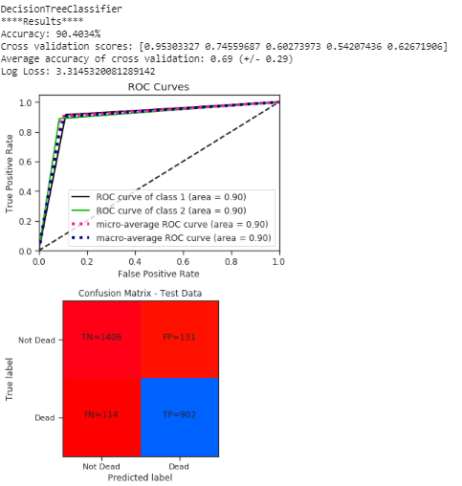
Supervised Modelling Continued..
SGD Classifier Model
Decision Tree Classifier Model

Slide 19
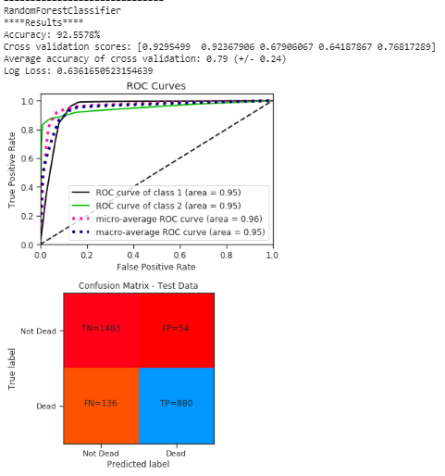
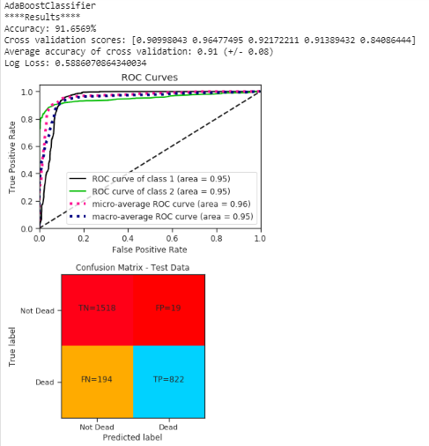
Supervised Modelling Continued..
Random Forest Classifier Model
ADA Boost Classifier Model

Slide 20


Supervised Modelling Continued..
Gradient Boost Classifier Model
Gaussian Naïve Bayes Classifier Model

Slide 21
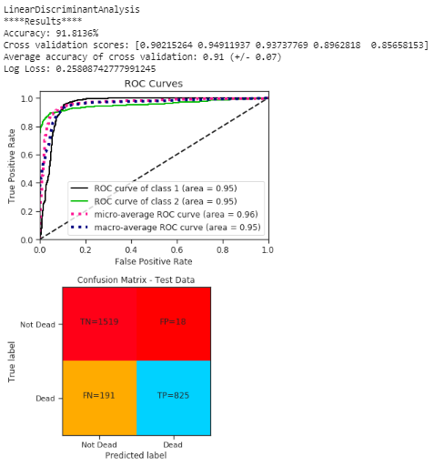

Supervised Modelling Continued..
Linear Discriminant Analysis Model
Quadratic Discriminant Analysis Model

Slide 22
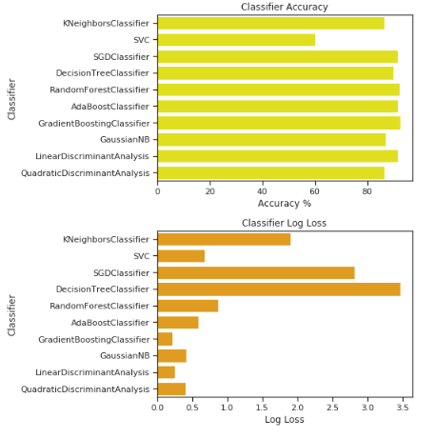
Best Model for patients 80 years and above
We are choosing Linear Discriminant Analysis as the best model in terms of prediction as well as log loss.

Slide 23
Conclusion
Linear Discriminant Analysis was able to provide an average prediction of 85% survival chances for patients 80 years and above with an accuracy of 91% and a Loss of 25% with consistent Cross Validation Scores. Even though it appears that elderly have good survival chances, we need to keep in mind that our predictions were based on the dataset surveyed between 1993 to 1996.
Our dataset also doesn’t capture some of the essential variables like height, weight, BMI, cholesterol, whether patients were smokers or alcoholics or diabetics and their measures, which, if provided, would help us make more accurate predictions.

Slide 24
Next Steps
Our predictions were for the 90s where medical facilities and surveying techniques were not as much advanced as it is in the current age. Our next steps can be to survey the current stroke patients with all the essential variables and risk factors and use iteration and evaluation techniques and re-use the models which we used for this dataset and compare our findings and see if the differences were statistically significant or not using T-tests and P-Values.

Slide 25



Credits
Prof. Anna Czlonkowska
Dr. hab Maciej Niewada
Prof. Peter Sandercock

Slide 26
Thank you!

