Slide 1
Intelligence Diggers
CHALLENGE 3 : RISK MANAGEMENT

Slide 2



MEET MY TEAM
Bhavya Gulati
Saurabh Thakur
Sukriti Sharma
MS in CS, USC
MS in CS, USC
MS in CS, USC
Information Science Institute, Graduate Research Assistant
Information Science Institute, Graduate Research Assistant
Information Science Institute, Graduate Research Assistant
3 member

Slide 3
Statistics
Planned Expenditure: (2012) $1.3B
Current Expenditure: (2017) $3.5B
Expected Expenditure: (2018 - end) $8.5B
Reason: Delayed identification of Social and Environmental Risks

Slide 4



Problem with Current Approach:
Huge data to Process
Real Time analysis is Tough
Costly Analysis

Slide 5
Intelligent Risk Analysis System
Components:
1. Global Risk Monitoring.
2. Mining Site Analyzer.

Slide 6
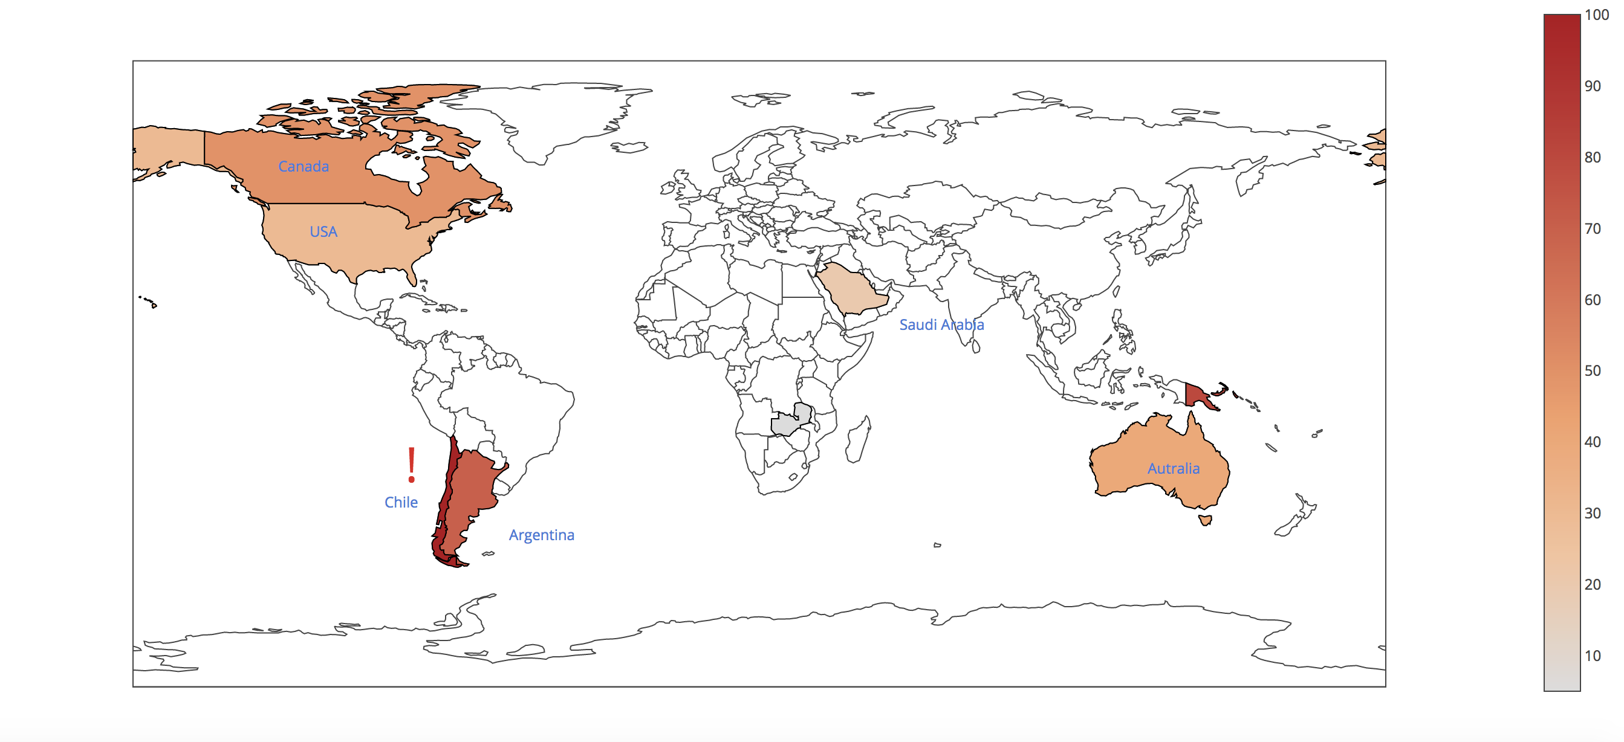
Global Risk Monitor
High level global overview of all mining sites.

Slide 7
Mining Site Analyzer
3 Major Insights: 1. Sentiment Polarity
2. Key news articles (Also local languages work)
3. Major risk category identification
4. Contextual plots based on major risk identified

Slide 8

How we Do it?
Google gdelt api
Microsoft Cognitive Services (Risk Categorization)
Key news articles
Key News articles
Major risk category
Microsoft NLP Services (Sentiment Analysis)
Sentiment Polarity
Intelligent Risk Analysis System
Insights

Slide 9
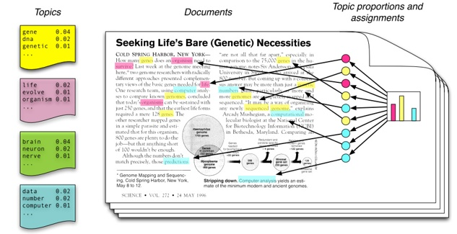

Future Scope
Text Summarization
Suggesting Plan of action

Slide 10
Thank You

