Slide 1

CAPSTONE PROJECT- THE BATTLE OF THE NEIGHBORHOODS
Applied Data Science Capstone by IBM/Coursera

Slide 2
"Prospects of starting a Restaurant-cum-Catering service by inspecting the Zones of Chennai"
Business Problem:
Chennai being one of the metropolitan areas, is one of the growing IT hubs of India.
Select the busiest zones in Chennai where a constant crowd is guaranteed
Analyzing the office areas of the zones
The Business Problem can be stated as:
“What is the best place to open a Restaurant-cum-Catering Service in Chennai?”

Slide 3
Data (Requirement and collection)
Zones Data (along with Coordinates): Collected by web scraping and got Coordinates using Geocoders
Professional Venue Data: Collected using Foursquare by providing a unique category ID
Nearby Venues Data: Collected using Foursquare by exploring near the selected zone coordinates
Pricing Data: Collected manually from web-site for the selected zones

Slide 4
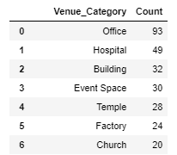
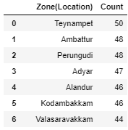
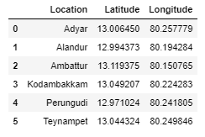
Exploratory Data Analysis
All the 15 zones of Chennai were analysed to find the most frequent venue and the top professional zones.
Based on this data 6 top busiest zones of Chennai are selected for further analysis

Slide 5
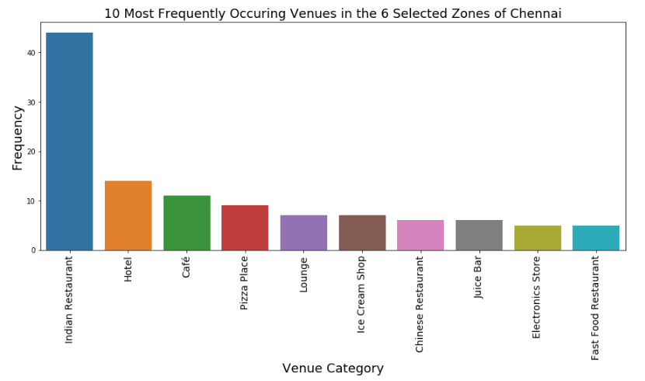
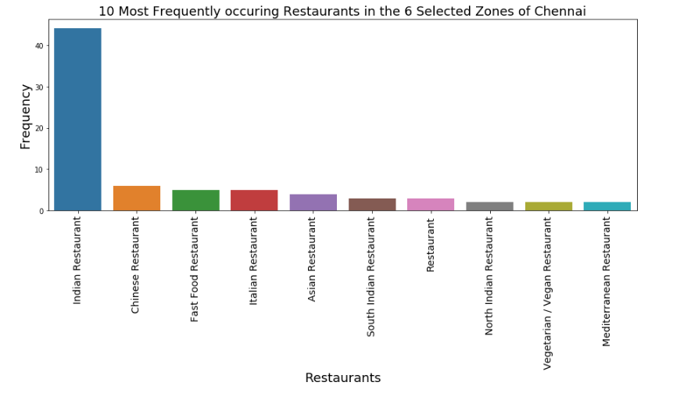
Exploratory Data Analysis
We can see that the most frequent place in these selected zones is “Indian Restaurant”.
The most demanded cuisine is Indian.

Slide 6
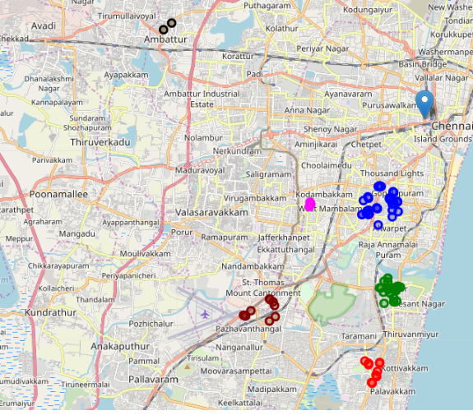

Exploratory Data Analysis
This Folum map shows how the restaurants are distributed and their count in the selected zones.
Location Count

Slide 7
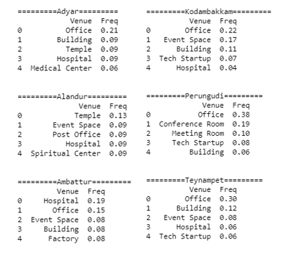
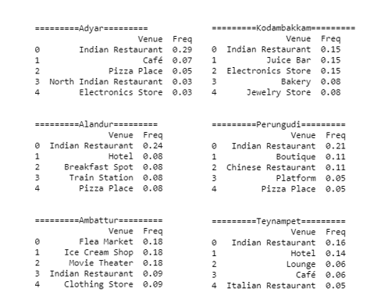
Analysis
To better under the venue categories, one hot encoding is used.
The top 6 frequent venues of each zone are found along with the frequency.

Slide 8
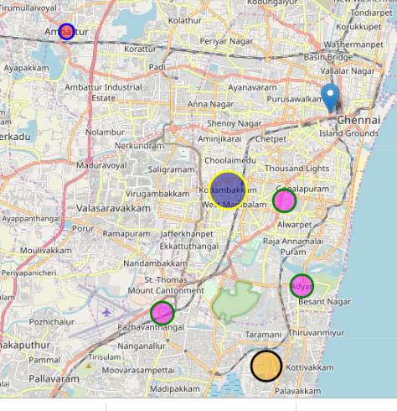
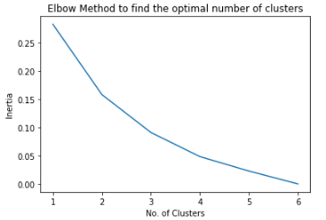
K-Means Clustering
Using the elbow method, the number of clusters are selected (clustering with least inertia is preferred)
The zones are clustered into 4 clusters

Slide 9
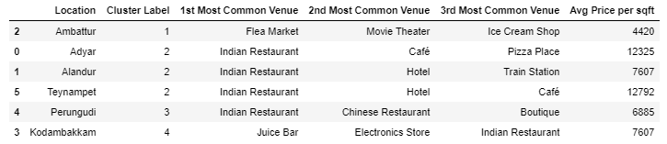
K-Means Clustering
Cluster 1 contains zones whose common venues are not restaurants: Entertainment and shopping areas
Cluster 2 contains zones whose 1st most frequent venue is a restaurant (with the highest frequencies)
Cluster 3 contains zones with top 2 most common venues being restaurants
Cluster 4 contains zones whose 1st common venue is a restaurant but with the same frequency as the 2nd and 3rd common venues.

Slide 10
Results and Discussion
‘Adyar’, ’Kodambakkam’, ’Perungudi’ and ’Teynampet’ zones have ‘Office’ as the 1st frequent professional venue with ‘Perungudi’ having the highest frequency among them.
This tells us that these 4 zones, out of the 6 selected zones, will be good for our business as our potential customers are employees.
Also, Indian Restaurants are the most frequent venues near the selected zones, suggesting the type of cuisine customers in that area prefer.
Teynampet has the most restaurants, out of all the selected zones, based on the venues explored.
'Ambattur' has the least average price per sqft, followed by 'Perungudi', among the selected zones.
With maximum frequency of offices and moderate restaurants in the area ‘Perungudi’ seems like a potential zone to open up our Restaurant-cum-Catering service.
The pricing data also seems favorable to this. Clustering also shows these venues in cluster 3 which represents the cluster with restaurants as the frequent venues.

Slide 11
Conclusion
Understood how to deal with real life data science projects using some of the popular Python packages such as seaborn, folium, BeautifulSoup and geocoders.
I have also got a glimpse of how web scraping is done and how FourSquare can be used to acquire data of frequent venues in a selected area.
The idea of opening a “Restaurant-cum-Catering service in an area which has a huge pool of office workers (‘Perungudi’) is an interesting and a potential idea to try in Chennai where Catering Services are not very well established
Although the analysis is very preliminary and requires a lot of refining based on the data used (refined ward data per each zone, pricing data) it will be of great help in the beginning stages of the business plan.

