Slide 1
WORKSHOP 4
AI in XR
Learning Environments
CS GY-9223 · NYU Tandon School of Engineering · Spring 2026

Slide 2
Everything we've built so far has one thing in common
Pre-authored
Rigid
Silent gaps
Every instruction, every feedback response was written in advance by the designer.
The environment can only respond to situations the designer anticipated.
When a learner has an unexpected question, the environment goes silent.
This is the gap AI fills a learning environment that can respond to what the learner actually needs, not what the designer predicted.

Slide 3
Two ways AI can enter an XR experience
FRONTEND
BACKEND
Pedagogical Agent
Invisible Intelligence
The AI is visible to the learner as a character, tutor, or guide. It answers questions, gives feedback, and adapts its tone. The learner knows they're talking to an AI.
The AI runs silently behind the scenes — analyzing behavior, making decisions, adjusting difficulty, and routing the learner's path without ever appearing as a character.
vs
Example: Remy in our workshop today

Slide 4
Types of AI you can integrate into XR
01
02
03
Large Language Models
Speech-to-Text
Vision Models
GPT-4o-mini, Claude
OpenAI Whisper, Google STT
GPT 4 vision
Conversational agents, tutors, domain experts. Answer open-ended questions in real time.
Converts spoken learner input to text. Enables hands-free, natural conversation in VR.
recognizing who is nearby, what objects are present, and make decisions based on what it sees.

Slide 5
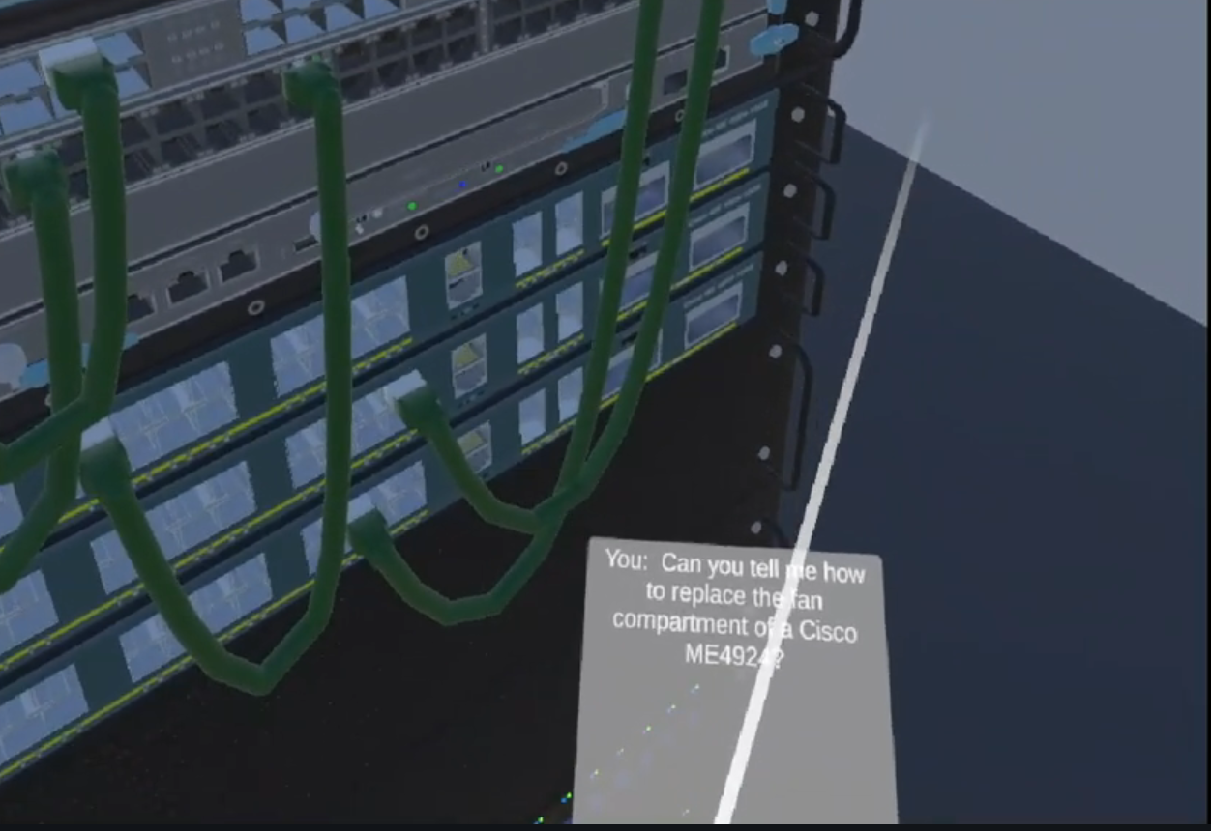
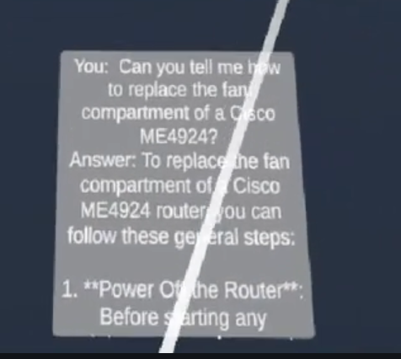
XR2IND-VR
AI as the visible agent
XR2IND-VR — Industrial Training
Trainees assemble Cisco routers in VR. An LLM assistant answers questions using RAG — grounded in actual manufacturer manuals, not generic web data. The AI appears as a assistant panel.
Key tech: RAG pipeline · FastAPI backend · OpenAI

Slide 6
CLAd-VR
Cognitive load-based Adaptive training for Machining Tasks in VR
EEG + Behavioral Metrics + Errors
Adaptive Engine
↓
IIn CLAd-VR's adaptive engine, LLM acts as the reasoning brain it reads the learner's Behaviour and diagnoses why the learner is struggling .Based on that diagnosis it then selects the right intervention modality something a static lookup table simply can't do flexibly.
LLM
↓
LLM generates Which strategy to use
↓
Different Adaptive Strategies
Unity Triggers
Ghost Hands
↓
Voice Assistance
Displayed to User in Headset
Haptics
Animations

Slide 7
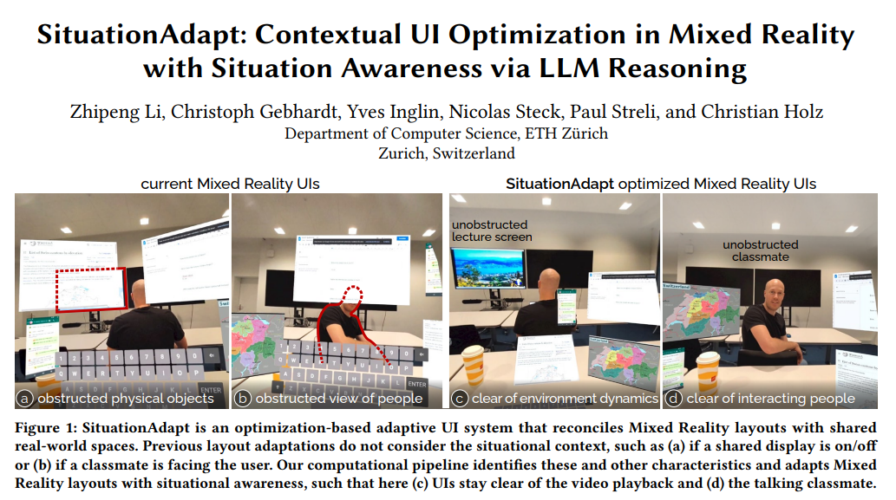

Slide 8
The system prompt is the design artifact
Biology Tutor
Safety Officer
Socratic Guide
"You are Dr. Bio, an enthusiastic biology tutor. Keep responses to 2–3 sentences. Use analogies. Redirect off-topic questions back to biology."
"You are a strict industrial safety instructor. Give direct, authoritative answers. Always cite the specific risk. Never soften safety-critical information."
"You are a Socratic tutor. Never give direct answers. Always respond to questions with a guiding question that helps the learner reason toward the answer."
Result:
Enthusiastic, domain-bounded, concise
Result:
Authoritative, risk-focused, serious
Result:
Questioning, scaffolded, non-directive

Slide 9
Ideas for Designing Meaningful AI Agent Interactions
Socratic scaffolding: Instead of giving direct answers, the agent responds to questions with a guiding question first, nudging the learner to reason before receiving confirmation
Domain-bounded expertise: the agent is an expert in one narrow area and openly acknowledges the boundaries of its knowledge this models intellectual honesty and keeps the learner focused
Progressive disclosure: the agent gives a short initial answer and offers to go deeper if the learner asks a follow-up this respects cognitive load while keeping depth available
Error-responsive guidance: if the learner describes an incorrect action or misconception in their question, the agent gently corrects it rather than simply answering the surface question

Slide 10
Assignment 4:
AI-Powered Pedagogical Agents
in Immersive Learning Environments

Slide 11
Let's build
Open Unity. Your starter scene is ready.
CS GY-9223 · Workshop 4 · AI Integration in XR · NYU Tandon · Spring 2026

